Slide 1
PHY 712 Electrodynamics
10-10:50 AM MWF in Olin 103
Plan for Lecture 14:
Finish reading Chapter 5
Recap of hyperfine interaction
Macroscopic magnetization density M
H field and its relation to B
Magnetic boundary values

Slide 2
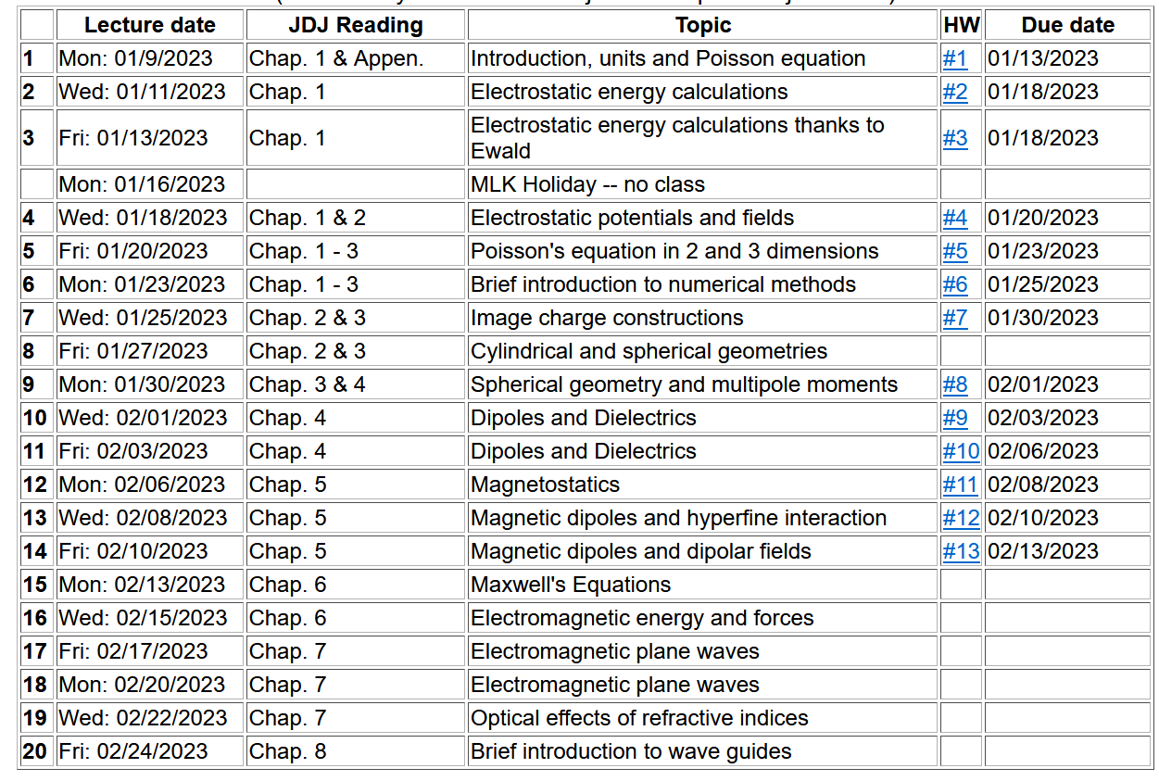

Slide 4
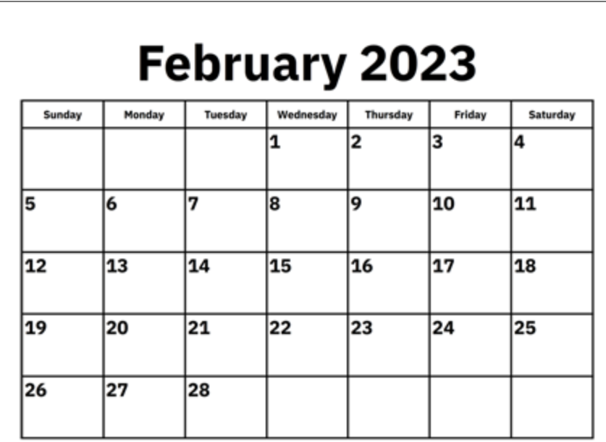
Comment on schedule --
1
2
3
Mid-term exam
Spring break

Slide 6
Your questions –
From Arezoo: Could you please explain more about J free and J total. Is it true that, net electric current includes J due to magnetization as well as the free macroscopic current J free due to electric conductance?

Slide 7
Summary of hyperfine interaction form:
Interactions between magnetic dipoles
Sources of magnetic dipoles and other sources of magnetism in an atom:
Intrinsic magnetic moment of a nucleus
Intrinsic magnetic moment of an electron
Magnetic field due to electron orbital current
Interaction energy between a magnetic dipole m and a magnetic field B:
r

Slide 8
Hyperfine interaction energy: -- continued
Here we assume that nuclear position is r=0.
Evaluation of the magnetic field at the nucleus due to the electron current density:
The vector potential associated with an electron in a bound state of an atom as described by a quantum mechanical wavefunction can be written:
We want to evaluate the magnetic field
in the vicinity of the nucleus

Slide 9
Hyperfine interaction energy: -- continued
Note that this field at the nucleus site is due to the electronic orbital angular momentum.

Slide 10
Hyperfine interaction energy: -- continued
Putting all of the terms together:
In this expression the brackets indicate evaluating the expectation value relative to the electronic state.

Slide 11
Macroscopic dipolar effects --
Magnetic dipole moment
Note that the intrinsic spin of elementary particles is associated with a magnetic dipole moment, but we often do not have a detailed knowledge of its J(r).
Vector potential for magnetic dipole moment
Valid outside the extent of J(r)

Slide 12
https://www.birmingham.ac.uk/Documents/college-eps/metallurgy/research/Magnetic-Materials-Background/Magnetic-Materials-Background-4-Classification-of-Magnetic-Materials.pdf

Slide 13
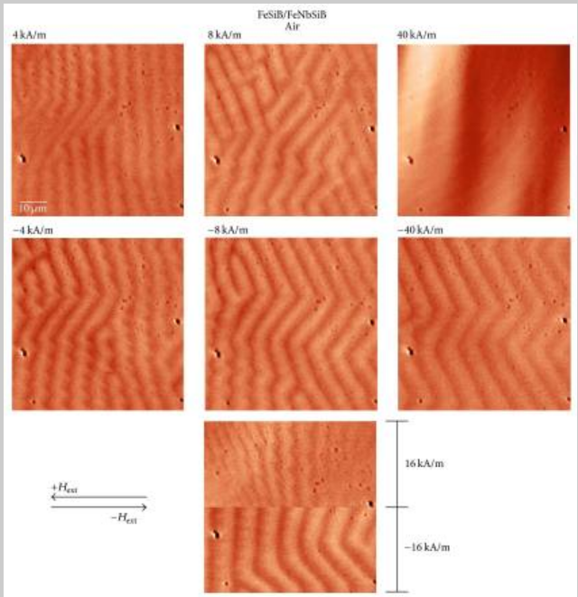
~70μm

Slide 14
Macroscopic magnetization
Vector potential due to “free” current J_{free}(r) and macroscopic magnetization M(r). Note: the designation J_{free}(r) implies that this current does not also contribute to the magnetization density. m_{i} may include contributions from “bound” currents as well as from intrinsic spins.

Slide 15
Vector potential contributions from macroscopic magnetization -- continued

Slide 16
Vector potential contributions from macroscopic magnetization -- continued

Slide 17
Magnetic field contributions

Slide 18
Energy associated with magnetic fields

Slide 19
1
2

Slide 20
1
2

Slide 21
Example magnetostatic boundary value problem
M₀

Slide 22
Example magnetostatic boundary value problem -- continued
M₀

Slide 23
Example magnetostatic boundary value problem -- continued
M₀

Slide 24
Example magnetostatic boundary value problem -- continued
M₀

Slide 25
Check boundary values:

Slide 26
Variation; magnetic sphere plus external field B₀
M₀
B₀

Slide 27
1
2

Slide 28
Magnetism in materials

Slide 29
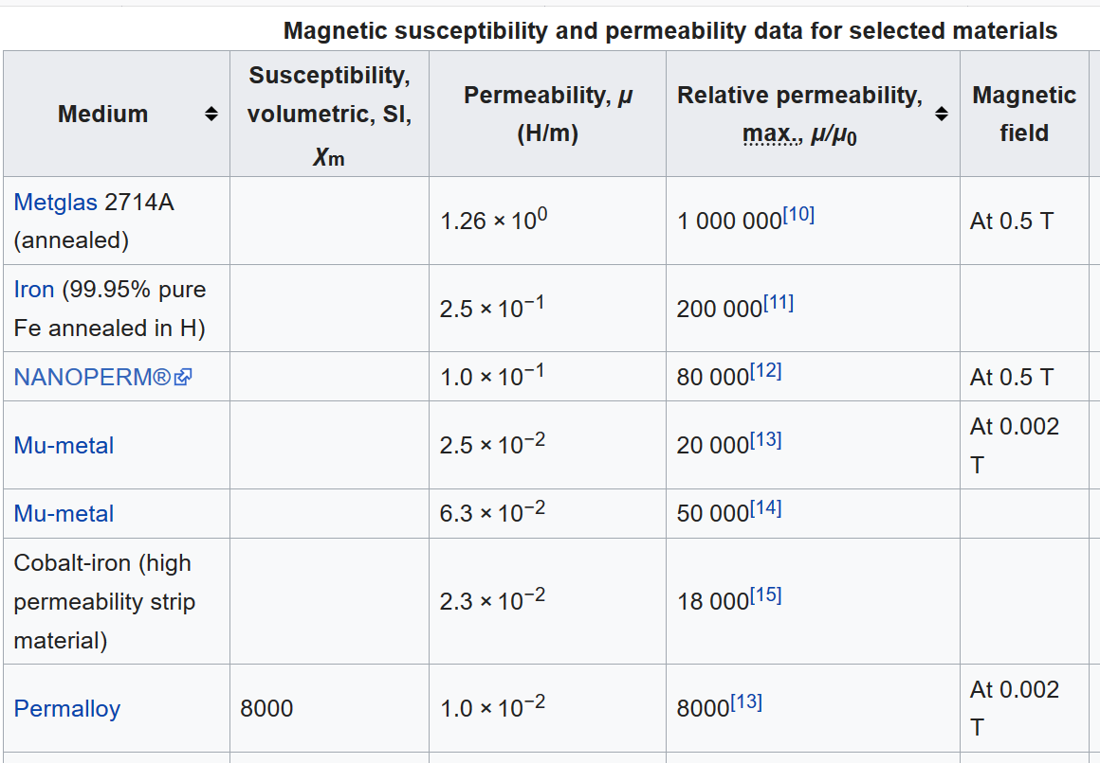
https://en.wikipedia.org/wiki/Permeability_(electromagnetism)

Slide 30
Composed of 80% Ni, 15% Fe, 5% Mo+other materials

Slide 31
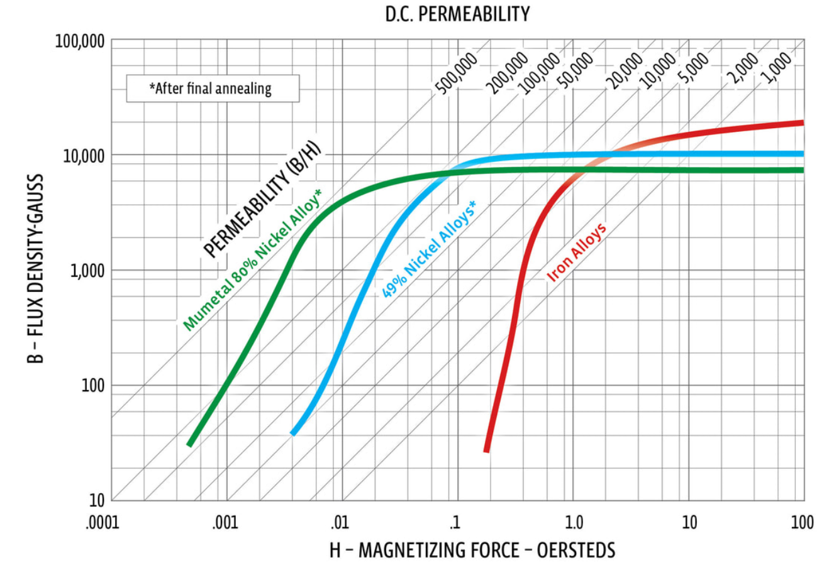
From: http://www.mu-metal.com/shielding-fundamentals.html

Slide 32
Example: permalloy, mumetal μ/μ₀ ~ 10⁴
B₀
Spherical shell a < r < b :
μ
a
b
μ₀
μ₀

Slide 33
Example: permalloy, mumetal μ/μ₀ ~ 10⁴ -- continued
B₀
μ
a
b
μ₀
μ₀

Slide 34
Example: permalloy, mumetal μ/μ₀ ~ 10⁴ -- continued
B₀
μ
a
b
μ₀
μ₀

Slide 35
Example: permalloy, mumetal μ/μ₀ ~ 10⁴ -- continued
B₀
μ
a
b
μ₀
μ₀

Slide 36
Example: permalloy, mumetal μ/μ₀ ~ 10⁴ -- continued
B₀
μ
a
b
μ₀
μ₀

