Slide 1
PHY 712 Electrodynamics
10-10:50 AM Online
Notes for Lecture 22:
Chap. 8 in Jackson – Wave Guides
-- second shortened lecture
Rectangular wave guides
Rectangular resonant cavity

Slide 2
For 2/27/2023-3/03/2023:
Individual work on take home exam
Shortened class lectures on Chapter 8 of Jackson

Slide 4
Boundary values for ideal conductor
At the boundary of an ideal conductor, the E and H fields decay in the direction normal to the interface.
E₀
H₀

Slide 5
Wave guides – dielectric media with one or more metal boundary
Continuity conditions for fields near metal boundaries --
E
H
Waveguide terminology
TEM: transverse electric and magnetic (both E and H fields are perpendicular to wave propagation direction)
TM: transverse magnetic (H field is perpendicular to wave propagation direction)
TE: transverse electric (E field is perpendicular to wave propagation direction)

Slide 6
Analysis of rectangular waveguide
Boundary conditions at surface of waveguide:
E_{tangential}=0, B_{normal}=0
y
x
z
ε μ
Cross section view
b
a

Slide 7
Analysis of rectangular waveguide
y
x
z

Slide 8
Solution of Maxwell’s equations within the pipe:
F = E or H
propagation along z.

Slide 9
Maxwell’s equations within the pipe in terms of all 6 components:

Slide 10
TE modes for rectangular wave guide continued:

Slide 11
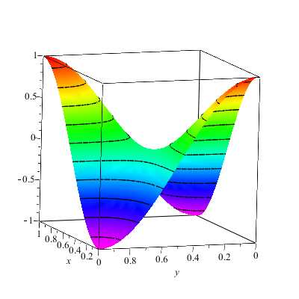
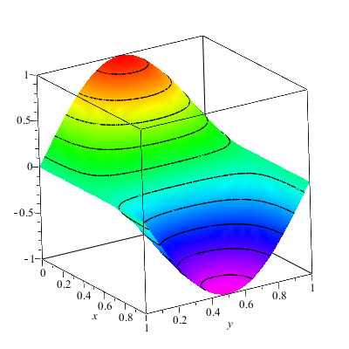
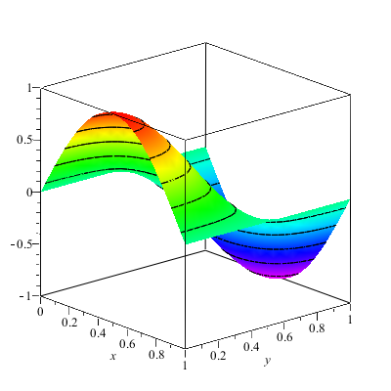
Solution for m=n=1

Slide 12
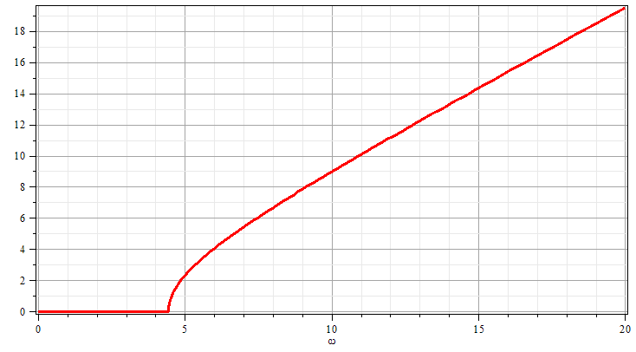
Solution for m=n=1
k
ω

Slide 13
Now consider the case of a rectangular box bounded by an ideal conductor --
Resonant cavity
y
x
z
Propagating wave form becomes a standing wave along z.

Slide 14
Resonant cavity
y
x
z
14

Slide 15
Now consider the case of a rectangular box bounded by an ideal conductor --
Resonant cavity
y
x
z

Slide 16
For example --
Typically, microwave oven use frequencies of 2.45 GHz and the wavelength is ~12 cm

