Slide 1
PHY 712 Electrodynamics
10-10:50 AM MWF Olin 103
Notes for Lecture 25:
Continue reading Chap. 9
Electromagnetic waves due to specific sources
Dipole radiation examples
Radiation from antennas

Slide 5
Discussion: Tentative plan for remainder of the course
Week of March 20 -- JDJ #11 Special relativity
Week of March 27 -- JDJ #14 especially synchrotron
Week of April 3 -- special topics
Week of April 10 -- special topics
Week of April 17 -- review
Week of April 24 -- presentations
Week of May 1 -- final take home
Final grades due May 9

Slide 6
Your questions –
From Arezoo: In slide 11, blue diagram and purple diagram are both exact results? What is the difference?
From Banasree: I don’t understand what different values of kd in those graphs physically means for antenna.

Slide 7
Electromagnetic waves from time harmonic sources

Slide 8
Electromagnetic waves from time harmonic sources – continued:

Slide 9
Important results from last time – EM waves from time harmonic sources – open isotropic boundaries

Slide 11
Example of dipole radiation source
Note that the continuity of charge and current must be satisfied. For the Fourier amplitudes, the relations are as bellow:
Jackson’s clever trick!

Slide 12
Example of dipole radiation source
From the analysis valid for kr>>1 and kR<<1:

Slide 13
Example of dipole radiation source -- exact results for r>>R:
Agrees with dipole approximation for kR<<1.

Slide 14
More details --
Correct when this term is negligible.
Notes:
An example of using the spherical harmonic expansion to analyze “exact” expressions for the scalar and vector potentials.

Slide 15
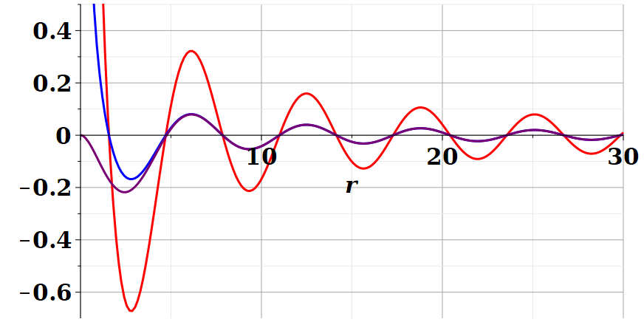
Example continued
For kR=1
Dipole approximation
Re(Ã(r,ω))
/R
exact
Blue curves represent long range part of exact expression
For kR=0.1
Dipole approximation
Re(Ã(r,ω))
exact
/R
Notes:
Comparing the values of the vector potential calculated using the asymptotic expansion (r→infinity) with the exact evaluation. You see that the difference occurs only within the source extent.

Slide 16
Continued review of dipole results --

Slide 17
Review:
Electromagnetic waves from time harmonic sources – continued:
Notes:
In the long wavelength limit, the dipole approximation is numerically close to the physical situation.

Slide 18
Review:
Electromagnetic waves from time harmonic sources – continued:
Notes:
Continued analysis of vector and scalar potential fields following Jackson Section 9.2.

Slide 19
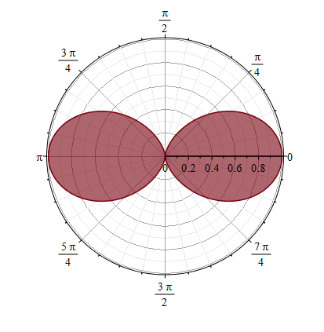
Properties of dipole radiation field for kr >>1:
z
Example:
r
θ
p
E
Note that vectors r, E, B are mutually orthogonal
y
x
B
Notes:
Geometric properties of dipolar fields.

Slide 20
Alternative approach
Notes:
Up to now, we have worked with the exact spherical harmonic expansion, evaluating the results in certain limits. Now consider analyzing the Green’s function integral directly without use of Bessel functions. You may recognize this treatment as the Born approximation encountered in quantum mechanical scattering theory.

Slide 21
For our example:
➔Results equivalent to Bessel function expansion in the limit kr → ∞.
Notes:
This approach is similar to the Bessel function expansion if more terms were used.

Slide 22
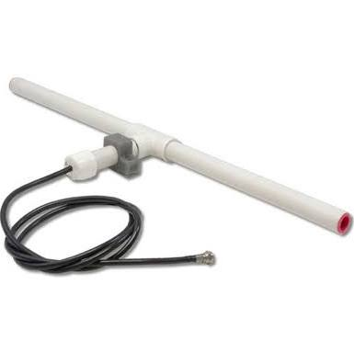
r
Other radiation sources using
``alternative approach’’
z
Linear center-fed antenna
θ
d/2
Notes:
Up to now, we have been thinking about sources on the atomic scale. The analysis also works for macroscopic sources such as antennas. This example which follows your textbook is called a center fed antenna.

Slide 23
Alternative approach – linear center-fed antenna continued
Notes:
Analyzing the vector potential in this “Born” approximation, we obtain an analytic result for the radiation distribution.

Slide 24
Alternative approach – linear center-fed antenna continued
Notes:
The radiation pattern is quite sensitive to the relationship between the antenna length d and the wavelength of the radiation.

Slide 25
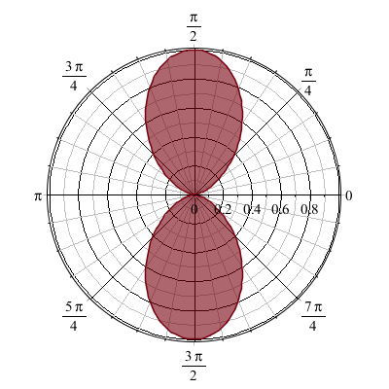
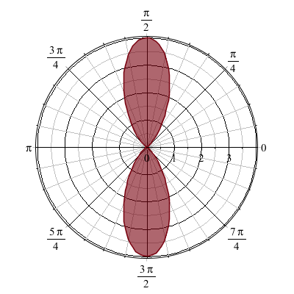
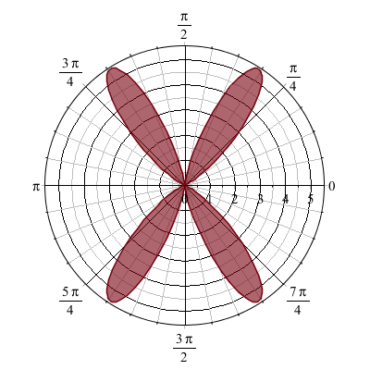
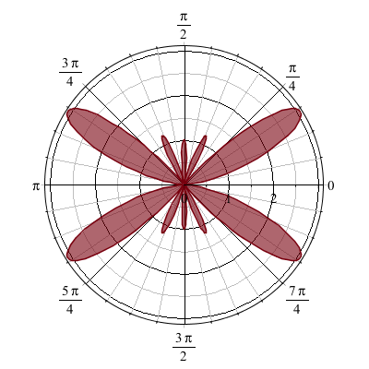
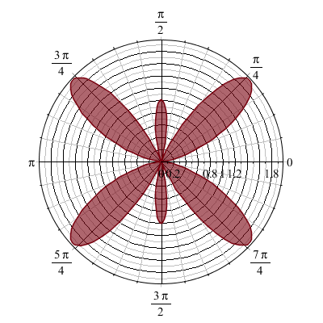
Alternative approach – linear center-fed antenna continued
kd=π 2π 3π 4π 5π
Interesting patterns for special values of kd
Notes:
Here are some polar plots of the radiation patterns for various cases.

Slide 26
Some details --
kd=π 2π 3π 4π 5π
Polar plot:
Angle indicates values of theta
Radius indicates value scaled to 1.
θ

Slide 27
Next time – we will consider the effects of multiple antennas (antenna arrays including interference effects) and radiation due to light scattering (from Chapter 10 of your textbook).

