Slide 1
PHY 712 Electrodynamics
10-10:50 AM MWF Olin 103
Notes for Lecture 37:
Some quantum effects in electrodynamics
-- General quantum states of EM fields and related correlations functions
Review of eigenstates of EM Hamiltonian and of Glauber’s coherent states
Squeezed states
Correlation measurements on EM signals

Slide 2
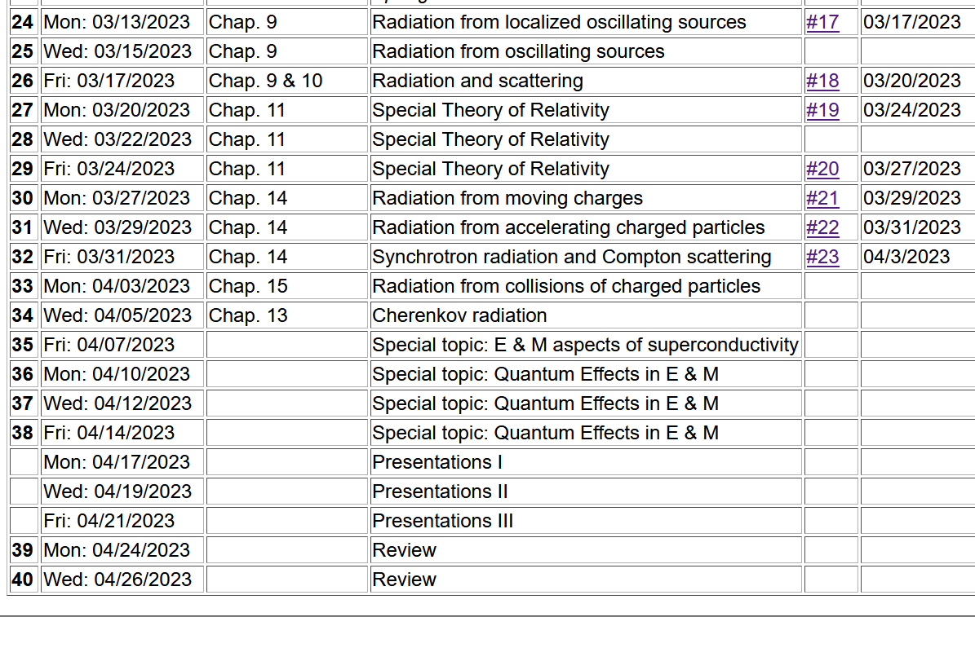

Slide 4
Review of what we learned from Lecture 36

Slide 7
A convenient superposition thanks to R. Glauber, PR 131, 2766 (1963)

Slide 8
Single mode coherent state continued
This means that variance of the E field for the coherent state is independent of the amplitude Λ. Therefore, for large Λ the variance is small in comparison.

Slide 10
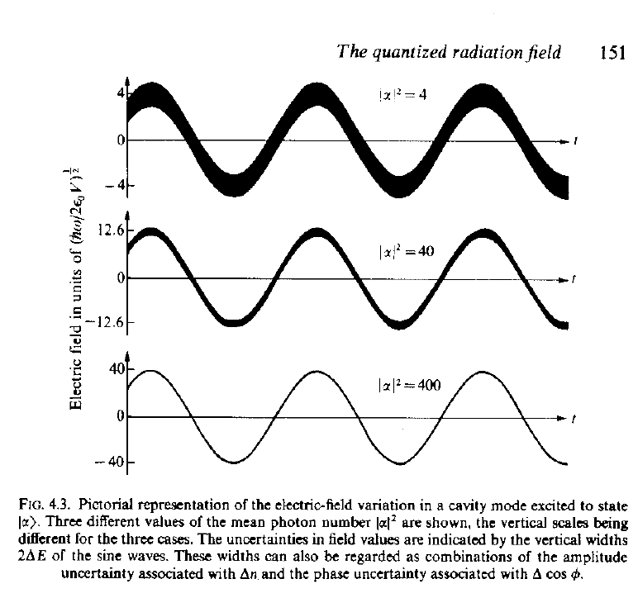
Visualization of coherent state electric fields for various amplitudes
Source:
R. Loudon, “The Quantum Theory of Light”

Slide 11
Additional properties of single mode coherent state --

Slide 12
Interpretation of a single mode coherent state

Slide 13
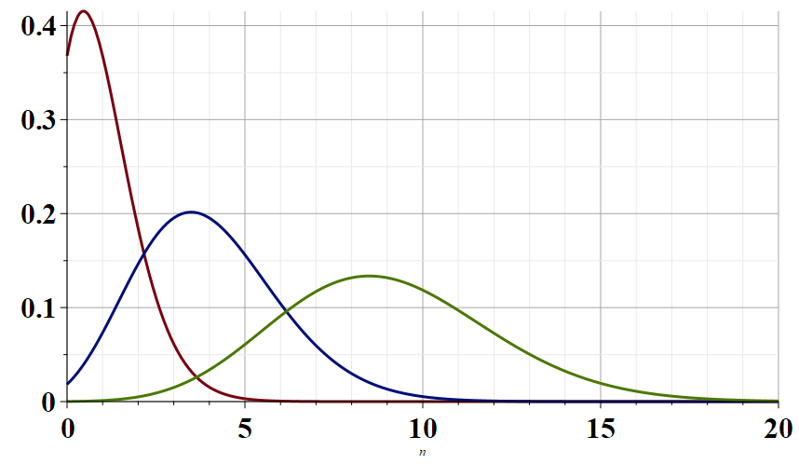
Λ=1
Λ=2
Λ=3
n

Slide 14
Further analysis and modifications of the “coherent state”

Slide 15
In terms of the eigenstates of the EM Hamiltonian:

Slide 16
For the coherent state:
In this sense, the coherent state represents the minimum uncertainty process.

Slide 17
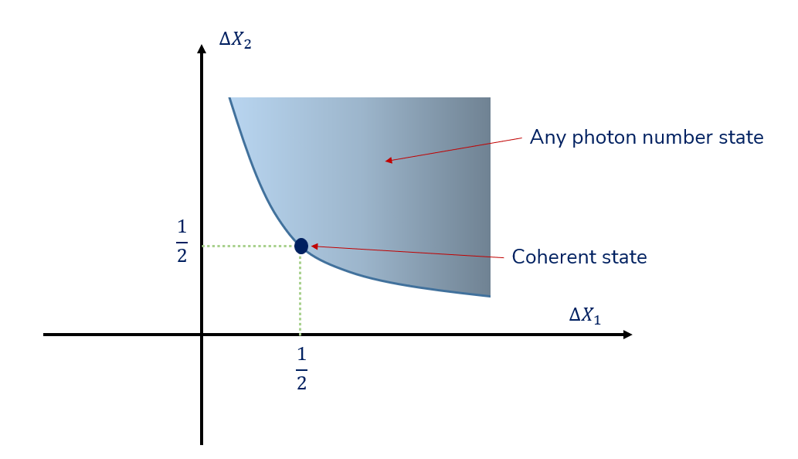
Plot of possible standard deviations (Figure from Prof. A. Kandada)
It is possible to modify the coherent state to produce fields with other properties within the blue region of the plot

