Slide 1
PHY 712 Electrodynamics
10-10:50 AM MWF Olin 103
Notes for Lecture 38:
Quantum effects in electrodynamics
Connections to experiment
Coherent states
Squeezed states
More complicated states

Slide 2
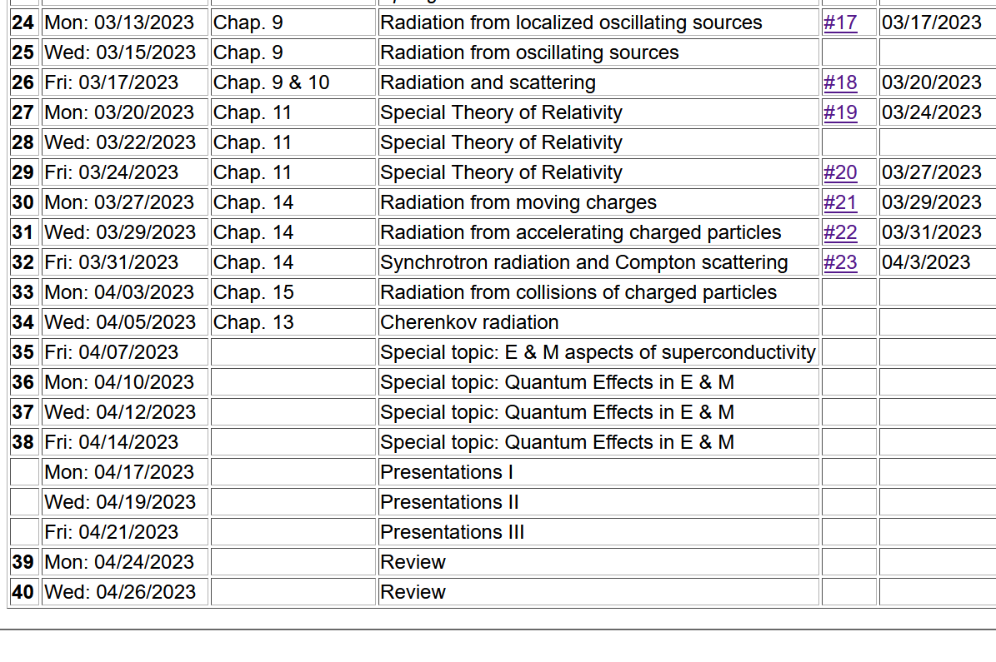

Slide 3
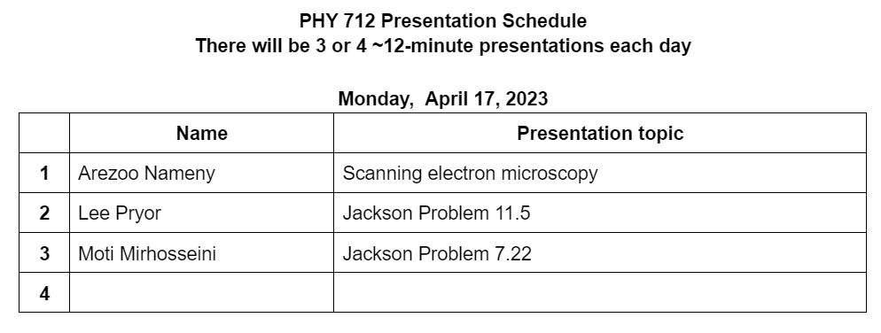

Slide 6
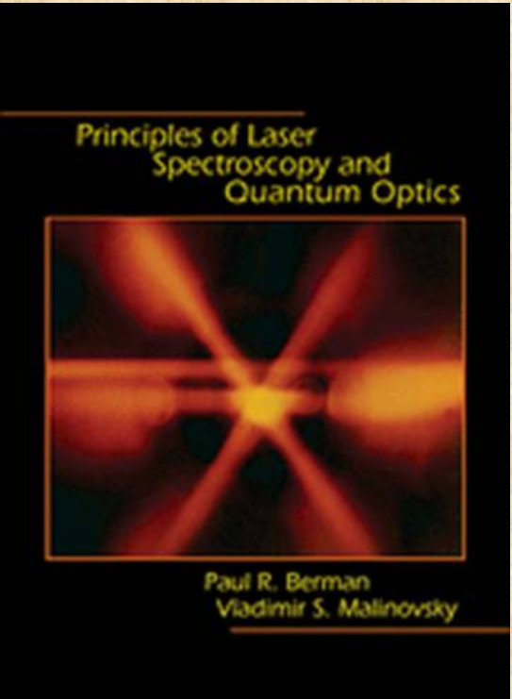
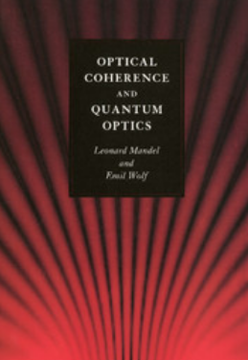
Recommended reading
Princeton U Press 2010
Cambridge U Press 1995

Slide 7
More comments about the coherent state
Previously we discussed Glauber’s coherent state (which Prof. Kandada assures me is well realized as the output of continuous wave (CW) lasers) formed as a superposition of single photon eigenstates:

Slide 8
Further analysis and modifications of the “coherent state”

Slide 9
In terms of the eigenstates of the EM Hamiltonian:

Slide 10
For the coherent state:
In this sense, the coherent state represents the minimum uncertainty process. For the pure phonon eigenstates, only the vacuum state has this minimum uncertainty.

Slide 12
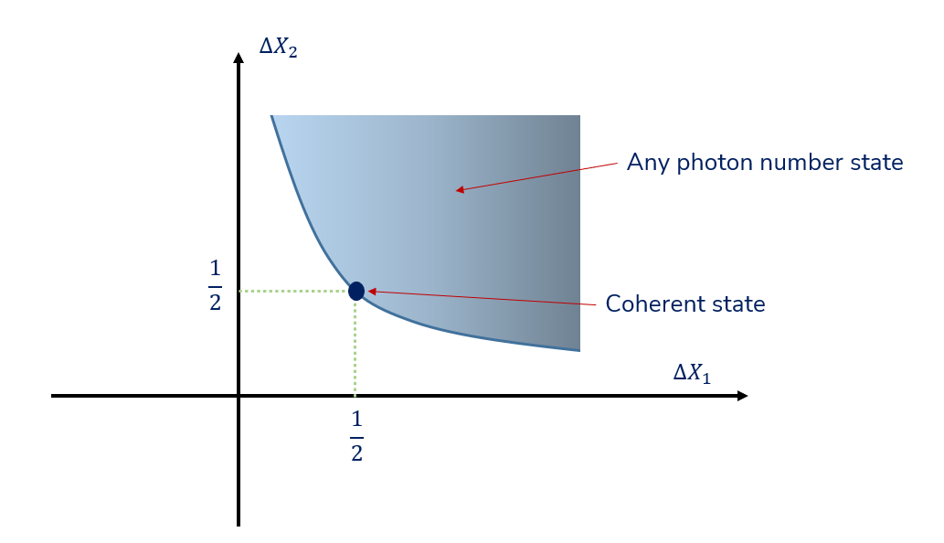
Plot of possible standard deviations (Figure from Prof. A. Kandada)
It is possible to modify the coherent state to produce fields with other properties within the blue region of the plot.

Slide 14
Better(?) description of squeezed states thanks to Berman ad Malinovsky ➔ two-photon coherent state
Coherent state operator
“Squeezing” operator
Vacuum state

Slide 15
Properties of the squeezed state continued --

Slide 16
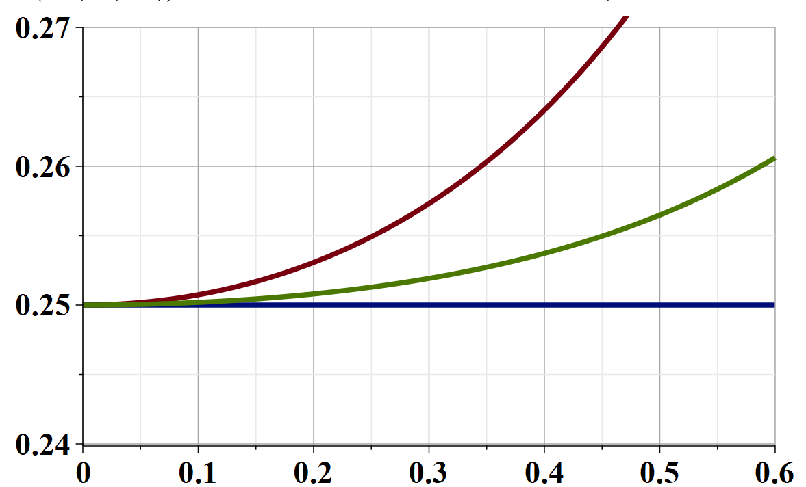
θ=π/4
θ=π/8
θ=0
r

Slide 17
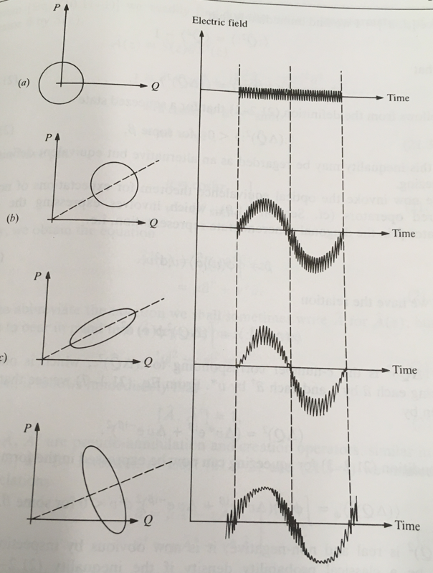
Squeezed states can be generated by taking a photon of frequency ω and using devices to generate two photons
of frequency ω/2.
Coherent state with α=0
From Mandel & Wolf
Coherent state with |α|>0
Squeezed state with controlled
phase
Squeezed state with controlled
amplitude

Slide 18
More complicated states
Notion of “entangled” states (according to Berman and Malinovsky) –
Example involving two particles

