Slide 1
PHY 712 Electrodynamics
10-10:50 AM MWF Olin 103
Notes for Lecture 39:
Review –
Motivation of final exam and how to optimize the experience; some comments on effective use of Maple, Mathematica
Some important mathematical tools and review of problem solving techniques
Particular electrodynamics topics

Slide 2
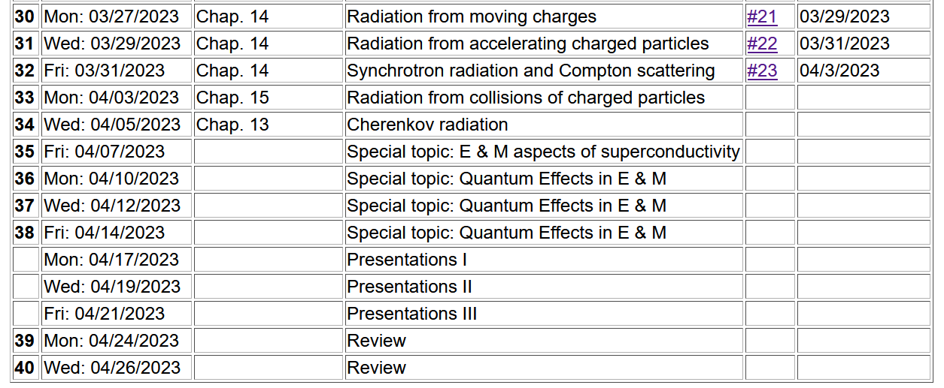
Important dates: Final exams available Apr. 26
Exams and outstanding HW due May 9
Also – Please fill out online course questionnaire for PHY 712
-- your feedback helps us to adjust the course for the better

Slide 3
What will you do after May 9?
Relax a minute or two
Several of you will want to start preparing for the Qualifier Exams which will be administered (tentative dates):
Monday, June 12 to Thursday, June 15 during the hours 1:00 – 4:00 pm.

Slide 4
Motivation for giving/taking final exam
Opportunity to review/solidify knowledge in the topic
Opportunity to practice problem solving techniques appropriate to the topic
Assessment of performance. Accordingly, the work you turn in must be your own (of course).
You are encouraged to consult with your instructor (but no one else!) if any questions arise about the exam questions
Extra credit awarded if you find errors/inconsistencies/ambiguities in the exam questions

Slide 5
Instructions on exam:
Note: This is a ``take-home'' exam which can be turned in any time before 5 PM Tuesday, May 9, 2023. In addition to each worked problem, please attach ALL Maple (or Mathematica, Matlab, Wolfram, etc.), work sheets as well as a full list of resources used to complete these problems. It is assumed that all work on the exam is performed under the guidelines of the honor code. In particular, if you have any questions about the material, you may consult with the instructor but no one else. For grading purposes, each question in multi-part problems are worth equal weight. Credit will be assigned on the basis of both the logical steps of the solution and on the correct answer.

Slide 6
More advice about exam –
It is important that the instructor is able to read your work and understand your reasoning.
Since you will be using Maple or Mathematica or ?? to evaluate some of your results, consider integrating them into your exam paper or perhaps paste snips into your favorite word processor.
Your exam paper does not need to be a work of art, but it does need to be readable. If you prefer to submit your exam paper electronically, that will be fine. (I may print it myself.)

Slide 7
Example solution using Maple --
Text mode
Math mode

Slide 9
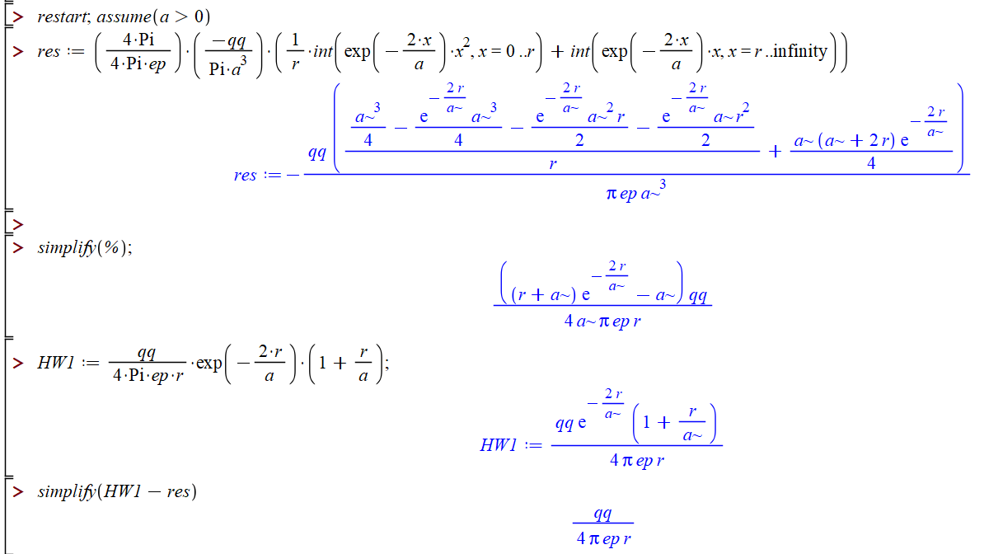
HW #8 continued --

Slide 10
More advice – accumulated trusted equations/mathematical relationships and know how to use them
Jackson
pg. 783

Slide 11
Jackson pg. 783
Note that some of the “fundamental” constants change slightly over the years……

Slide 12
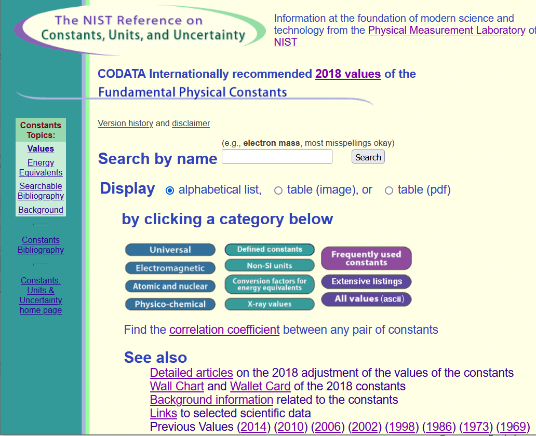
Source for standard measurements –
https://physics.nist.gov/cuu/Constants/index.html

Slide 13
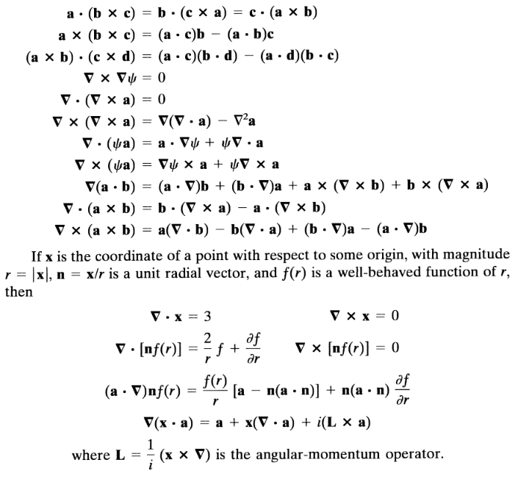
Vector relations

Slide 14
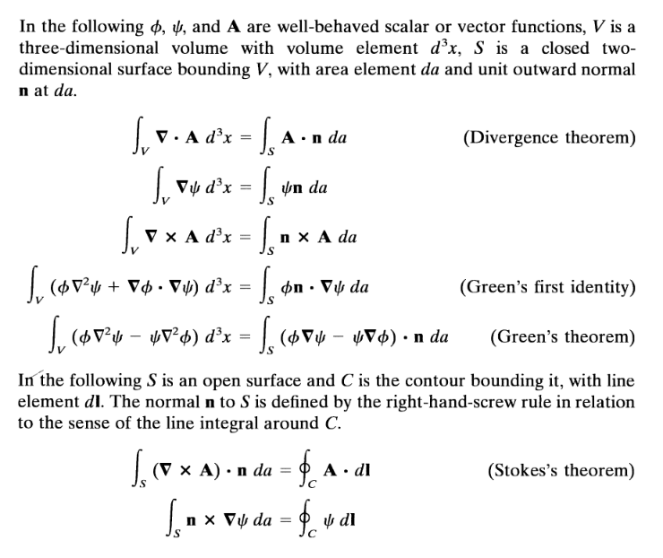

Slide 17
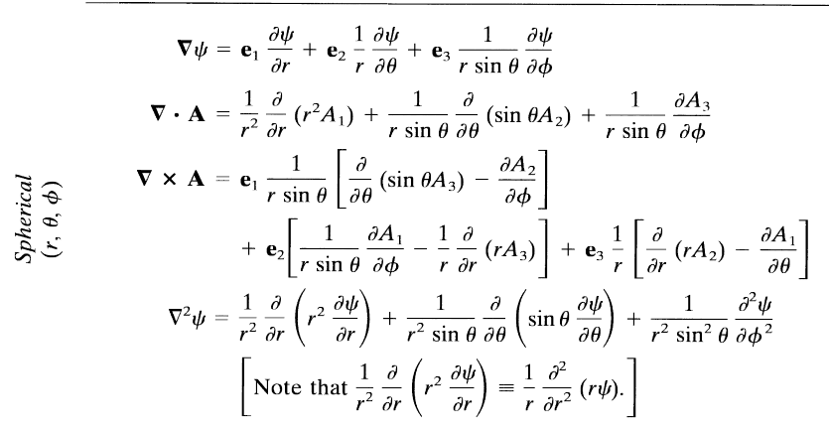

Slide 18
Comment on cartesian unit vectors versus local (cylindrical or spherical) unit vectors
Note that Cartesian unit coordinates are fixed in space, but curvilinear unit coordinates change with angle.

Slide 19
Special functions -- many are described in Jackson
Additional source -- https://dlmf.nist.gov/

Slide 21
More relationships

Slide 22
elementary charge: e=1.6021766208 x 10⁻¹⁹ C
=4.80320467299766 x 10⁻¹⁰ statC

Slide 23
Energy and power (SI units)

Slide 27
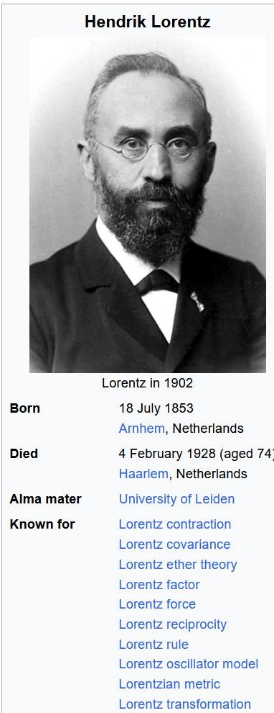
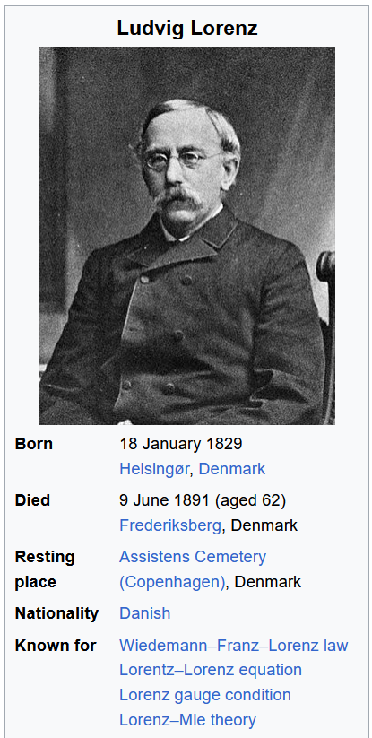
According to Wikipedia --

Slide 28
In your “bag” of tricks:
Direct (analytic or numerical) solution of differential equations
Solution by expanding in appropriate orthogonal functions
Green’s function techniques

Slide 29
How to choose most effective solution method --
In general, Green’s functions methods work well when source is contained in a finite region of space

Slide 31
Electromagnetic waves from time harmonic sources

Slide 32
Electromagnetic waves from time harmonic sources – continued:

Slide 33
Electromagnetic waves from time harmonic sources – continued:

Slide 34
Electromagnetic waves from time harmonic sources – continued:

Slide 35
Electromagnetic waves from time harmonic sources – continued:

Slide 36
Example of dipole radiation source

Slide 37
Example of dipole radiation source -- continued
Relationship to pure dipole approximation (exact when kR➔0)

Slide 38
Electromagnetic waves from time harmonic sources – for dipole radiation --:

Slide 39
Another useful approximation for analyzing radiation for time harmonic sources --

Slide 40
Radiation from a moving charged particle
z
.
v
r-R_{q}(t_{r})=R
q
Θ
r
R_{q}(t)
y
x

Slide 41
Liènard-Wiechert potentials –(Gaussian units)

Slide 42
Electric and magnetic fields far from source:

Slide 43
Poynting vector:

Slide 44
Lorentz transformations
y
y’
v
x
x’
y’
y
x’
x

Slide 45
Note, the concept of the Lorentz transformation is quite general, but the specific transformation form given in the following slides is special to the relative velocity along the x-axis.

Slide 46
Lorentz transformations -- continued

Slide 47
Velocity relationships
➔

Slide 48
Field strength tensor
For stationary frame
For moving frame

Slide 49
➔ This analysis shows that the E and B fields must be treated as components of the field strength tensor and that in order to transform between inertial frames, we need to use the tensor transformation relationships:
Transformation of field strength tensor

Slide 50
Inverse transformation of field strength tensor

