Slide 1
PHY 712 Electrodynamics
10-10:50 AM MWF Olin 103
Class notes for Lecture 3:
Reading: Chapter 1 (especially 1.11) in JDJ;
Continued discussion/derivation of Ewald summation methods
Example for CsCl

Slide 2
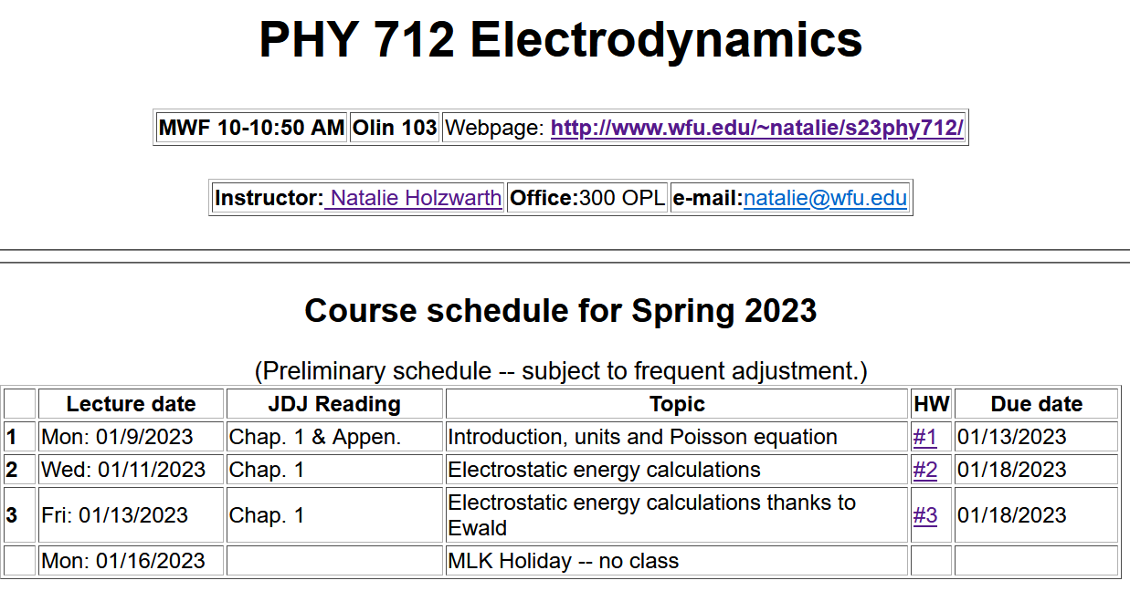
3

Slide 4
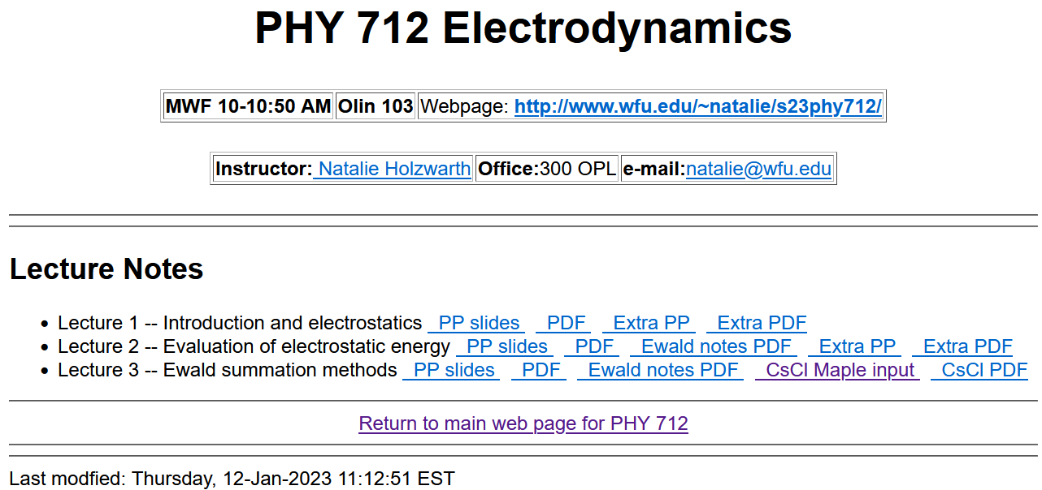
The details are presented in the pdf file Ewaldnotes.pdf

Slide 5
Your questions –
From Zezhong -- For CsCl structure graph demonstrations, is there any specific reason that Cl atoms are connected by bonds but Cs atoms are not connected? I found that it was the same for the graph demonstration of CsCl in lecture 2.
Short answer – The bonds are drawn arbitrarily. The notion of bonds has a quantum mechanical origin and Coulombic interactions are very long range. However, the bonds do help with visualizing the structure.

Slide 6
Last time, we argued that we need to carry out the following summation of all pairs of ions using Ewald’s very clever trick with the erf and erfc functions:
Must be evaluated in “reciprocal” space
Can be converged as is (in real space)
In order to make progress, we need to systematically enumerate all of the ion positions in the system

Slide 7
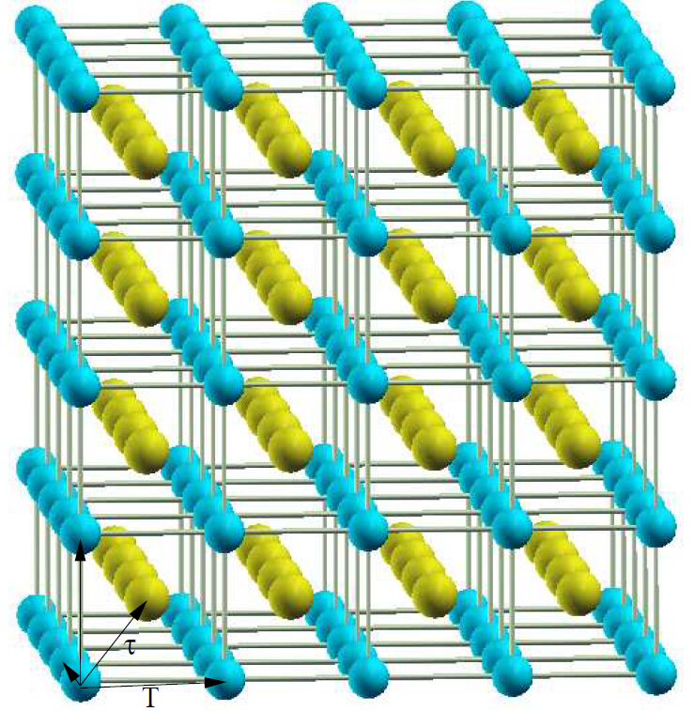
Using CsCl as our example system
Cs
Cl
Notice that a unit cell contains one Cl and one Cs

Slide 8
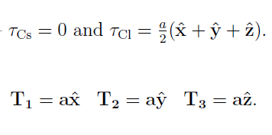
For CsCl --
a
Note that in general --

Slide 9
Note – this works for CsCl and more generally

Slide 10
For CsCl:
q_{Cs}=e
q_{Cl}=-e

Slide 11
For evaluating w₁ which needs to be evaluated in reciprocal space, additional considerations are needed --
It can be shown that --
Volume of unit cell
in real space

Slide 12
Preview – what happens if
is true?
Subtract out self-energy contribution

Slide 13
Continued --
Preview – what happens if
is true?

Slide 14
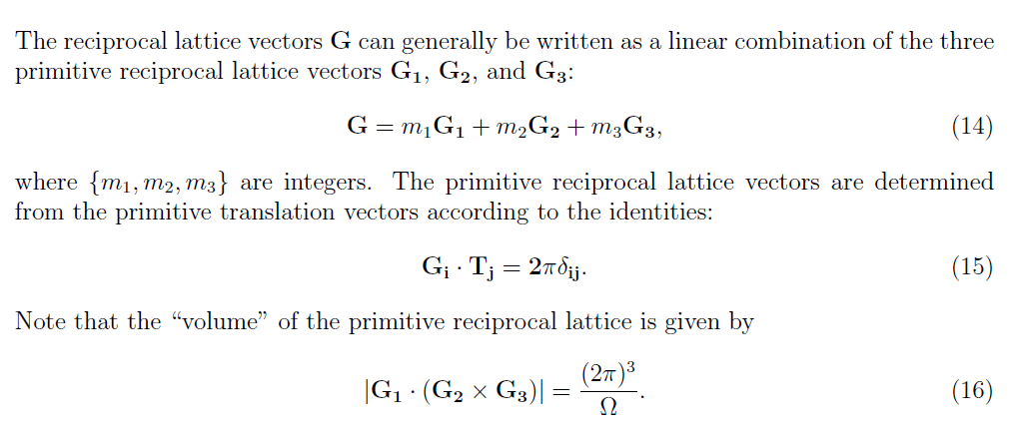
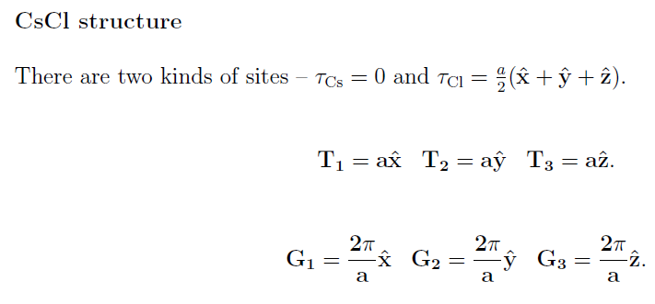
Back to “proof” --
Example --

Slide 15
Consider the summation;
Behavior of function for various values of M:
M=8
M=3

Slide 16
“Proof” of identity --

Slide 17
Final result --

Slide 19
divergent results
+ appropriate changes of variables and order of integration

Slide 20
Divergent term

Slide 21
Problem – Electrostatic energy of a periodic non-neutral system is not defined!
Solution -- Add uniform compensating charge and find the electrostatic energy of periodic neutral system, carefully analyzing diverging terms to determine a convergent expression.

Slide 22
Some details
Cancels divergence
Extra contribution

Slide 23
For CsCl --
a

Slide 24
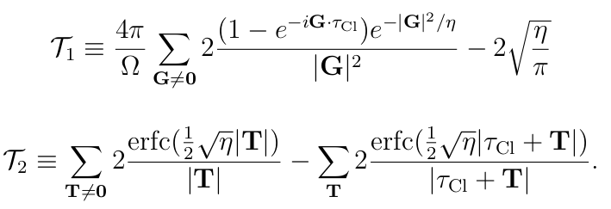
➔Can be evaluated using Maple or Mathematica or other programming language

