Slide 1
PHY 712 Electrodynamics
10-10:50 AM MWF Olin 103
Notes for Lecture 40:
Review –
Thanks for a great semester
Review of cylindrical coordinate systems
Other review topics
Course questionnaire

Slide 2
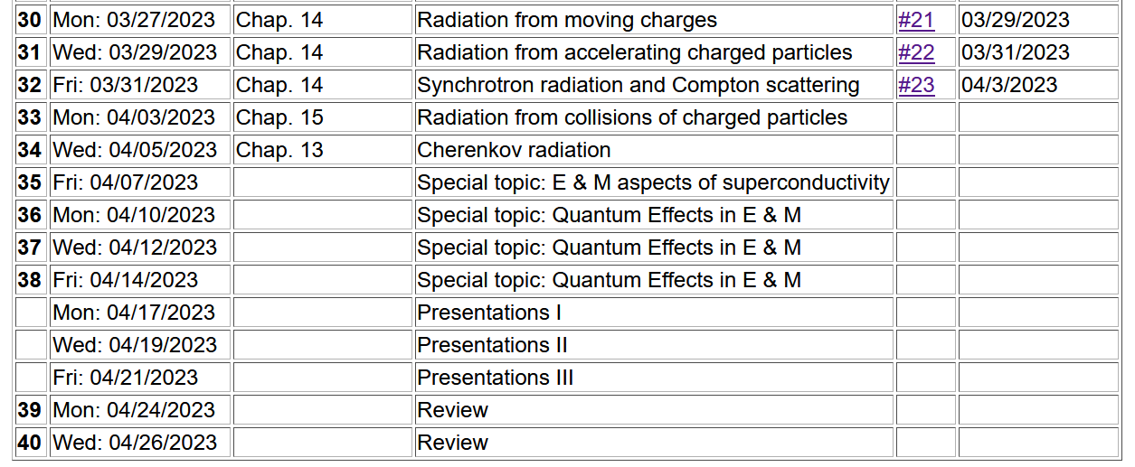
Important dates: Final exams available Apr. 26 before 5 PM
Exams and outstanding HW due May 9
Also – Please fill out online course questionnaire for PHY 712
-- your feedback helps us to adjust the course for the better

Slide 3
Review of cylindrical coordinates
Slides from Lecture 8 --

Slide 4
Solution of the Poisson/Laplace equation in various geometries ➔cylindrical geometry with no z-dependence (infinitely long wire, for example):
φ
ρ

Slide 5
Solution of the Poisson/Laplace equation in various geometries ➔cylindrical geometry with no z-dependence (infinitely long wire, for example):
φ
ρ

Slide 6
Solution of the Poisson/Laplace equation in various geometries -- cylindrical geometry with no z-dependence (infinitely long wire, for example):
φ
ρ
➔m=integer

Slide 7
Solution of the Poisson/Laplace equation in various geometries -- cylindrical geometry with no z-dependence (infinitely long wire, for example):
φ
ρ

Slide 8
Note that this example is similar to the construction for the 2-d cartesian case --

Slide 9
Cartesian example continued --

Slide 10
Note that, because we are using curvilinear coordinates, the Wronskian and the form of the delta function is modified.
More details given in Jackson Sec. 3.7 - 3.11.

Slide 11
Comments and details
φ
r
Note that in this case, we have assumed that the surface integral contributions are trivial.

Slide 12
Example – uniform cylindrical shell:
z
Top view:
a
b
y
r
x

Slide 13
Question – Why only m=0 for this case?

Slide 14
Some details

Slide 15
Example continued -- m=0 only --
Top view:
a
b

Slide 16
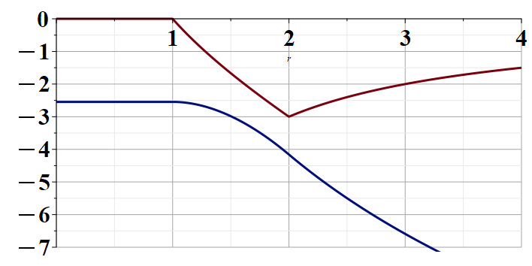
Example continued --
r
a
b

Slide 17
Solution of the Poisson/Laplace equation in various geometries -- cylindrical geometry with z-dependence
φ
ρ
z

Slide 18
Cylindrical geometry continued:
φ
ρ
z

Slide 19
https://dlmf.nist.gov/

Slide 21
Cylindrical geometry continued:
φ
ρ
z

Slide 22
Solutions of Laplace equation inside cylindrical shape
Example with non-trivial boundary value at z=L
Well behaved at ρ=0
m=0
m=1
m=2
kρ

Slide 23
Solutions of Laplace equation inside cylindrical shape
Example with non-trivial boundary value at z=L

Slide 24
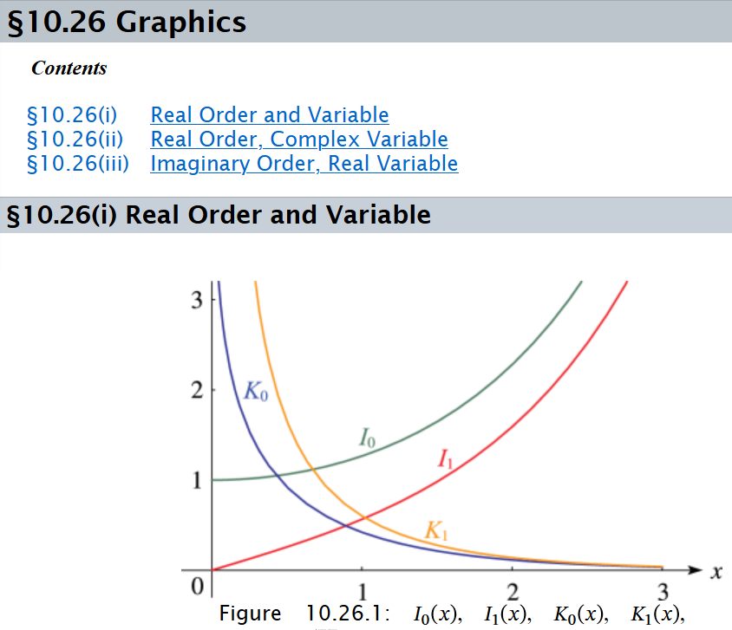

Slide 25
Solutions of Laplace equation inside cylindrical shape
Example with non-trivial boundary value at ρ=a
m=0
m=1
m=2
kρ

Slide 26
Solutions of Laplace equation inside cylindrical shape
Example with non-trivial boundary value at ρ=a

Slide 27
Green’s function for Dirchelet boundary value inside cylinder:

Slide 28
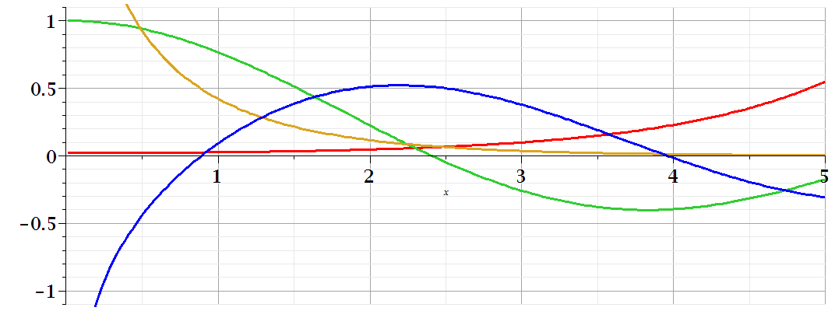
Comments on cylindrical Bessel functions
m=0
K₀
I₀/50
J₀
N₀

Slide 29
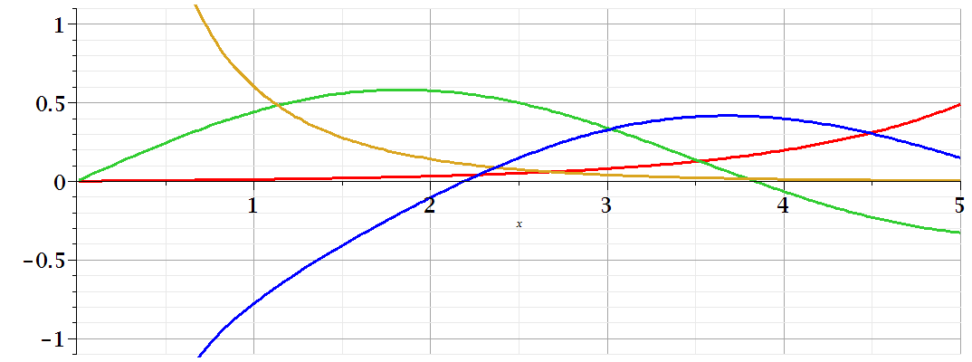
Comments on cylindrical Bessel functions
K₁
m=1
I₁/50
J₁
N₁

Slide 30
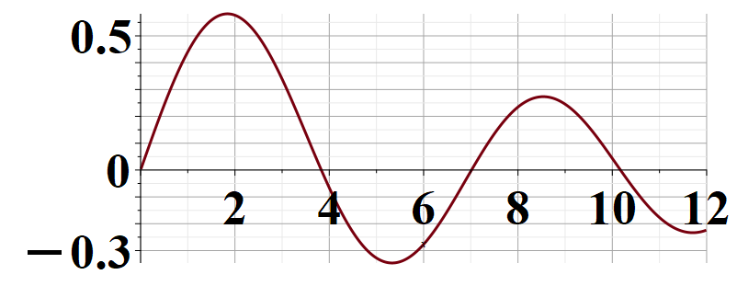
Some useful identities involving cylindrical Bessel functions from Jackson Sec. 3.7
m=1

Slide 31
Some comments on synchrotron radiation spectra from large synchrotron facilities
Slides from Lecture 31

Slide 32
z
r
.
θ
β
y
β
Top view:
x
ρ
y
x

Slide 33
z
r
.
θ
β
y
β
x

Slide 34
z
r
.
θ
β
y
β
x

Slide 36
Some details:
Modified Bessel functions
Exponential factor

Slide 37
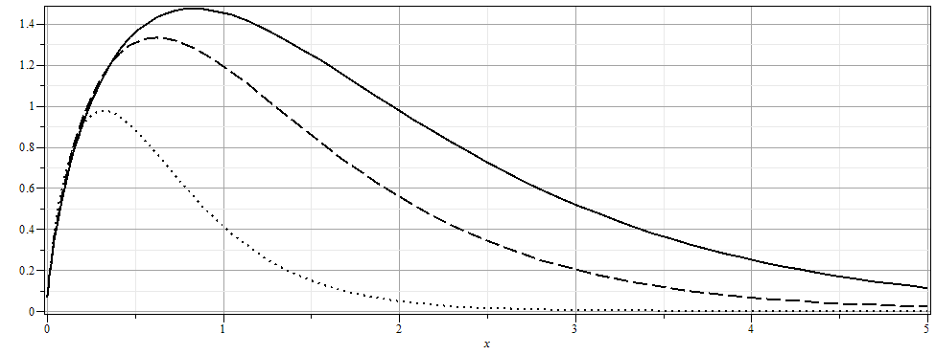

Slide 38
More details

Slide 39
Time to fill out assessment questionnaire for PHY 712 --

