Slide 1
PHY 712 Electrodynamics
10-10:50 AM MWF in Olin 103
Class notes for Lecture 6:
Reading: Chapter 1 - 3 in JDJ
Introduction to numerical methods
Finite difference
Finite element
Notes:
In this lecture, we will discuss some of the very basics of numerical solutions of the Poisson equation.

Slide 2
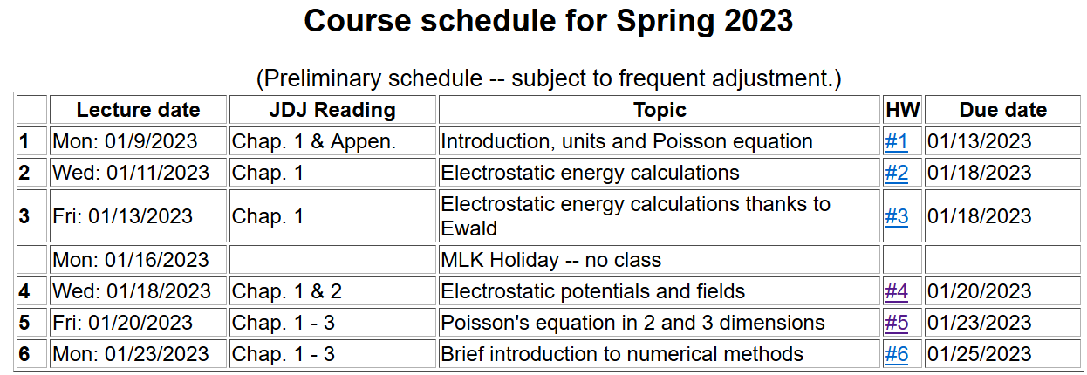
Notes:
Updated schedule

Slide 3
Recall example from Lecture 5:
a
b

Slide 5
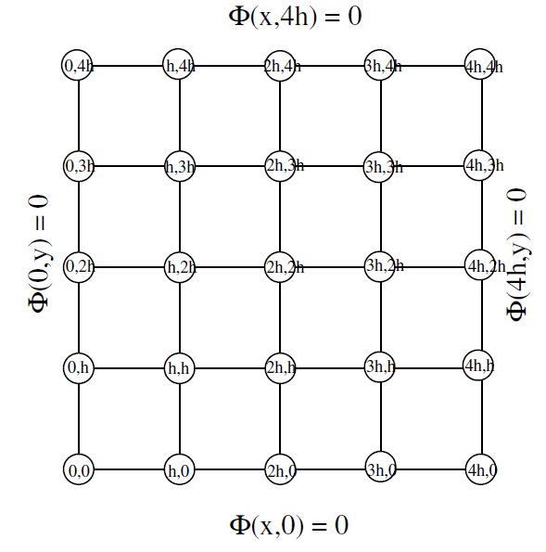
Some details for fine grid --
9 interior grid points
➔reduced to 6 evaluation points using symmetry

