Slide 1
PHY 712 Electrodynamics
10-10:50 AM MWF in Olin 103
Class notes for Lecture 8:
Finish reading Chap. 2 and start Chap. 3
Solution of Poisson/Laplace equation for special geometries –
Cylindrical
Spherical

Slide 2
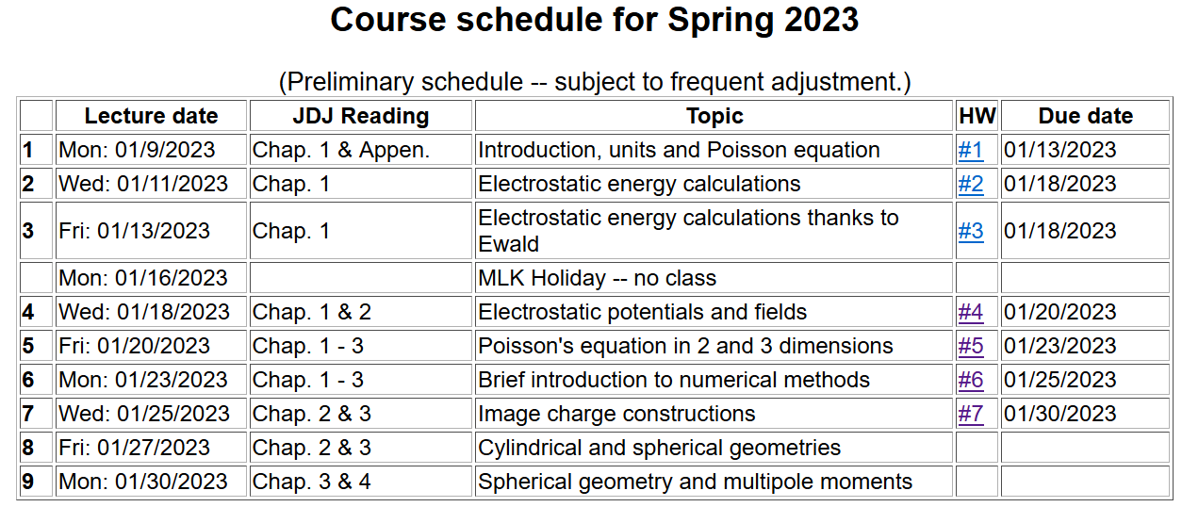

Slide 3
Solution of the Poisson/Laplace equation in various geometries ➔cylindrical geometry with no z-dependence (infinitely long wire, for example):
φ
ρ

Slide 4
Solution of the Poisson/Laplace equation in various geometries ➔cylindrical geometry with no z-dependence (infinitely long wire, for example):
φ
ρ

Slide 5
Solution of the Poisson/Laplace equation in various geometries -- cylindrical geometry with no z-dependence (infinitely long wire, for example):
φ
ρ
➔m=integer

Slide 6
Solution of the Poisson/Laplace equation in various geometries -- cylindrical geometry with no z-dependence (infinitely long wire, for example):
φ
ρ

Slide 7
Note that the previous example is similar to the construction for the 2-d cartesian case --

Slide 8
Cartesian example continued --

Slide 9
Note that, because we are using curvilinear coordinates, the Wronskian and the form of the delta function has to be modified.

Slide 10
Comments and details
φ
r
Note that in this case, we have assumed that the surface integral contributions are trivial.

Slide 11
Example – uniform cylindrical shell:
z
Top view:
a
b
y
r
x

Slide 12
Question – Why only m=0 for this case?

Slide 13
Some details

Slide 14
Example continued -- m=0 only --
Top view:
a
b

Slide 15
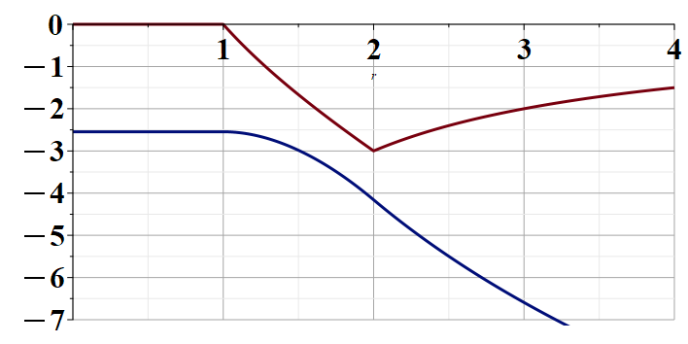
Example continued --
a
b
r

Slide 16
Solution of the Poisson/Laplace equation in various geometries -- cylindrical geometry with z-dependence
φ
ρ
z

Slide 17
Cylindrical geometry continued:
φ
ρ
z

Slide 18
Cylindrical geometry continued:
φ
ρ
z

Slide 19
Solutions of Laplace equation inside cylindrical shape
Example with non-trivial boundary value at z=L
m=0
m=1
m=2
kρ

Slide 20
Solutions of Laplace equation inside cylindrical shape
Example with non-trivial boundary value at z=L

Slide 21
Solutions of Laplace equation inside cylindrical shape
Example with non-trivial boundary value at ρ=a
m=0
m=1
m=2
kρ

Slide 22
Solutions of Laplace equation inside cylindrical shape
Example with non-trivial boundary value at ρ=a

Slide 23
Green’s function for Dirchelet boundary value inside cylindar:

Slide 24
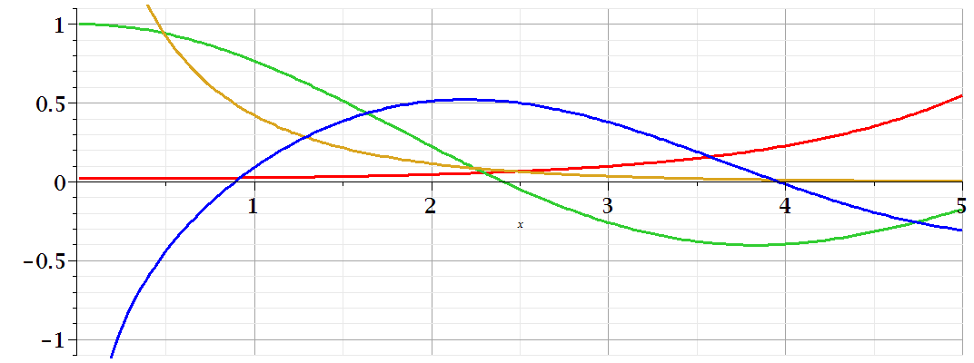
Comments on cylindrical Bessel functions
m=0
K₀
I₀/50
J₀
N₀

Slide 25
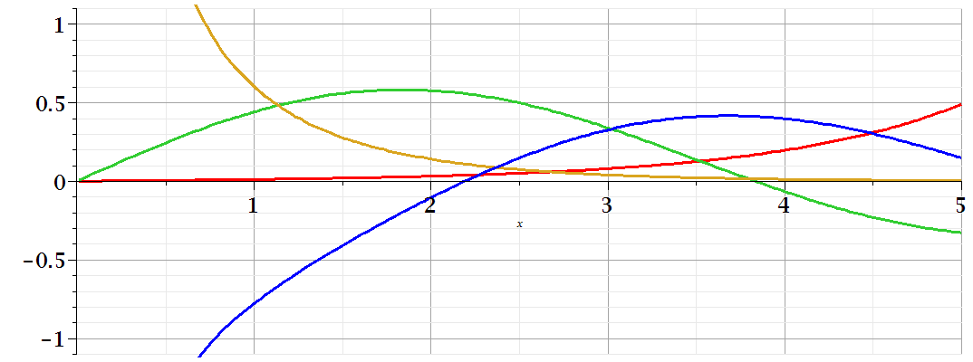
Comments on cylindrical Bessel functions
K₁
m=1
I₁/50
J₁
N₁

Slide 26
Some useful identities involving cylindrical Bessel functions

Slide 27
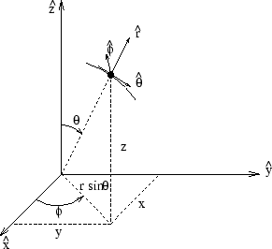
Poisson and Laplace equation in spherical polar coordinates
http://www.uic.edu/classes/eecs/eecs520/textbook/node32.html

Slide 28
Poisson and Laplace equation in spherical polar coordinates -- continued

Slide 29
Properties of spherical harmonic functions

Slide 30
Useful identity:

Slide 31
Example -- continued

Slide 32
Useful identity:

Slide 33
Useful identity:

Slide 34
Some spherical harmonic functions:

