Slide 1
PHY 712 Electrodynamics
10-10:50 AM MWF Olin 103
Notes for Lecture 1:
Reading: Appendix 1 and Chapters I&1
Course structure and expectations
Units – SI vs Gaussian
Electrostatics – Poisson equation
Notes:
Welcome to Electrodynamics. In this lecture we will discuss the course structure and jump right into Chapters I (introduction) and 1 (electrostatics).

Slide 2
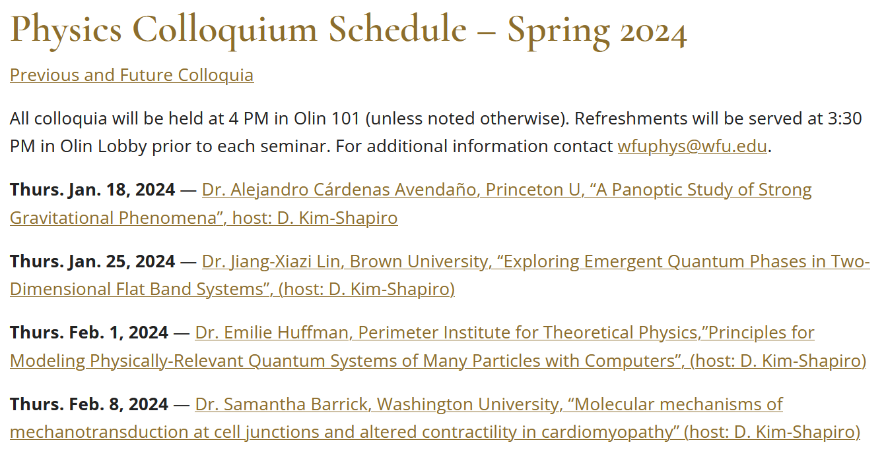
Comment on upcoming physics colloquia –
https://physics.wfu.edu/wfu-phy-news/colloquium/seminar-spring-2024/

Slide 3
4 PM Olin 101

Slide 4
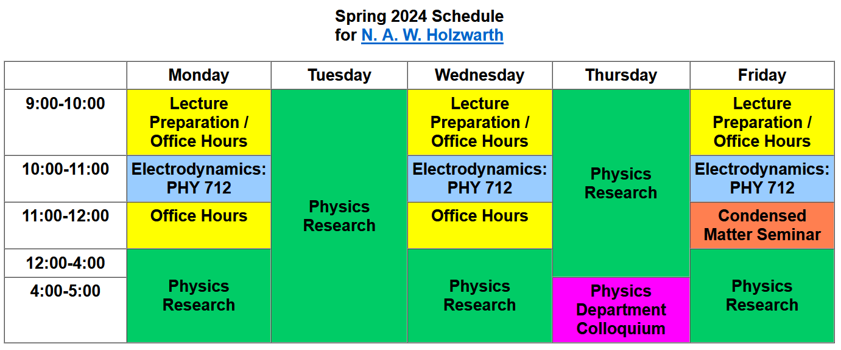

Slide 5
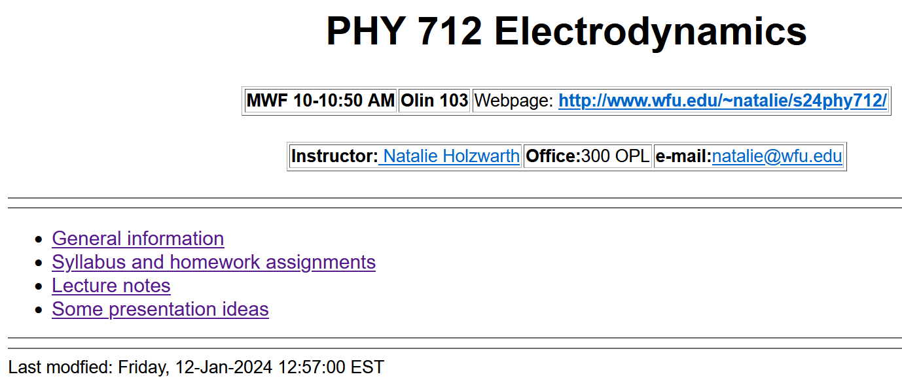
http://users.wfu.edu/natalie/s24phy712/
Notes:
Back to our regularly scheduled program. Our webpage is set up and is the source of all information about the course.

Slide 6
Optional supplements
Textbook
Third edition
Notes:
The text book is the 3rd addition of the classic textbook by John David Jackson. (Please note that you will need the 3rd edition in order to follow the lectures.) Some of you may want another (perhaps less mathematically focused) and will find that the textbook by Andrew Zangwill to be helpful. Personally, I find that Jackson’s text has served me well to understand the basics of electrodynamics.

Slide 7
http://users.wfu.edu/natalie/s24phy712/info
Notes:
Information about the course structure is on our web page. The structure of the course is very much like the structure we used last semester for PHY 711. We want to focus class time on discussing your questions. Please prepare at least one question 3 hours before (preferably the night before) each class. We will use your questions as well as spontaneous questions to form the basis of the class discussions. Again, there will typically be one homework per class, nominally due the day of the next class meeting.

Slide 8
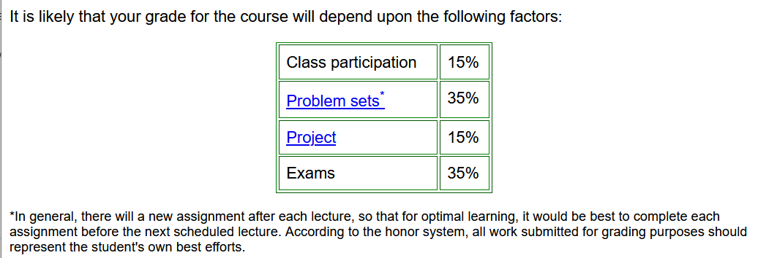
➔ Email your questions >= 1 hour before each class, schedule weekly one-on-one meetings, and/or attend office hours
Notes:
This is the expected grade distribution. Last semester the weekly one-on-one meetings seemed to be mostly productive, particularly for improving the completely online format. We will try to continue this during the spring semester. I need information from you to set up the appropriate timing.

Slide 9
Notes:
This semester we will also have individual projects due at the end of the semester. Here is a list from last year. During the course, please keep your eye out for topics that interest you worthy of your extra attention.

Slide 10
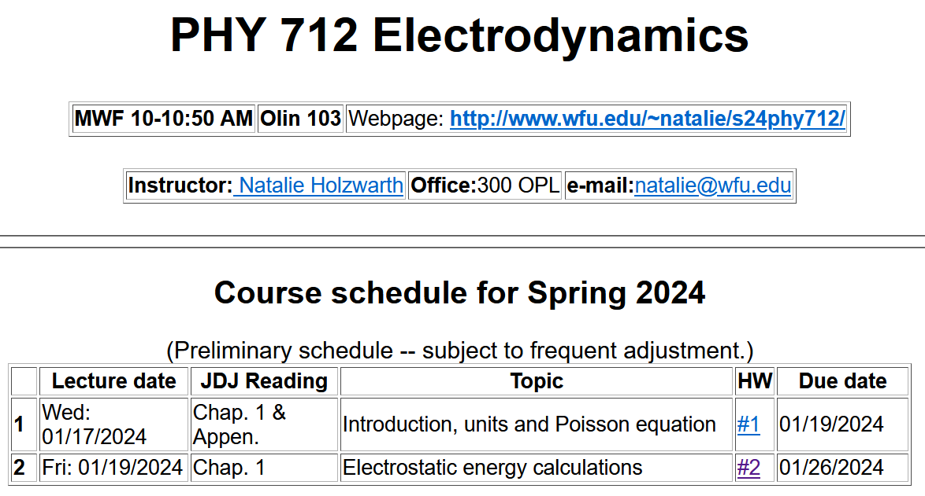
http://users.wfu.edu/natalie/s24phy712/homework/
H:
Notes:
The class schedule is available on the webpage and except for today’s lecture topic, subject to change. (The schedule is based on the topics we covered last year.)

Slide 11
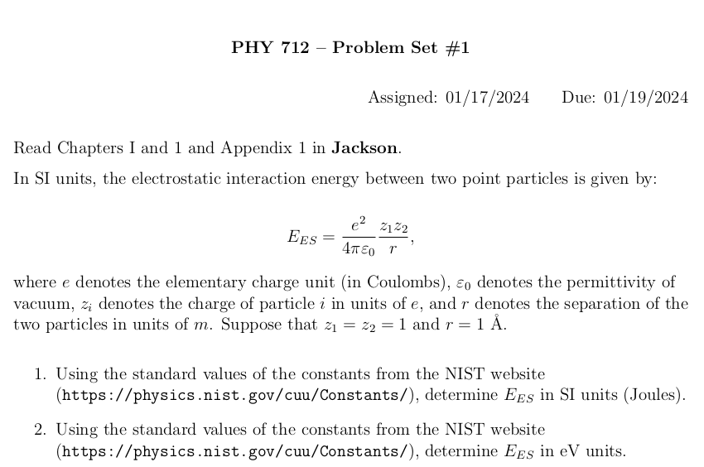
Notes:
This is a “warm up” problem to review energy units for an electrostatic interaction.

Slide 12
https://physics.nist.gov/cuu/Constants/

Slide 13
Preferences on HW
Due 3 times a week?
Due once a week on Friday?
Due once a week on Wednesday?
Due once a week on Monday?
Other?

Slide 14
Tentative additional information –
Spring break March 9-17
Mid term grades due March 11
Wed May 1 – Last day of class
May 3-10 – Final exams
Notes:
.

Slide 15
Remember to check your algebraic manipulation software --
https://software.wfu.edu/audience/students/
Notes:
It is expected that some of your homework will need to use algebraic manipulation software such as Maple or Mathematica which are available at the website mentioned above.

Slide 16
Material discussed in Appendix of textbook --
Notes:
Now for some discussion of our favorite topic. First we need to be clear about units. In general, the standard unit system is “SI”. The appendix discusses alternative unit systems found in the literature and IN THE SECOND HALF OF THIS TEXTBOOK!!!!! While for mechanics this is not such a big deal, for E & M it causes great pain and suffering.

Slide 17
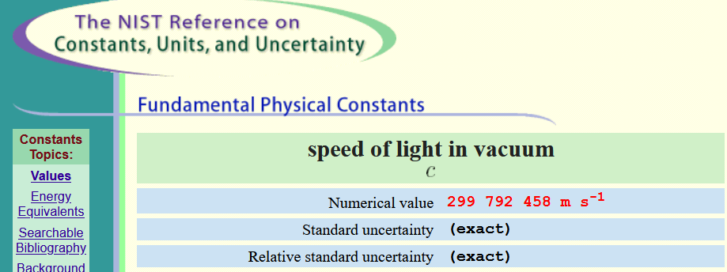

Slide 18
Notes:
Here are some relationships between the two unit systems used in this text.

Slide 19
m/s²
cm/s²
Notes:
More about units

Slide 20
Notes:
More about units. Note that while SI units are the current “standard”, many papers in the literature and older textbooks use other unit systems.

Slide 21
As we will see throughout the course, the E and B fields represent the basic electric and magnetic fields while the other fields include or represent electric and magnetic effects of matter.
Notes:
More about units. Note that while SI units are the current “standard”, many papers in the literature and older textbooks use other unit systems.

Slide 22
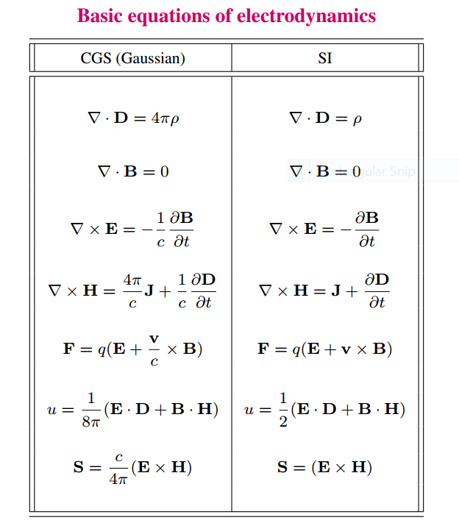
Notes:
Maxwell’s equations and other relationships that we will see during this course in the two unit systems.

Slide 23
Units choice for this course:
SI units for Jackson in Chapters 1-10
Gaussian units for Jackson in Chapters 11-16
Electrostatics
q₂
q₁
q₃
q₄
Notes:
Starting review of electrostatics both for a discrete collection of charges and for a continuous distribution of charge.

Slide 24
Electrostatics
Discrete versus continuous charge distributions
Notes:
Note that we can use a Dirac delta function to express discrete charges in terms of a distribution. The digression lists some useful relationships for various coordinate systems.

Slide 25
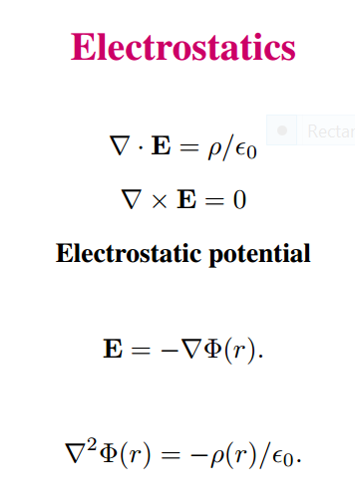
Differential equations --
Notes:
In addition to the integral relationships, electrostatics can also be expressed in terms of differential forms. Mathematically, the electrostatic potential is a convenient form in which to analyze electrostatic systems.

Slide 26
Relationship between integral and differential forms of electrostatics --
Notes:
Comparison of differential and integral relationships.

Slide 27
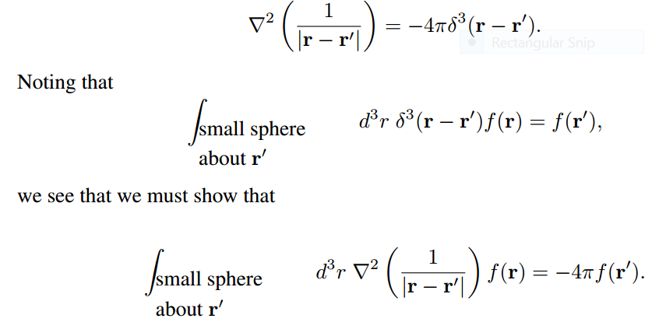
Relationship between integral and differential forms of electrostatics --
Need to show:
Notes:
The identity of the differential and integral forms follows from the singular behavior of the Coulomb kernel expressed on the top line. We need to “prove” this identity.

Slide 28
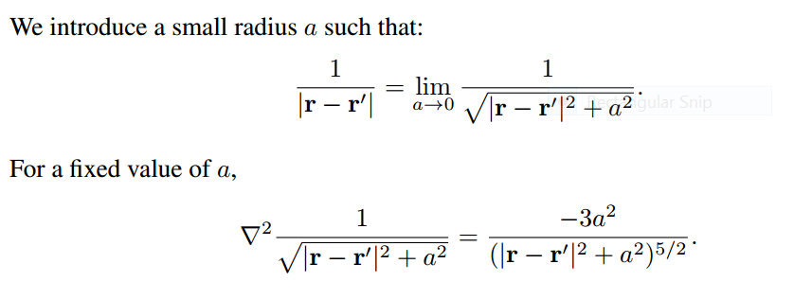
Notes:
Proof using the limit of an expression for a→0.

Slide 29
Notes:
Analytic results for finite a.

Slide 30
➔
➔
Notes:
From analytic result, evaluate for fixed R and a→0. Find that the result is independent of R and the identity is found to be justified.

Slide 31
Memorable identity

