Slide 1
PHY 712 Electrodynamics
10-10:50 AM MWF Olin 103
Notes for Lecture 12:
Start reading Chap. 5 (Sec. 5.1-5.5 in JDJ)
Magnetostatics
Vector potential
Example: current loop

Slide 2
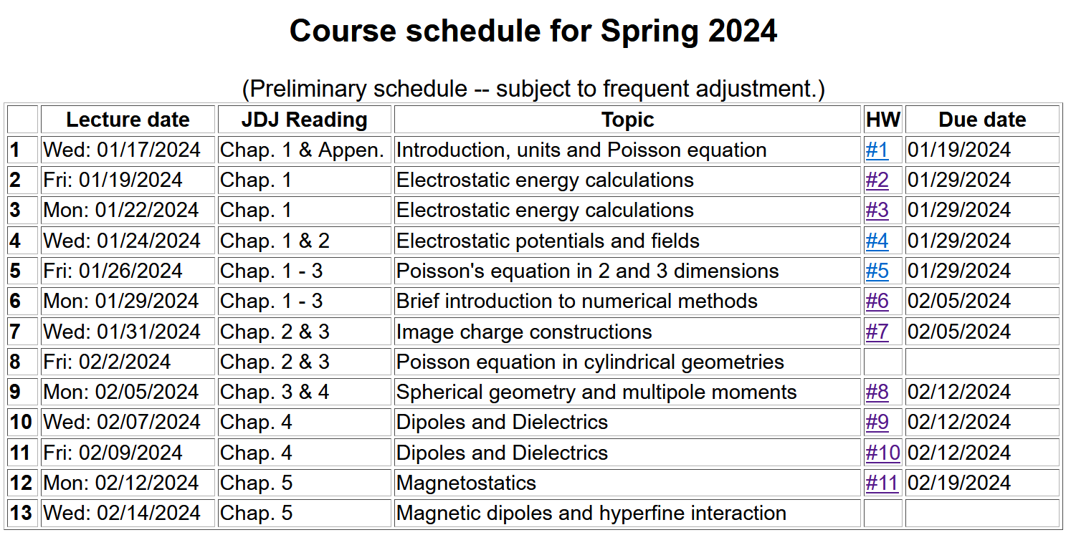

Slide 3
Note that it is possible to solve this problem using ideas learned in beginning physics (such PHY 114).

Slide 4
Magnetostatics
Magnetic flux density or magnetic induction field B
Steady state (constant in time) current density J
y
q_{i}
v_{i}
Real life examples:
Steady macroscopic current
Quantum mechanical eigenstates with non-trivial current density.
r_{i}
x

Slide 5
Comparison of electrostatics and magnetostatics

Slide 6
Alternative forms magnetostatic equations

Slide 7
=0

Slide 8
Alternative forms magnetostatic equations -- continued

Slide 9
Differential forms of magnetostatic equations:
Magnetostatic vector potential

Slide 10
Non uniqueness of the magnetostatic vector potential

Slide 11
Differential form of Ampere’s law in terms of vector potential:

Slide 12
Integral form may not be a good idea in this case ---

Slide 13
Further comments about HW #11
Using PHY 114 approach
J₀
Top view

Slide 14
Magnetostatics example: current loop
z
r
Integral form may be OK for this case…
y
x

Slide 15
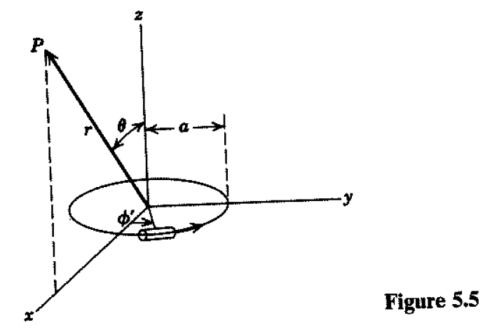
Magnetostatics example: current loop -- continued

Slide 16
Magnetostatics example: current loop -- continued

Slide 17
Examination of k
Note that k=0 when θ=0 and when r →infinity
k=1 when θ=π/2 and r = a

Slide 18
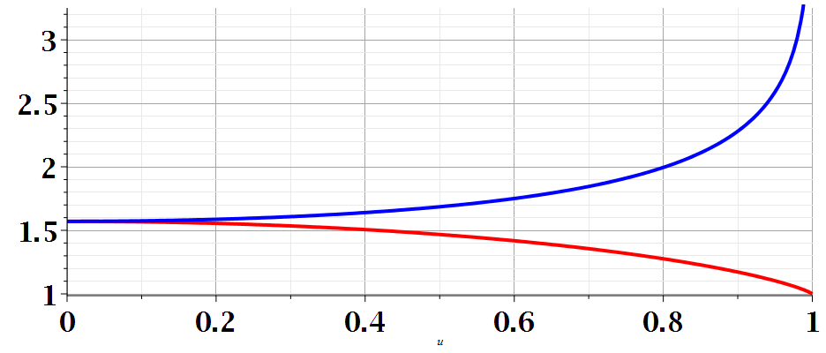
Standard eliptic functions --
m

Slide 19
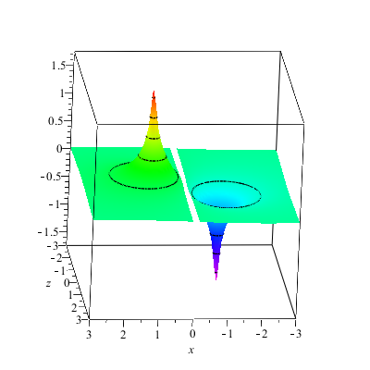
Magnetostatics example: current loop -- continued
A_{y}(x,z)

Slide 20
Magnetostatics example: current loop -- continued
Evaluation for special cases

Slide 21
Evaluation for special case k² → 0

Slide 22
Evaluation for special case k² → 0

Slide 23
Magnetostatics example: current loop -- continued

Slide 24
Other examples of current density sources:

Slide 25
Magnetic vector potential for this case:

Slide 26
Some details -- (note – this case simplifies more quickly than most…)

