Slide 1
PHY 712 Electrodynamics
10-10:50 AM MWF in Olin 103
Class notes for Lecture 13:
Continue reading Chap. 5 – Sec. 5.6-5.7 in JDJ
Examples of magnetostatic fields
Magnetic dipoles
Hyperfine interaction

Slide 2
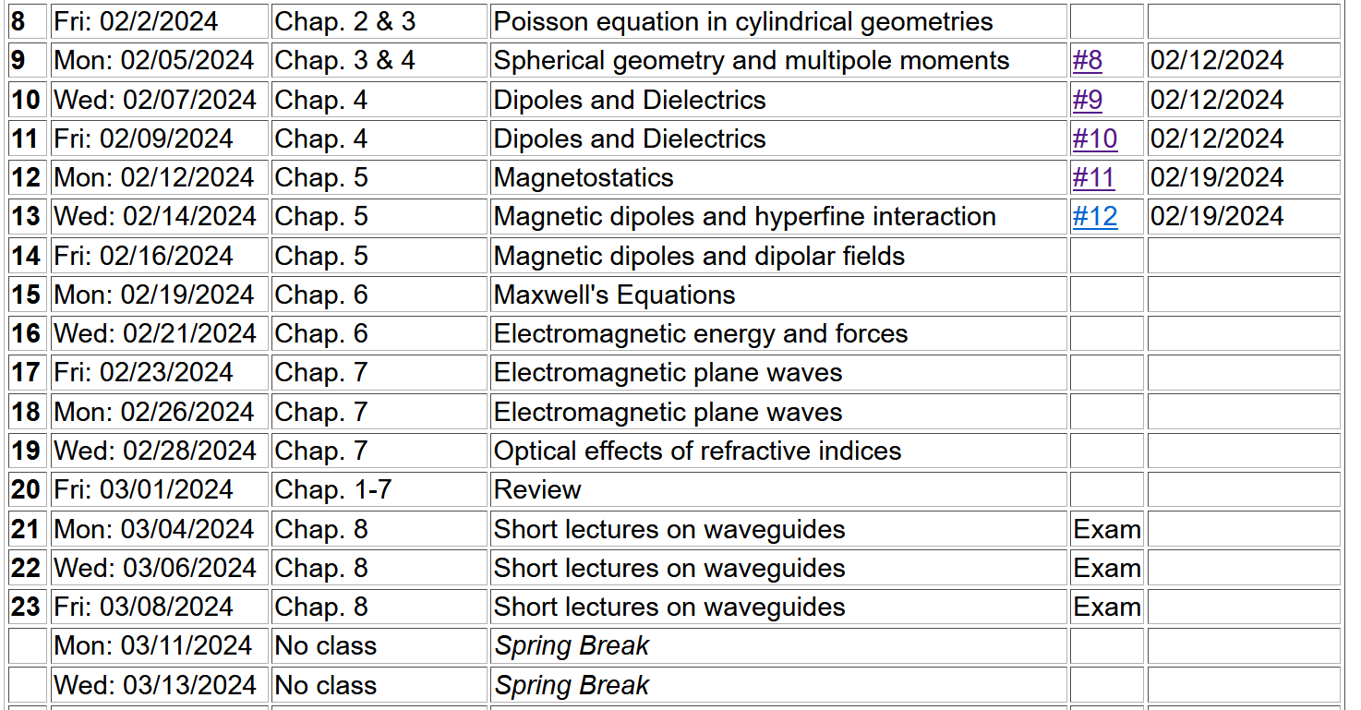

Slide 4
Comment about spherical polar coordinates
Ref: https://www.cpp.edu/~ajm/materials/delsph.pdf

Slide 5
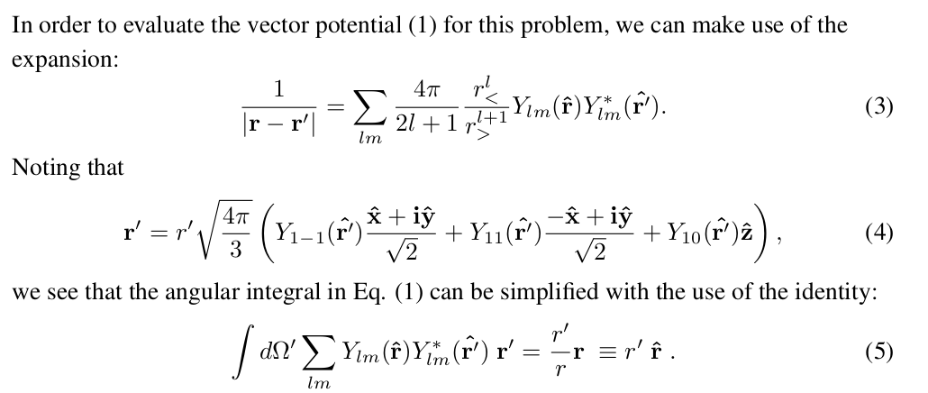
Note result given in “detailed” pdf file:

Slide 7
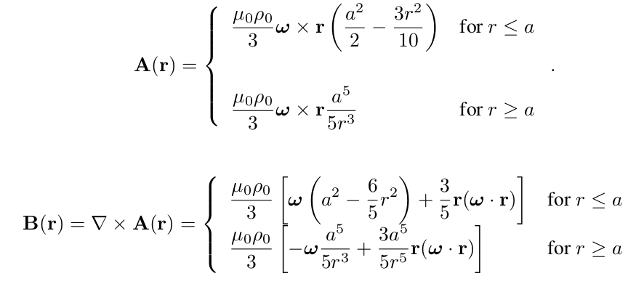
Example macroscopic localized current source --
For the model current density --

Slide 8
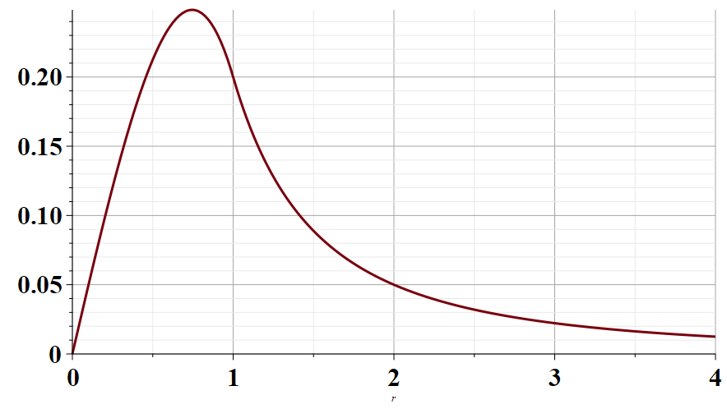
Radial part of A(r)
r/a →

Slide 9
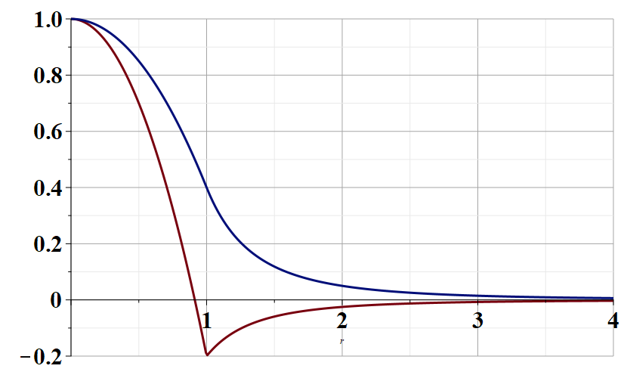
r parallel to ω
Radial part of B(r)
r/a →
r perpendicular to ω

Slide 10
Various forms of Ampere’s law :

Slide 11
Other examples of current density sources:

Slide 12
Details of the electron orbital magnetic dipole moment
Note that:

Slide 13
Significance of magnetic dipole – multipole approximation to vector potential and magnetic field

Slide 14
Summary of magnetic field generated by point magnetic dipole moment discussed in the detailed notes:

Slide 15
