Slide 1
PHY 712 Electrodynamics
10-10:50 AM MWF in Olin 103
Plan for Lecture 14:
Finish reading Chapter 5 (Sec. 5.8-5.12)
Recap of hyperfine interaction
Macroscopic magnetization density M
H field and its relation to B
Magnetic boundary values

Slide 2
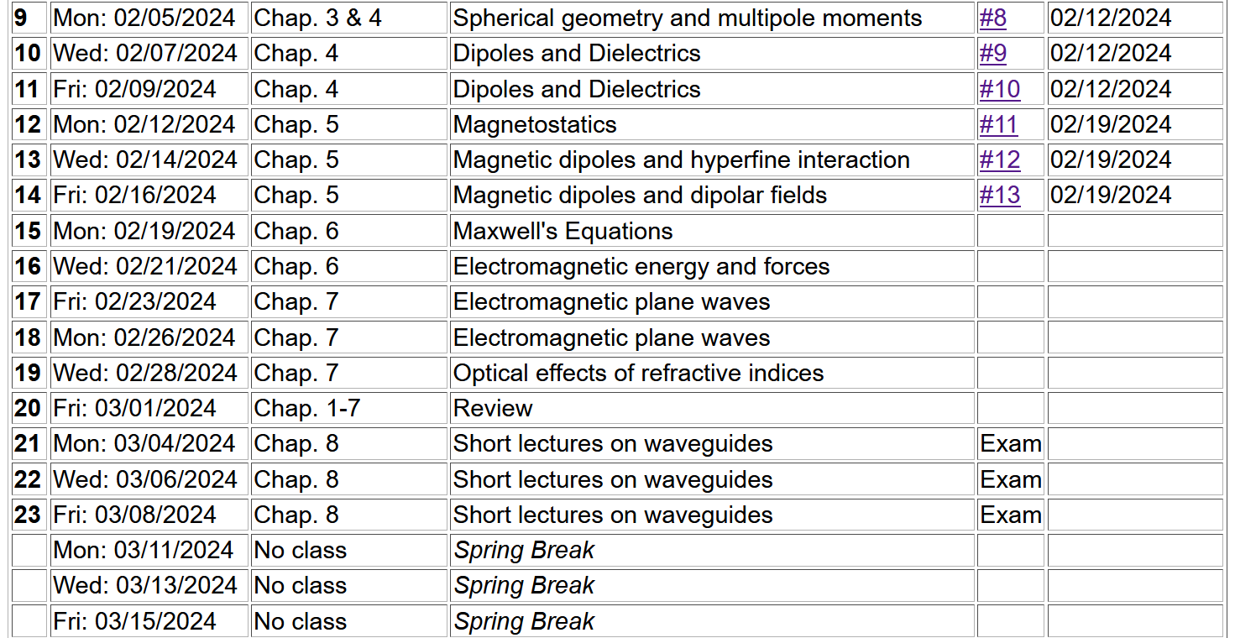

Slide 4
Summary of hyperfine interaction form:
Interactions between magnetic dipoles
Sources of magnetic dipoles and other sources of magnetism in an atom:
Intrinsic magnetic moment of a nucleus
Intrinsic magnetic moment of an electron
Magnetic field due to electron orbital current
Interaction energy between a magnetic dipole m and a magnetic field B:
r

Slide 5
Hyperfine interaction energy: -- continued
Here we assume that nuclear position is r=0.
Evaluation of the magnetic field at the nucleus due to the electron current density:
The vector potential associated with an electron in a bound state of an atom as described by a quantum mechanical wavefunction can be written:
We want to evaluate the magnetic field
in the vicinity of the nucleus

Slide 6
Hyperfine interaction energy: -- continued
Note that this field at the nucleus site is due to the electronic orbital angular momentum.

Slide 7
Hyperfine interaction energy: -- continued
Putting all of the terms together:
In this expression the brackets indicate evaluating the expectation value relative to the electronic state.

Slide 8
Macroscopic dipolar effects --
Magnetic dipole moment
Note that the intrinsic spin of elementary particles is associated with a magnetic dipole moment, but we often do not have a detailed knowledge of its J(r).
Vector potential for magnetic dipole moment
Valid outside the extent of J(r)

Slide 9
https://www.birmingham.ac.uk/Documents/college-eps/metallurgy/research/Magnetic-Materials-Background/Magnetic-Materials-Background-4-Classification-of-Magnetic-Materials.pdf

Slide 10
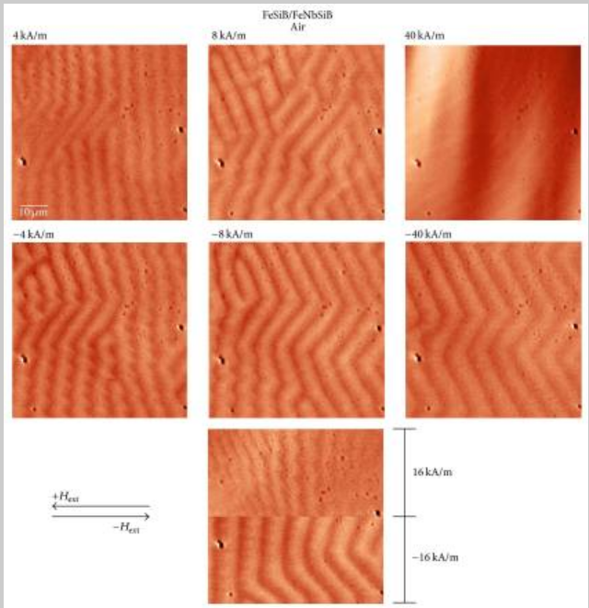
~70μm

Slide 11
Macroscopic magnetization
Vector potential due to “free” current J_{free}(r) and macroscopic magnetization M(r). Note: the designation J_{free}(r) implies that this current does not also contribute to the magnetization density. m_{i} may include contributions from “bound” currents as well as from intrinsic spins.

Slide 12
Vector potential contributions from macroscopic magnetization -- continued

Slide 13
Vector potential contributions from macroscopic magnetization -- continued

Slide 14
Magnetic field contributions

Slide 15
Energy associated with magnetic fields

Slide 16
1
2

Slide 17
1
2

Slide 18
Example magnetostatic boundary value problem
M₀

Slide 19
Example magnetostatic boundary value problem -- continued
M₀

Slide 20
Example magnetostatic boundary value problem -- continued
M₀

Slide 21
Example magnetostatic boundary value problem -- continued
M₀

Slide 22
Check boundary values:

Slide 23
Variation; magnetic sphere plus external field B₀
M₀
B₀

Slide 24
1
2

Slide 25
Magnetism in materials

Slide 26
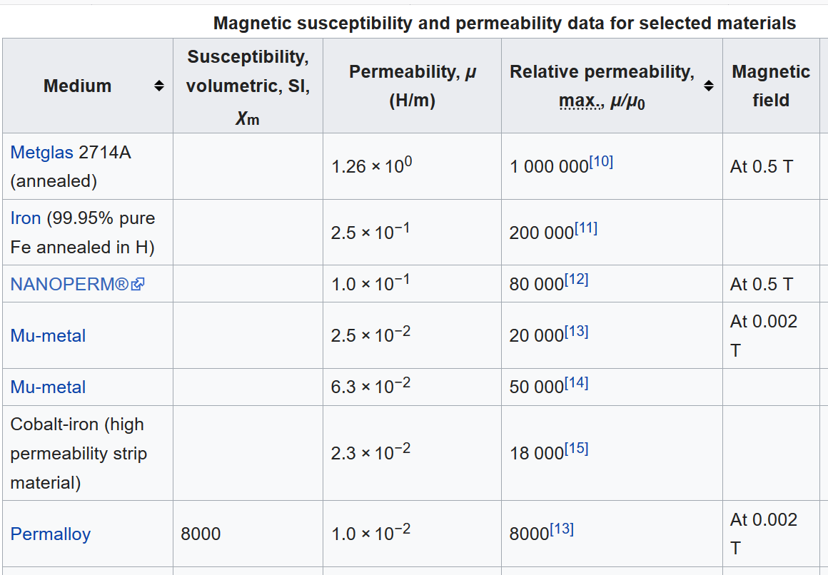
https://en.wikipedia.org/wiki/Permeability_(electromagnetism)

Slide 27
Composed of 80% Ni, 15% Fe, 5% Mo+other materials

Slide 28
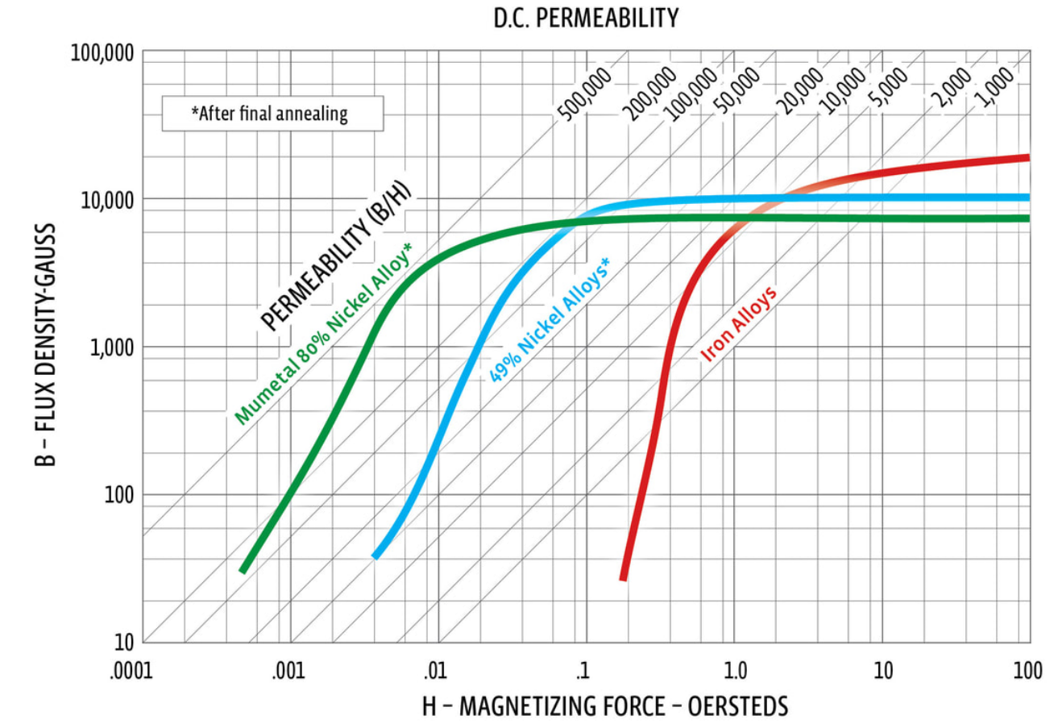
From: http://www.mu-metal.com/shielding-fundamentals.html

Slide 29
Example: permalloy, mumetal μ/μ₀ ~ 10⁴
B₀
Spherical shell a < r < b :
μ
a
b
μ₀
μ₀

Slide 30
Example: permalloy, mumetal μ/μ₀ ~ 10⁴ -- continued
B₀
μ
a
b
μ₀
μ₀

Slide 31
Example: permalloy, mumetal μ/μ₀ ~ 10⁴ -- continued
B₀
μ
a
b
μ₀
μ₀

Slide 32
Example: permalloy, mumetal μ/μ₀ ~ 10⁴ -- continued
B₀
μ
a
b
μ₀
μ₀

Slide 33
Example: permalloy, mumetal μ/μ₀ ~ 10⁴ -- continued
B₀
μ
a
b
μ₀
μ₀

