Slide 1
PHY 712 Electrodynamics
10-10:50 AM MWF in Olin 103
Notes for Lecture 16:
Finish reading Chapter 6 (Sec. 6.6-6.10 in JDJ) (some sections covered in less detail)
Some details of Liénard-Wiechert results
Energy density and flux associated with electromagnetic fields
Time harmonic fields

Slide 2
Many events this week –
TODAY ➔

Slide 3
Many events this week –
TOMORROW ➔
APS is one of several synchrotron light source facilities throughout the world.

Slide 4
Many events this week –
FRIDAY ➔

Slide 5
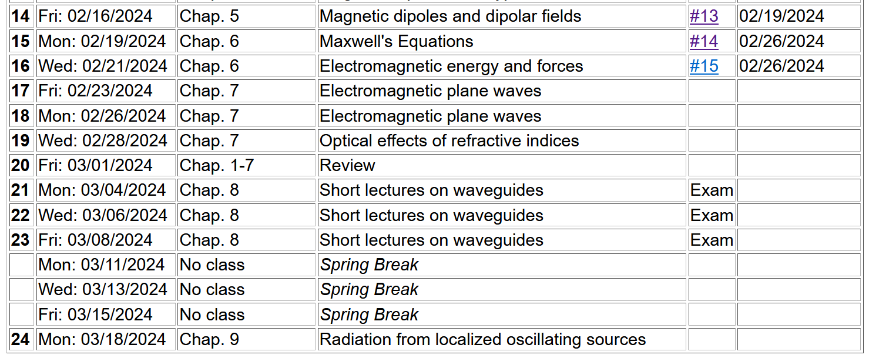

Slide 6
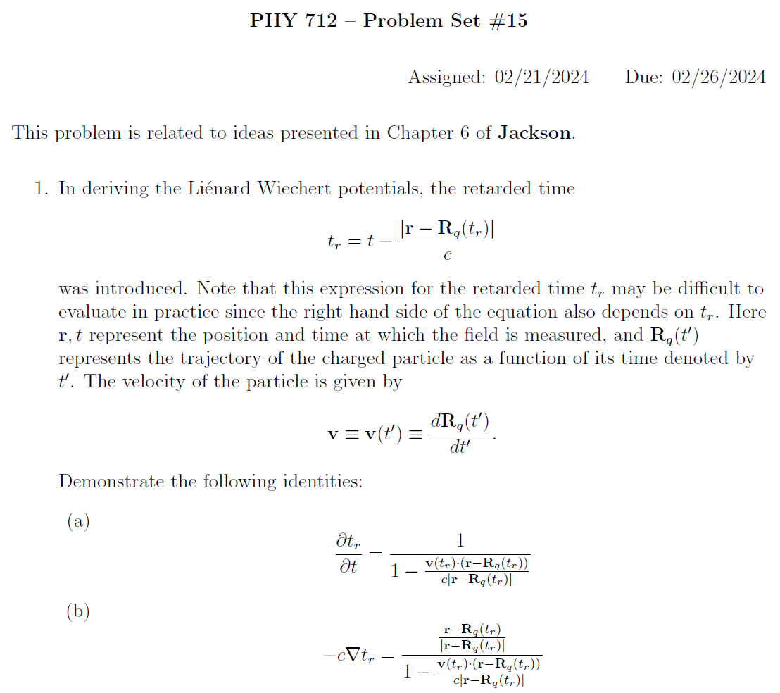

Slide 7
Your questions:
From Gabby: If possible, for review on Wednesday, could we go over Green's functions and the process of how to derive a function we would need for a particular problem? I know we mainly covered it in electrostatics, but we didn't get to practice it too much in the HWs so I am still a bit confused.
Comment: This is a very good suggestion. For today, perhaps we can discuss the properties of the Green’s function and how it works. The general construction of Green’s functions for a particular differential operator is a course in itself that we have discussed in PHY 711 and 712. We should definitely include some of those points in the mid term review.

Slide 8
Slide from Lecture 15
Solution of Maxwell’s equations in the Lorentz gauge

Slide 10
Solution of Maxwell’s equations in the Lorentz gauge – Review from previous lecture --
Liénard-Wiechert potentials and fields --
Determination of the scalar and vector potentials for a moving point particle (also see Landau and Lifshitz The Classical Theory of Fields, Chapter 8.)
Consider the fields produced by the following source: a point charge q moving on a trajectory R_{q}(t).
R_{q}(t)
q

Slide 11
Solution of Maxwell’s equations in the Lorentz gauge -- continued
We performing the integrations over first d³r’ and then dt’
making use of the fact that for any function of t’,
where the ``retarded time'' is defined to be

Slide 12
Comment about delta functions -- See Pg. 26 in Jackson
f(x) →
_{x→}

Slide 13
Some details --
Using notation:
➔

Slide 14
Solution of Maxwell’s equations in the Lorentz gauge -- continued
Resulting scalar and vector potentials:
Notation:

Slide 15
Solution of Maxwell’s equations in the Lorentz gauge -- continued
In order to find the electric and magnetic fields, we need to evaluate
The trick of evaluating these derivatives is that the retarded time t_{r} depends on position r and on itself. We can show the following results using the shorthand notation:
and

Slide 16
Solution of Maxwell’s equations in the Lorentz gauge -- continued

Slide 17
Back to general case --
Maxwell’s equations
Energy analysis of electromagnetic fields and sources

Slide 18
Energy analysis of electromagnetic fields and sources - continued

Slide 19
Energy analysis of electromagnetic fields and sources - continued

Slide 20
Momentum analysis of electromagnetic fields and sources

Slide 21
Summary -- By considering a complete system involving self-contained sources and fields, we examined the energy and force relationships and introduce energy and force equivalents of the electromagnetic fields

Slide 23
Comment on treatment of time-harmonic fields

Slide 24
Comment on treatment of time-harmonic fields -- continued
Equations in time domain in frequency domain
Note -- in all of these, the real part is taken at the end of the calculation.

Slide 25
Comment on treatment of time-harmonic fields -- continued

Slide 26
Summary and review
Maxwell’s equations

Slide 27
Maxwell’s equations

Slide 28
Analysis of Maxwell’s equations without sources -- continued:

Slide 29
Analysis of Maxwell’s equations without sources -- continued:
Both E and B fields are solutions to a wave equation:

Slide 30
Analysis of Maxwell’s equations without sources -- continued:
Note: ε, μ, n, k can all be complex; for the moment we will assume that they are all real (no dissipation).

Slide 31
Analysis of Maxwell’s equations without sources -- continued:

Slide 32
Analysis of Maxwell’s equations without sources -- continued:
Transverse Electric and Magnetic (TEM) waves

