Slide 1
PHY 712 Electrodynamics
10-10:50 AM in Olin 103
Discussion about Lecture 17:
Read Chap. 7 (Sec. 7.1-7.3 in JDJ)
Plane polarized electromagnetic waves
Reflectance and transmittance of electromagnetic waves – extension to anisotropy and complexity

Slide 2
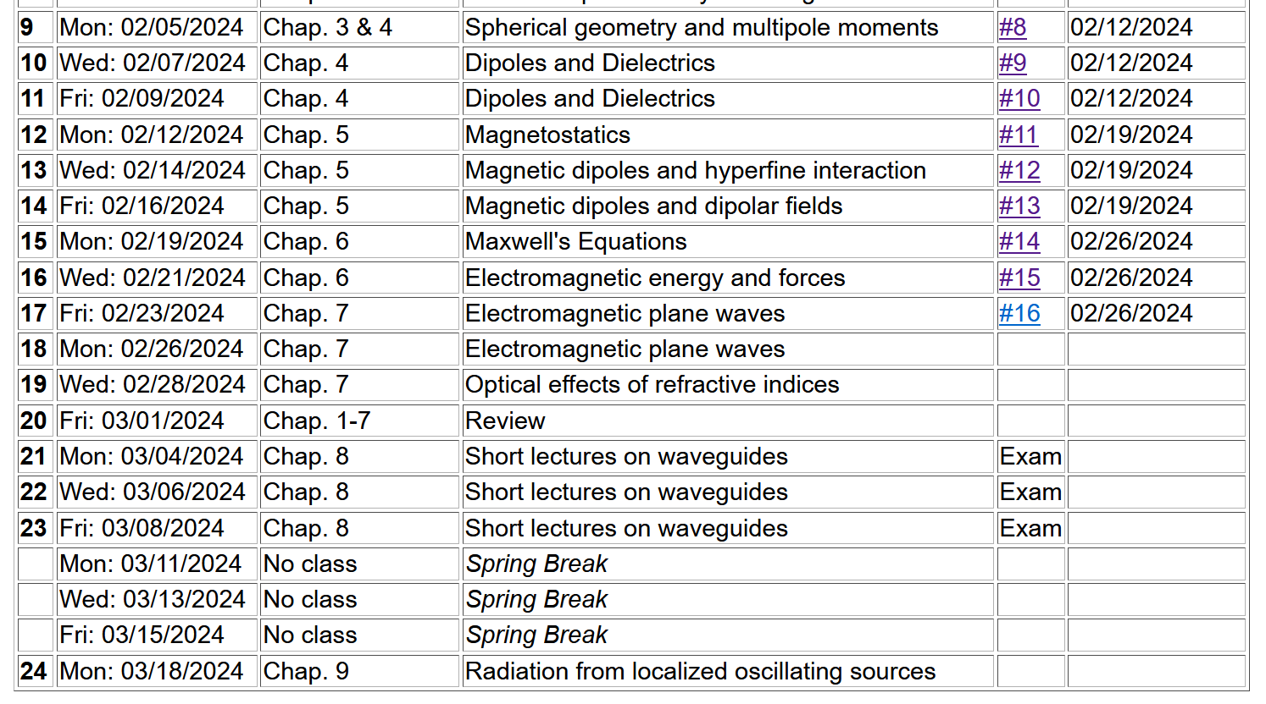

Slide 4
Maxwell’s equations

Slide 5
Analysis of Maxwell’s equations without sources -- continued:

Slide 6
Analysis of Maxwell’s equations without sources -- continued:
Both E and B fields are solutions to a wave equation:

Slide 7
Analysis of Maxwell’s equations without sources -- continued:
Note: ε, μ, n, k can all be complex; for the moment we will assume that they are all real (no dissipation).

Slide 8
Analysis of Maxwell’s equations without sources -- continued:
E₀
B₀
k

Slide 9
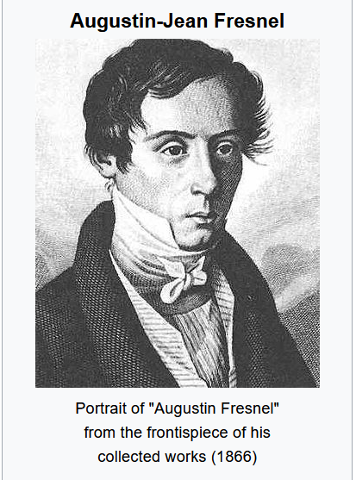
Detailed analysis of reflection and refraction of plane polarized electromagnetic waves
Note that apparently, Fresnel deduced properties of reflection and refraction before Maxwell’s equations were published.
However, we can see how these results follow directly from Maxwell’s equations.
1788-1827

Slide 10
Reflection and refraction of plane electromagnetic waves at a plane interface between dielectrics (assumed to be lossless)
μ’ ε’
k’
θ
μ ε
k_{R}
k_{i}
i
R

Slide 11
Reflection and refraction -- continued
μ’ ε’
θ
k’
μ ε
k_{i}
k_{R}
i
R

Slide 12
Reflection and refraction -- continued
Snell’s law – matching phase factors at boundary plane z=0.
μ’ ε’
θ
k’
μ ε
k_{i}
k_{R}
i
R

Slide 13
Reflection and refraction -- continued
μ’ ε’
θ
k’
μ ε
k_{i}
k_{R}
i
R

Slide 14
Reflection and refraction -- continued
μ’ ε’
θ
k’
μ ε
k_{i}
k_{R}
i
R

Slide 15
Reflection and refraction -- continued
s-polarization – E field “polarized” perpendicular to plane of incidence
μ’ ε’
θ
k’
μ ε
k_{i}
k_{R}
i
R

Slide 16
Reflection and refraction -- continued
p-polarization – E field “polarized” parallel to plane of incidence
μ’ ε’
θ
k’
μ ε
k_{i}
k_{R}
i
R

Slide 17
Reflection and refraction -- continued
μ’ ε’
θ
k’
μ ε
k_{i}
k_{R}
i
R

Slide 18
For s-polarization

Slide 19
For p-polarization

Slide 20
Special case: normal incidence (i=0, θ=0)

Slide 21
Multilayer dielectrics (Problem #7.2)
n₁
n₂
n₃
k_{a}
k_{i}
k_{t}
k_{b}
k_{R}
d

Slide 22
Extension of analysis to anisotropic media --

Slide 23
Consider the problem of determining the reflectance from an anisotropic medium with isotropic permeability μ₀ and anisotropic permittivity ε₀ κ where:
By assumption, the wave vector in the medium is
confined to the x-y plane and will be denoted by
The electric field inside the medium is given by:

Slide 24
Inside the anisotropic medium, Maxwell’s equations are:
After some algebra, the equation for E is:
From E, H can be determined from

Slide 25
The fields for the incident and reflected waves are the same as for the isotropic case.
Note that, consistent with Snell’s law:
Continuity conditions at the y=0 plane must be applied for the following fields:
There will be two different solutions, depending of the polarization of the incident field.

Slide 26
Solution for s-polarization

Slide 27
Solution for p-polarization

Slide 28
Extension of analysis to complex dielectric functions – for next time --

