Slide 1
PHY 712 Electrodynamics
10-10:50 AM in Olin 103
Discussion for Lecture 20:
Review of Chapters 1-7
Comment on what to expect with the take- home exam
Main topics covered
Some details of past HW problems

Slide 2
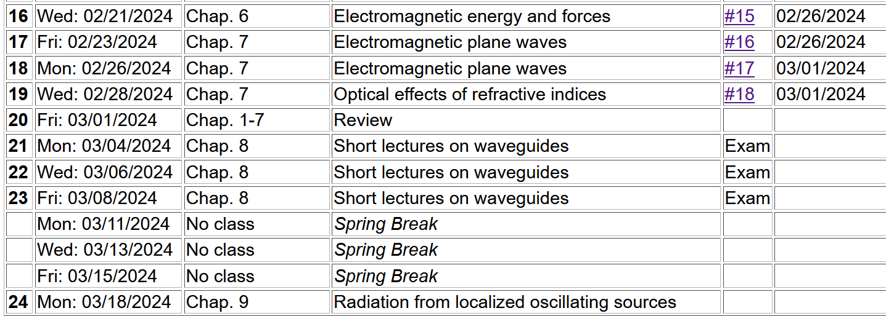
For 3/04/2024-3/08/2024:
Individual work on take home exam
Shortened class lectures on Chapter 8 of Jackson

Slide 3
Motivation for giving/taking mid-term exam
Opportunity to review/solidify knowledge in the topic
Opportunity to practice problem solving techniques appropriate to the topic
Assessment of performance. Accordingly, the work you turn in must be your own (of course).
You are encouraged to consult with your instructor (but no one else!) if any questions arise about the exam questions
Extra credit awarded if you report errors/inconsistencies/ambiguities in the exam questions

Slide 4
Instructions on exam:
Note: This is a ``take-home'' exam which can be turned in any time before 4 PM Friday, March 8, 2024. In addition to each worked problem, please attach ALL Maple (or Mathematica, Matlab, Wolfram, etc.), work sheets as well as a full list of resources used to complete these problems. It is assumed that all work on the exam is performed under the guidelines of the honor code. In particular, if you have any questions about the material, you may consult with the instructor but no one else. For grading purposes, each question in multi-part problems are worth equal weight. Credit will be assigned on the basis of both the logical steps of the solution and on the correct answer.

Slide 5
More advice about exam –
It is important that the instructor is able to read your work and understand your reasoning.
Since you will be using Maple or Mathematica or ?? to evaluate some of your results, please include the software work (or snips of it) into your exam materials.
Your exam paper does not need to be a work of art, but it does need to be readable. If you prefer to submit your exam paper electronically, that will be fine. (I may print it myself.)

Slide 6
More advice – accumulate trusted equations/mathematical relationships and know how to use them
Jackson
pg. 783

Slide 7
Jackson pg. 783

Slide 8
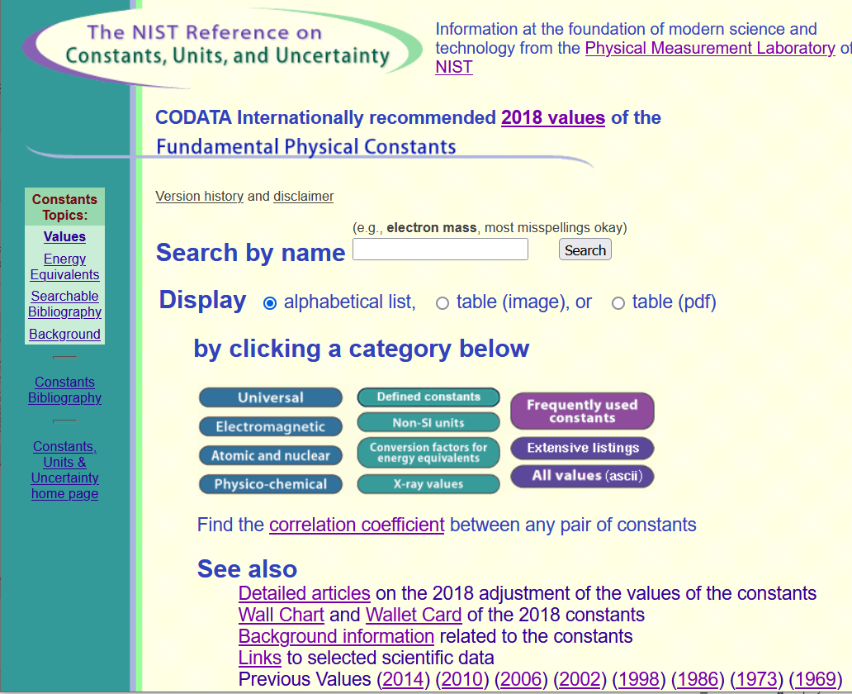
Source for standard measurements –
https://physics.nist.gov/cuu/Constants/index.html

Slide 9
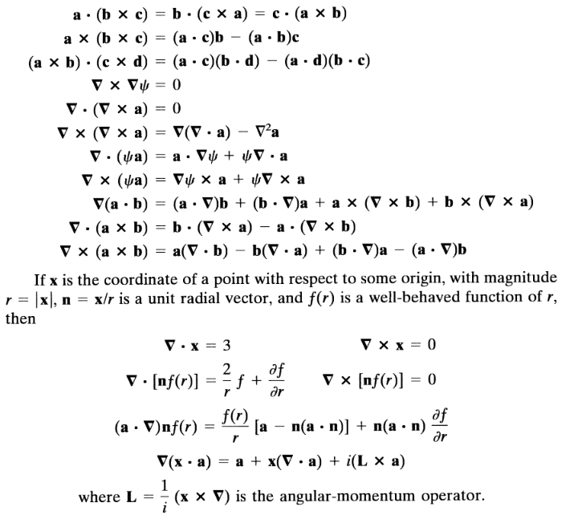
Vector relations

Slide 10
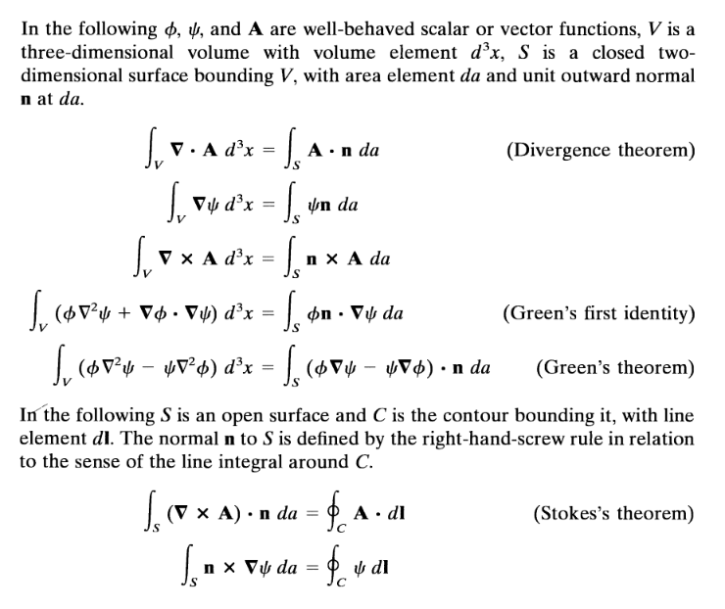

Slide 13
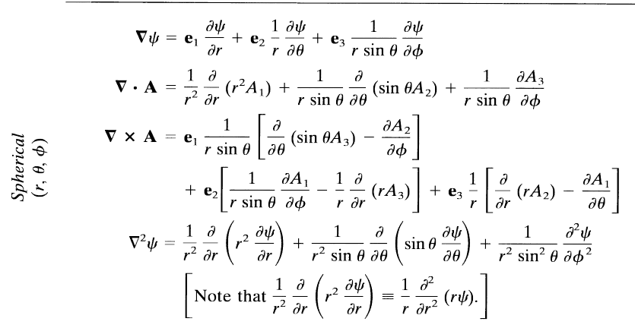

Slide 14
Comment on cartesian unit vectors versus local (cylindrical or spherical) unit vectors

Slide 15
Special functions -- many are described in Jackson
Additional source -- https://dlmf.nist.gov/

Slide 17
More relationships

Slide 18
elementary charge: e=1.602176634 x 10⁻¹⁹ C
(when using Gaussian units, charge is in “stat Coulombs”)

Slide 19
Energy and power (SI units)

Slide 23
In your “bag” of tricks:
Direct (analytic or numerical) solution of differential equations
Solution by expanding in appropriate orthogonal functions
Green’s function techniques
Solving Maxwell’s equations

Slide 24
How to choose most effective solution method --
In general, Green’s functions methods work well when source is contained in a finite region of space

Slide 25
How to construct and use Green’s functions
Starting with relevant physical equations (in this case, typically Maxwell’s equations), reduce them so that you are working with a differential equation for single multivariable function.
Construct a Green’s function, ideally one which is both the inverse of the differential operator and also handles the boundary values. (Always check)
Evaluate the integrals.
Check that everything makes sense.

Slide 26
Methods for constructing Green’s functions for second order differential equations
Use two independent solutions of the homogeneous differential equation
Orthogonal function expansion
Combination of both

Slide 27
General procedure for constructing Green’s function for one-dimensional system using 2 independent solutions of the homogeneous equations
Beautiful method; but only works in one dimension.

Slide 29
Orthogonal function expansion -- continued

Slide 30
Orthogonal function expansions in 2 and 3 dimensions – for cartesian coordinates:
(See Eq. 3.167 in Jackson for example.)

Slide 31
Combined orthogonal function expansion and homogeneous solution construction of Green’s function
in 2 and 3 dimensions.
For the two and three dimensional cases, we can use this technique in one of the dimensions in order to reduce the number of summation terms. These ideas are discussed in Section 3.11 of Jackson.

Slide 32
Green’s function construction -- continued

Slide 34
General form for a 2-dimensional example
Note that the idea is very general, but the details are highly dependent on the form of the differential equation.

Slide 35
Example that is useful for spherical polar coordinates where the eigenfunction expansion is used for the angular variables and the homogeneous solution is used for the radial variable. This form is designed to produce solutions that vanish for r → ∞.

Slide 36
Maxwell’s equations

Slide 37
E₀
B₀
k

Slide 38
HW10

Slide 39
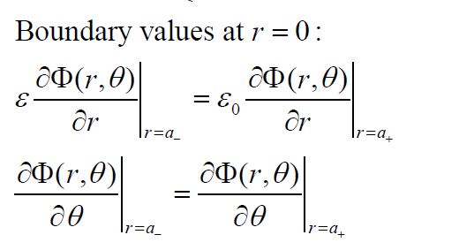
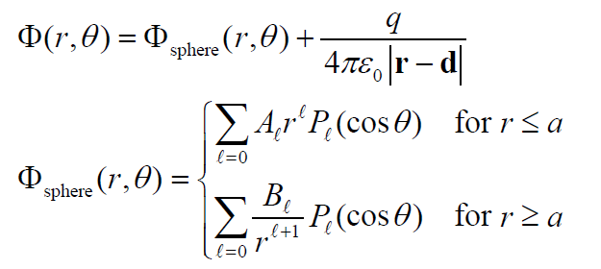
There are several ways of approaching this problem. One convenient way is to consider the effects of the dielectric sphere and point charge separately

Slide 40
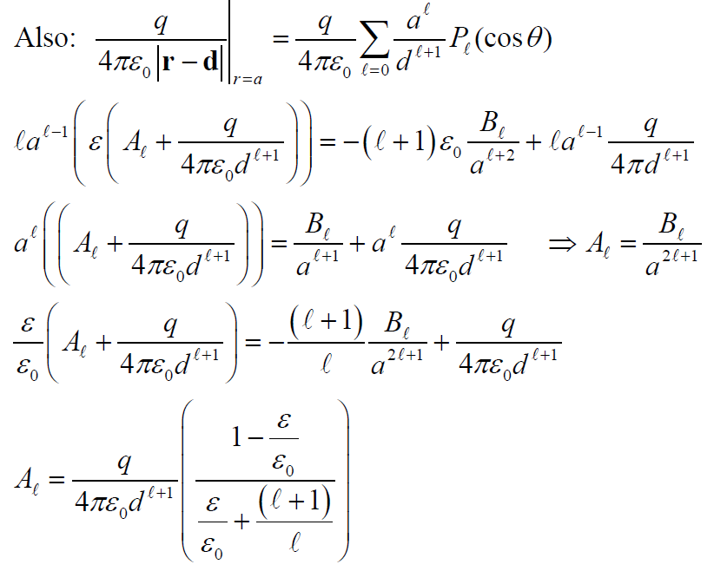

Slide 41
Is this answer unique?

