Slide 1
PHY 712 Electrodynamics
10-10:50 AM in Olin 103
Notes for Lecture 22:
Wave Guides
Chap. 8 (Sec. 8.2++) in Jackson –
Cylindrical wave guides
Coaxial cables

Slide 2
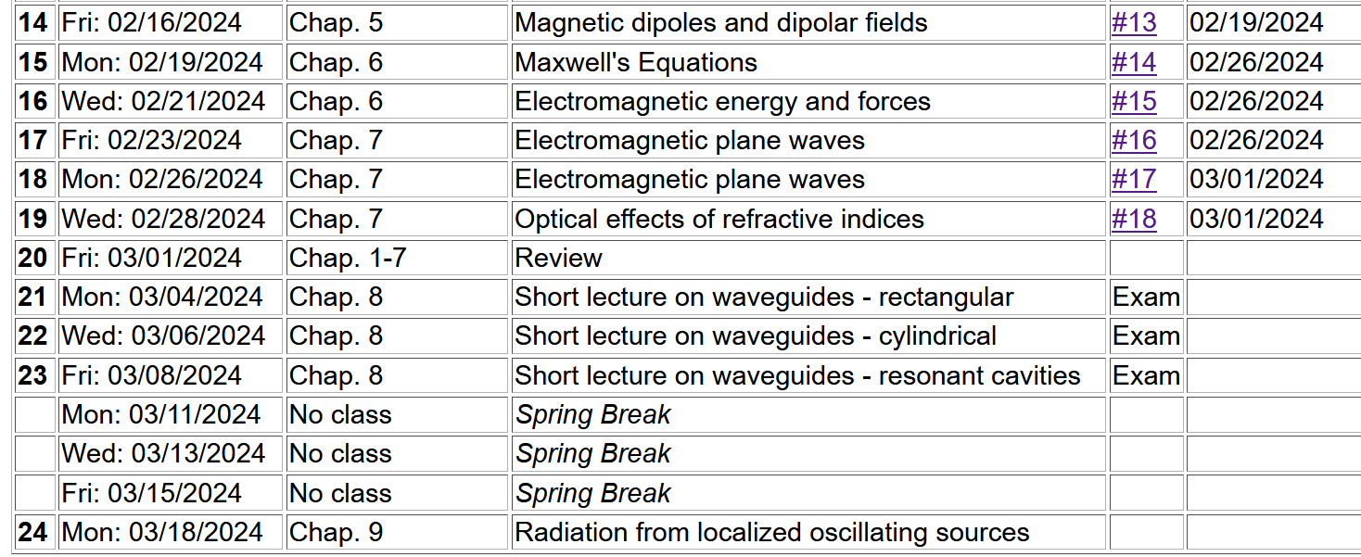
For 3/03/2024-3/08/2024:
Individual work on take home exam
Shortened class lectures on Chapter 8 of Jackson

Slide 3
4 PM Olin 101

Slide 5
Boundary values of EM fields near the surface
of an ideal conductor
At the boundary of an ideal conductor, the E and H fields decay in the direction normal to the interface.
H₀
➔Use these properties to manipulate the form of EM waves
E₀

Slide 6
Wave guides – dielectric media with one or more metal boundary
Continuity conditions for fields near metal boundaries --
E
H
Waveguide terminology
TEM: transverse electric and magnetic (both E and H fields are perpendicular to wave propagation direction)
TM: transverse magnetic (H field is perpendicular to wave propagation direction)
TE: transverse electric (E field is perpendicular to wave propagation direction)

Slide 7
Analysis of rectangular waveguide
Boundary conditions at surface of waveguide:
E_{tangential}=0, B_{normal}=0
y
x
z
Cross section view
b
a

Slide 8
Analysis of rectangular waveguide
y
x
z

Slide 9
Solution of Maxwell’s equations within the pipe:
F = E or H
propagation along z.

Slide 10
Maxwell’s equations within the pipe in terms of all 6 components:

Slide 11
TE modes for rectangular wave guide continued:

Slide 12
Solution for m=n=1
k
ω

Slide 13
Now consider a simple cylindrical waveguide
r
z
For the rectangular geometry, Maxwell’s equations within the pipe:

Slide 14
Simple cylindrical waveguide -- continued
r
z
For the cylindrical geometry, Maxwell’s equations within the pipe:

Slide 15
Simple cylindrical waveguide
r
z

Slide 16
Simple cylindrical waveguide -- continued

Slide 17
r
z

Slide 18
Note that in the examples with the “simple” waveguide, having a single outer metallic boundary, TE or TM modes can be produced.
For a more complicated design, it is possible to have TEM modes --

Slide 19
Wave guides – dielectric media with one or more metal boundary
Coaxial cable
TEM modes
Simple optical pipe
TE or TM modes
k
k
E
H
Waveguide terminology
TEM: transverse electric and magnetic (both E and H fields are perpendicular to wave propagation direction)
TM: transverse magnetic (H field is perpendicular to wave propagation direction)
TE: transverse electric (E field is perpendicular to wave propagation direction)

Slide 20
Wave guides
Top view:
z
μ ε
Inside medium, μ ε assumed to be real
a
b
Coaxial cable
TEM modes
(following problem 8.2 in Jackson’s text)

Slide 21
Electromagnetic waves in a coaxial cable -- continued
Top view:
μ ε
ρ
a
φ
b

Slide 22
Electromagnetic waves in a coaxial cable -- continued
Top view:
μ ε
ρ
a
φ
b

