Slide 1
PHY 712 Electrodynamics
10-10:50 AM in Olin 103
Notes for Lecture 23:
Chap. 8 (Sec. 8.7) in Jackson
Wave Guides
Review of wave guide equations
Rectangular resonant cavity

Slide 2
Note: Exam is due <= 4 PM today. Please include work done with Maple, Mathematica, etc. either in print or electronically, as well as a list of references that you used.
Have a great spring break!

Slide 3
Boundary values for ideal conductor
At the boundary of an ideal conductor, the E and H fields decay in the direction normal to the interface.
E₀
H₀

Slide 4
Wave guides – dielectric media with one or more metal boundary
Continuity conditions for fields near metal boundaries --
E
H
Waveguide terminology
TEM: transverse electric and magnetic (both E and H fields are perpendicular to wave propagation direction)
TM: transverse magnetic (H field is perpendicular to wave propagation direction)
TE: transverse electric (E field is perpendicular to wave propagation direction)

Slide 5
Analysis of rectangular waveguide
Boundary conditions at surface of waveguide:
E_{tangential}=0, B_{normal}=0
y
x
z
ε μ
Cross section view
b
a

Slide 6
Analysis of rectangular waveguide
y
x
z

Slide 7
Solution of Maxwell’s equations within the pipe:
F = E or H
propagation along z.

Slide 8
Maxwell’s equations within the pipe in terms of all 6 components:

Slide 9
TE modes for rectangular wave guide continued:

Slide 10
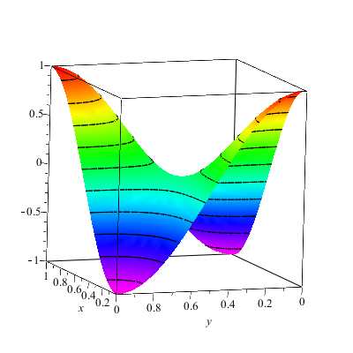
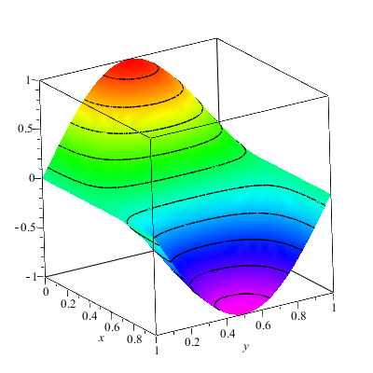
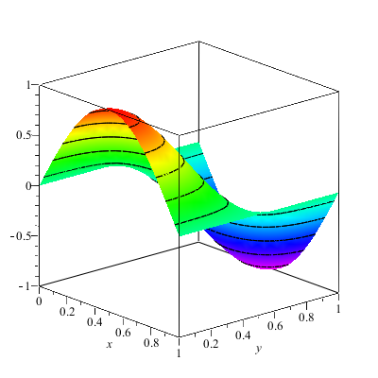
Solution for m=n=1

Slide 11
Solution for m=n=1
k
ω

Slide 12
Now consider the case of a rectangular box bounded by an ideal conductor --
Resonant cavity
y
x
z
Propagating wave form becomes a standing wave along z.

Slide 13
Resonant cavity
y
x
z
13

Slide 14
Now consider the case of a rectangular box bounded by an ideal conductor --
Resonant cavity
y
x
z

Slide 15
For example --
Typically, microwave oven use frequencies of 2.45 GHz and the wavelength is ~12 cm
Resources online: https://www.sfu.ca/phys/346/121/resources/physics_of_microwave_ovens.pdf
https://impi.org/wp-content/uploads/2019/09/History-MW-ovens.pdf
Other info on waveguides for fiber optics –
https://www.thefoa.org/tech/wavelength.htm

