Slide 1
PHY 712 Electrodynamics
10-10:50 AM MWF Olin 103
Notes on Lecture 24:
Digression on some Mathematical Methods and
Sources of radiation Chap. 9 (Sec. 9.1-9.3)
Digression on tools for solving ordinary differential equations – Method of Frobenius
Electromagnetic waves due to specific sources
Dipole radiation patterns

Slide 2
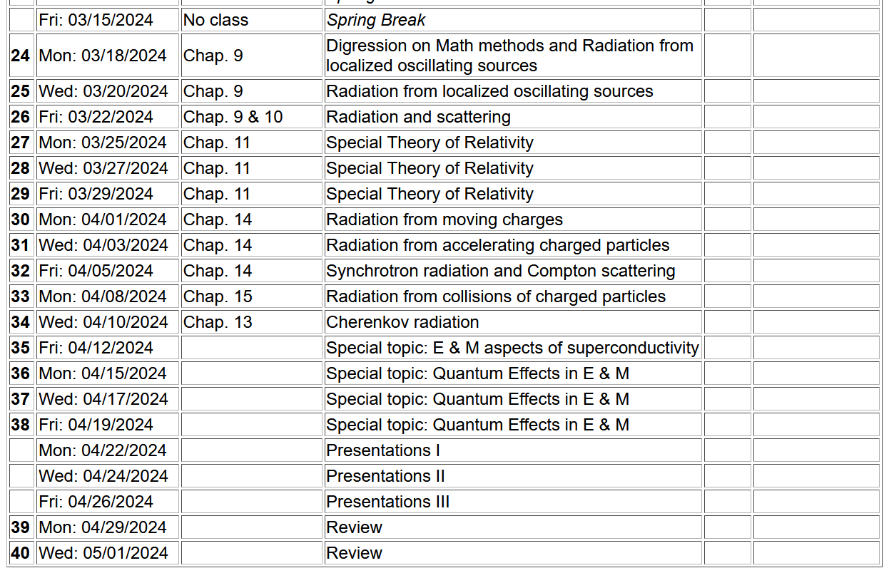
Tentative schedule for the remaining semester --

Slide 3
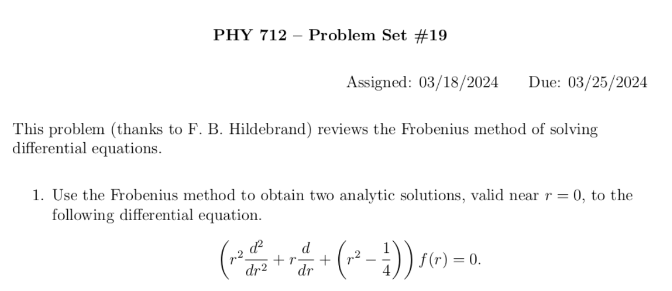

Slide 4
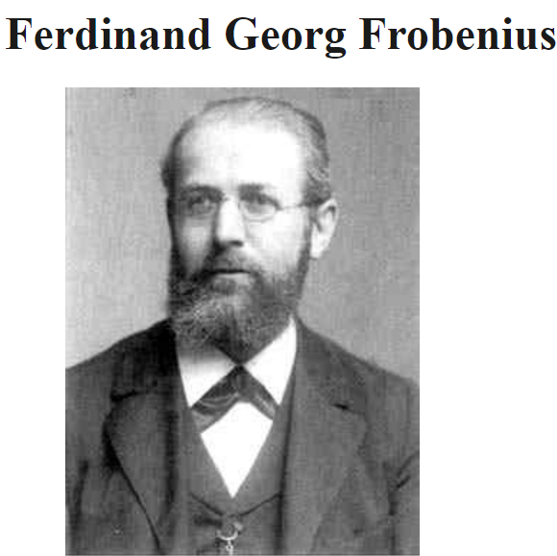
Digression on tools for solving ordinary differential equations – Method of Frobenius
https://mathshistory.st-andrews.ac.uk/Biographies/Frobenius/
Born: 26 October 1849
Berlin-Charlottenburg, Prussia (now Germany)
Died: 3 August 1917
Berlin, Germany
Summary: Georg Frobenius combined results from the theory of algebraic equations, geometry, and number theory, which led him to the study of abstract groups, the representation theory of groups and the character theory of groups. He also developed method for linear differential equations.

Slide 6
Continued --

Slide 7
Maxwell’s equations
Notes:
Since Maxwell’s equations were introduced and used in Chapters 6-8, we have focused on the properties of the fields themselves. Now we will begin to study how these fields are produced by particular sources. The sources that we will consider are harmonic in time and their spatial form (considered to be localized in space) is represented by a multiplicative factor. More generally, we are considering one component in the Fourier transform for the source function. The results are quite different from the Liénard-Wiechert potentials discussed a few weeks ago. In this slide, Maxwell’s equations are presented for the case that the sources are completely represented by the charge and current densities.

Slide 8
Formulation of Maxwell’s equations in terms of vector and scalar potentials
Notes:
It is convenient to express the coupled vector fields in terms of the scalar and vector potentials as we have discussed previously.

Slide 9
Formulation of Maxwell’s equations in terms of vector and scalar potentials -- continued
Complicated coupled mess!

Slide 10
Formulation of Maxwell’s equations in terms of vector and scalar potentials -- continued
This choice decouples the equations for the scalar and vector potentials.
Notes:
We will focus our attention on the Lorentz Gauge representations. In this case, the scalar potential and each of the three Cartesian components of the vector potential each have to solve an inhomogeneous differential equation of the same form.

Slide 11
Solution of Maxwell’s equations in the Lorentz gauge -- continued
Notes:
For a spatially localized source, the physically meaningful solution can be written as an integral over the source time t’ and space r’ as discussed previously before.

Slide 12
Electromagnetic waves from time harmonic sources
Notes:
Now we specialize to the pure harmonic time dependence. Mathematically, we will evaluate the sources with the complex function exp(-iωt), taking the real part at the end of the analysis. Note that because we need to conserve charge, the continuity equation must satisfied which consequently means that the current and charge densities are functionally related.

Slide 13
Electromagnetic waves from time harmonic sources – continued:
Notes:
Putting the form of the source term in the integral, we can first perform the integral over the source time t’, resulting in the last equation of the slide. Notice that the full solution of the differential equation also may have a solution to the inhomogeneous equation as represented by the last term.

Slide 14
Electromagnetic waves from time harmonic sources – continued:
Notes:
From the results on the previous slide, we can explicitly write out the solutions for the scalar and vector potentials in terms of the charge and current densities.

Slide 15
Electromagnetic waves from time harmonic sources – continued:
Notes:
In order to evaluate the equations on the previous slide, we can make use an exact expansion in terms of spherical harmonic functions and spherical Bessel and Hankel functions. The proof of this expansion is not trivial, but some details are available in Jackson (near Eq. 9.98) and from the NIST website https://dlmf.nist.gov/10.60. It naturally follows that the scalar potential can be expressed as a sum of spherical harmonic functions time corresponding radial forms.

Slide 16
Electromagnetic waves from time harmonic sources – continued:
Notes:
It naturally follows that the vector potential can be expressed as a sum of spherical harmonic functions time corresponding radial forms.

Slide 17
Forms of spherical Bessel and Hankel functions:
Notes:
These relationships of spherical Bessel functions are given on page 426 of Jackson.

Slide 18
Notes:
This material summarizes some of the results from Section 9.6 of Jackson

Slide 19
Electromagnetic waves from time harmonic sources – continued:
Notes:
What is the rational/significance of the last two equations?

Slide 20
Some details:
Notes:
Do you agree with these results?

Slide 21
Electromagnetic waves from time harmonic sources – continued -- some details:
Notes:
From this analysis, for a source confined within a sphere of radius R, the radiation field for the lm component of the field has a radial form proportional to a spherical Hankel function.

Slide 22
Electromagnetic waves from time harmonic sources – continued:
Note that these results are “exact” when r is outside the extent of the charge and current density.
Notes:
Some further relations can be derived due to the continuity equation for the current density and the charge density.

Slide 24
Electromagnetic waves from time harmonic sources – continued -- now considering the dipole approximation
Notes:
The previous slides gave rigorous results far from the source. In this slide we consider further approximations. The kr’<<1 case is also referenced as the long wavelength approximation.

Slide 25
Some details -- continued:
(assuming confined source)
Notes:
Dipole approximation continued.

Slide 26
Electromagnetic waves from time harmonic sources – in the dipole approximation continued:
Note: in this case we have assumed a restricted extent of the source such that kr’<<1 for all r’ with significant charge/current density.
Notes:
Dipole approximation continued.

Slide 27
Electromagnetic waves from time harmonic sources – in dipole approximation -- continued:
Notes:
Dipole approximation continued.

Slide 28
Example of radiation source -- exact treatment
Notes:
Comparison of exact asymptotic results with dipole approximation.

Slide 29
Example of radiation source – exact treatment continued
Relationship to dipole approximation (exact when kR➔0)
Notes:
Comparison of exact asymptotic results with dipole approximation – continued.

Slide 30
Summary of results
Exact --
Dipole approximation --

