Slide 1
PHY 712 Electrodynamics
10-10:50 AM MWF Olin 103
Discussion for Lecture 33:
Including topics from Chaps. 13 & 15 in JDJ
1. Radiation from collisions of charged particles
X-ray tube
Radiation from Rutherford scattering
2. Cherenkov radiation
Notes:
In this lecture we will discuss some examples of radiation due to charged particles colliding. It is a complicated topic which quite a few famous physicists have worked on. We will also briefly discuss Cherenkov radiation.

Slide 2
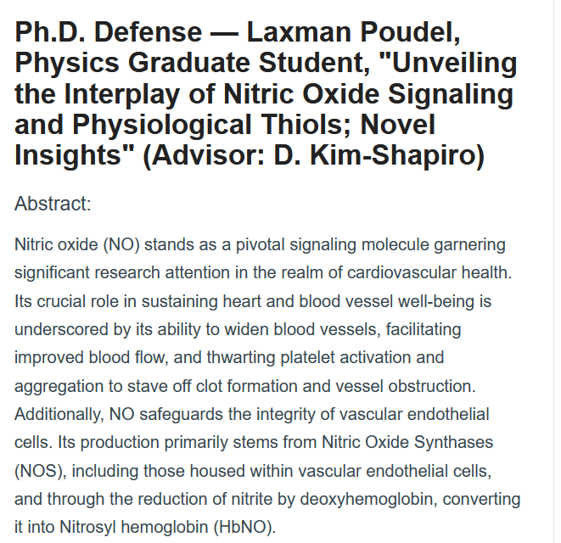
Thursday 4/11/2024 at 9-10 AM in ZSR auditorium

Slide 3
4 PM in Olin 101

Slide 4
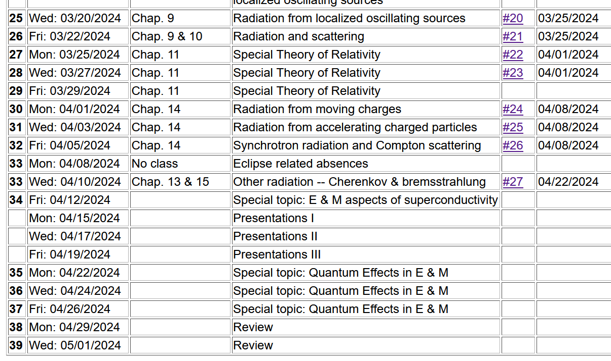
Notes:
This is the revised schedule, subject to your input.

Slide 5
Due 4/22/2024

Slide 6
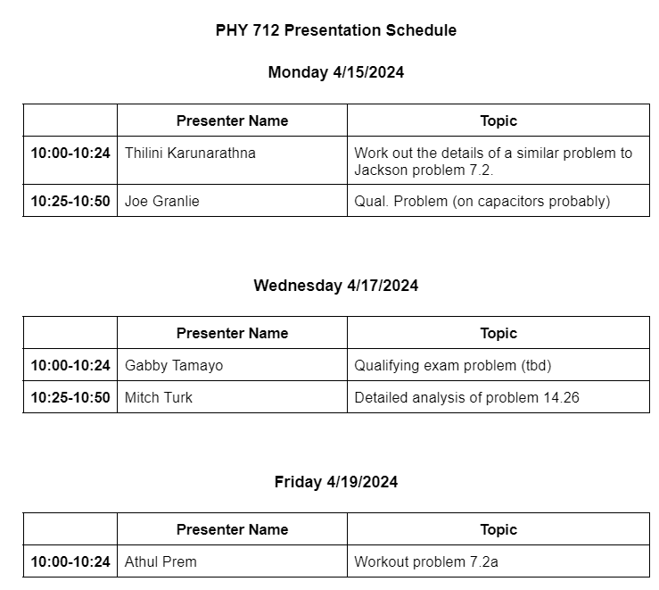

Slide 7
Generation of X-rays in a Coolidge tube
https://www.orau.org/ptp/collection/xraytubescoolidge/coolidgeinformation.htm
Invented in 1913. Associated with the German word “bremsstrahlung” – meaning breaking radiation.

Slide 8
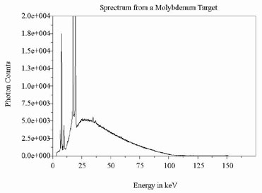
http://www.ndt-ed.org/EducationResources/CommunityCollege/Radiography/Physics/xrays.htm
Quantum effects – due to the resonant excitation of electrons from core states of Mo

Slide 9
Radiation during collisions of charged particles
β
−β(t)
Δβ
r
θ
β(t)
β(t+Δt)
φ
Δβ
Notes:
Starting from the intensity analysis for radiation due to a charged particle moving in a trajectory with beta representing its velocity/c. We will consider the velocity changing due to a collision process and analyze the radiation at small frequencies.

Slide 10
Results from previous analyses:
Note that in the following slides we are taking the limit ω→0
but keeping the notation of the differential intensity….
Note that ε is perpendicular to r.

Slide 11
Radiation during collisions -- continued
In the limit β→0, this is the same as the non-relativistic case.
Notes:
For beta<<1, we can neglect the denominator of the expression and obtain the non-relativistic expression. It is also convenient to analyze the relativistic case when the change in velocity is small.

Slide 12
Radiation during collisions -- continued
β
r
θ
φ
Δβ
polarization in r and β plane
polarization perpendicular to r and β plane
Notes:
It is convenient to consider two different polarizations of the radiation – parallel (meaning in the plane of the observation point r and the initial velocity of the particle) and perpendicular (meaning perpendicular to that plane).

Slide 13
Some details:
β
(using geometry of Fig. 15.2 in Jackson)
r
θ
φ
Δβ
Note: This is a wild assumption!
Notes:
Showing the detailed geometry of the scattering process.

Slide 14
Consistent with
radiation from charged particles.
Convenient geometry
Wild guess
Notes:
Evaluating the vectors.

Slide 15
z
Radiation during collisions -- continued
β
r
θ
y
φ
Δβ
x
Notes:
It is possible to analytically integrate over all solid angles.

Slide 16
Notes:
Some details of the analysis. With all of these considerations, we still need to estimate delta beta.

Slide 17
Need to consider the mechanics of collision; it is convenient to parameterize in terms of momentum --
Estimation of Δβ
q
Δβ
q
β(t)
β(t+Δt)
mass of particle having charge q
What are the conditions for the validity of this result?

Slide 18
What are possible mechanisms for the momentum transfer Q?

Slide 19
Estimation of Δβ or Q -- for the case of Rutherford scattering
q
Δβ
q
β(t)
β(t+Δt)
Ze
p’
θ’
Q
p
Notes:
Delta beta will depend on the particular system. As an example, consider the case of Rutherford scattering.. Here are some of the equations we used in classical mechanics class.

Slide 20
Case of Rutherford scattering -- continued
q
p(t+Δt)
θ’
Q
Ze
p(t)
Does the algebra work out?
Notes:
It is convenient to express the results in terms of the momentum transfer Q.

Slide 21
Case of Rutherford scattering -- continued
q
p(t+Δt)
θ’
Q
Ze
p(t)
Notes:
It is of interest to estimate the probability of the radiation occurring which depends on the product of the radiation intensity for a given momentum transfer and the cross section as a function of momentum transfer.

Slide 22
How do the limits of Q occur?
Jackson suggests that these come from the limits of validity of the analysis.
Seems like cheating?
Perhaps fair?
Notes:
But we are not done. Thinking of the case of the charged particle moving through the target material, there will be a range of momentum transfers that should be integrated as indicated here. Note that we have assumed that the frequency of the radiation is very small. Here we consider how frequency might ener this analysis.

Slide 23
Comment on frequency dependence --
Here τ is the effective collision time.

Slide 24
How to estimate the collision time?
Jackson uses the following analysis in terms of the impact parameter b:

Slide 25
λ= “fudge factor” of order unity
Notes:
Hans Bethe considered this problem and also introduced a “correction” for quantum effects.

Slide 26
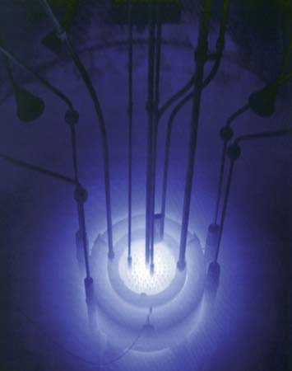
Cherenkov radiation
Cherenkov radiation emitted by the core of the Reed Research Reactor located at Reed College in Portland, Oregon, U.S.
Cherenkov radiation. Photograph. Encyclopædia Britannica Online. Web. 12 Apr. 2013. http://www.britannica.com/EBchecked/media/174732
Notes:
This is a view of Cherenkov radiation with its typical blue glow.

Slide 27
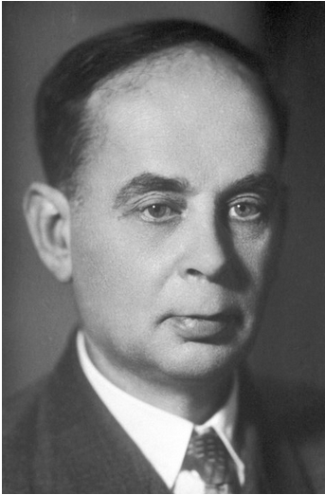
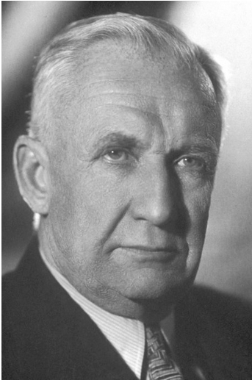
https://www.nobelprize.org/prizes/physics/1958/ceremony-speech/
Notes:
A Nobel prize was awarded for the discovery and explanation of this phenomenon.

Slide 28
References for notes: Glenn S. Smith, An Introduction to Electromagnetic Radiation (Cambridge UP, 1997), Andrew Zangwill, Modern Electrodynamics (Cambridge UP, 2013)
Cherenkov radiation
Discovered ~1930; bluish light emitted by energetic charged particles traveling within dielectric materials
Note that some treatments give a different definition of the critical angle θ_{c}
θ_{c}
q
Notes:
A diagram describing the phenomenon.

Slide 29
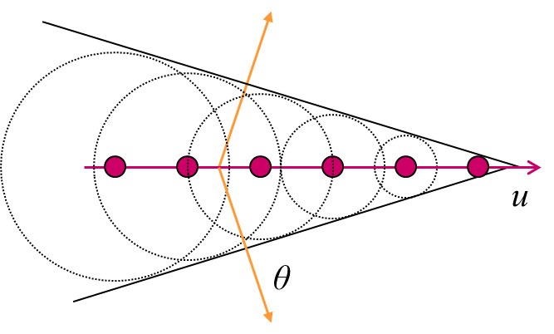
From: http://large.stanford.edu/courses/2014/ph241/alaeian2/
Electric field direction
Particle velocity
Notes:
Snapshots of the particle as it moves through the medium and of the wave fronts generated.

Slide 30
For v/c<1:
t_{r1}
v
t_{r3}
t_{r2}
t
(t-t_{r3})c
For v/c>1
(t-t_{r3})c
t_{r1}
v
t_{r3}
t_{r2}
t

Slide 31
Here the values of μ and ε depend on the material and on frequency.
R_{q}(t)
q
Notes:
Analysis of the scalar and vector potentials in the dielectric medium due to the particle of charge q.

Slide 32
Liénard-Wiechert potential solutions for charged particle moving within a material with refractive index n:
Notes:
Find the Lienard Wiechert solutions within the medium. Here, the major difference from previous solutions is that the wave speed c_{n} depends on the refractive index of the medium.

Slide 33
Which of these particles could produce Cherenkov radiation?
A neutron with speed c?
An electron with speed 0.6c?
A proton with speed 0.6c?
An electron with speed 0.8c?
An alpha particle with speed 0.8c?
None of these?

Slide 34
Further comment –
As discussed particularly in Chap. 13 of Jackson, a particle moving within a medium is likely to be slowed down so that the Cherenkov effect will only happen while β_{n}>1.

Slide 35
Recall – in Lecture 29, we considered a particle moving
at constant velocity v in vacuum:
y
y’
v
b
q
x
x’
z
z’
Electric and magnetic fields produced →

Slide 36
Some details for vacuum case --

Slide 37
For Cherenkov case --
r
R(t)
R(t_{r})
vt_{r}
vt
Notes:
For the vacuum case v<c, but not it is possible for v>c_{n}. Here we can solve the quadratic equation for the variables of the problem. The physical solution must be positive.

Slide 38
For β_{n}>1, how can the equality be satisfied?
No problem
It cannot be satisfied.
It can only be satisfied for special conditions
Moreover, there are two retarded time solutions!

Slide 39
r
Original diagram:
R(t)
R(t_{r})
θ
vt_{r}
vt
What is the significance of changing the diagram?
r
New diagram:
R(t_{r})
R(t)
θ
vt_{r}
vt

Slide 40
r
R(t)
R(t_{r})
θ(t)
vt_{r}
vt
Notes:
Continuing the analysis for the variables needed to determine the scalar and vector potentials.

Slide 41
Recall the Liénard-Wiechert potential solutions:
Notes:
Find the Lienard Wiechert solutions within the medium. Here, the major difference from previous solutions is that the wave speed c_{n} depends on the refractive index of the medium.

Slide 42
Liénard-Wiechert potentials for two
solutions:
r
R(t)
R(t_{r})
θ(t)
vt_{r}
vt
Notes:
In order for the analysis to be consistent, cos(theta)<0 and sin(theta)<1/beta.

Slide 43
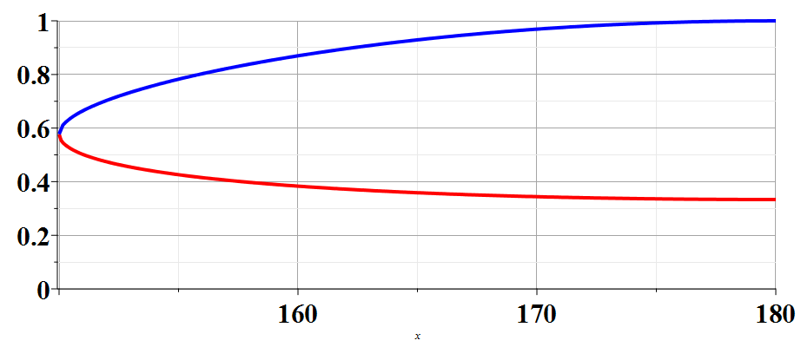
R(t_{r})/R(t)
β_{n}=2
150
θ
Notes:
Plot showing two solutions as a function of theta for a particular beta.

Slide 44
Physical fields for β_{n} > 1 -- two retarded solutions contribute
r
R(t)
R(t_{r})
θ(t)
vt_{r}
vt
Notes:
Here we use the Heaviside step function to ensure that the angle theta is in the correct range.

Slide 45
Physical fields for β_{n} > 1
Notes:
Summary of results for potentials and the corresponding electric and magnetic fields.

Slide 46
From these results, we need to generate the power spectrum – following the approach in Sec. 23.7 in Zangwill’s textbook.

Slide 47
Wavelengths --
700 600 500

Slide 48
Intermediate steps:
r
R(t)
R(t+Δt)
θ(t)
θ(t+Δt)
vt
vΔt
Notes:
Some details for finding the fields.

Slide 49
Power radiated:

Slide 50
From these results, we arrive at an approximate expression in terms of a constant K and critical angle θ_{c:}
r
R(t_{c})
R(t_{c}+Δt)
θ_{c}
θ(t_{c}+Δt)
vt_{c}
vΔt

Slide 51
Analysis continued --

Slide 53
From this expression, how would you explain that Cherenkov radiation is typically observed as a blue glow?
It is still a mystery.
It is obvious from the result.

