Slide 1
PHY 712 Electrodynamics
10-10:50 AM MWF Olin 103
Notes for Lecture 36:
Some quantum effects in electrodynamics
-- General quantum states of EM fields and related correlations functions
Review of eigenstates of EM Hamiltonian and of Glauber’s coherent states
Comments on experimental situation
Squeezed states

Slide 2
Final exam will be a take-home exam with similar form to mid-term due May 10??

Slide 4
References –
Consultation with Professor Kandada
Rodney Loudon, “The quantum theory of light” (1983)
Leonard Mandel and Emil Wolf, “Optical Coherence and Quantum Optics” (2013)
Yanhua Shih, “An Introduction to Quantum Optics” (2021) (some typos, but generally informative)
Paul R Berman and Vladimir S. Malinovsky, “Principles of Laser Spectroscopy and Quantum Optics” (2011)

Slide 5
Review of what we learned from Lecture 35
For a single mode plane wave with wave vector k, frequency
ω_{k} and polarization σ:

Slide 8
A convenient superposition thanks to R. Glauber, PR 131, 2766 (1963)

Slide 9
Single mode coherent state continued
This means that variance of the E field for the coherent state is independent of the amplitude Λ. Therefore, for large Λ the variance is small in comparison.

Slide 11
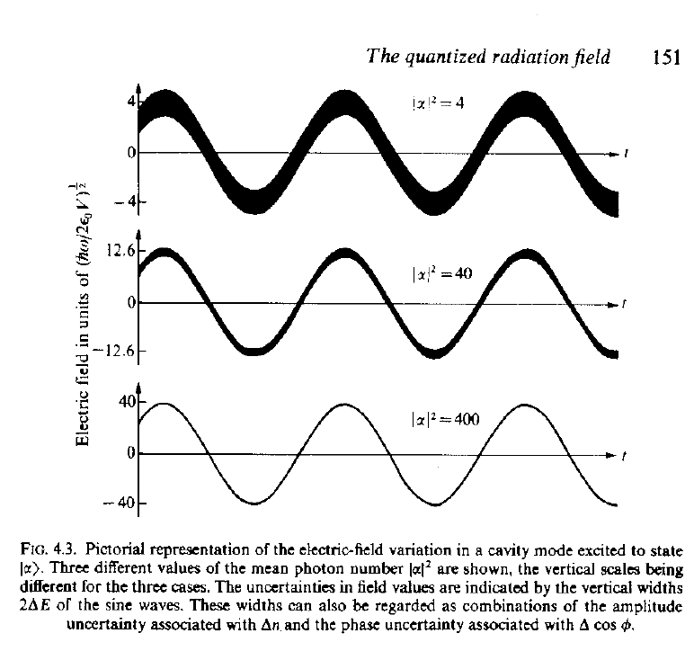
Visualization of coherent state electric fields for various amplitudes
Source:
R. Loudon, “The Quantum Theory of Light”

Slide 12
Additional properties of single mode coherent state --

Slide 13
Interpretation of a single mode coherent state

Slide 14
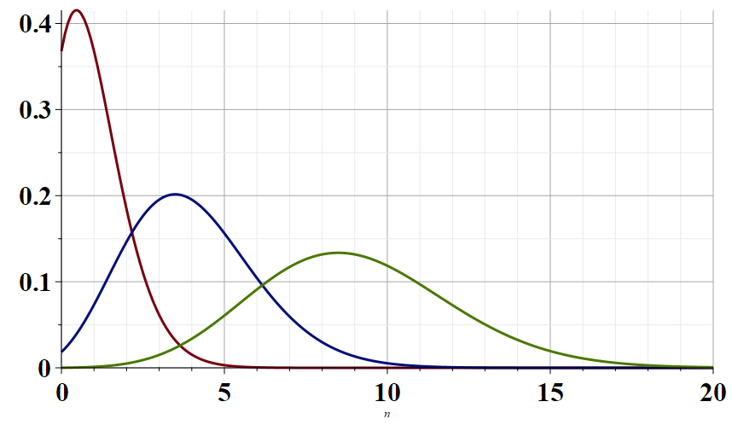
Λ=1
Λ=2
Λ=3
n

Slide 16
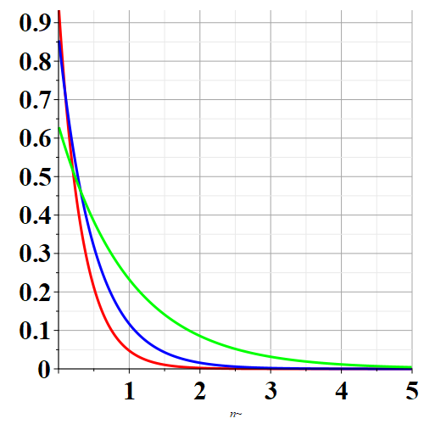
Γ = 3
P_{n}
Γ = 2
Γ = 1
n

Slide 17
Other thoughts about the coherent photon state from Professor Kandada and from the Mandel and Wolf textbook –
It turns out that the coherent state basis can be quite well realized using laser technology
There are problematic issues with the coherent state basis stemming from the fact that it is mathematically “over complete”.
Despite these mathematical difficulties, because of #1 and related experimental processes, the coherent state formalism remains useful.

Slide 18
A derivation of the coherent state from Mandel and Wolf:

Slide 19
It turns out that the amplitude and phase of the fields have complicated non-commuting relationships resulting in a Heisenberg uncertainty relationship. Unfortunately, the direct representation of the phase operator is complicated, and it is convenient to express the phenomenon through related operators.

Slide 20
Further analysis and modifications of the “coherent state”

Slide 21
In terms of the eigenstates of the EM Hamiltonian:
In terms of coherent states: --

Slide 22
For the coherent state:
In this sense, the coherent state represents the minimum uncertainty process.

Slide 23
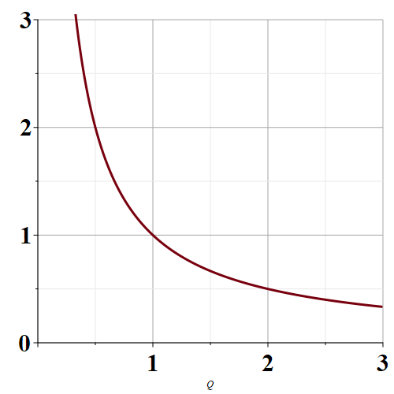
Allowed variance products
Range of values
allowed by quantum
mechanics
ΔP
ΔQ
Coherent state

Slide 24
“Squeezed” state with larger ΔP but smaller ΔQ.
Allowed variance products
Range of values
allowed by quantum
mechanics
ΔP
“Squeezed” state with smaller ΔP but larger ΔQ.
ΔQ
Coherent state

