Slide 1
PHY 712 Electrodynamics
10-10:50 AM MWF Olin 103
Notes for Lecture 37:
Quantum effects in electrodynamics
Connections to experiment
Coherent states
Squeezed states
More complicated states

Slide 2
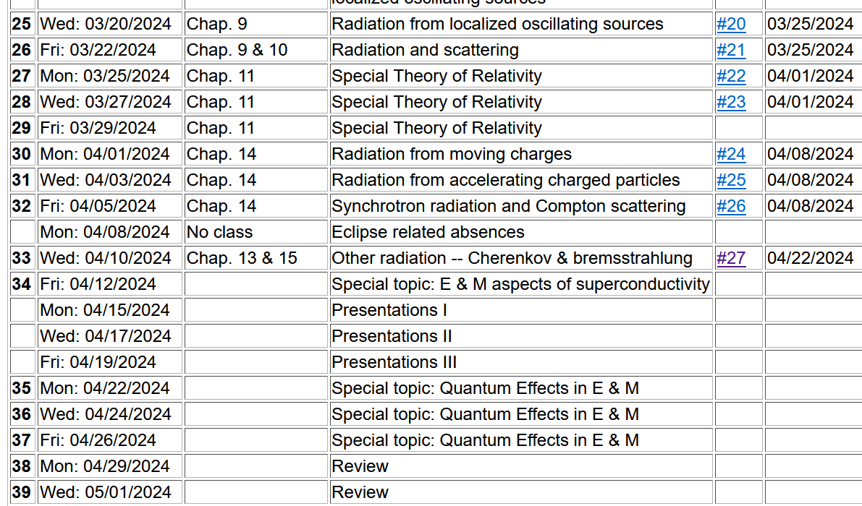
Final take-home exam – due May 10, 2024
Will need focus involving analysis and evaluations
Will cover topics discussed throughout course

Slide 3
References –
Consultation with Professor Kandada
Rodney Loudon, “The quantum theory of light” (1983)
Leonard Mandel and Emil Wolf, “Optical Coherence and Quantum Optics” (2013)
Yanhua Shih, “An Introduction to Quantum Optics” (2021) (some typos, but generally informative)
Paul R Berman and Vladimir S. Malinovsky, “Principles of Laser Spectroscopy and Quantum Optics” (2011)
Christopher C. Gerry and Peter L. Knight, “Introductory Quantum Optics” (2nd Edition) (2024)

Slide 4
Review of equations related to quantized EM fields --
Note that some texts
define Q and P with
a prefactor of ½.

Slide 5
For the coherent state:
In this sense, the coherent state represents the minimum uncertainty process.

Slide 6
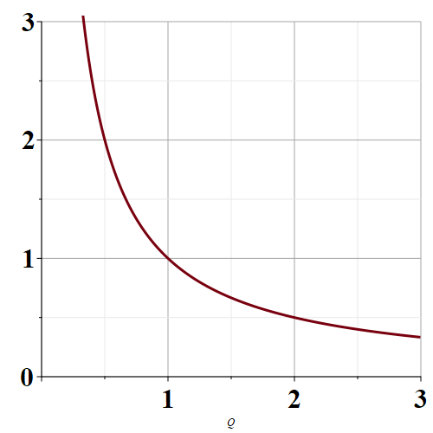
Allowed variance products
Range of values
allowed by quantum
mechanics
ΔP
ΔQ
Coherent state

Slide 7
“Squeezed” state with larger ΔP but smaller ΔQ.
Allowed variance products
Range of values
allowed by quantum
mechanics
ΔP
“Squeezed” state with smaller ΔP but larger ΔQ.
ΔQ
Coherent state

Slide 8
In terms of the eigenstates of the EM Hamiltonian:
In terms of coherent states: --

Slide 9
For the coherent state:
In this sense, the coherent state represents the minimum uncertainty process.

Slide 10
How can we transform the quadrature functions to reduce the variances of ΔQ or ΔP?

Slide 13
Evaluating the variance --

Slide 14
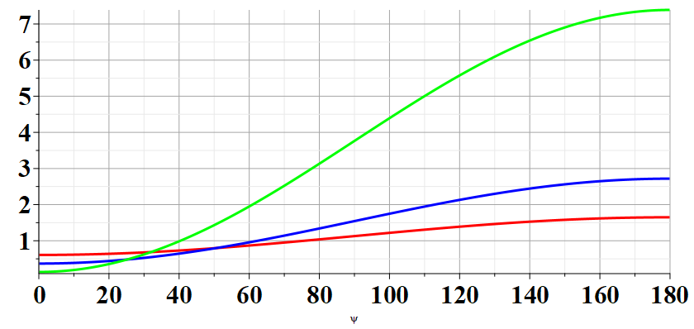
r=1.0
r=0.5
r=0.25
θ−2β

Slide 15
Searching for the best squeeze parameters
For each r, the smallest result is obtained when β=θ/2
➔Despite the constraints of the uncertainty principle, it is possible to improve the measurement of one of the two non-commuting processes.

Slide 16
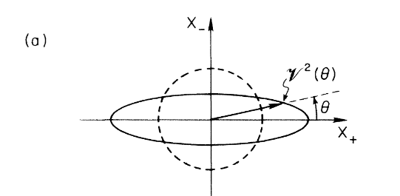
Experimental evidence
Coherent state
Squeezed state

Slide 17
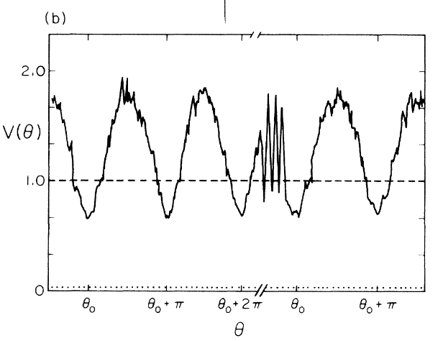

Slide 18
