Slide 1
PHY 712 Electrodynamics
10-10:50 AM MWF Olin 103
Notes for Lecture 38:
Review –
Motivation of final exam and how to optimize the experience; some comments on effective use of Maple, Mathematica
Some important mathematical tools and review of problem solving techniques
Particular electrodynamics topics

Slide 2
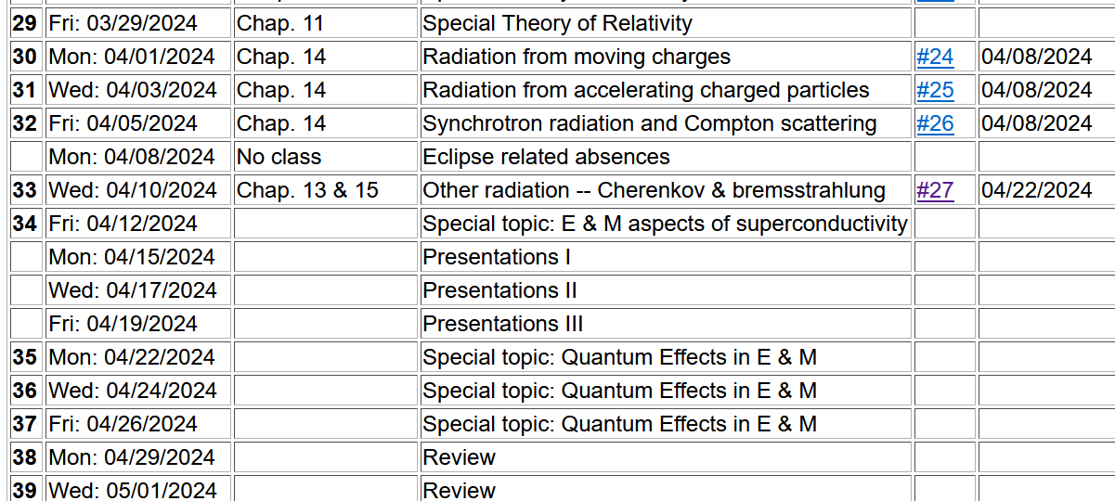
Important dates: Final exams available ~May 2
Exams and outstanding HW due May 10
Also – Please fill out online course questionnaire for PHY 712
-- your feedback helps us to adjust the course for the better

Slide 3
What will you do after May 10?
Relax a minute or two
Several of you will want to start preparing for the Qualifier Exams which will be administered (tentative dates):
Monday, June 17 to Thursday, June 20 during the hours 1:00 – 4:00 pm.

Slide 4
Motivation for giving/taking final exam for PHY 712
Opportunity to review/solidify knowledge in the topic
Opportunity to practice problem solving techniques appropriate to the topic
Assessment of performance. Accordingly, the work you turn in must be your own (of course).
You are encouraged to consult with your instructor (but no one else!) if any questions arise about the exam questions
Extra credit awarded if you find errors/inconsistencies/ambiguities in the exam questions

Slide 5
Instructions on exam:
Note: This is a ``take-home'' exam which can be turned in any time before 5 PM Tuesday, May 10, 2024. In addition to each worked problem, please attach ALL Maple (or Mathematica, Matlab, Wolfram, etc.), work sheets as well as a full list of resources used to complete these problems. It is assumed that all work on the exam is performed under the guidelines of the honor code. In particular, if you have any questions about the material, you may consult with the instructor but no one else. For grading purposes, each question in multi-part problems are worth equal weight. Credit will be assigned on the basis of both the logical steps of the solution and on the correct answer.

Slide 6
More advice about exam –
It is important that the instructor is able to read your work and understand your reasoning.
Since you will be using Maple or Mathematica or ?? to evaluate some of your results, consider integrating them into your exam paper or perhaps paste snips into your favorite word processor.
Your exam paper does not need to be a work of art, but it does need to be readable. If you prefer to submit your exam paper electronically, that will be fine. (I may print it myself.)

Slide 7
Example solution using Maple --
Text mode
Math mode

Slide 8
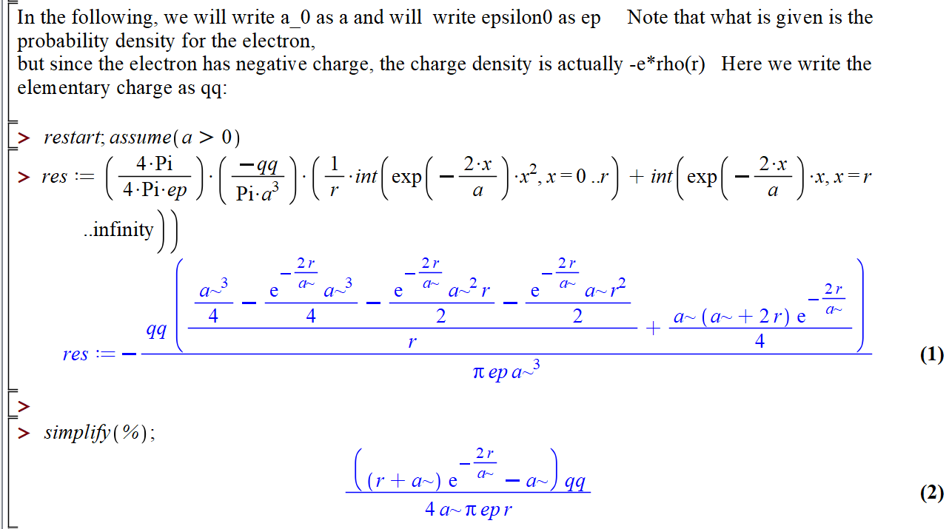

Slide 9
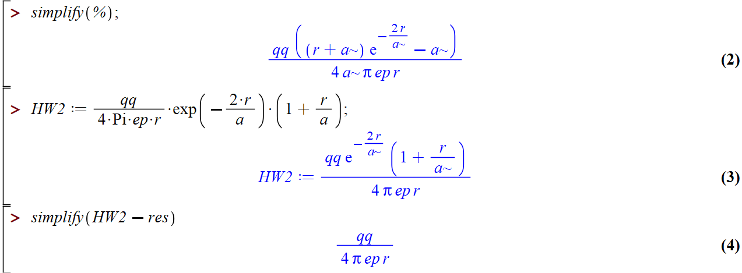
HW #8 continued --

Slide 10
More advice – accumulated trusted equations/mathematical relationships and know how to use them
Jackson
pg. 783

Slide 11
Jackson pg. 783
Note that some of the “fundamental” constants change slightly over the years……

Slide 12
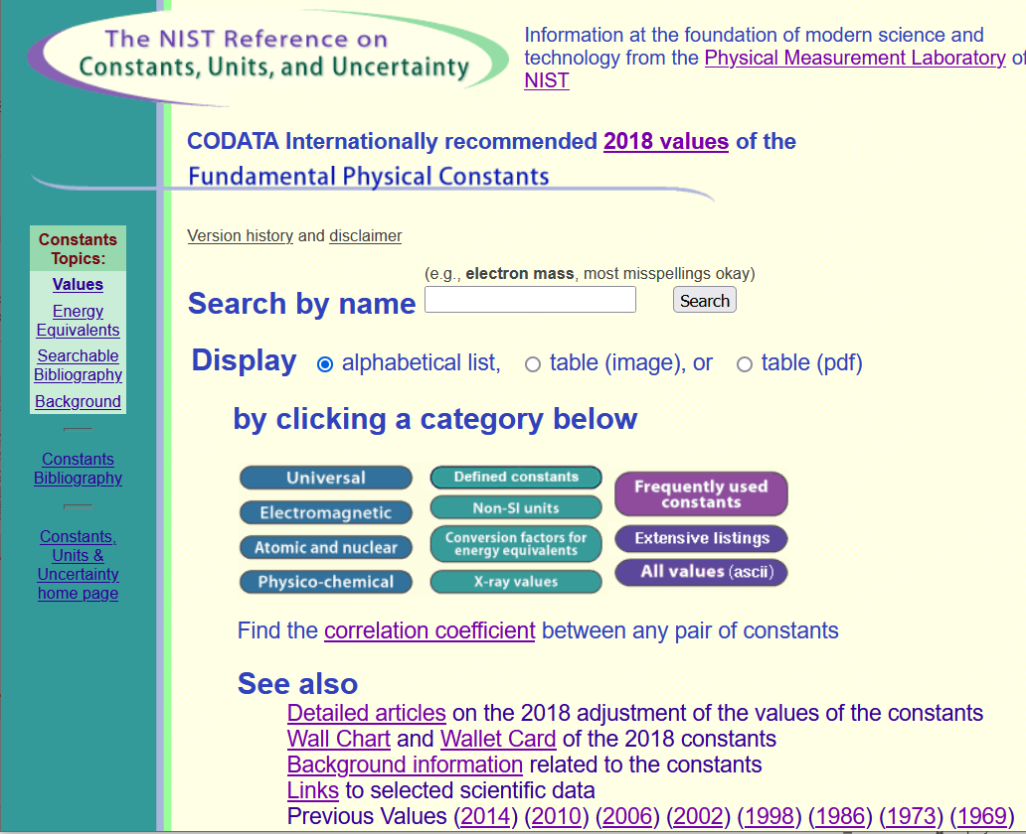
Source for standard measurements –
https://physics.nist.gov/cuu/Constants/index.html

Slide 13
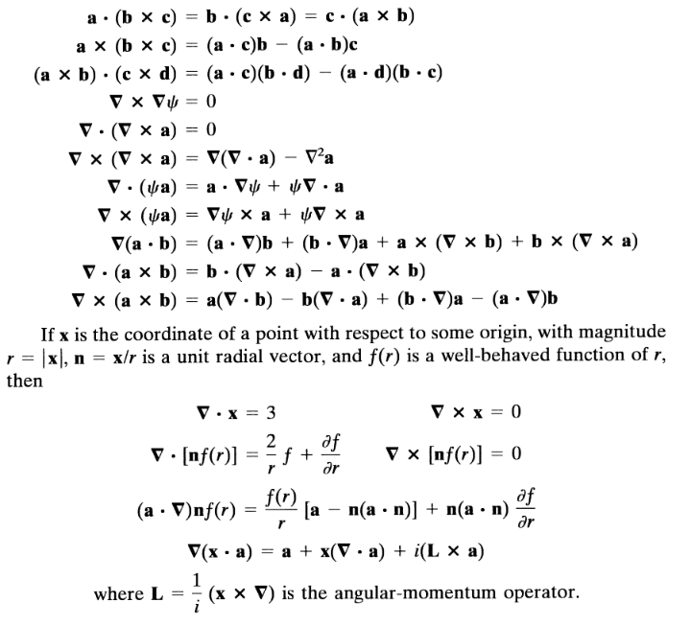
Vector relations

Slide 14
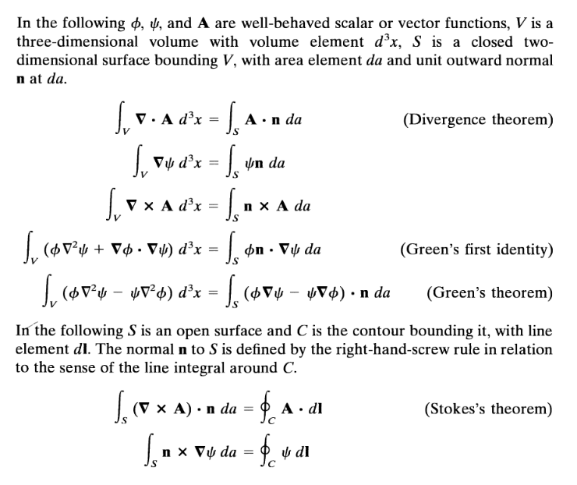

Slide 17
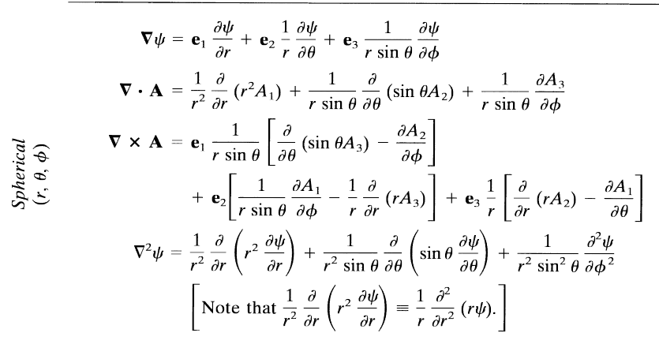

Slide 18
Comment on cartesian unit vectors versus local (cylindrical or spherical) unit vectors
Note that Cartesian unit coordinates are fixed in space, but curvilinear unit coordinates change with angle.

Slide 19
Special functions -- many are described in Jackson
Additional source -- https://dlmf.nist.gov/

Slide 20
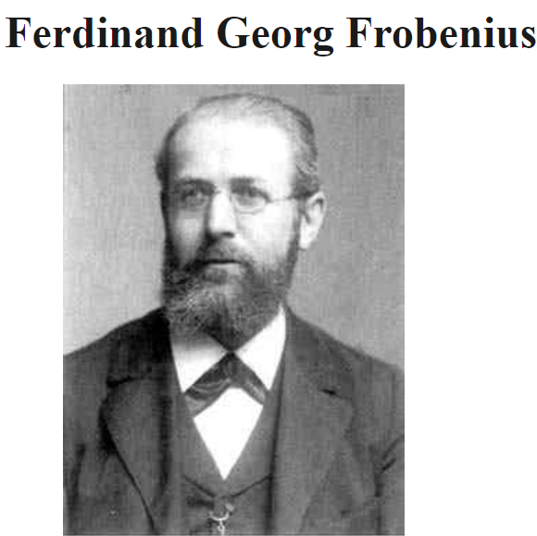
Digression on tools for solving ordinary differential equations – Method of Frobenius
https://mathshistory.st-andrews.ac.uk/Biographies/Frobenius/
Born: 26 October 1849
Berlin-Charlottenburg, Prussia (now Germany)
Died: 3 August 1917
Berlin, Germany
Summary: Georg Frobenius combined results from the theory of algebraic equations, geometry, and number theory, which led him to the study of abstract groups, the representation theory of groups and the character theory of groups. He also developed methods for solving linear differential equations.

Slide 22
Continued --

Slide 23
Example

Slide 24
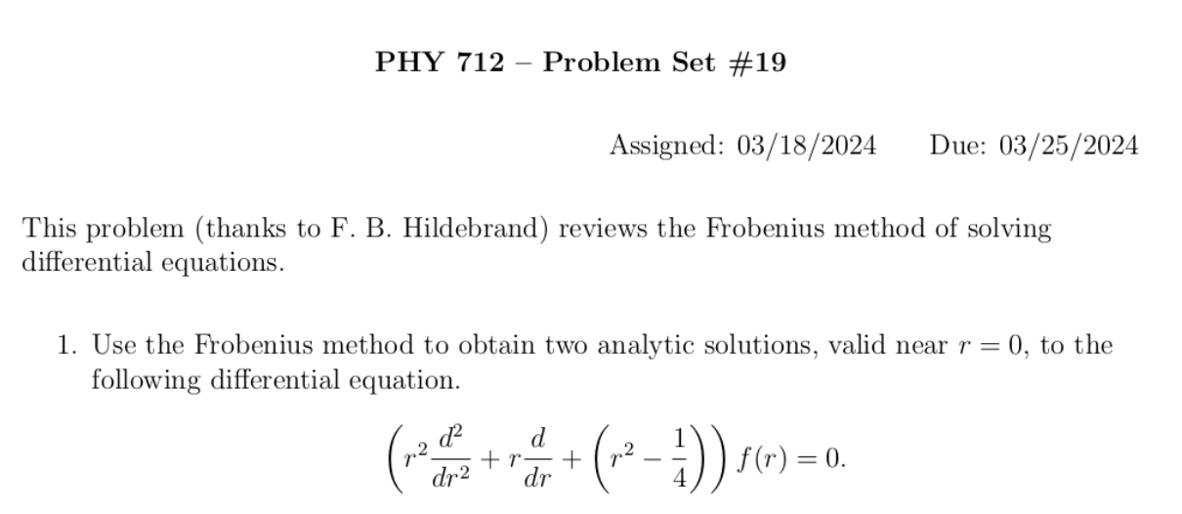
Another example

Slide 26
More relationships

Slide 27
elementary charge: e=1.6021766208 x 10⁻¹⁹ C
=4.80320467299766 x 10⁻¹⁰ statC

Slide 28
Energy and power (SI units)

Slide 32
In your “bag” of tricks:
Direct (analytic or numerical) solution of differential equations
Solution by expanding in appropriate orthogonal functions
Green’s function techniques

Slide 33
How to choose most effective solution method --
In general, Green’s functions methods work well when source is contained in a finite region of space

Slide 35
Electromagnetic waves from time harmonic sources

Slide 36
Electromagnetic waves from time harmonic sources – continued:

Slide 37
Electromagnetic waves from time harmonic sources – continued:

Slide 38
Electromagnetic waves from time harmonic sources – continued:

Slide 39
Electromagnetic waves from time harmonic sources – continued:

Slide 40
Example of dipole radiation source
Note that this result is valid for all k.

Slide 41
Example of dipole radiation source -- continued
Relationship to pure dipole approximation (exact when kR➔0)

Slide 42
Electromagnetic waves from time harmonic sources – for dipole radiation --:

Slide 43
Another useful approximation for analyzing radiation for time harmonic sources --

Slide 44
Radiation from a moving charged particle
z
.
v
r-R_{q}(t_{r})=R
q
Θ
r
R_{q}(t)
y
x

Slide 45
Liènard-Wiechert potentials –(Gaussian units)

Slide 46
Electric and magnetic fields far from source:

Slide 47
Poynting vector:

Slide 48
Lorentz transformations
y
y’
v
x
x’
y’
y
x’
x

Slide 49
Note, the concept of the Lorentz transformation is quite general, but the specific transformation form given in the following slides is special to the relative velocity along the x-axis.

Slide 50
Lorentz transformations -- continued

Slide 51
Velocity relationships
➔

Slide 52
Field strength tensor
For stationary frame
For moving frame

Slide 53
➔ This analysis shows that the E and B fields must be treated as components of the field strength tensor and that in order to transform between inertial frames, we need to use the tensor transformation relationships:
Transformation of field strength tensor

Slide 54
Inverse transformation of field strength tensor

