Slide 1
PHY 712 Electrodynamics
10-10:50 AM MWF Olin 103
Notes for Lecture 39:
Review –
Thanks for a great semester
Continued review of topics and problem solving strategies

Slide 2
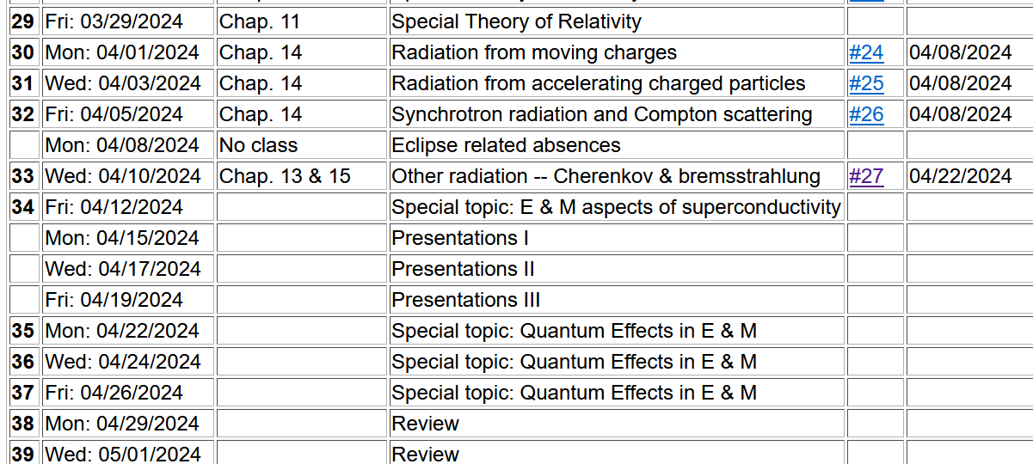
Important dates: Final exams available ~May 2
Exams and outstanding HW due May 10

Slide 3
From Lecture 24 --
Electromagnetic waves from time harmonic sources

Slide 4
Electromagnetic waves from time harmonic sources – continued:

Slide 5
Electromagnetic waves from time harmonic sources – continued:

Slide 6
Electromagnetic waves from time harmonic sources – continued:

Slide 7
Electromagnetic waves from time harmonic sources – continued:

Slide 8
Example of dipole radiation source
Note that this result is valid for all k.

Slide 9
Forms of spherical Bessel and Hankel functions:

Slide 10
Some details
For r>>R, these terms are negligible

Slide 11
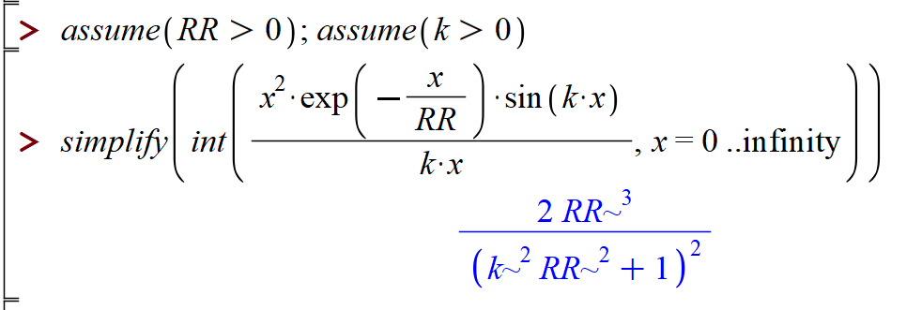
More details for r>>R

Slide 12
More details for r>>R

Slide 13
Example of dipole radiation source -- continued
Relationship to pure dipole approximation (exact when kR➔0)

Slide 14
Electromagnetic waves from time harmonic sources – for dipole radiation --:

Slide 15
Another useful approximation for analyzing radiation for time harmonic sources --

Slide 16
Radiation from a moving charged particle
z
.
v
r-R_{q}(t_{r})=R
q
Θ
r
R_{q}(t)
y
x

Slide 17
Liènard-Wiechert potentials –(Gaussian units)

Slide 18
Electric and magnetic fields far from source:

Slide 19
Lorentz transformations
y
y’
v
x
x’
y’
y
x’
x

Slide 20
Note, the concept of the Lorentz transformation is quite general, but the specific transformation form given in the following slides is special to the relative velocity along the x-axis.

Slide 21
Lorentz transformations -- continued

Slide 22
Velocity relationships
➔

Slide 23
Field strength tensor
For stationary frame
For moving frame

Slide 24
➔ This analysis shows that the E and B fields must be treated as components of the field strength tensor and that in order to transform between inertial frames, we need to use the tensor transformation relationships:
Transformation of field strength tensor

Slide 25
Inverse transformation of field strength tensor

Slide 26
Some comments on synchrotron radiation spectra from large synchrotron facilities
Slides from Lecture 31

Slide 27
z
r
.
θ
β
y
β
Top view:
x
ρ
y
x

Slide 28
z
r
.
θ
β
y
β
x

Slide 29
z
r
.
θ
β
y
β
x

Slide 31
Some details:
Modified Bessel functions
Exponential factor

Slide 32
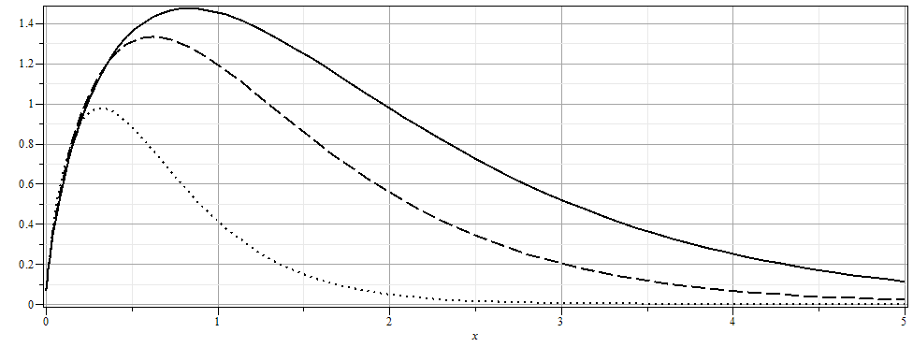

Slide 33
More details

Slide 34
Quantum effects in E & M
--Review of what we learned from Lecture 35
For a single mode plane wave with wave vector k, frequency
ω_{k} and polarization σ:

Slide 37
A convenient superposition thanks to R. Glauber, PR 131, 2766 (1963)

Slide 38
Single mode coherent state continued
This means that variance of the E field for the coherent state is independent of the amplitude Λ. Therefore, for large Λ the variance is small in comparison.

Slide 39
Review of cylindrical coordinates
Slides from Lecture 8 --

Slide 40
Solution of the Poisson/Laplace equation in various geometries ➔cylindrical geometry with no z-dependence (infinitely long wire, for example):
φ
ρ

Slide 41
Solution of the Poisson/Laplace equation in various geometries ➔cylindrical geometry with no z-dependence (infinitely long wire, for example):
φ
ρ

Slide 42
Solution of the Poisson/Laplace equation in various geometries -- cylindrical geometry with no z-dependence (infinitely long wire, for example):
φ
ρ
➔m=integer

Slide 43
Solution of the Poisson/Laplace equation in various geometries -- cylindrical geometry with no z-dependence (infinitely long wire, for example):
φ
ρ

Slide 44
Note that this example is similar to the construction for the 2-d cartesian case --

Slide 45
Cartesian example continued --

Slide 46
Note that, because we are using curvilinear coordinates, the Wronskian and the form of the delta function is modified.
More details given in Jackson Sec. 3.7 - 3.11.

Slide 47
Comments and details
φ
r
Note that in this case, we have assumed that the surface integral contributions are trivial.

Slide 48
Example – uniform cylindrical shell:
z
Top view:
a
b
y
r
x

Slide 49
Question – Why only m=0 for this case?

Slide 50
Some details

Slide 51
Example continued -- m=0 only --
Top view:
a
b

Slide 52
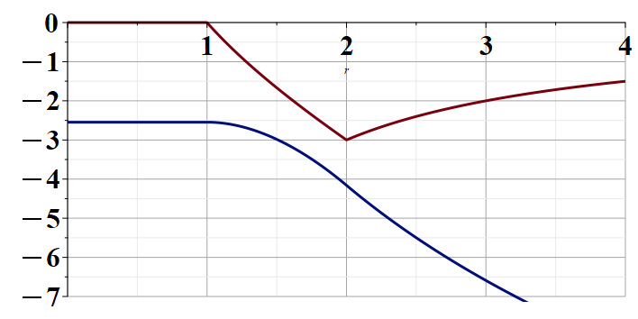
Example continued --
r
a
b

Slide 53
Solution of the Poisson/Laplace equation in various geometries -- cylindrical geometry with z-dependence
φ
ρ
z

Slide 54
Cylindrical geometry continued:
φ
ρ
z

Slide 55
https://dlmf.nist.gov/

Slide 57
Cylindrical geometry continued:
φ
ρ
z

Slide 58
Solutions of Laplace equation inside cylindrical shape
Example with non-trivial boundary value at z=L
Well behaved at ρ=0
m=0
m=1
m=2
kρ

Slide 59
Solutions of Laplace equation inside cylindrical shape
Example with non-trivial boundary value at z=L

Slide 60
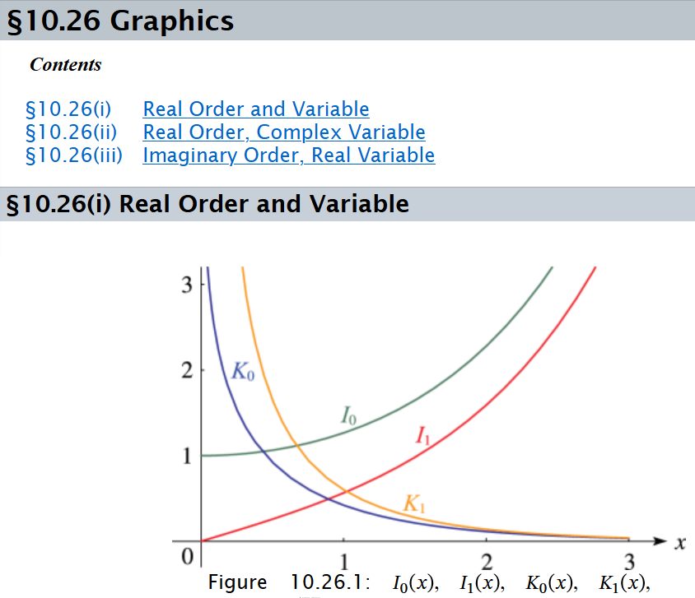

Slide 61
Solutions of Laplace equation inside cylindrical shape
Example with non-trivial boundary value at ρ=a
m=0
m=1
m=2
kρ

Slide 62
Solutions of Laplace equation inside cylindrical shape
Example with non-trivial boundary value at ρ=a

Slide 63
Green’s function for Dirchelet boundary value inside cylinder:

Slide 64
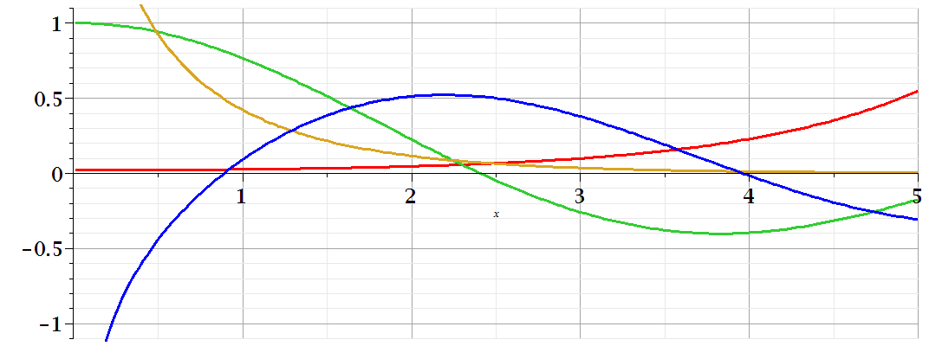
Comments on cylindrical Bessel functions
m=0
K₀
I₀/50
J₀
N₀

Slide 65
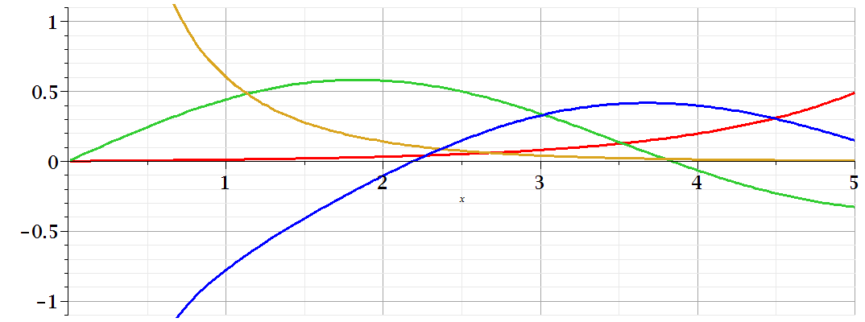
Comments on cylindrical Bessel functions
K₁
m=1
I₁/50
J₁
N₁

Slide 66
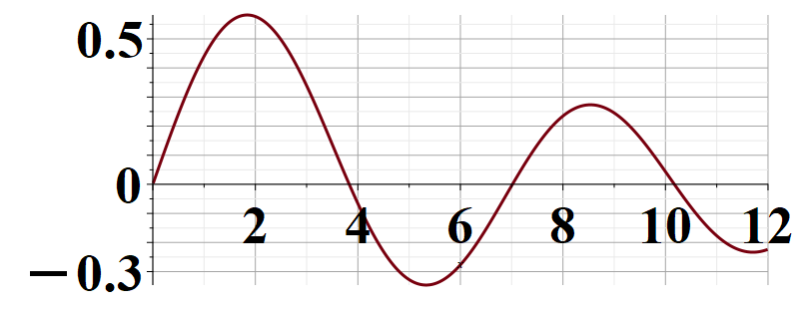
Some useful identities involving cylindrical Bessel functions from Jackson Sec. 3.7
m=1

