Slide 1
PHY 712 Electrodynamics
10-10:50 AM MWF in Olin 103
Class notes for Lecture 8:
Solution of Poisson/Laplace equation for special geometries –
• Cylindrical – (Sec. 2.11, 3.7, 3.8, 3.11 in JDJ)
• Spherical -- (Sec. 3.1-3.6 in JDJ); next lecture

Slide 2
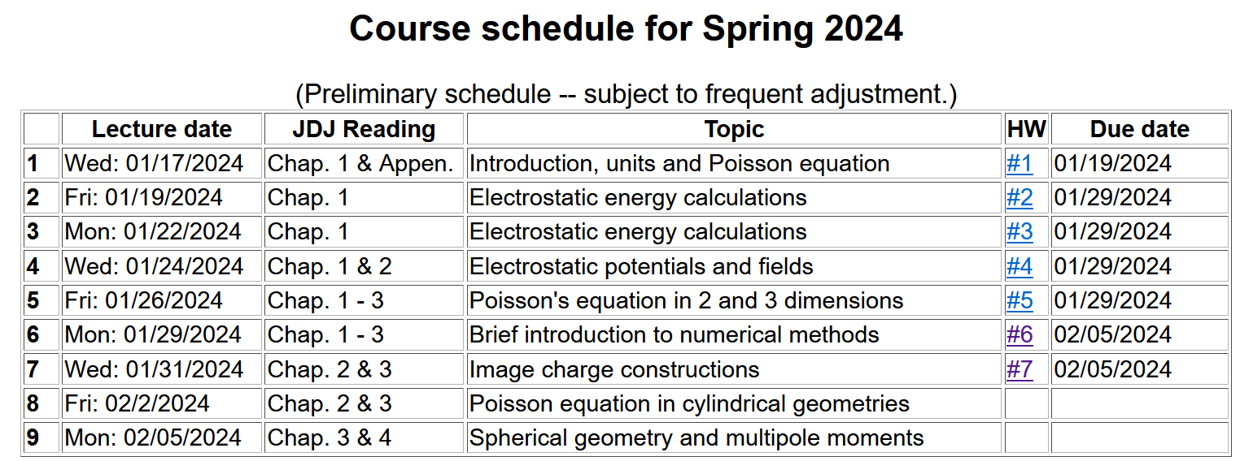

Slide 3
Comment on surface boundary conditions – As discussed in JDJ (Sec. 1.9), there are two named boundary conditions – named for famous mathematicians.
• Dirichlet boundary condition is named for specifying the potential function Φ(r) on the boundary.
• Neumann boundary condition is named for specifying the electric field function E(r) on the boundary.

Slide 4
Solution of the Poisson/Laplace equation in various geometries ➔cylindrical geometry with no z-dependence (infinitely long wire, for example):
φ
ρ

Slide 5
Solution of the Poisson/Laplace equation in various geometries ➔cylindrical geometry with no z-dependence (infinitely long wire, for example):
φ
ρ

Slide 6
Solution of the Poisson/Laplace equation in various geometries -- cylindrical geometry with no z-dependence (infinitely long wire, for example):
φ
ρ
➔m=integer

Slide 7
Solution of the Poisson/Laplace equation in various geometries -- cylindrical geometry with no z-dependence (infinitely long wire, for example):
φ
ρ

Slide 8
Note that the previous example is similar to the construction for the 2-d cartesian case --

Slide 9
Cartesian example continued --

Slide 10
Note that, because we are using curvilinear coordinates, the Wronskian and the form of the delta function is modified.
More details given in Jackson Sec. 3.7 - 3.11.

Slide 11
Comments and details
φ
r
Note that in this case, we have assumed that the surface integral contributions are trivial.

Slide 12
Example – uniform cylindrical shell:
z
Top view:
a
b
y
r
x

Slide 13
Question – Why only m=0 for this case?

Slide 14
Some details

Slide 15
Example continued -- m=0 only --
Top view:
a
b

Slide 16
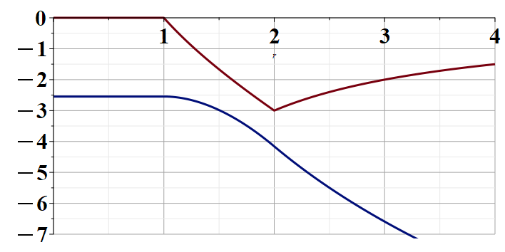
Example continued --
r
a
b

Slide 17
Solution of the Poisson/Laplace equation in various geometries -- cylindrical geometry with z-dependence
φ
ρ
z

Slide 18
Cylindrical geometry continued:
φ
ρ
z

Slide 19
https://dlmf.nist.gov/

Slide 21
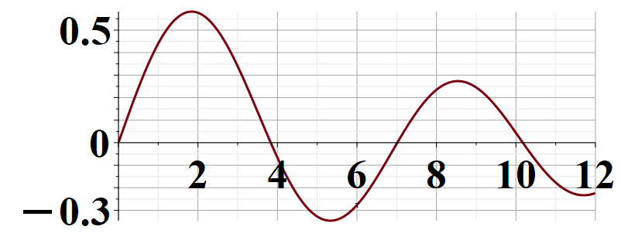
Some useful identities involving cylindrical Bessel functions from Jackson Sec. 3.7
m=1

Slide 22
Cylindrical geometry continued:
φ
ρ
z

Slide 23
Solutions of Laplace equation inside cylindrical shape
Example with non-trivial boundary value at z=L
Well behaved at ρ=0
m=0
m=1
m=2
kρ

Slide 24
Solutions of Laplace equation inside cylindrical shape
Example with non-trivial boundary value at z=L

Slide 25
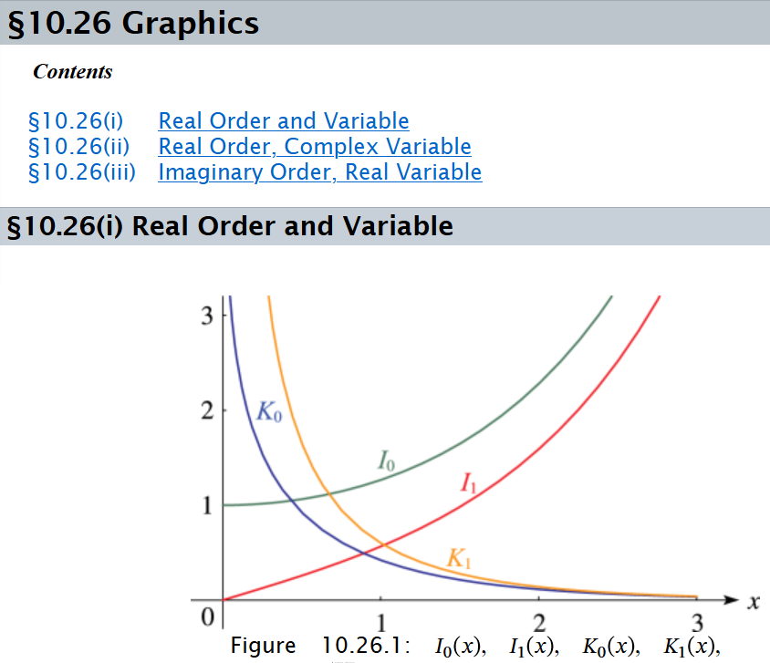

Slide 26
Solutions of Laplace equation inside cylindrical shape
Example with non-trivial boundary value at ρ=a
m=0
m=1
m=2
kρ

Slide 27
Solutions of Laplace equation inside cylindrical shape
Example with non-trivial boundary value at ρ=a

Slide 28
Green’s function for Dirchelet boundary value inside cylinder:

Slide 29
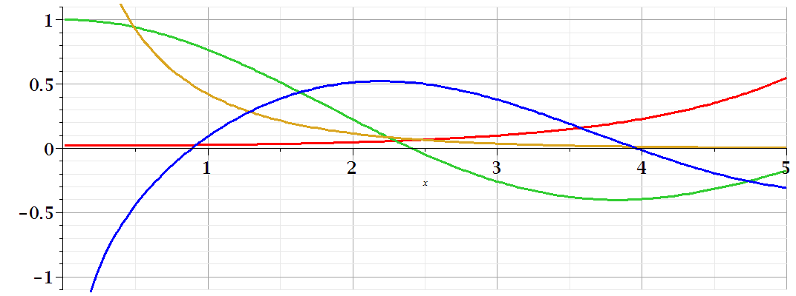
Comments on cylindrical Bessel functions
m=0
K₀
I₀/50
J₀
N₀

Slide 30
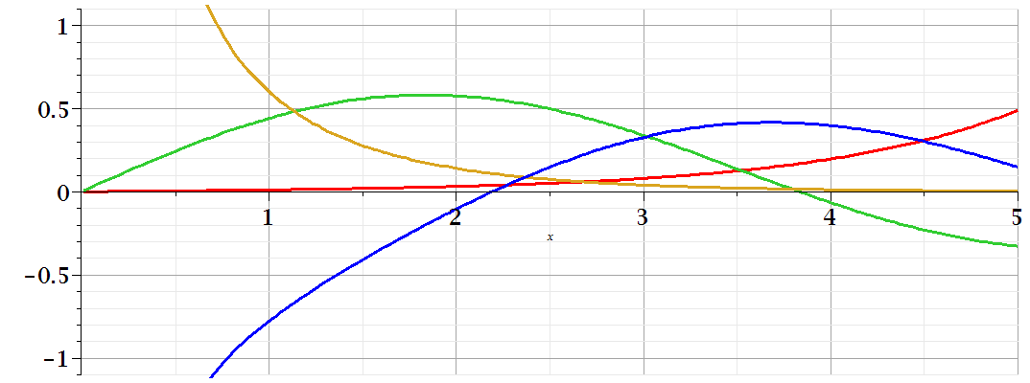
Comments on cylindrical Bessel functions
K₁
m=1
I₁/50
J₁
N₁

