Slide 1

DC Circuits
Ch. 27
These circuit elements and many others can be combined to produce a limitless variety of useful devices
wire
open switch
closed switch
2-way switch
Two devices are in series if they are connected at one end, and nothing else is connected there
Two devices are in parallel if they are connected at both ends
+
ideal battery
1.5 V
–
47 μF
capacitor
4.7 kΩ
resistor
Notes:
https://www.youtube.com/watch?v=aIhk9eKOLzQ
Are you smarter than a MIT grad

Slide 2
Resistors in Parallel and in Series
R₁
R₂
When resistors are in series, the same
current must go through both of them
The total voltage difference is
The two resistors act like one with resistance
When resistors are in parallel, the same potential is across both of them
The total current through them is
The two resistors act like one with resistance
R₁
R₂

Slide 3
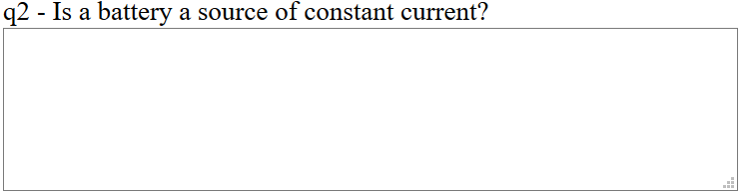
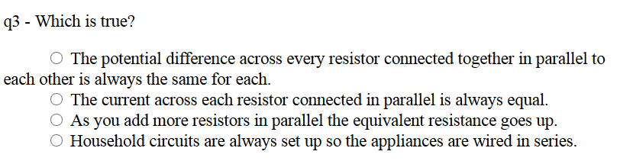


Warmup 10c
Notes:
Are there other types of lights that uses these (JIT)

Slide 4
Parallel and Series - Formulas
 | Capacitor | Resistor | Inductor*
Series
Parallel
Fundamental Formula
* To be defined in a later chapter

Slide 5
The Voltage Divider
Many circuits can be thought of as a voltage divider
  Intentionally or unintentionally
What’s the voltage drop across each of the resistors?
R₁
+
E
–
R₂
The larger resistor gets most of the voltage
If Mr. Curious has a resistance of 10 kΩ and the light bulb has a resistance of 240 Ω, how bright is Mr. Curious?
+
–
120 V
Not very bright
Notes:
Do light bulb demo
JIT – what is EMF – potential difference across battery, poor words (historical), ignores –ir.

Slide 6
Ans A
Ans C

Slide 7
Ans C

Slide 8
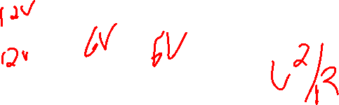
Ans A
Ans A

Slide 9
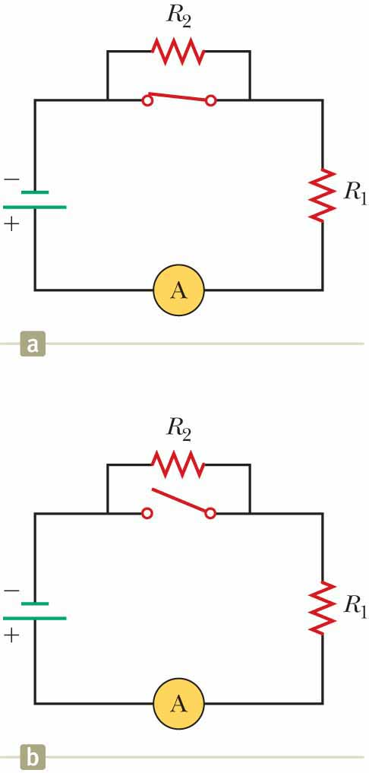

Quick Quiz 27.2
JIT
With the switch in the circuit of the top figure closed, there is no current in R₂ because the current has an alternate zero-resistance path through the switch. There is current in R₁, and this current is measured with the ammeter (a device for measuring current) at the bottom of the circuit. If the switch is opened (the bottom figure), there is current in R₂. What happens to the reading on the ammeter when the switch is opened?
The reading goes up.
The reading goes down.
The reading does not change.
Ans b

Slide 10
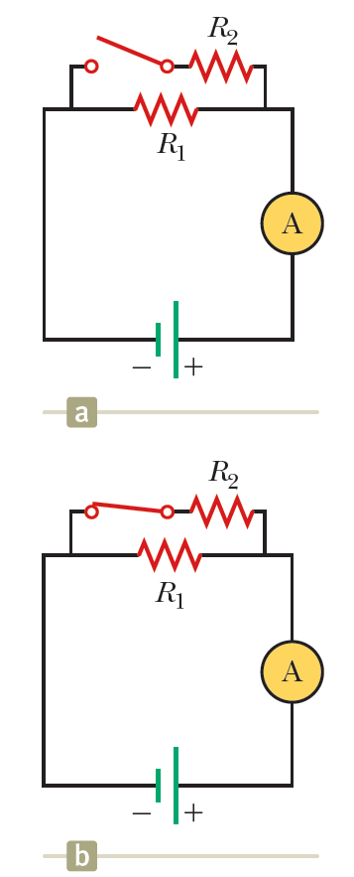

Quick Quiz 27.3
JIT
With the switch in the circuit of the top figure is open, there is no current in R₂. There is current in R₁, however, and it is measured with the ammeter at the right side of the circuit. If the switch is closed (the bottom figure), there is current in R₂. What happens to the reading on the ammeter when the switch is closed?
The reading increases.
The reading decreases.
The reading does not change.
Ans a

Slide 11
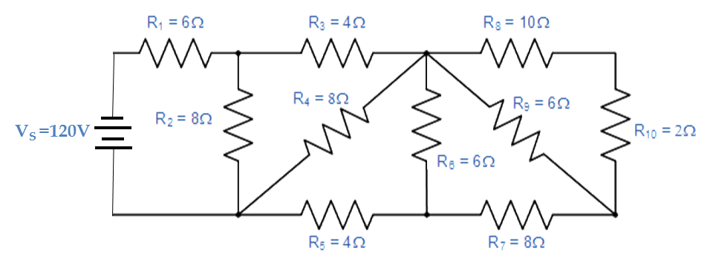

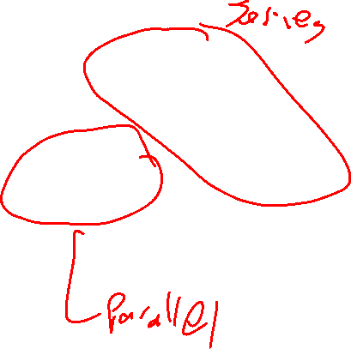
Which resistors are in series and which are in parallel

Slide 12
Solve on Board

Slide 13
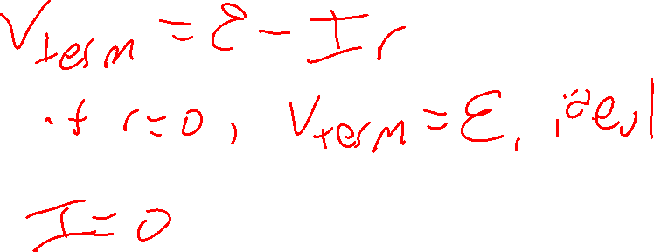
Warmup 10c

Slide 14

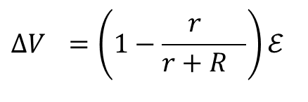
Ideal vs. Non-Ideal Batteries
Up until now, we’ve treated a battery as if it produced a fixed voltage, no matter what we demand of it
Real batteries also have resistance
  It limits the current and therefore the power that can be delivered
If the internal resistance r is small compared to other resistances in the problem, we can ignore it
ε
–
+
ideal battery
r
ε
–
+
realistic battery
The maximum potential difference ε across the battery is called electromotive force (emf)
10 Ω
30 V
$$ΔV_{term}=ℰ−Ir$$
–
+
A 30 V battery with 10 Ω of resistance is connected to a 50 Ω resistor. What is the actual voltage across the 50 Ω resistor?
A) 30 V B) 36 V C) 6 V
D) 25 V E) 24 V
50 Ω
$$ΔV_{}=\left(1−\frac{r_{}}{r+R_{}}\right)ℰ$$
Notes:
Dashed lines are for the battery – like in Fig 28-1. deltaV is also R/(r+R)Εpsilon = (50/60)30

Slide 15
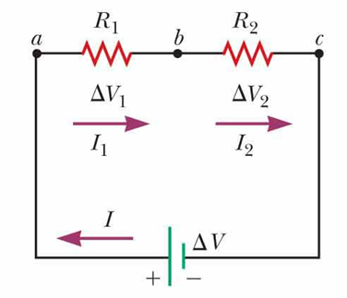
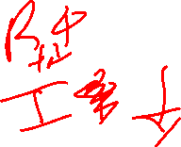
Quick Quiz 27.4 Part I
JIT
In the figure, a third resistor is added in series with the first two. What happens to the current in the battery?
increases,
decreases,
remains the same.
Ans b
Notes:
Adding another series resistor increases the total resistance of the circuit and therefore reduces the current in the circuit.

Slide 16

Quick Quiz 27.4 Part II
JIT
What happens to the terminal voltage of the battery?
increases,
decreases,
remains the same.
Ans a

Slide 17
Kirchoff’s First Law
The total current into any vertex equals the current out of that vertex
How to apply it:
First, assign a current and a direction to every pathway
  Two components in series will always have the same current
At every vertex, write the equation:
12 V
I₁
–
+
3 Ω
I₂
+
–
B
A
Which equation do you get for point A?
A) I₁ + I₂ = I₃ B) I₂ + I₃ = I₁
C) I₁ + I₃ = I₂ D) I₁ + I₂ + I₃ = 0
5 Ω
6 V
The equation from point B is
4 Ω
I₃
You always get one
redundant equation

Slide 18
Kirchoff’s Second Law
The total voltage change around a loop is always zero
How to apply it:
First, assign a direction to every loop
  I often pick clockwise
Start anywhere, and set 0 equal to sum of potential change from each piece:
For batteries: ΔV = ε
  It is an increase if you go from – to +
  It is a decrease if you go from + to –
For resistors: ΔV = IR
  It is a decrease if you go with the current
  It is an increase if you go against the current
12 V
I₁
–
+
3 Ω
I₂
+
–
5 Ω
6 V
4 Ω
I₃

Slide 19
Kirchoff’s Second Law (2)
What is Kirchoff’s Second Law for the purple loop?
A) 0 = +5I₂ – 6 – 4I₃ B) 0 = +5I₂ + 6 – 4I₃
C) 0 = –5I₂ – 6 – 4I₃ D) 0 = –5I₂ + 6 – 4I₃
12 V
I₁
–
+
3 Ω
I₂
+
–
Three equations in three unknowns: solve it
We can let Maple do it for us
5 Ω
6 V
> solve({i3=i1+i2,0=-5*i2-6-4*i3,
0=18-3*i1+5*i2},[i1,i2,i3]);
4 Ω
I₃
Negative currents means we guessed the wrong way
Not a problem

Slide 20

Solve on Board

Slide 21
Kirchoff’s Laws with Capacitors
I
If know which side is positive then that is high potential – work like battery.
Q
The voltage change is given by ΔV = Q/C
  It is a decrease if (+)Q is the side you are going in
  It is an increase if Q is the side you are going out
The current is related to the time change of Q
  Add minus sign if I doesn’t enter from the same side as Q – it is minus if decreasing
If you are in a steady state, the current through a capacitor is always zero
C
+
–
In this circuit, in the steady state, where is current flowing?
+
+
It’s really just a battery and two resistors in series!
–
–
Notes:
If know + and – q then + is at high potential.

Slide 22

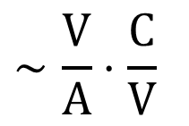


The Simplest RC Circuit
R
Q₀
In the circuit shown at left, the capacitor starts with charge Q₀. At time t = 0, the switch is closed. What happens to the charge Q?
C
I
Current begins to flow around the loop, so the charge Q will change
This is a differential equation, and therefore hard to solve
Check the units:
$$∼\frac{V}{A}⋅\frac{C}{V}$$
$$∼\frac{C}{\frac{C}{s}}$$
$$RC∼Ω⋅F$$
$$∼s$$
Notes:
Show how get Q0

Slide 23
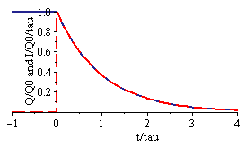
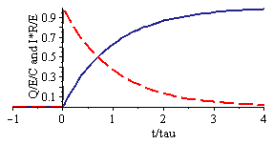
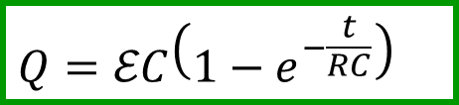
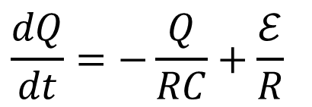
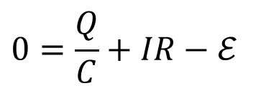
Charging and Discharging Capacitors
The combination RC = τ is called the time constant
  It’s the characteristic time it takes to discharge
We can work out the current from
Q
I
R
+
C
–
In this circuit, the capacitor is initially uncharged, but at t = 0 the switch is closed
ε
$$\frac{dQ}{dt}=−\frac{Q}{RC}+\frac{ℰ}{R}$$
$$0=\frac{Q}{C}+IR−ℰ$$
$$Q=ℰC\left(1−e^{−\frac{t}{RC}}\right)$$
Notes:
Show I, same as discharging, just opposite direction (note how drawn).

Slide 24
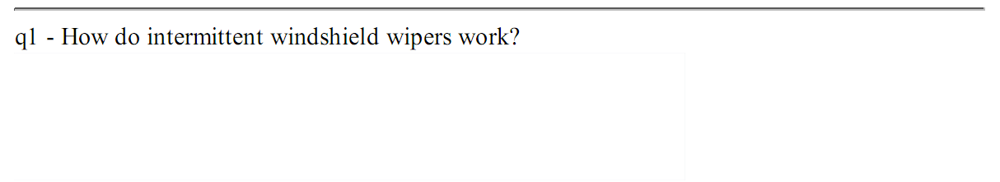
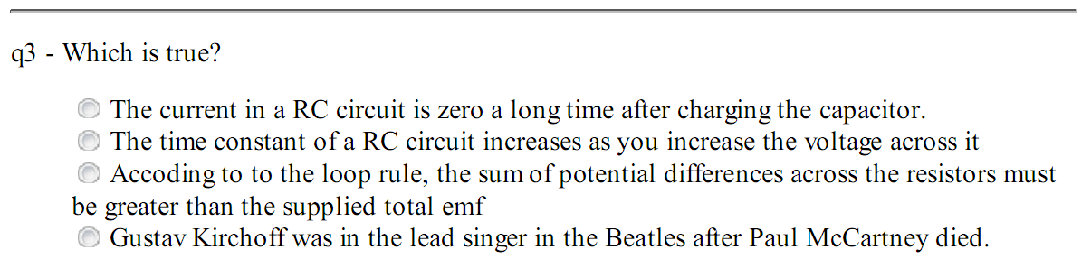
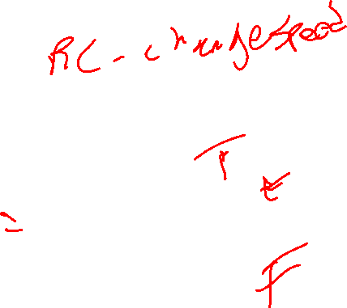
Warmup 11

Slide 25
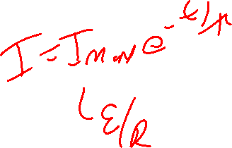
Ans A

Slide 26
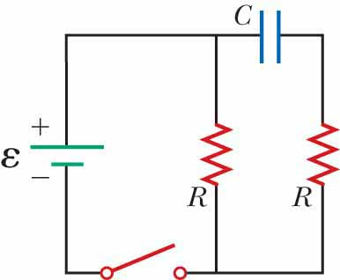
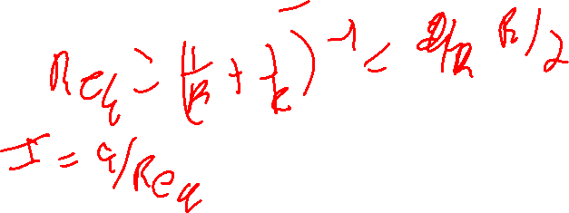
Quick Quiz 27.5 Part I
JIT
Consider the circuit in the figure and assume the battery has no internal resistance. Just after the switch is closed, what is the current in the battery?
0
ε /2R
2ε/R
ε/R
impossible to determine
Ans c

Slide 27
Quick Quiz 27.5 Part II
JIT
After a very long time, what is the current in the battery?
0
ε /2R
2ε /R
ε /R
impossible to determine
Ans d

Slide 28
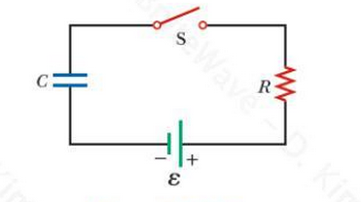
Solve on Board

Slide 29
Ammeters and Voltmeters
An ammeter is a device that measures the current (amps) anywhere in a circuit
  To use it, you must route the current through it
  A perfect ammeter should have zero resistance
A voltmeter is a device that measures the potential difference (volts) between any two points in a circuit
  To use it, you can simply connect to any two points
  A perfect voltmeter has infinite resistance
A
V
A
Which meter is installed incorrectly?
A) Left voltmeter B) Right voltmeter
C) Left ammeter D) Right ammeter
E) All are correct
+
V
A
–
V
Voltmeters should be connected to two places in an existing circuit
  The left voltmeter is placed correctly
A voltmeter has infinite resistance
  The right one effectively blocks the current on the right

Slide 30
Household Wiring
*Actually, this is alternating current, later chapter
All household appliances consume electrical power
  Think of them as resistors with fixed resistance R
Devices are designed to operate at 120 V*
  Often, they give the wattage at this voltage
  Can easily get the effective resistance from
To make sure power is given to each device, they are all placed in parallel
Fuse
box
A
+
–
Inside House
If you put too many things on at once, a lot of current is drawn
The wires, which have some resistance, will start to get hot
To avoid setting the house on fire, add a fuse (or a circuit breaker)

Slide 31
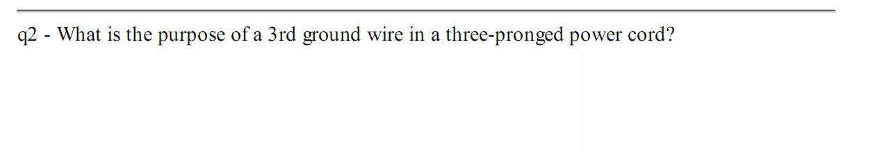
Warmup 11
Notes:
JIT why ground connnected to neutral (neutral goes to ground). And note – neutral not connected to casing.
Can you plug in three pong in two prong outlet – yes.

Slide 32
Why three wires?
If a device is functioning properly, you need only two wires
  “Live” and “Neutral” wires
Toaster
If the live wire accidentally touches the casing, the person can be electrocuted
The wrong solution – connect the neutral to the casing
Now imagine the neutral wire breaks
  The person again can be electrocuted
The right solution: Add a third “ground” wire connected directly to ground
  Normally no current will flow in this wire
  If the hot wire touches the casing, it will trigger the fuse/circuit breaker and protect the person

Slide 33
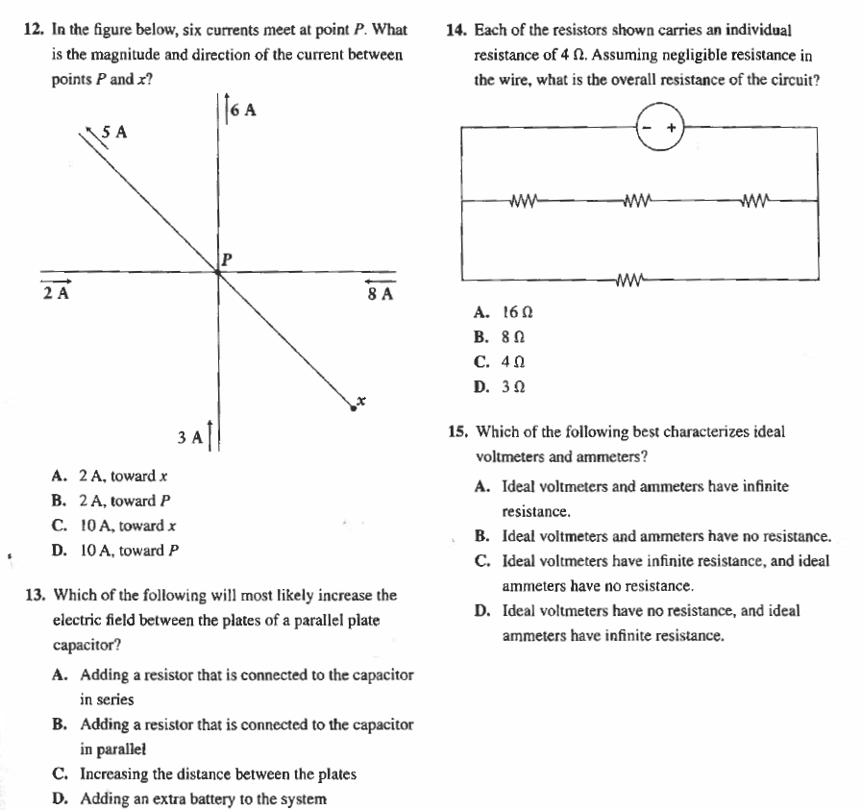
MCAT Practice Problems
Ans 12. A
Ans 14 D
Ans 13. D
Ans 15. C

