Slide 1
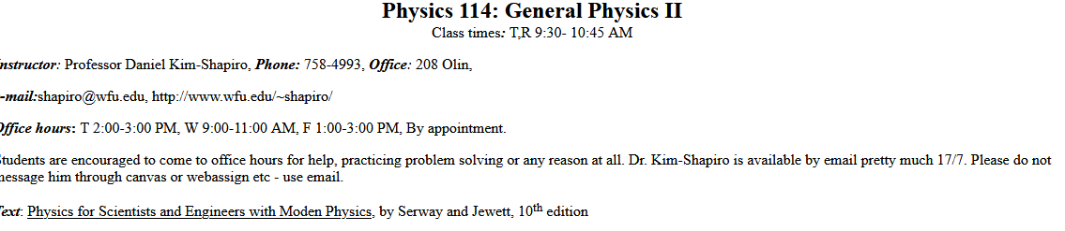
Web Page http://users.wfu.edu/shapiro/Phy11423/

Slide 2
Homework and webassign
All homework is on webassign Key is wfu 5308 8637. Bookstore can sell you a license, or you can get it online
  Personalized problems, you need to get correct to 1% or better
  Link to webassign is on the class web page
Due about every week Personalized problems – you can’t copy
  Five chances to get it right
Getting help is encouraged
  Ask a friend, ask me, come to office hours
First assignment is due on Friday January 20, 2023
http://www.webassign.net/student.html
Labs
You are required to sign up for PHY 114L
You must pass the lab to pass the class
Labs begin after MLK day, January 23, 2023.

Slide 3
Background
Prerequisites
Physics: PHY 113 (or 111), mechanics, etc.
  You should have a good understanding of basic physics
  Be familiar with units and keeping track of them, scientific notation
  Should know key elementary formulas like F = ma
Mathematics: MTH 111, introductory calculus
  Know how to perform derivatives of any function
  Understand definite and indefinite integration
  Work with vectors either abstractly or in coordinates
Note – Next few slides are what you should already know. If you do not, please see me.

Slide 4
SI Units
Fundamental units
Time second s
Distance meter m
Mass kilogram kg
Temperature Kelvin K
Charge Coulomb C
Red boxes mean memorize this, not just here, but always!
Derived units
Force Newtons N kg ⋅m/s²
Energy Joule J N⋅m
Power Watt W J/s
Frequency Hertz Hz s⁻¹
Elec. Potential Volt V J/C
Capacitance Farad F C/V
Current Ampere A C/s
Resistance Ohm Ω V/A
Mag. Field Tesla T N⋅s/C/m
Magnetic Flux Weber Wb T⋅m²
Inductance Henry H V⋅s/A
Metric Prefixes
10⁹ G Giga-
10⁶ M Mega-
10³ k kilo-
1
10⁻³ m milli-
10⁻⁶ μ micro-
10⁻⁹ n nano-
10⁻¹² p pico-
10⁻¹⁵ f femto-

Slide 5
Vectors
A scalar is a quantity that has a magnitude, but no direction
  Mass, time, temperature, distance
  In a book, denoted by math italic font
A vector is a quantity that has both a magnitude and a direction
  Displacement, velocity, acceleration
  In books, usually denoted by bold face
  When written, usually draw an arrow over it
In three dimensions, any vector can be described
in terms of its components
  Denoted by a subscript x, y, z
The magnitude of a vector is how long it is
  Denoted by absolute value symbol, or
  same variable in math italic font
z
v_{x}
y
v_{z}
v_{y}
x

Slide 6
Finding Components of Vectors
If we have a vector in two dimensions, it is pretty easy to compute its components from its magnitude and direction
y
v
v_{y}
We can go the other way as well
v_{x}
x
In three dimensions it is harder

Slide 7
Unit Vectors
We can make a unit vector out of any vector
  Denoted by putting a hat over the vector
  It points in the same direction as the original vector
The unit vectors in the x-, y- and z-direction are very useful – they are given their own names
  i-hat, j-hat, and k-hat respectively
  Often convenient to write arbitrary vector in terms of these
Adding and Subtracting Vectors
To graphically add two vectors, just connect them head to tail
To add them in components, just add
each component
Subtraction can be done the same way

Slide 8
Multiplying Vectors
There are two ways to multiply two vectors
The dot product produces a scalar quantity
  It has no direction
  It can be pretty easily computed from geometry
  It can be easily computed from components
The cross product produces a vector quantity
  It is perpendicular to both vectors
  Requires the right-hand rule
  Its magnitude can be easily computed from geometry
  It is a bit of a pain to compute from components

Slide 9
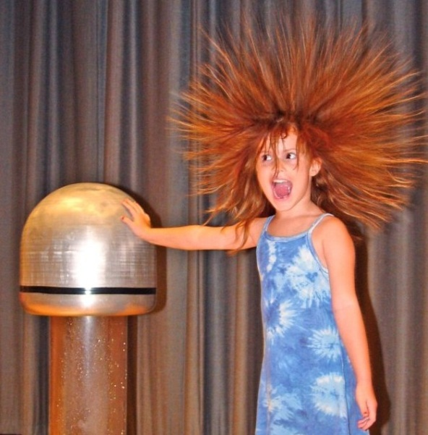

Electricity
θ
s
b
b
θ
r
r
z
50 kV
Cleanair
a
q
b
a
Dirty air
+
-

Slide 10
Electric Fields
Chapter 22
Electric Charge
Electric forces affect only objects with charge
Charge is measured in Coulombs (C). A Coulomb is a lot of charge
Charge comes in both positive and negative amounts
Charge is conserved – it can neither be created nor destroyed
Charge is usually denoted by q or Q
There is a fundamental charge, called e
  All elementary particles have charges that
  are simple multiples of e
Particle q
Proton e
Neutron 0
Electron -e
Oxygen nuc. 8e
Higgs Boson 0
Red dashed line means you should be able to use this on a test, but you needn’t memorize it

Slide 11
CT1-Three pithballs are suspended from thin threads. Various objects are then rubbed against other objects (nylon against silk, glass against polyester, etc.) and each of the pithballs is charged by touching them with one of these objects. It is found that pithballs 1 and 2 repel each other and that pithballs 2 and 3 repel each other. From this we can conclude that
A. 1 and 3 carry charges of opposite sign.
B. 1 and 3 carry charges of equal sign.
C. all three carry the charges of the same sign.
D. one of the objects carries no charge.
E we need to do more experiments to determine the sign of the charges.
ANS C (also B)

Slide 12
Charge can be spread out
Charge may be at a point, on a line, on a surface, or throughout a volume
Linear charge density λ units C/m
  Multiply by length
Surface charge density σ units C/m²
  Multiply by area
Charge density ρ units C/m³
  Multiply by volume
– 3.0 μC/cm
2 cm
A box of dimensions 2 cm × 2 cm × 1 cm has charge density ρ = 5.0 μC/cm³ throughout and linear charge density
λ = – 3.0 μC/cm along one long diagonal. What is the total charge?
A) 2 μC B) 5 μC C) 11 μC D) 29 μC E) None of the above
5.0 μC/cm³
1 cm
2 cm

Slide 13
The nature of matter
Matter consists of positive and negative charges in very large quantities
There are nuclei with positive charges
Surrounded by a “sea” of negatively
charged electrons
+
+
+
+
To charge an object, you can add some charge to the object, or remove some charge
  But normally only a very small fraction
  10⁻¹² of the total charge, or less
+
+
+
+
+
+
+
+
+
+
+
+
Electric forces are what hold things together
  But complicated by quantum mechanics
Some materials let charges move long distances, others do not
  Normally it is electrons that do the moving
Insulators only let their charges move a very short distance
Conductors allow their charges to move a very long distance

Slide 14
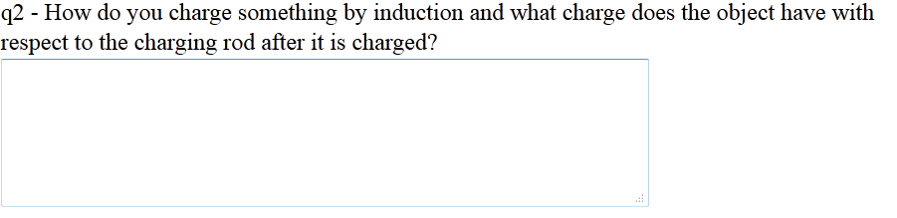
Warmup01
https://www.earthing.com/pages/what-is-earthing#

Slide 15
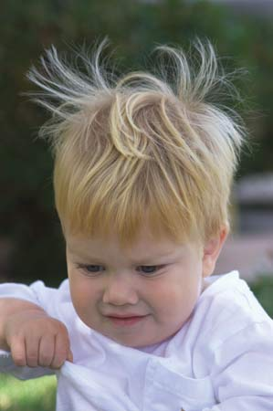
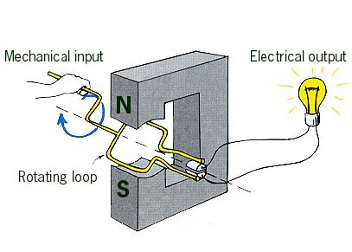
Some ways to charge objects
By rubbing them together
  Not well understood
By chemical reactions
  This is how batteries work
By moving conductors in a magnetic field
  Get to this later
By connecting them to conductors that have charge already
  That’s how outlets work
Charging by induction
  Bring a charge near an extended conductor
  Charges move in response
  Ground and negative charge flows in
  Remove the ground
  Remove charge
–
–
–
–
–
What happens when rod is negative?
–
–
+
+
–
–
–
–
+
–
–
–
–
–
–
–
–
+
–
–
–
+
–
–
–
–
+

Slide 16
Like quick quiz 22.2
CT 2. Three pithballs are suspended from thin threads. It is found that pithballs 1 and 2 attract each other and that pithballs 2 and 3 attract each other. From this we can conclude that
A. 1 and 3 carry charges of opposite sign.
B 1 and 3 carry charges of equal sign.
C all three carry the charges of the same sign.
D one of the objects carries no charge.
E we need to do more experiments to determine the sign of the charges.
ANS E

Slide 17
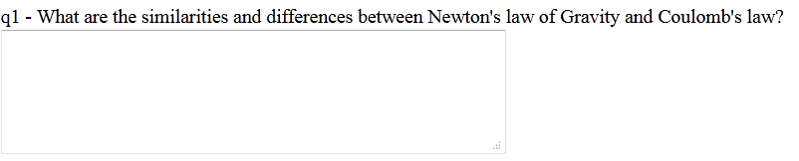
Warmup 01

Slide 18
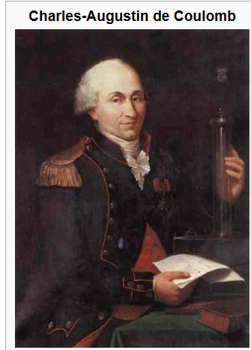
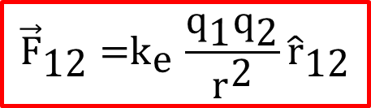
Coulomb’s Law
Like charges repel, and unlike charges attract
The force is proportional to the charges
It depends on distance (inverse square)
q₁
q₂
$${\vec{\text{F}}}_{\text{12}}{\text{=}\text{k}}_{\text{e}}\frac{{\text{q}}_{\text{1}}{\text{q}}_{\text{2}}}{{\text{r}}^{\text{2}}}{\hat{\text{r}}}_{\text{12}}$$
Notes
The r-hat just tells you the direction of the force, from 1 to 2
The Force as written is by 1 on 2
Sometimes this formula is written in terms of a
quantityε₀ called the permittivity of free space

Slide 19
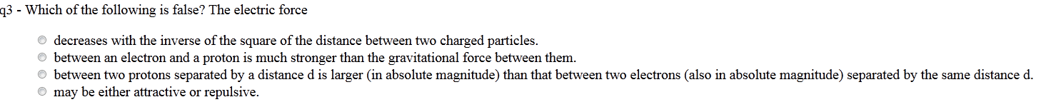
Warmup 01

Slide 20
Three point charges are located at the corners of an equilateral triangle as shown below. Calculate the net electric force on the 7.0 μC charge.
Use superposition
Solve on Board (so take notes).

Slide 21
Sample Problem
+2.0 μC
5.0 cm
5.0 cm
What is the direction of the force on the purple charge?
Up B) Down C) Left
D) Right E) None of the above
–2.0 μC
5.0 cm
7.2 N
–2.0 μC
7.2 N
The separation between the purple charge and each of the other charges is identical
The magnitude of those forces is identical
The brown charge creates a repulsive force at 45° down and left
The green charge creates an attractive force at 45° up and left
The sum of these two vectors points straight left

Slide 22
ANS C

Slide 23
Quick Quiz 22.3
JIT
Object A has a charge of +2 μC, and object B has a charge of +6 μ C. Which statement is true about the electric forces on the objects?
Ans B

Slide 24
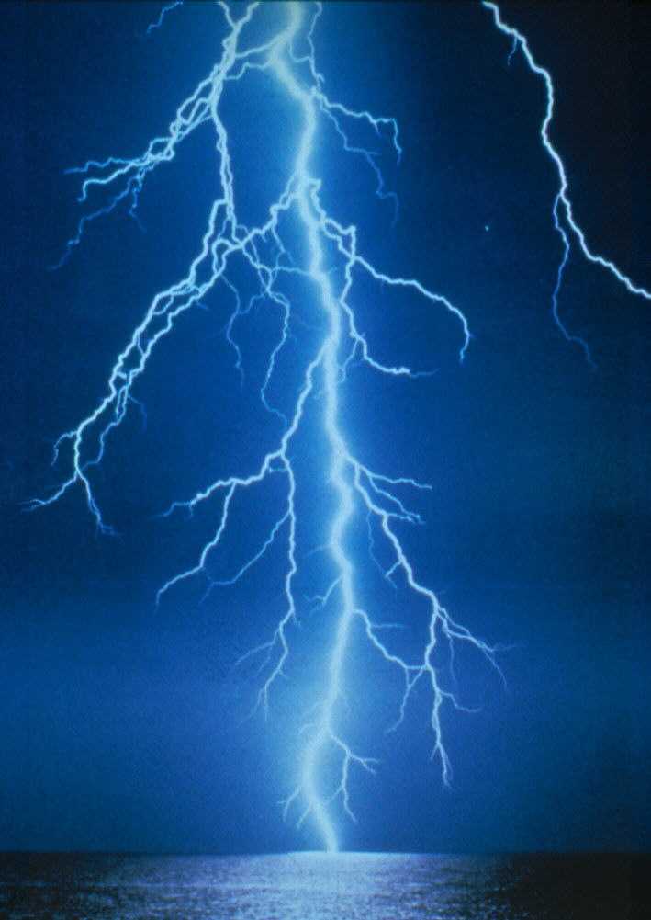
Electric Field
Lightning is associated with very strong electric fields in the atmosphere.

Slide 25
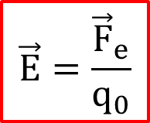
The Electric Field
Suppose we have some distribution of charges
We are about to put a small charge q₀ at a point r
What will be the force on the charge at r?
Every term in the force is proportional to q₀
The answer will be proportional to q₀
Call the proportionality constant E, the electric field
q₀
r
$$\vec{E}=\frac{{\vec{F}}_{e}}{q_{0}}$$
The units for electric field are N/C
It is assumed that the test charge q₀ is small enough that the other charges don’t move in response
The electric field E is a function of r, the position
It is a vector field, it has a direction in space everywhere
The electric field is assumed to exist even if there is no test charge q₀ present

Slide 26
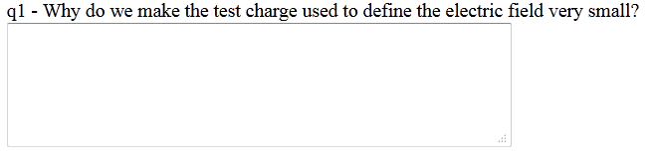
Warmup 02

Slide 27
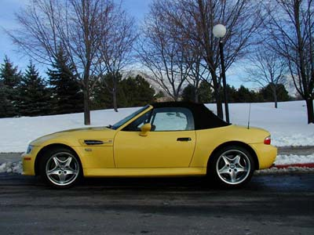

Why Do We Use an Idea of Electric Field?
In our everyday life we use to an idea of contact forces:
Example: The force exerted by a hammer on a nail
The friction between the tires of a car and the road
However electric force can act on distances.
How to visualize it?
Even Newton had trouble with understanding forces acting from distances.
T
Gravitational force is acting on distances
Solution:
Let’s introduce the idea of field.

Slide 28
GRAVITATIONAL FIELD
ELECTRIC FIELD
Earth
+q
m₀
Source of field
Test mass
Source of field
Test charge
Electric field is generated and described
by source charge +q.
Test charge q₀ is a detector of electric field.
Gravitational field is described by
source mass (mass of Earth).
Test mass m is a detector of
gravitational field.
Test charge q₀ <<q, so field is undisturbed.

Slide 29

Definition of an Electric Field
We have positive and negative charges.
The electric field is defined as the electric force
$${\vec{F}}_{e}$$
acting on a positive
test charge +q₀ placed at that point divided by test charge:
Direction of an electric field:
+q₀
P
(repulsive force)
+q
+q₀
(attractive force)
P
-q

Slide 30
Electric Field from Discrete Distribution of Charges
The electric field at point P due to a group of source charges
can be written as:
Example:
Find an electric field at point P generated by charges q₁ =20μC and q₂ = -30μC in a distance r₁ =1m and r₂ =2m from point P, respectively.
y
q₁
1m
x
2m
P
q₂

Slide 31


Slide 32
Electric Field from Discrete Distribution of Charges
The electric field at point P due to a group of source charges
can be written as:
Example:
Find an electric field at point P generated by 2 charges each with value q at a distance 2d from each other.
y
P
x
y
d
d
q
q

Slide 33
Electric Field from Discrete Distribution of Charges
The electric field at point P due to a group of source charges
can be written as:
Example:
Find an electric field at point P generated by 2 charges each with value q at a distance 2d from each other.
What direction will the electric field at P be pointed?
+y D) +x
-y E) –x
Combination of x and y
y
P
x
y
d
d
q
q

Slide 34
Electric Field from Discrete Distribution of Charges
The electric field at point P due to a group of source charges
can be written as:
Example:
Find an electric field at point P generated by 2 charges each with value q at a distance 2d from each other.
y
P
x
y
d
d
q
q

Slide 35
Electric Field from Discrete Distribution of Charges
The electric field at point P due to a group of source charges
can be written as:
Example:
Find an electric field at point P generated by 2 charges each with value q at a distance 2d from each other.
What do we expect the electric field to look like as a function of y and q for y >> d?
y
P
x
y
d
d
q
q

Slide 36
Electric Field Lines
These are fictitious lines we sketch which point in the direction of the electric field.
1) The direction of at any point is tangent to the electric field line at that point.
2) The density of lines of force in any region is proportional to the magnitude of in that region
Lines never cross.

Slide 37
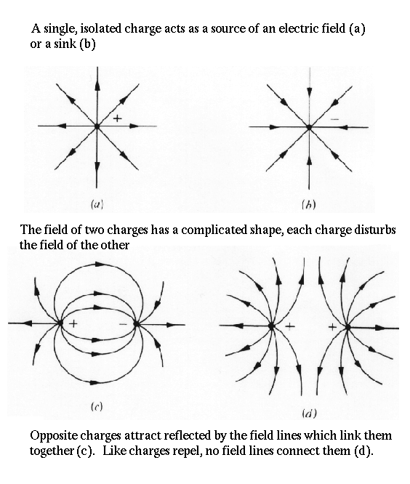

Slide 40

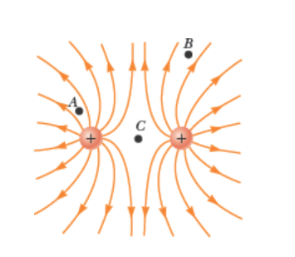
JIT
Ans A, B, C. What is E at point C?

Slide 41
Quick Quiz 22.4
JIT
A test charge of +3 μC is at a point P where an external electric field is directed to the right and has a magnitude of 4 × 10⁶ N/C. If the test charge is replaced with another test charge of −3 μC, what happens to the external electric field at P?
It is unaffected.
It reverses direction.
It changes in a way that cannot be determined.
Ans A

Slide 42
Ans B

Slide 43
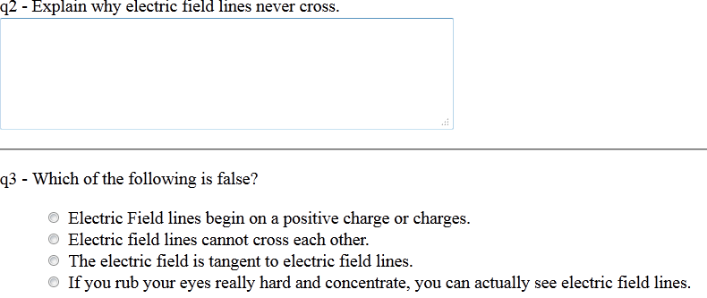
Warmup02

