Slide 1
Ch. 23
Gauss's Law
Electric Flux
Electric flux is the amount of electric field going across a surface
It is defined in terms of a direction, or normal unit vector, perpendicular to the surface
For a constant electric field, and a flat surface, it is easy to calculate
Denoted by Φ_{E}
Units of N⋅m²/C
When the surface is flat, and the fields are constant, you can just use multiplication to get the flux
When the surface is curved, or the fields are not constant, you have to perform an integration
Notes:
Here use A X normal unit vector for A vector of text.
Really when everything in integral is constant, you can just multiply.
So, if E dot n is constant along surface – you are OK.

Slide 2
Warmup 03

Slide 3
Like example 23.4
Ans C
Is the answer independent of the shape?

Slide 4
PCV at L’institut Superieur du Pedagogy

Slide 5
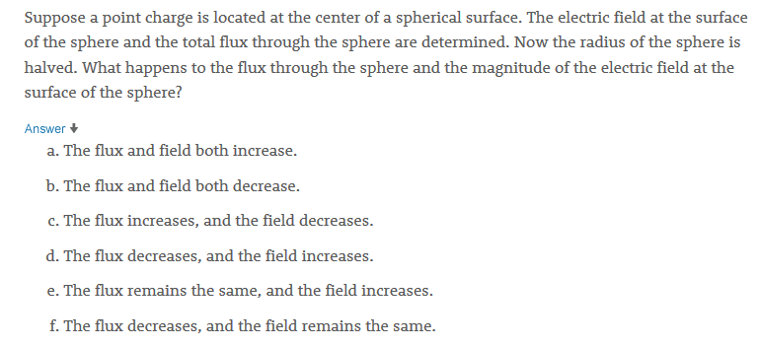
Quick Quiz 23.1
JIT
Ans e

Slide 6
Warmup 03

Slide 7
Solve on Board

Slide 8
Total Flux Out of Various Shapes
A point charge q is at the “center” of a (a) sphere (b) joined hemispheres (c) cylinder. What is the total electric flux out of the shape?
b
a
q
q
a
q

Slide 9
Electric Flux (Hard example)
A point charge q is at the center of a cylinder of radius a and height 2b. What is the electric flux out of (a) each end and (b) the lateral surface?
θ
top
s
b
b
θ
r
r
z
a
Consider a ring of radius s and thickness ds
q
b
a
lateral surface

Slide 10
Gauss’s Law
No matter what shape you use, the total electric flux out of a region containing a point charge q is 4πk_{e}q = q/ε₀.
Why is this true?
Electric flux is just measuring how many field lines come out of a given region
No matter how you distort the shape, the field lines come out somewhere
If you have multiple charges inside the region their effects add
However, charges outside the region do not contribute
q
q₄
$$ϕ_{E}=\oint{\vec{E}∙d\vec{A}=\frac{q_{in}}{ϵ_{0}}}$$
q₃
q₁
q₂

Slide 11
Warmup 03

Slide 12
Using Gauss’s Law to find total charge
A cube of side a has an electric field of constant magnitude |E| = E pointing directly out on two opposite faces and directly in on the remaining four faces. What is the total charge inside the cube?
A) 6Ea²ε₀ B) – 6Ea²ε₀ C) 2Ea²ε₀ D) – 2Ea²ε₀ E) None of the above
a
a
a
Notes:
Do easy problem first – point charge,
And problem 4 points on page 696.

Slide 13
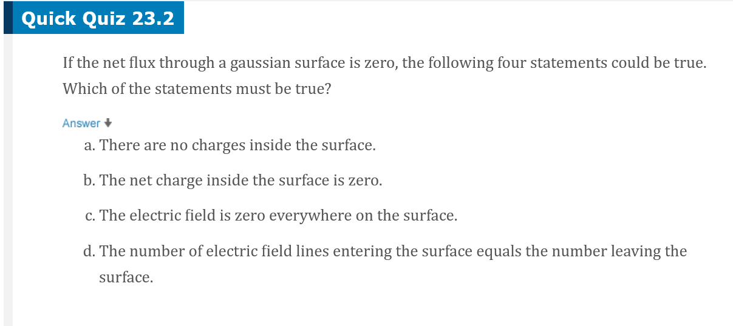
JIT Quick Quiz 23.2
Ans B and D

Slide 14
Ans C

Slide 15
Ans E (B&C)

Slide 16
Using Gauss’s Law to find flux
A very long box has the shape of a regular pentagonal prism. Inscribed in the box is a sphere of radius R with surface charge density σ. What is the electric flux out of one lateral side of the box?
Perspective view
The flux out of the end caps is negligible
Because it is a regular pentagon, the flux from the other five sides must be the same
End view

Slide 17
Using Gauss’s Law to find E-field
A sphere of radius a has uniform charge density ρ throughout. What is the direction and magnitude of the electric field everywhere?
Clearly, all directions are created equal in this problem
Certainly the electric field will point away from the sphere at all points
The electric field must depend only on the distance
Draw a sphere of radius r around this charge
Now use Gauss’s Law with this sphere
r
a
Is this the electric field everywhere?
Notes:
Do point charge first
Then do as point charge with q = PV

Slide 18
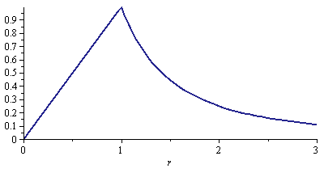
Using Gauss’s Law to find E-field (2)
A sphere of radius a has uniform charge density ρ throughout. What is the direction and magnitude of the electric field everywhere? [Like example 23.6]
When computing the flux for a Gaussian surface, only include the electric charges inside the surface
r
a
r/a

Slide 19
Electric Field From a Line Charge
What is the electric field from an infinite line with linear charge density λ?
L
r
Electric field must point away from the line charge, and depends only on distance
Add a cylindrical Gaussian surface with radius r and length L
Use Gauss’s Law
The ends of the cylinder don’t contribute
On the side, the electric field and the normal are parallel

Slide 20
Electric Field From a Plane Charge
What is the electric field from an infinite plane with surface charge density σ?
Electric field must point away from the surface, and depends only on distance d from the surface
Add a box shaped Gaussian surface of size 2d × L × W
Use Gauss’s Law
The sides don’t contribute
On the top and bottom, the electric field and the normal are parallel
Notes:
Text uses cylinder. If truly infinite, never far from it. Consider 45 degrees area pf charge increaases as r squared as does 1/E.

Slide 21
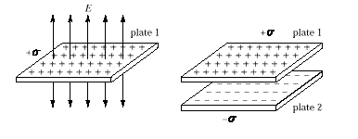
Ans A
Notes:
Text discusses this, page 699

Slide 22
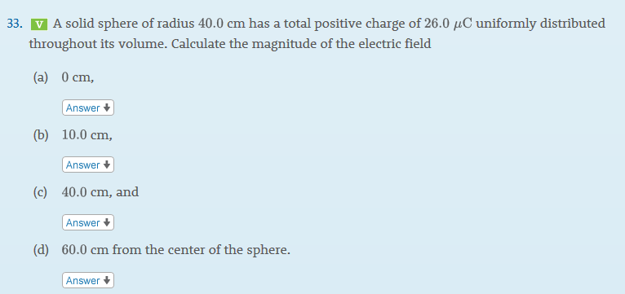
Serway 23-33
Solve on Board

