Slide 1
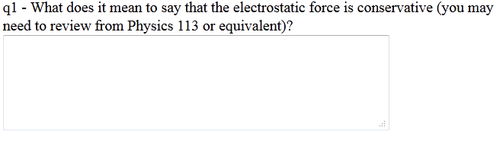
Electric Potential
Ch. 24
Electric Potential Energy
Warmup 05
Notes:
slide 10 (warmup 6). slide 23 (line charge white board problem, "A long straight wire..."),

Slide 2
Electric Potential Energy
JJIT – charge free to move in field
Electric fields produce forces; forces do work
Since the electric fields are doing work,
they must have potential energy
  The amount of work done is the change in the potential energy
The force can be calculated from the charge and the electric field
q
E
s
ds
If the path or the electric field are not straight lines, we can get the change in energy by integration
  Divide it into little steps of size ds
  Add up all the little steps
Notes:
Start with warmup05 q1

Slide 3
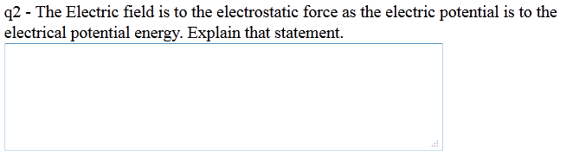
Warmup 05

Slide 4
The Electric Potential
Just like for electric forces, the electric potential energy is always proportional to the charge
Just like for electric field, it makes sense to divide by the charge and get the electric potential V:
Using the latter formula is a little tricky
  It looks like it depends on which path you take
  It doesn’t, because of conservation of energy
Electric potential is a scalar; it doesn’t have a direction
Electric potential is so important, it has its own unit, the volt (V)
  A volt is a moderate amount of electric potential
Electric field is normally given as volts/meter
[V] = [E][s]=N●m/C=J/C=volt=V
Notes:
Wamup05 q2 also quick quiz 3 pg 718
Potential energy stored in a system due to configuration of its parts.
Potential is property of charges/electric field defining hw much work could be done per unit charge.
Point charge by itself has potential, no potential energy. Like Force and E field.
Battery has potential.

Slide 5
Calculating the Electric Potential
To find the potential at a general point B:
Pick a point A which we will assign potential 0
Pick a path from A to B
  It doesn’t matter which path, so pick the simplest possible one
Perform the integration
Example: Potential from a uniform electric field E:
Choose r = 0 to have potential zero
V low
V high
E
+
Equipotential lines are perpendicular to E-field
E-field lines point from high potential to low
Positive charges have the most energy at high
potential
Negative charges have the most energy at low potential
-
Notes:
Do up with y = 0 have V = 0. Example consant E field. Say 5 N/C what is delta V?

Slide 6
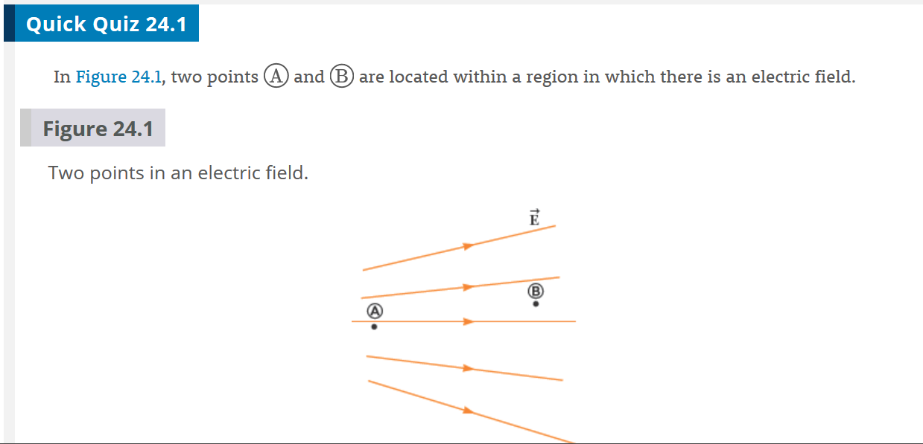
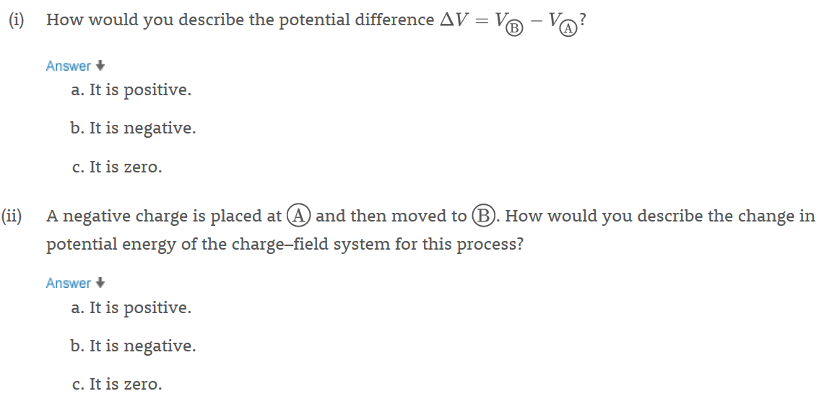
JIT
Ans (i) b (ii) a

Slide 7
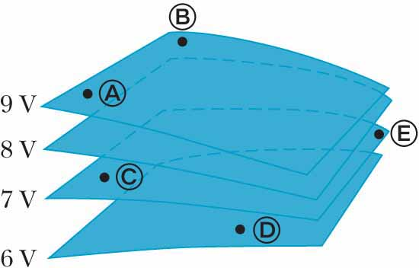
Quick Quiz 24.2
The labeled points in the figure are on a series of equipotential surfaces associated with an electric field. Rank (from greatest to least) the work done by the electric field on a positively charged particle that moves from A to B, from B to C, from
C to D, and from D to E.
Ans
B to C,
C to D,
A to B,
D to E

Slide 8


Slide 9
JIT – like example 24.2
Solve on Board
Solve on Board

Slide 10
Why Electric Potential is useful
It is a scalar quantity – that makes it easier to calculate and work with
It is useful for problems involving conservation of energy
A proton initially at rest moves from an initial point with V = 0 to a point where V = - 1.5 V. How fast is the proton moving at the end?
Find the change in potential energy
V =0
V = -1.5 V
E
+
Since energy is conserved, this must be counter-balanced by a corresponding increase in kinetic energy
1.5 V
Notes:
Would answer be different if had it going from V=1.5 V to V =0?
Note energy is qV.

Slide 11
MCAT Practice Problem
TTwo parallel conducting plates are separated by a distance d. One plate carries a charge +Q and the other charge carries a charge of –Q. The voltage difference between the plates in 12 V. If a +2 μC charge is released from rest at the positive plate, how much kinetic energy does it have when it reaches the negative plate?

Slide 12
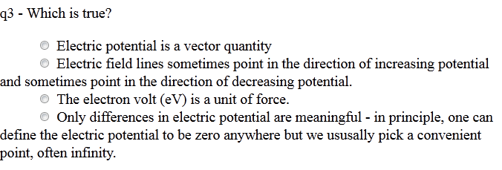
Warmup 05

Slide 13
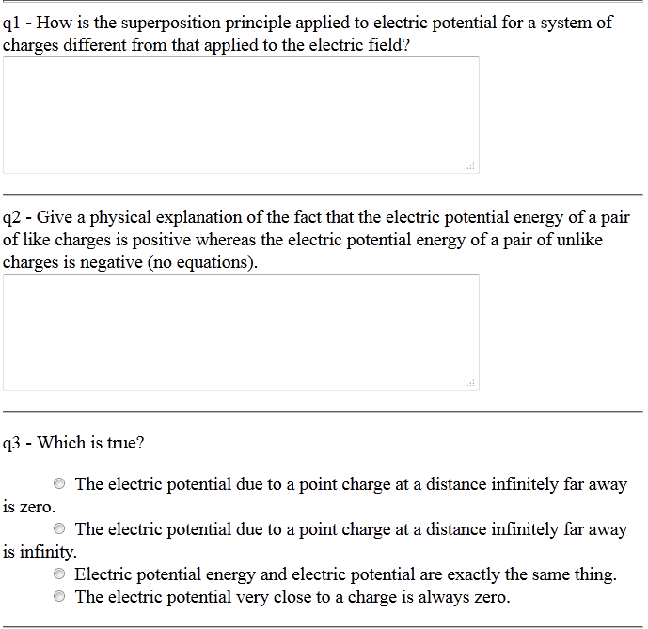
Warmup 06

Slide 14
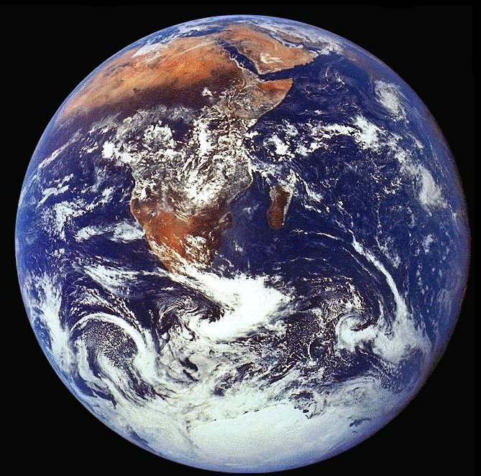
The Zero of the Potential
We can only calculate the difference between the electric potential between two places
This is because the zero of potential energy is arbitrary
  Compare U = mgh from gravity
There are two arbitrary conventions used to set the zero point:
  Physicists: Set V = 0 at ∞
  Electrical Engineers: Set V = 0 on the Earth
In circuit diagrams, we have a specific symbol
to designate something has V = 0.
V = 0
Anything attached here has V = 0
Notes:
Warmup05 q3
Choice arbitray eg constant E field between parallel plates

Slide 15
Potential From a Point Charge
r
q
Integrate from infinity to an arbitrary distance
For a point charge, the equipotential
surfaces are spheres centered on the charge
For multiple charges, or for continuous charges, add or integrate
Notes:
Warmup06 q1 and q2 and q3. Note summing absoulte values of kq/r^2 which is positive.
Plot V vs r for +/-q,

Slide 16
Calculating Potentials is Straight-Forward
q
q
q
q
Four charges q are each arranged symmetrically around a central point, each a distance a from that point. What is the potential at that point?
A) 0 B) 2k_{e}q/a C) 4k_{e}q/a D) None of the above
JIT – Like example 24.3B. What is the change in potential energy if now bring in a 5th charge Q from infinity to the central point.
Notes:
DU = Uf-Ui = Uf-0= 4kqQ/a

Slide 17
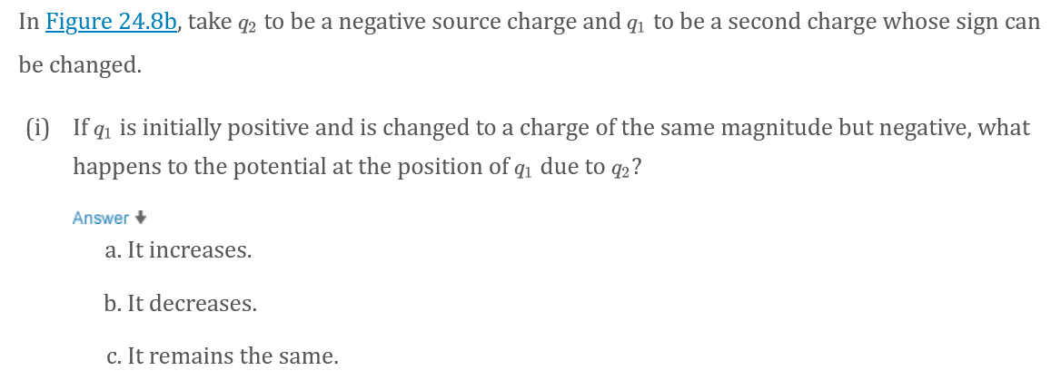
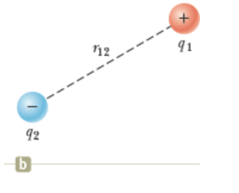
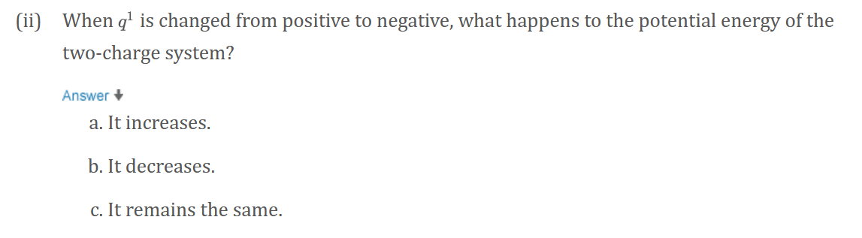
JIT Quick Quiz 24.3
Ans (i) c, (ii) a

Slide 18
Ans B
Notes:
Do same with potential energy

Slide 19
Ans A

Slide 20
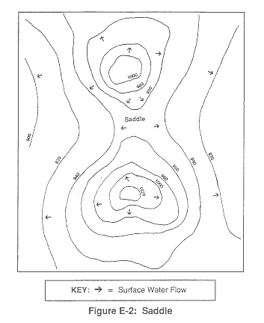
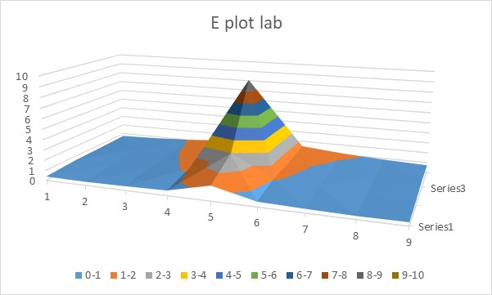
Equipotential Lines Are Like Topographical Maps
Regions of high potential are like “mountains”
  For positive charges, they have a lot of energy there
Regions of low potential are like “valleys”
  For positive charges, they have minimum energy there
Electric fields point down the slope
  Closely spaced equipotential lines means big electric field

Slide 21
Understanding Equipotential Lines
In the graph below, what type of charge is at X, and what at Y?
Positive, both places B) Positive at X, negative at Y
C) Negative at X, positive at Y D) Negative, both places
Positive charges don’t want to climb the high
mountain at Y
  Must be positive charge repelling
  them!
Positive charges want to flow into
low valley at X
  Must be negative charge attracting them!
Electric fields are perpendicular to equipotential surfaces
potentials in kV
-1
+1
0
-2
+2
-3
X
Y
-4
+4
+3

Slide 22
Conductors and Gauss’s Law
Conductors are materials where charges are free to flow in response to electric forces
The charges flow until the electric field is neutralized in the conductor
Inside a conductor, E = 0
Draw any Gaussian surface inside the conductor
In the interior of a conductor, there is no charge
The charge all flows to the surface
Notes:
Do all Warmup04
Conductors in equilibrium: (1) E zero inside, (2) charge on surface, (3) outside is sigma/eo, (4) greatest at point

Slide 23
Electric Field at Surface of a Conductor
Because charge accumulates on the surface of a conductor, there can be electric field just outside the conductor
Will be perpendicular to surface
We can calculate it from Gauss’s Law
Draw a small box that slightly penetrates
the surface
The lateral sides are small and have no flux through them
The bottom side is inside the conductor and has no electric field
The top side has area A and has flux through it
The charge inside the box is due to the surface charge σ
We can use Gauss’s Law to relate these
Notes:
, pg 700

Slide 24
Where does the charge go?
A hollow conducting sphere of outer radius 2 cm and inner radius 1 cm has q = +80π nC of charge put on it. What is the surface charge density on the inner surface? On the outer surface?
A) 20 nC/cm² B) 5 nC/cm² C) 4 nC/cm² D) 0
E) None of the above
The Gaussian surface is entirely contained in the conductor; therefore E = 0 and electric flux = 0
Therefore, there can’t be any charge on the inner surface
80π nC
1 cm
From the symmetry of the problem, the charge will be uniformly spread over the outer surface
2 cm
cutaway view
The electric field:
The electric field in the cavity and in the conductor is zero
The electric field outside the conductor can be found from Gauss’s Law
Notes:
Point charge q/4Pi eps0 w/ q = 80 pi. Note at r = 2 cm, sigma/eps0 is same: 20/4 cm^2

Slide 25
Ans B

Slide 26
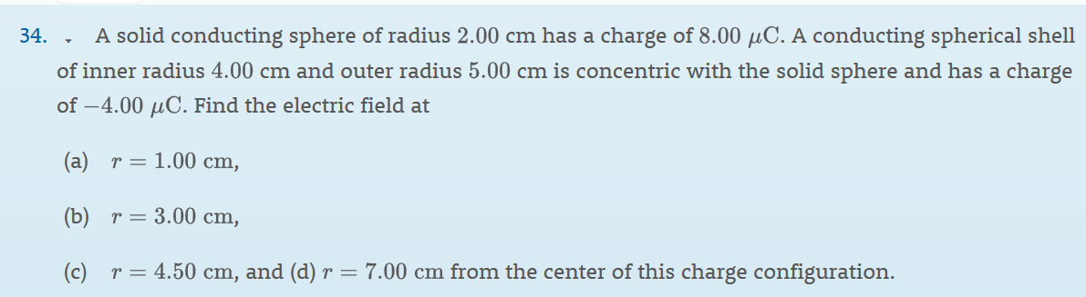
Serway 24-34
Solve on Board

Slide 27
Solve on Board
Notes:
Charges set up to neitralize field in conductor.

Slide 28
Conductors and Batteries
A conductor has zero electric field inside it
Therefore, conductors always have constant potential
A wire is a thin, flexible conductor: circuit diagram looks like this:
A switch is a wire that can be connected or disconnected
open switch
closed switch
A battery or cell is a device that creates a fixed potential difference
The circuit symbol for a battery looks like this:
  The long side is at higher potential
  It is labeled by the potential difference
1.5 V
0 V
What is the potential at point X?
A) 11 V B) -11 V C) +10 V
D) – 10 V E) +8 V F) -8 V
1 V
3 V
– 1 V
9 V
+ 8 V
X

Slide 29
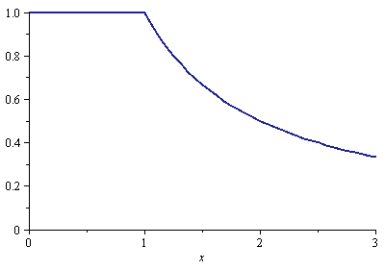
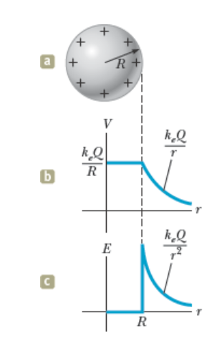
Conducting Spheres
Given the charge q on a conducting sphere of radius
R, what is the potential everywhere?
Outside the sphere, the electric field is the same as
for a point charge
Therefore, so is the potential
Inside, the potential is constant
It must be continuous at the boundary
q
R
JIT – Figure 24.21
Notes:
Do simple problem. Metal sphere with charge 2 microcoulombs and radius of 2 m. What is potential and E at 1 m and 3 m?
Think about work to get charge to surface – if big change in V, means a lot of work to get charge to surface – couldn’t do it.

Slide 30

Sample Problem
q₁
q₂
Two widely separated conducting spheres, of radii R₁ = 1.00 cm and R₂ = 2.00 cm, each have 6.00 nC of charge put on them. What is their potential? They are then joined by an electrical wire. How much charge do they each end up with, and what is the final potential?
After connections, their potentials must be equal
Notes:
Warmup 07 q1, q2, q3

Slide 31
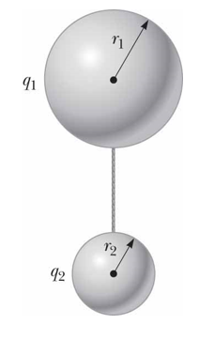
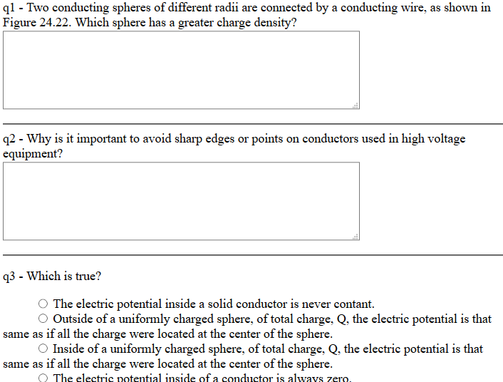
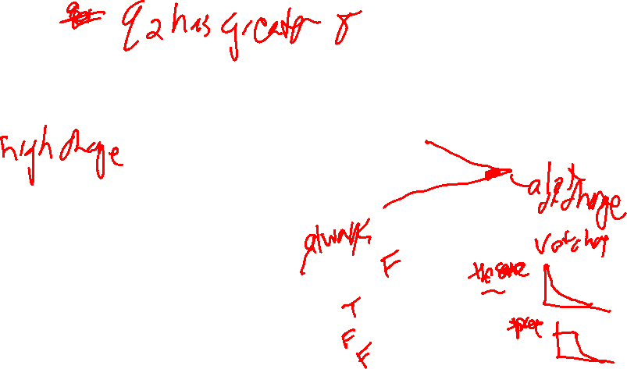
Warmup 07
Notes:
Fig 24.22 has two spheres with q1 and q2 and r1>r2.

Slide 32
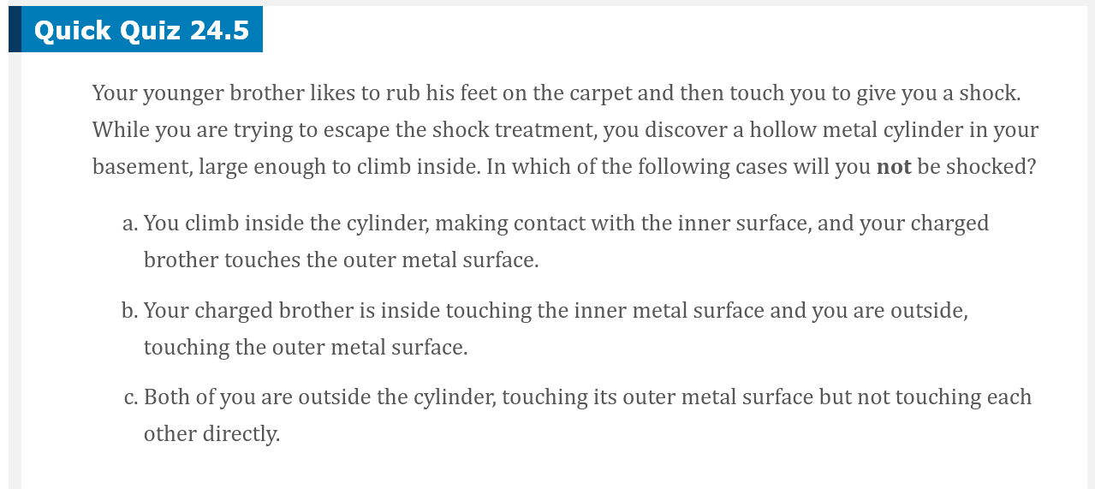
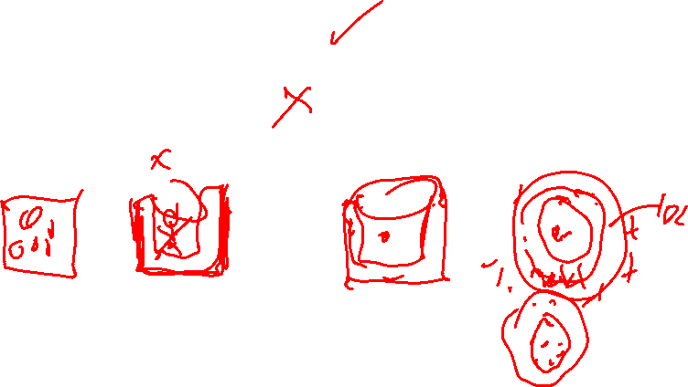
JIT
Ans A
Notes:
Figure 24.23 Va = Vb so intregral of Eds is zero regardless of path.
E is zero. Q inside is zero

Slide 33

Electric Fields near conductors
q₁
q₂
The potential for the two spheres ended up the same
The electric fields at the surface are not the same
The more curved the surface is, the higher the electric field is there
Very strong electric field here
A sharp point can cause charged particles to spontaneously be shed into air, even though we normally think of air as an insulator [ionize air]
Called “Corona discharge”

Slide 34
The Lightning Rod
Rain drops “rubbing” against the air can cause a separation of charge
This produces an enormous electric field
If electric field gets strong enough, it can cause breakdown of atmosphere
Put a pointy rod on top of the building you want to protect
Coronal discharge drains away the charge near the protected object
Lightning hits somewhere else
+
+
+
+
+
+
+
+
+
+
+
+
+
+
+
+
+
+
+
+
+

Slide 35
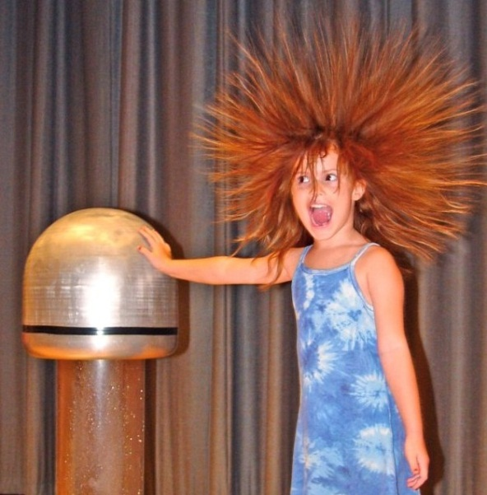
The Van de Graff Generator
Hollow conducting sphere, insulating belt, source of electric charge
Source causes charge to move to the belt
Belt rotates up inside sphere
Charge jumps to conductor inside sphere
Charge moves to outside of sphere
Since all the charge is on the outside of the sphere,
process can be repeated indefinitely.
-

