Slide 1
Capacitors and Dielectrics
Ch 25
Capacitors
Conductors are commonly used as places to store charge
You can’t just “create” some positive charge somewhere, you have to have corresponding negative charge somewhere else
Definition of a capacitor:
Two conductors, one of which stores charge +Q, and the other of which stores charge –Q.
Can we relate the charge Q that develops to the voltage difference ΔV?
Gauss’s Law tells us the electric field between the conductors
Integration tells us the potential difference
–Q
+Q
b
a
ΔV

Slide 2
Capacitance
The relationship between voltage difference and charge is always linear
This allows us to define capacitance
Capacitance has units of Coulomb/Volt
Also known as a Farad, abbreviated F
A Farad is a very large amount of capacitance
Let’s work it out for concentric conducting spheres:
What’s the capacitance of the Earth, if we put the “other part” of the charge at infinity?

Slide 3
Parallel Plate Capacitors
A
A “more typical” geometry is two large, closely spaced, parallel conducting plates
Area A, separation d.
Let’s find the capacitance:
Charge will all accumulate on the inner surface
Let +σ and –σ be the charges on each surface
As we already showed using Gauss’s law, this means there will be an electric field given by
If you integrate the electric field over the distance d, you get the potential difference
d
Circuit symbol for a capacitor:
To get a large capacitance, make the area large and the spacing small

Slide 4
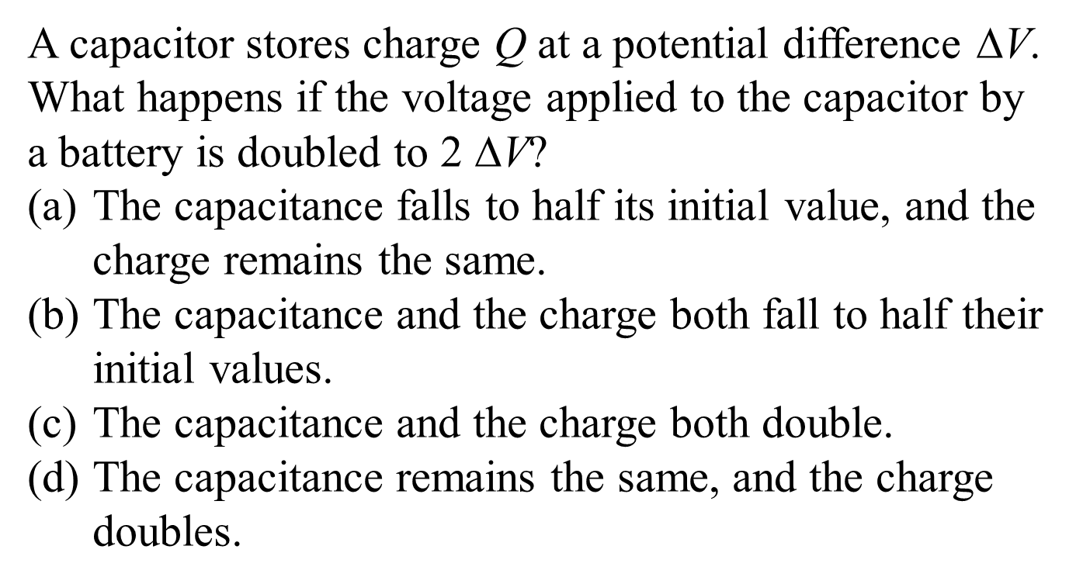
JIT – Quick Quiz 25.1
Ans d

Slide 5
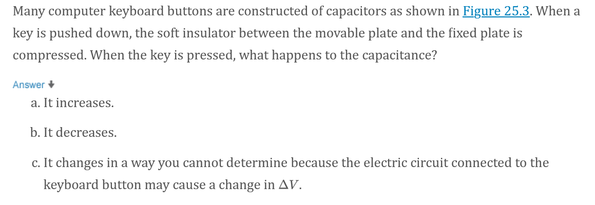
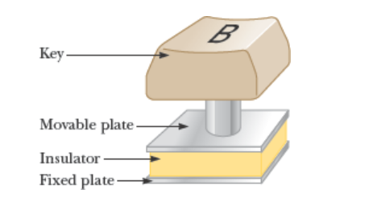
JIT – Quick Quiz 25.2
Ans A

Slide 6
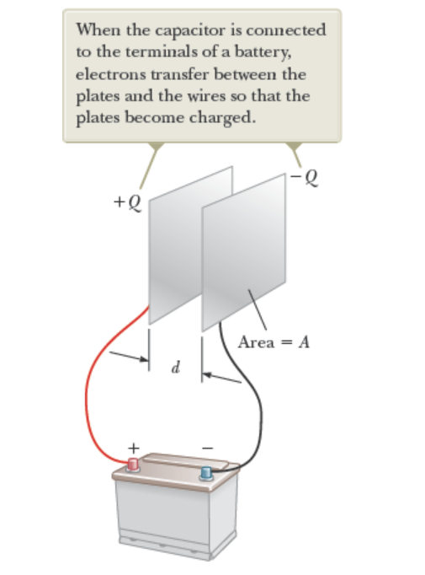
Warmup 08
JIT Figure 25.2 How does charge flow. Where do electrons come from?

Slide 7
Capacitors in Parallel
When we close the switch, how much charge flows from the battery?
A) 36 μC B) 4 μC C) 18 μC
D) 8 μC E) 10 μC
2 V
3 μF
6 μF
The voltage difference across each capacitor will be 2 V.
When capacitors are connected like this at both ends, we say they are connected in parallel
The combined capacitors act like a single capacitor with capacitance:

Slide 8
Capacitors in Series
ΔV₁
When we close the switch, which capacitor gets more charge Q on it?
A) The one with the bigger capacitance
B) The one with the smaller capacitance
C) They get the same amount of charge
D) Insufficient information
ΔV₂
+Q
-Q
+Q
-Q
ΔV
C₁
C₂
Charge flows to the left side of the first capacitor
Since capacitors have balanced charge, the right side must have the equal and opposite charge
The only place it can get this charge is the left side of the right capacitor
The charges on the second capacitor are also balanced
The voltage difference on each capacitor is not the same, since only one end is connected. But the charge is the same.
The two voltages differences can be added together

Slide 9
Warmup 08
Notes:
Q = CV, bigger C means bigger Q. C equivalent larger in parallel.

Slide 10
Series and Parallel
When two circuit elements are connected at one end, and nothing else is connected there, they are said to be in series
C₁
C₂
When two circuit elements are connected at both ends, they are said to be in parallel
C₁
C₂
These formulas work for more than two circuit elements as well.
C₄
C₂
C₃
C₁
C₅

Slide 11
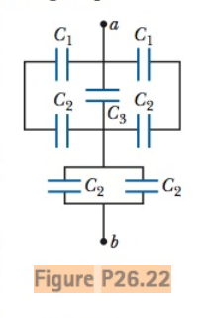
Which are parallel and which are in series?
C1 and C2 on top are in series – call Ceq1.
Ceq1 are in parallel with each other and C3. Call all these Ctop. On bottom, C2s are in parallel and the whole the bottom is then in series with top.

Slide 12
Ans B
Ans C
Ans A,B

Slide 13
Sample Problems
60 μF
What is the capacitance of the structure shown at left?
A) 180 μF B) 120 μF C) 30 μF
D) 20μF E) none of the above
60 μF
60 μF
They are connected end-to-end, so they are in series
Now add a wire across the middle. The two ends of the middle capacitor are at the same potential; therefore, there is no charge on this capacitor
You might as well ignore it

Slide 14
Complicated Capacitor Circuits
For complex combinations of capacitors, you can replace small structures by equivalent capacitors, eventually simplifying everything
The capacitance of the capacitors in pF below is marked.
What is the effective capacitance of all the capacitors shown?
Capacitors 1 and 5 are connected at both ends- therefore they are parallel
4
3
2
6
1
5
2
Capacitors 3 and 6 are connected at just one end – therefore they are series
10 V
All three capacitors are now connected at both ends – they are all in parallel

Slide 15
Solve on board (like ex 25.3)

Slide 16
Warmup09

Slide 17
Energy in a capacitor
Suppose you have a capacitor with charge q already on it, and you try to add a small additional charge dq to it, where dq is small. How much energy would this take?
The side with +q has a higher potential
Moving the charge there takes energy
The small change in energy is:
–q
+q
Now, imagine we start with zero charge and build it up gradually to q = Q
It makes sense to say an uncharged capacitor has U = 0
dq

Slide 18
Energy in a capacitor (2)
20 V
1 μF
2 μF
Capacitors in parallel have the same voltage difference ΔV
The larger capacitor has more energy
For each of the two circuits, which capacitor gets more energy in it?
A) The 1 μF capacitor in each circuit
B) The 2 μF capacitor in each circuit
C) The 1 μF capacitor in the top circuit, the 2 μF capacitor in the bottom circuit
D) The 2 μF capacitor in the top circuit, the 1 μF capacitor in the bottom circuit
E) They are equal in each circuit
20 V
1 μF
2 μF
Capacitors in series have the same charge Q
The smaller capacitor has more energy

Slide 19
Ans A

Slide 20
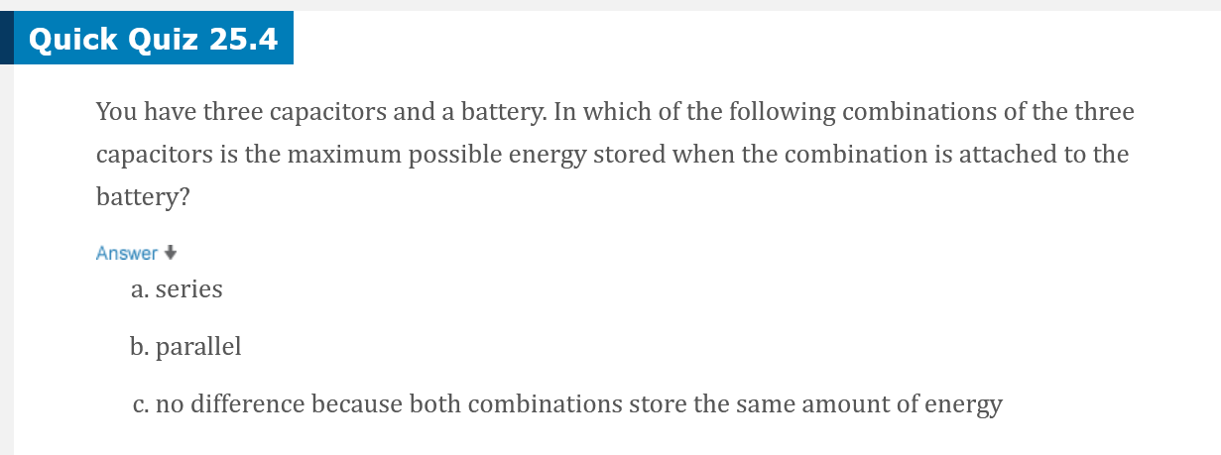
JIT
Ans B
Notes:
Sum of 1/2CV^2 and parallel has V across al while series is split

Slide 21
Energy density in a capacitor
Suppose you have a parallel plate capacitor with
area A, separation d, and charged to voltage ΔV.
(1) What’s the energy divided by the volume between the plates?
(2) Write this in terms of the electric field magnitude
Energy density is energy over volume
A
d
We can associate the energy with the electric field itself
This formula can be shown to be completely generalizable
It has nothing in particular to do with capacitors

Slide 22
Solve on Board

Slide 23
Warmup09

Slide 24
Dielectrics in Capacitors
––––––––––––
What should I put between the metal plates of a capacitor?
Goal – make the capacitance large
++++++++++++
+
+
The closer you put the plates together, the bigger the capacitance
It’s hard to put things close together – unless you put something between them
When they get charged, they are also very attracted to each other
Placing an insulating material – a dielectric – allows you to place them very close together
The charges in the dielectric will also shift
This partly cancels the electric field
Small field means smaller potential difference
C = Q/ΔV, so C gets bigger too
+
+
+
+
+
+
+
+
+
+

Slide 25
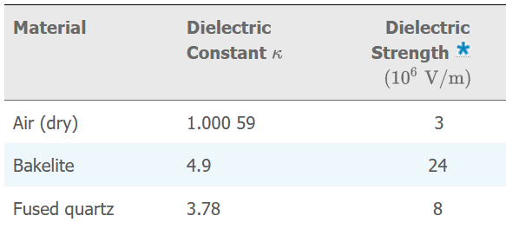
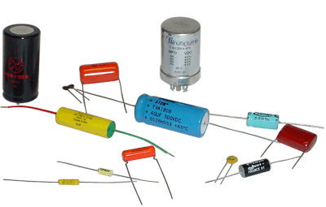
Choosing a dielectric
What makes a good dielectric?
Have a high dielectric constant κ
The combination κε₀ is also called ε, the permittivity
Must be a good insulator
Otherwise charge will slowly bleed away
Have a high dielectric strength
The maximum electric field at which the insulator suddenly (catastrophically) becomes a conductor
There is a corresponding breakdown voltage where the capacitor fails
JIT.
Given dielectric strength. Calculate breakdown voltage
For parallel plates :

Slide 26
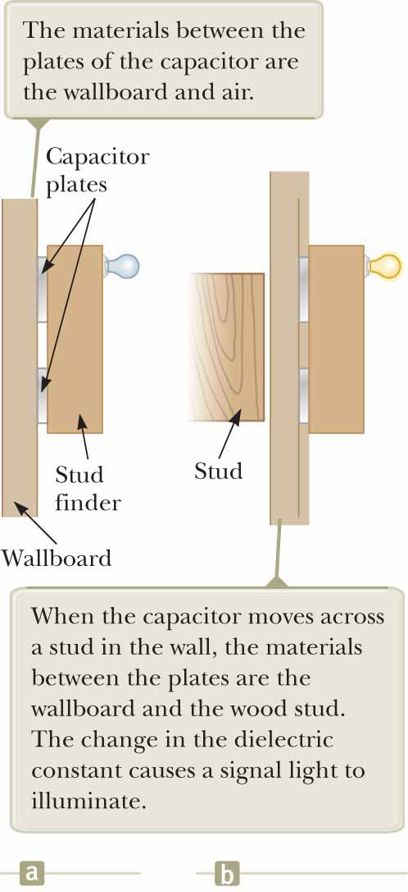
Quick Quiz 25.5 (JIT)
If you have ever tried to hang a picture or a mirror, you know it can be difficult to locate a wooden stud in which to anchor your nail or screw. A carpenter’s stud finder is a capacitor with its plates arranged side by side instead of facing each other as shown in the figure. When the device is moved over a stud, does the capacitance
increase or
decrease?
Notes:
The dielectric constant of wood (and of all other insulating materials, for that matter) is greater than 1; therefore, the capacitance increases (C = κC₀). This increase is sensed by the stud finder’s special circuitry, which causes an indicator on the device to light up.

Slide 27
Consider isolated capacitor
Ans B
Consider isolated capacitor after charging
Ans A
Ans A

Slide 28
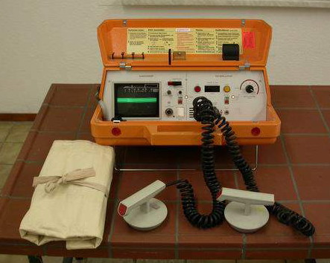
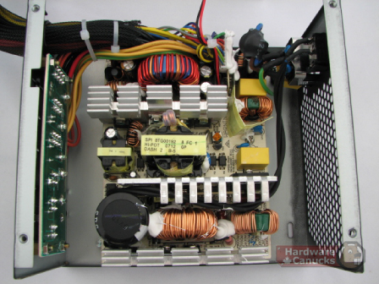
What are capacitors good for?
They store energy
The energy stored is not extremely large, and it tends to leak away over time
Gasoline or fuel cells are better for this purpose
They can release their energy very quickly
Camera flashes, defibrillators, research uses
They resist changes in voltage
Power supplies for electronic devices, etc.
They can be used for timing, frequency filtering, etc.
In conjunction with other parts

