Slide 1
Current and Resistance
CH 26
Current Density and Drift Velocity
Perfect conductors carry charge instantaneously from here to there
Perfect insulators carry no charge from here to there, ever
Real substances always have
some density n of charges q
that can move, however slowly
  Usually electrons
When you turn on an electric
field, the charges start to move with average velocity v_{d}
  Called the drift velocity
J
Why did I draw J to the right?
There is a current density J associated with this motion of charges
  Current density represents a flow of charge
Note: J tends to be in the direction of E, even when v_{d} isn’t

Slide 2
Current Density
Assume in each of the figures below, the number of charges drawn represents the actual density of charges moving, and the arrows represent equal drift velocities for any moving charges. In which case is there the greatest current density going to the left?
A
B
-
-
-
+
+
-
+
+
-
+
-
+
-
-
+
+
+
+
-
-
C
D
-
-
-
+
+
+
+
-
-
+
-
-
+
-
+
+
+
+
-
-

Slide 3
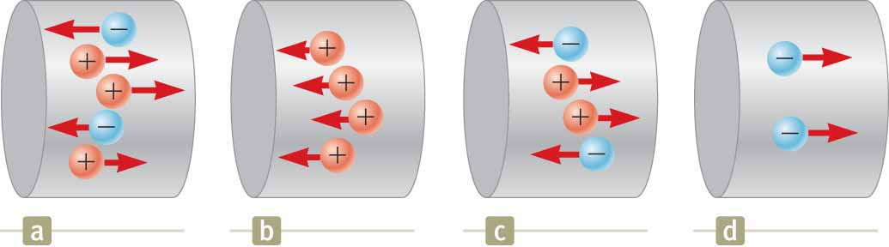
Quick Quiz 26.1
JIT
Consider positive and negative charges of equal magnitude moving horizontally through the four regions shown in the figure. Rank the current in these four regions from highest to lowest.
(a) > (b) = (c) > (d)

Slide 4
Ohm’s Law: Microscopic Version
In general, the stronger the electric field, the faster the charge carriers drift
The relationship is often proportional
Ohm’s Law says that it is proportional
  Ohm’s Law doesn’t always apply
The proportionality constant, denoted ρ, is called the resistivity
  It has nothing to do with charge density, even though it has the same symbol
  It depends (strongly) on the substance used and (weakly) on the temperature
Resistivities vary over many orders of magnitude
  Silver: ρ = 1.59×10⁻⁸ Ω⋅m, a nearly perfect conductor
  Fused Quartz: ρ = 7.5×10¹⁷ Ω⋅m, a nearly perfect insulator
  Silicon: ρ = 640 Ω⋅m, a semi-conductor
Ignore units for now

Slide 5


Current
It is rare we are interested in the microscopic current density
We want to know about the total flow of charge through some object
J
The total amount of charge flowing out of an object per unit time is called the current
  What are the units of I?
$$∼\frac{C⋅\left(\text{m}\text{/}\text{s}\right)m^{2}}{m^{3}}$$
$$I∼\frac{C}{s}=A$$
The ampere or amp (A) is 1 C/s
Current represents a change in charge
Almost always, this charge is being replaced somehow, so there is no accumulation of charge anywhere

Slide 6
Solve on Board

Slide 7
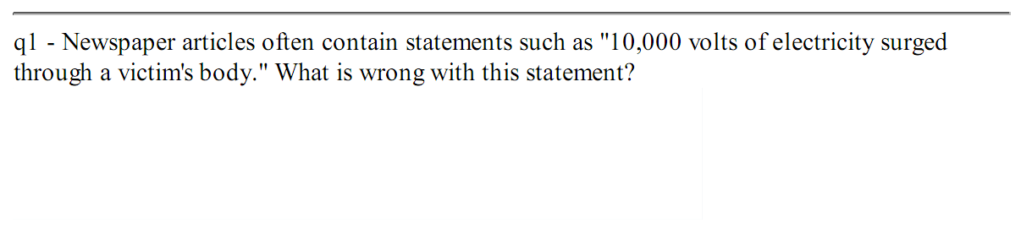
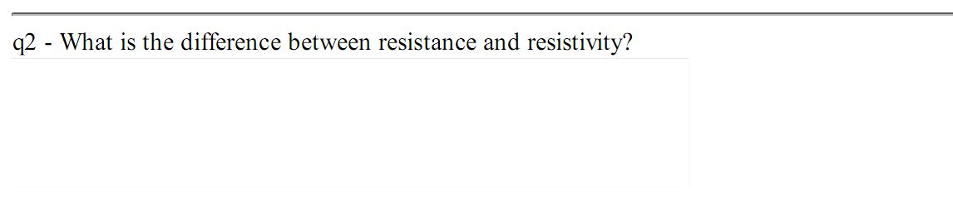
Warmup 10

Slide 8

Ohm’s Law for Resistors
Suppose we have a cylinder of material with conducting endcaps
  Length L, cross-sectional area A
  The material will be assumed to follow Ohm’s Microscopic Law
L
Apply a voltage ΔV across it
Define the resistance as
Then we have Ohm’s Law for devices
  Just like microscopic Ohm’s Law, doesn’t always work
Resistance depends on composition, temperature and geometry
  We can control it by manufacture
Resistance has units of Volts/Amps
  Also called an Ohm (Ω)
  An Ohm isn’t much resistance
Circuit diagram for resistor
$$R∼\frac{V}{A}=Ω$$

Slide 9
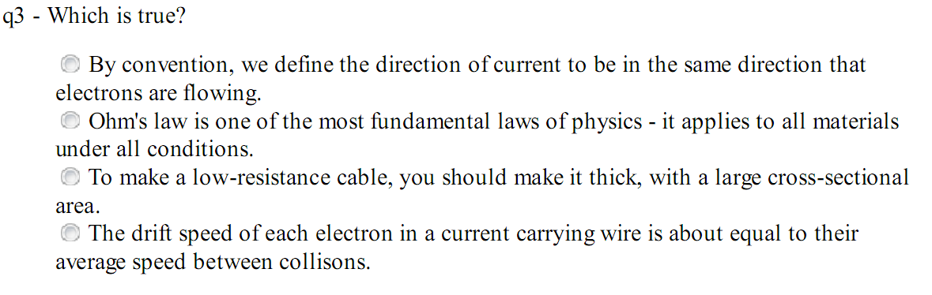
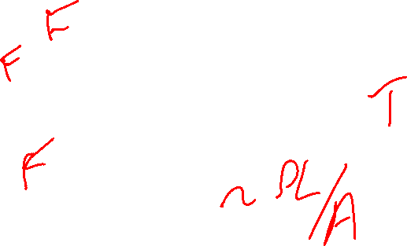
Warmup 10

Slide 10
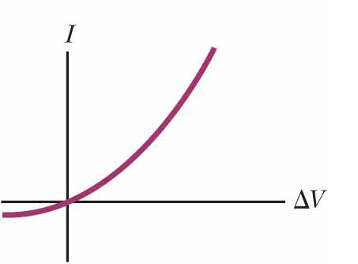
Quick Quiz 26.3
JIT
In the figure, as the applied voltage increases, does the resistance of the diode
increase,
decrease, or
remain the same?
b

Slide 11
Ohm’s Law and Temperature
Resistivity depends on composition and temperature
If you look up the resistivity ρ for a substance, it would have to give it at some reference temperature T₀
  Normally 20°C
For temperatures not too far from 20 °C, we can hope that resistivity will be approximately linear in temperature
  Look up ρ₀ and α in tables
For devices, it follows there will also be temperature dependence
The constants α and T₀ will be the same for the device
for tungsten, 0.0045 1/K
α for carbon, -0.005 1/K

Slide 12
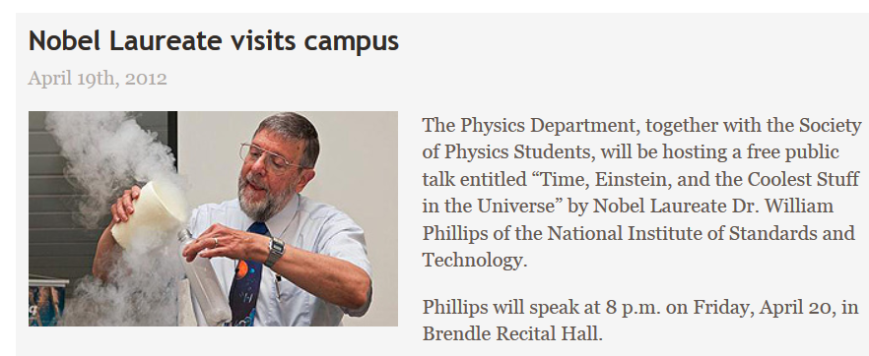



Slide 13
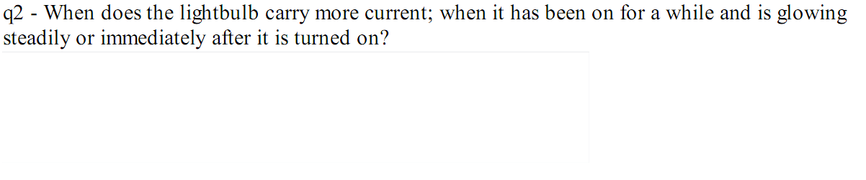
Warmup10b
This is basically Quick Quiz 26.4. Ans immediately (R lower).
Notes:
V = IR. R increases as it heats up, I decreases.

Slide 14
Sample Problem
Platinum has a temperature coefficient of α = 0.00392/°C. A wire at T = T₀ = 20.0°C has a resistance of R = 100.0 Ω. What is the temperature if the resistance changes to 103.9 Ω?
A) 0°C B) 10°C C) 20°C D) 30°C E) 40°C
F) None of the above

Slide 15
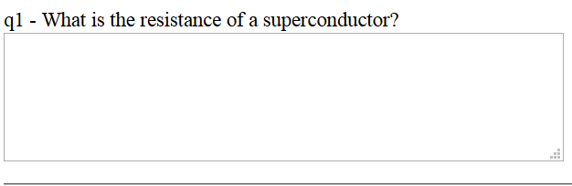

Warmup10b

Slide 16
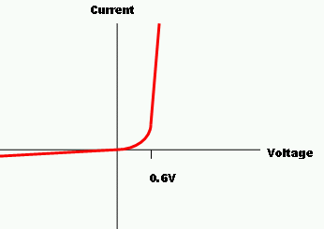
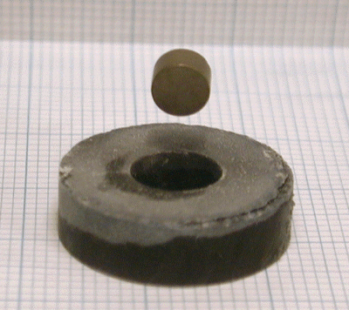
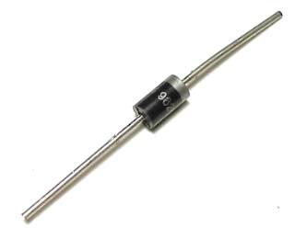
Non-Ohmic Devices
Some of the most interesting devices do not follow Ohm’s Law
Diodes are devices that let current through one way much more easily than the other way
Superconductors are cold materials that have no resistance at all
  They can carry current forever with no electric field

Slide 17
Power and Resistors
The charges flowing through a resistor are having their potential energy changed
ΔQ
Where is the energy going?
The charge carriers are bumping against atoms
They heat the resistor up
ΔV

Slide 18
Ans B
Ans A

Slide 19
Sample Problem
P = 100 W
Two “resistors” are connected to the same 120 V circuit, but consume different amounts of power. Which one has the larger resistance, and how much larger?
A) The 50 W has twice the resistance
B) The 50 W has four times the resistance
C) The 100 W has twice the resistance
D) The 100 W has four times the resistance
P = 50 W
ΔV = 120 V
The potential difference is the same across them both
The lower resistance one has more power
The one with twice the power has half the resistance

Slide 20
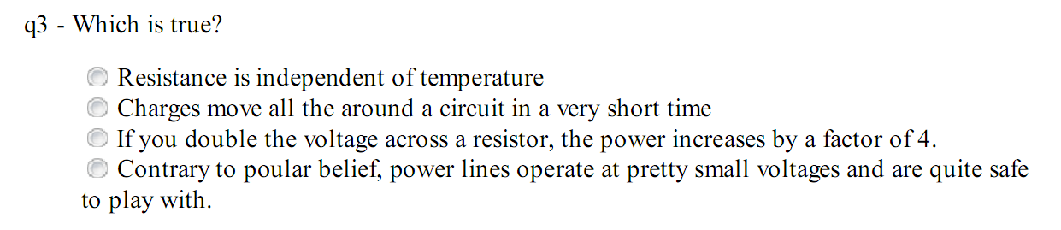
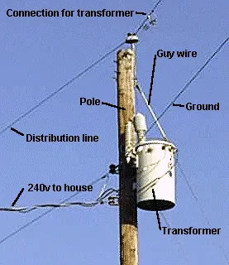
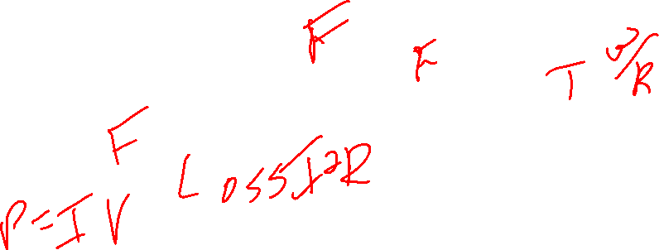
Warmup10b
Notes:
transformers and high voltage
Copper wires high R, Choose IV rather than I^2R, low current, high voltage. 7.5 kV

Slide 21
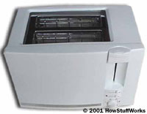
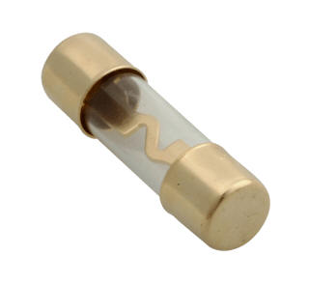

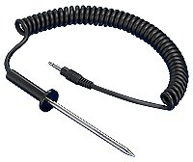
Uses for resistors
You can make heating devices using resistors
  Toasters, incandescent light bulbs, fuses
You can measure temperature by measuring changes in resistance
  Resistance-temperature devices
Resistors are used whenever you want a linear relationship between potential and current
  They are cheap
  They are useful
  They appear in virtually every electronic circuit

