Slide 1
Magnetic Sources
Ch. 29
Magnetic fields go around the wire – they are perpendicular to the direction of current
Magnetic fields are perpendicular to the separation between the wire and the point where you measure it - Sounds like a cross product!
The Biot-Savart Law
=
r
I
ds
Permeability of free space
The Amp is defined to work out this way

Slide 2
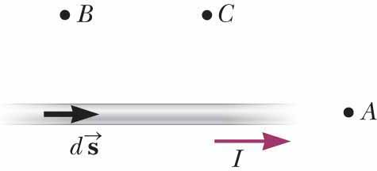
Quick Quiz 29.1
JIT
B > C > A
Notes:
Point B is closest to the current element. Point C is farther away, and the field is further reduced by the sinθ factor in the cross product ds × r. The field at A is zero because θ = 0.

Slide 3
Sample Problem
A loop of wire consists of two quarter circles of radii R and 2R, both centered at a point P, and connected with wires going radially from one to the other. If a current I flows in the loop, what is the magnetic field at the point P?
ds
ds
I
ds
Do one side at a time
First do one of the straight segments
ds and r-hat are parallel
No contribution to the integral
Other straight segment is the same
P
ds
R
2R
Now do inner quarter loop (assume x-y)
Outer loop opposite direction, similar

Slide 4
Magnetic Field from a Finite Wire
Magnetic field from a finite straight wire:
Let a be the distance the point is from the wire
Let x be the horizontal separation
P
a
Skip
Derivation
r
θ₁
ds
θ₂
-x₁
O
x
I
x₂
Warning: My θ differs from that of the book

Slide 5
Magnetic Field from a Wire
Magnitude is found from the formula
Direction is found from the right hand rule
Place thumb in direction of current flow
Fingers curl in direction of B-field
Infinite wire:
Angles are simple
a
θ₁
θ₂
I
Two wires have the same current I flowing through them. If we want the magnetic field between them to be large and up, we should have the current in the upper one flow _____ and the lower one ______
A) Left , Right B) Left, Left
D) Right, Left E) Right, Right

Slide 6
MCAT question
Ans D

Slide 7
Ans E

Slide 8
Sample problem
I
A regular hexagon whose center is a distance a = 1 cm from the nearest side has current I = 4.00 A flowing around it. The current flows N = 500 times around. What is the total magnetic field at the center?
60°
a
60°
60°
Draw in the two directions from the center to the corners of one segment
Top angle is one-sixth of a circle, or 60 degrees
Total angles in circle is 180, so other two angles are 60 each
Use formula to get magnetic field – right hand rule says up.
Multiply by all six side, and then by 500 cycles

Slide 9
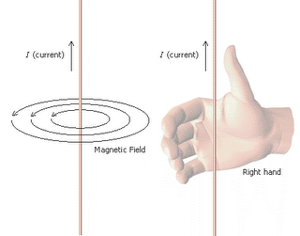
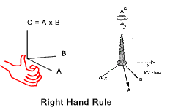
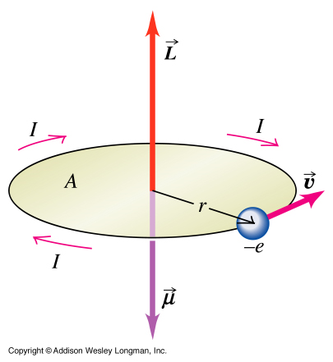
Right Hand Rule for Loops
I
If you curl your fingers in the direction the current flows, thumb points in direction of B-field inside the loop
Works for solenoids too (later)
B
Curl fingers around I and Thumb point to Mag dipole moment.
Also gives B inside a loop

Slide 10
Warmup 14

Slide 11
Force Between Parallel Wires
I₁
I₂
F
d
L
One wire – infinite – creates a magnetic field
Other wire – finite or infinite – feels the force
Attractive if current is parallel, repulsive if anti-parallel

Slide 12
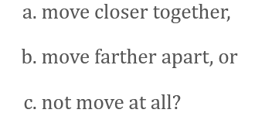
JIT Quick Quiz 29.2
Ans A

Slide 13
Ans B

Slide 14
Ans D

Slide 15
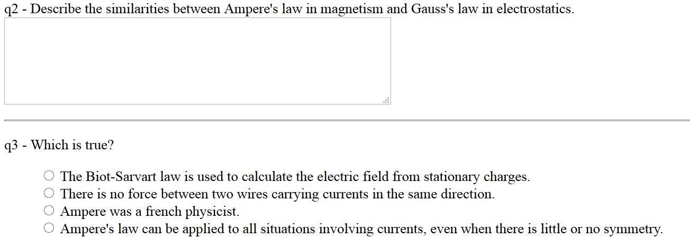
Warmup 14

Slide 16
Ampere’s Law (original recipe)
Suppose we have a wire coming out of the plane
Let’s integrate the magnetic field around a closed path
There’s a new symbol for such an integral
Circle means “over a closed loop”
The magnetic field is parallel to direction of integration
$$\oint{B⋅ds}$$
$$=B\oint{ds}$$
ds
ds cosθ
What if we pick a different path?
dφ
r
$$=\oint{\left(\frac{μ_{0}I}{2πr}\right)rdφ}$$
$$\oint{B⋅ds}$$
$$=\oint{Bds\cos{θ}}$$
I
$$\oint{B⋅ds}=μ_{0}I$$
We have demonstrated this is true no matter what path you take
We don’t even need a straight infinite wire
All that matters is that current passes through the closed Ampere loop

Slide 17
Understanding Ampere’s Law
If multiple currents flow through, add up all that are inside the loop
Use right-hand rule to determine if they count as + or –
Curl fingers in direction of Ampere loop
If thumb points in direction of current, plus, otherwise minus
The wire can be bent, the loop can be any shape, even non-planar
$$\oint{B⋅ds}=μ_{0}I$$
There are currents going in and out of the screen as sketched at right. What is the ingtegral of the magnetic field around the path sketched in purple?
A) μ₀(11 A) B) μ₀(-11 A) C) μ₀(3 A)
D) μ₀(-3 A) E) None of the above
1 A
2 A
4 A
5 A
7 A
Right hand rule causes thumb to point down
Downward currents count as +, upwards as –
Note. If point thumb in direction of net current and sum in direction of curled fingers, sum will be positive – B points in that direction.
$$\oint{B⋅ds}=μ_{0}\left(4 \text{A}−2 \text{A}−5 \text{A}\right)$$

Slide 18
JIT Quick Quiz 29.3
Ans c>a>d>b

Slide 19
JIT Quick Quiz 29.4
Ans a=c=d>b

Slide 20
Using Ampere’s Law
Ampere’s Law can be used – rarely – to calculate magnetic fields
Need lots of symmetry – usually cylindrical
A wire of radius a has total current I distribu-ted uniformly across its cross-sectional area. Find the magnetic field everywhere.
I
I
End-on view
Draw an Ampere loop outside the wire – it contains all the current
Magnetic field is parallel to the direction of this loop, and constant around it
Use Ampere’s Law
But we used a loop outside the wire, so we only have it for r > a
$$μ_{0}I=\oint{B⋅ds}$$
$$=B\oint{ds}$$

Slide 21
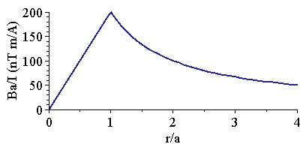
Using Ampere’s Law (2)
Now do it inside the wire
Ampere loop inside the wire does not contain all the current
The fraction is proportional to the area
a
$$μ_{0}I_{r}=\oint{B⋅ds}$$
End-on view

Slide 22
Warmup 15

Slide 23
Solenoids
Consider a planar loop of wire – any shape – with a current I going around it
Now, stack many, many such loops
Treat spacing as very closely spaced
Assume stack is tall compared to size of loop
Outside, most of the field cancels for ideal solenoid (long, thin, tightly packed)

Slide 24
Field Inside a Solenoid
It remains only to calculate the magnetic field inside
We use Ampere’s law
Recall, neglible B-field outside
$$μ_{0}I_{\text{tot}}=\oint{B⋅ds}$$
There may be many (N) current loops within this Ampere loop
Let n = N/L be loops per unit length
L
Works for any shape solenoid, not just cylindrical
For finite length solenoids, there are “end effects”

Slide 25
JIT Quick Quiz 29.5
Consider a solenoid that is very long compared with its radius. Of the following choices, what is the most effective way to increase the magnetic field in the interior of the solenoid?
double its length, keeping the number of turns per unit length constant
reduce its radius by half, keeping the number of turns per unit length constant
overwrap the entire solenoid with an additional layer of current-carrying wire
Ans C

Slide 26
Magnetic Flux
Magnetic flux is defined exactly the same way for magnetism as it was for electricity
A cylindrical solenoid of radius 10 cm has length 50 cm and has 1000 turns of wire going around it. What is the magnetic field inside it, and the magnetic flux through it, when a current of 2.00 A is passing through the wire?
A Tesla meter² is also called a Weber (Wb)

Slide 27
Gauss’s Law for Magnetism
Magnetic field lines always go in circles – there are no magnetic monopole sources
For closed surfaces, any flux in must go out somewhere else
$$Φ_{B}≡\oint{B⋅\hat{n}dA}=0$$
A regular tetrahedron (four sides, all congruent) has a cylin-drical magnet placed in the middle of the bottom face. There is a total of 0.012 T⋅m² of magnetic flux entering the bottom face. What is the total flux from one of the three top faces?
A) 0.006 T ⋅m² B) 0.004 T ⋅m² C) 0.003 T ⋅m²
D) 0.012 T ⋅m² E) None of the above
Flux in bottom must equal total flux out other three sides
Other three sides must have equal flux, by symmetry
Sign of entering flux is negative

Slide 28
Ans D

Slide 29
Solve on Board

Slide 30
Warmup 15
http://www.youtube.com/watch?v=A1vyB-O5i6E

