Slide 1
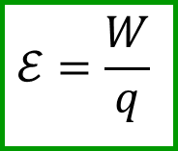
Faraday's Law
Ch. 30
Electromotive Force Revisited
When we say something has energy, it can do work
Electric potential is the potential energy per unit charge: the amount of
  work doable per unit charge
The amount of work a device can supply per unit charge is the electromotive force (EMF)
  Denoted ε
$$ℰ=\frac{W}{q}$$

Slide 2
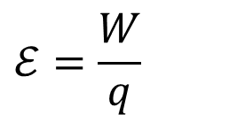
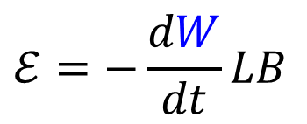
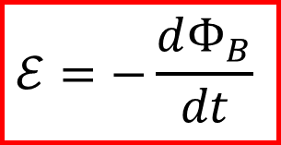
Motional EMF
v × B
W
Suppose you have the following circuit in
the presence of a magnetic field
  Charges inside the cylinder
Now let cylinder move
Moving charges inside conductor feel force
Force transport charges – it is capable of doing work
This force is like a battery - it produces EMF
v
L
B
$$ℰ=\frac{W}{q}$$
v is the rate of change of the width W
We can relate this to the change in magnetic flux
$$ℰ=−\frac{dΦ_{B}}{dt}$$
$$ℰ=−\frac{dW}{dt}LB$$

Slide 3
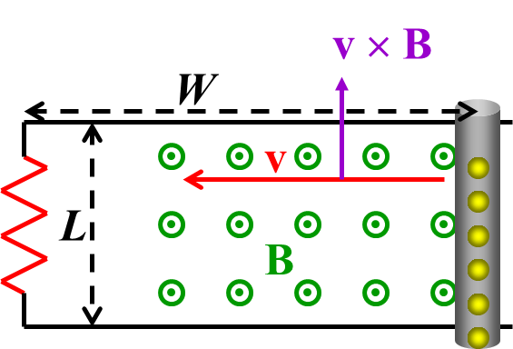
Lenz’s Law
Force on charges in rod move them upward gives counter-clockwise current.
Counter clockwise current increases flux through loop
The magnetic field of an induced current opposes the change that produced it.

Slide 4
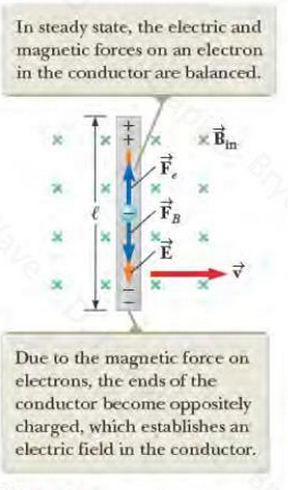
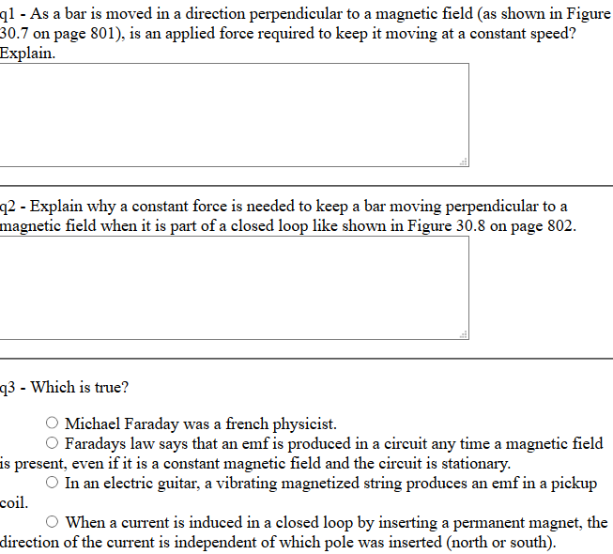
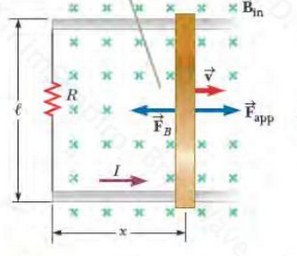
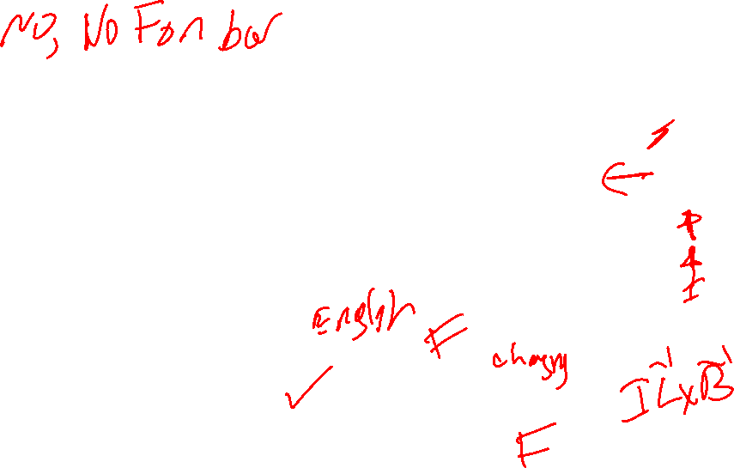
Warmup 16

Slide 5
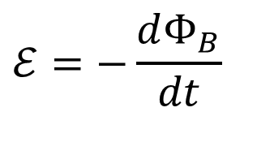
Concept questions
A wire, initially carrying no current, has a radius that starts decreasing at t = 0. As it shrinks, which way does current begin to flow in the loop?
A) Clockwise B) Counter-clockwise C) No current
D) Insufficient information
$$ℰ=−\frac{dΦ_{B}}{dt}$$
Flux into screen is decreasing.
Want to increase it to oppose that.

Slide 6
JIT Quick Quiz 30.1
Ans C

Slide 7
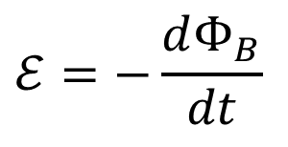
Lenz’s Law
As the wire shrunk, the magnetic flux decreased
But the wire acquired a current,
which tried to increase it
The induced current in a loop is in the direction that opposes the change in magnetic flux through the area enclosed by the loop
Current loops resist change
$$ℰ=−\frac{dΦ_{B}}{dt}$$
Move loop to the right
Current flows to maintain B-field
Current dies away
Move loop to the left
Current flows to kill B-field
Current dies away

Slide 8

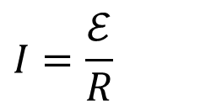

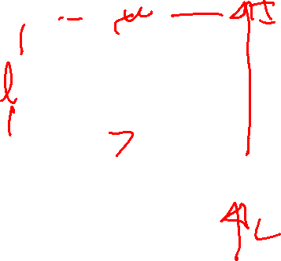

Power and Motional EMF
Resistor feels a voltage – current flows
$$ℰ=vLB$$
$$I=\frac{ℰ}{R}$$
v
$$𝒫=Iℰ$$
R
L
F
Where does the power come from?
Current is in a magnetic field
B
To get it to move, you must oppose this force
You are doing work
$$=Iℰ$$
The power dissipated in the resistor matches the mechanical power you must put in to move the rod

Slide 9
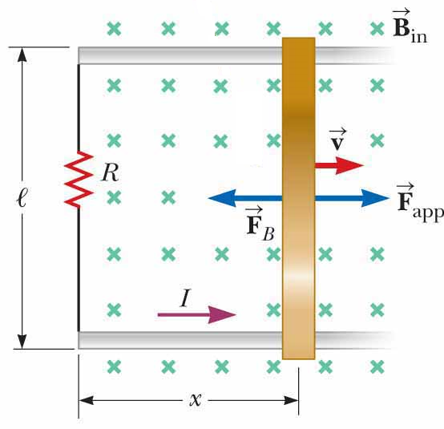
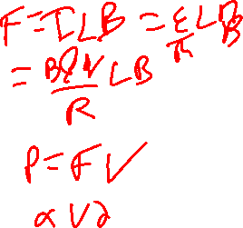
JIT Quick Quiz 30.2
In the figure, a given applied force of magnitude F results in a constant speed v and a power input P. Imagine that the force is increased so that the constant speed of the bar is doubled to 2v. Under these conditions, what are the new force and the new power input?
2F and 2P
4F and 2P
2F and 4P
4F and 4P
Ans C
Notes:
The force on the wire is of magnitude F_{app} = FB = IℓB, with I given by I = Bℓv/R. Therefore, the force is proportional to the speed and the force doubles. Because P = F_{app}v, the doubling of the force and the speed results in the power being four times as large.

Slide 10
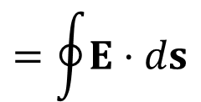
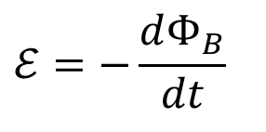
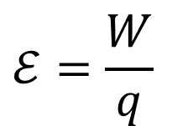
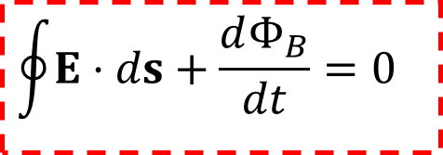
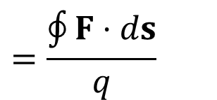
Electric Fields from Faraday
We can generate electromotive force – EMF – by moving the loop in and out of magnetic field
Can we generate it by moving the magnet?
Magnet
$$ℰ=−\frac{dΦ_{B}}{dt}$$
Faraday’s Law works whether the wire is moving or the B-field is changing*
How can there be an EMF in the wire in this case?
  Charges aren’t moving, so it can’t be magnetic fields
  Electric fields must be produced by the changing B-field!
The EMF is caused by an electric field that points around the loop
$$ℰ=\frac{W}{q}$$
$$=\frac{\oint{F⋅ds}}{q}$$
$$=\oint{E⋅ds}$$
$$\oint{E⋅ds}+\frac{dΦ_{B}}{dt}=0$$

Slide 11
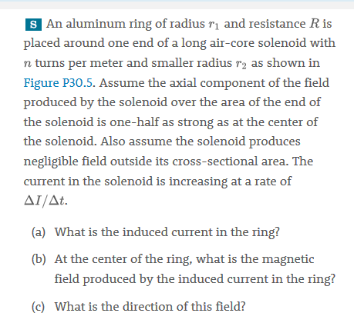
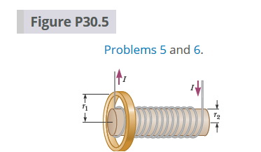
Solve on Board

Slide 12
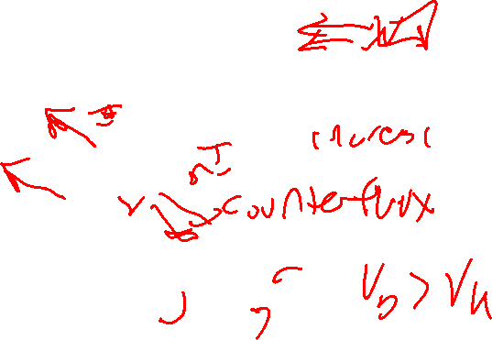
Ans B

Slide 13
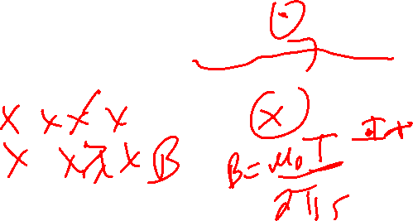
This is like Quick quiz 30.3
Ans B

Slide 14
Solve on Board

Slide 15
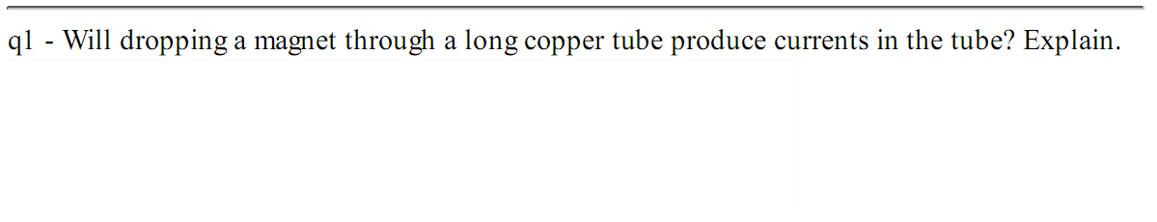
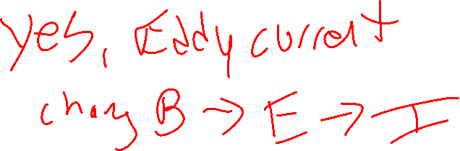
Warmup 17

Slide 16
Eddy Currents
S
N
What happens as I drop the magnet into the copper tube (Compare to if drop equivalent non-magnet)?
A) Falls as usual B) Falls slower
C) Falls faster D) Floats constant
E) Pops back up and out
S
N
As magnet falls, some places have magnetic fields that diminish
Current appears, replacing magnetic field
This acts like a magnet, pulling it back up
At bottom end, current appears to oppose change
This repels the magnet, slowing it down
N
S
Current is only caused by motion of magnet
  If motion stops, resistance stops current
If motion is small, opposition will be small
It doesn’t stop, it goes slowly

Slide 17
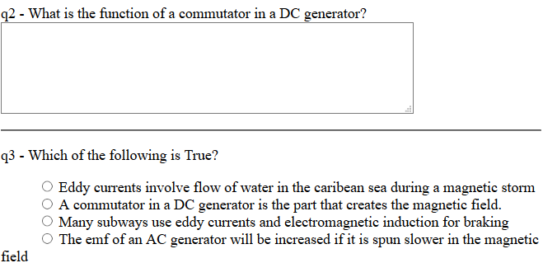
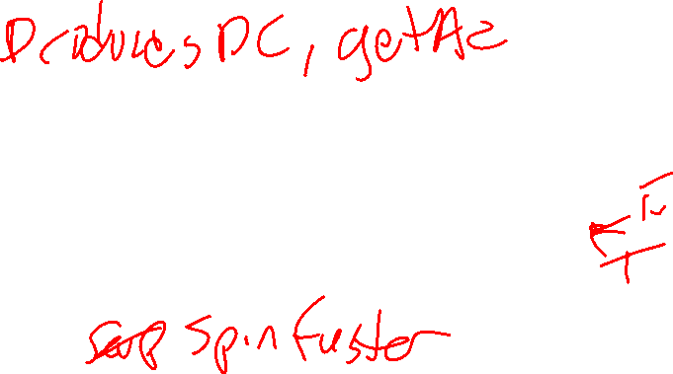
Warmup 17

Slide 18
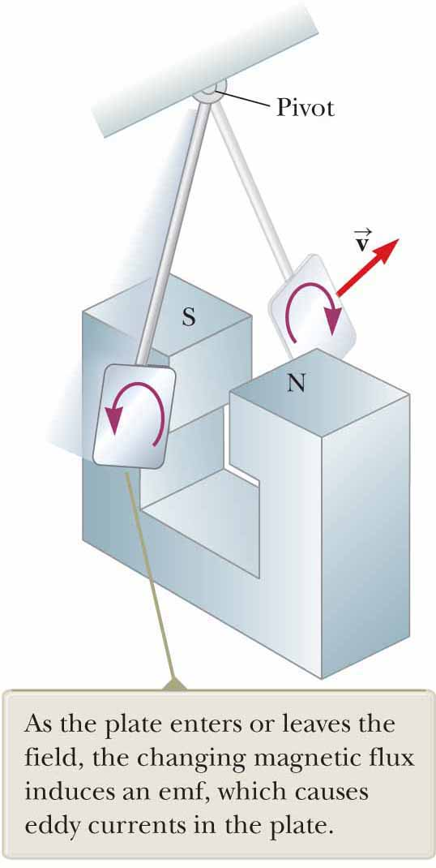
Eddy Currents, braking
Notes:
Recall: emf and current induced in loop of wire by changing magnetic flux
Imagine plate of metal (figure)
Consider plate as concentric circular conducting loops of various radii
Circulating currents (eddy currents) induced in bulk pieces of metal moving through magnetic field
Imagine plate swings back and forth through magnetic field
As plate enters field:
Changing magnetic flux induces emf in plate
Causes free electrons in plate to move
Producing swirling eddy currents
Lenz’s law: direction of eddy currents → they create magnetic fields that oppose change that causes currents
Eddy currents must produce effective magnetic poles on plate
Which are repelled by poles of magnet
Result: repulsive force that opposes motion of the plate
If opposite were true: plate would accelerate and its energy would increase after each swing
Violation of law of conservation of energy

Slide 19
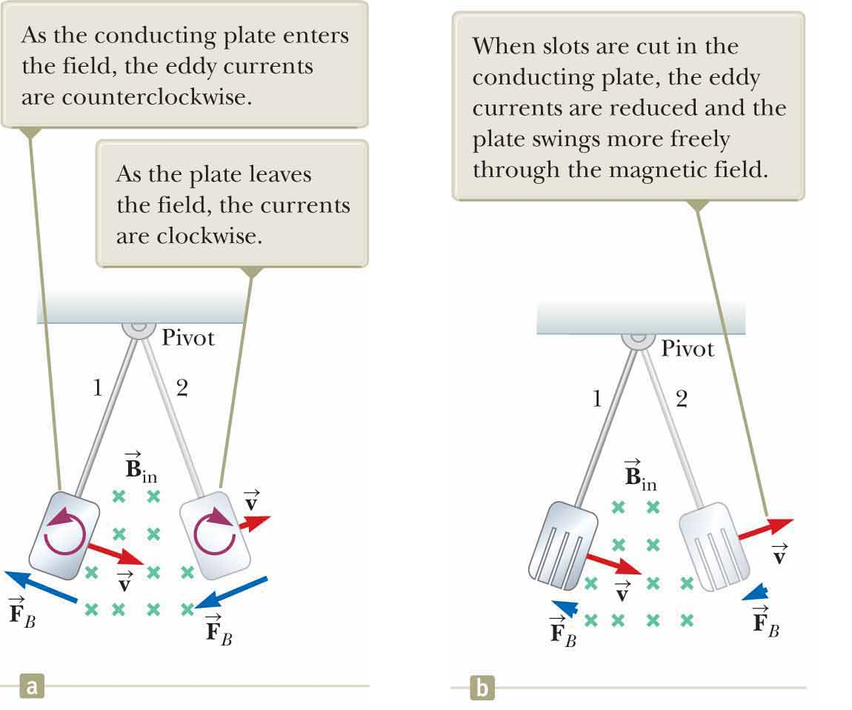
Eddy Currents
Notes:
Figure (a): B directed into page →
Induced eddy current counterclockwise as swinging plate enters field at position 1
Flux due to external magnetic field into screen through plate increasing
Lenz’s law:
Induced current must provide its own magnetic field out of screen
Opposite true as plate leaves field at position 2
Current clockwise
Because induced eddy current always produces magnetic retarding force F_{B} when plate enters or leaves field:
Swinging plate eventually comes to rest
If slots cut in plate (figure (b)):
Many conducting loops in plate cut
Eddy currents and corresponding retarding force greatly reduced
Braking systems on many subway and rapid-transit cars make use of electromagnetic induction and eddy currents
Electromagnet attached to train positioned near steel rails
Electromagnet = solenoid with iron core
Braking action occurs when large current passes through electromagnet
Relative motion of magnet and rails induces eddy currents in rails
Direction of currents produces drag force on moving train
Because eddy currents decrease steadily in magnitude as train slows down →
Braking effect smooth
As safety measure: some power tools use eddy currents to stop rapidly spinning blades once device turned off
Eddy currents often undesirable:
Represent transformation of mechanical energy to internal energy in resistance of metal
To reduce energy loss → conducting parts often laminated;
Built up in thin layers separated by nonconducting material (e.g., lacquer or a metal oxide)
Layered structure prevents large current loops
Effectively confines currents to small loops in individual layers
Used in transformer cores and motors to minimize eddy currents →
Increase efficiency of these devices

Slide 20
How to make an AC generator
Have a background source of magnetic fields, like permanent magnets
Add a loop of wire, attached to an axle that can be rotated
Add “slip rings” that connect the rotating loop to outside wires
Rotate the loop at angular frequency ω
Magnetic flux changes with time
This produces EMF
To improve it, make the loop repeat many (N) times
A

Slide 21
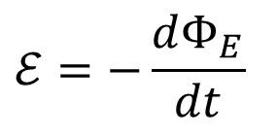
Sample Problem
A rectangular loop of wire 20 cm by 20 cm with 50 turns is rotated rapidly in a magnetic field B, so that the loop makes 60 full rotations a second. At t = 0 the loop is perpendicular to B. (a) What is the EMF generated by the loop, in terms of B at time t? (b) What B-field do we need to get a maximum voltage of 170 V?
The angle is changing constantly with time
After 1/60 second, it must have gone in one full circle
θ
loop of wire
The EMF is given by
$$ℰ=−\frac{dΦ_{E}}{dt}$$

Slide 22
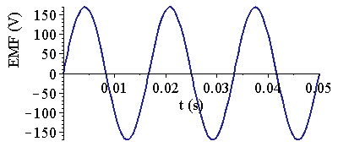
Comments on Generators:
The EMF generated is sinusoidal in nature (with simple designs)
This is called alternating current - it is simple to produce
This is actually how power is generated
Generators extremely similar to motors
– often you can use a single one for both
  Turn the axle – power is generated
  Feed power in – the axle turns
Regenerative braking for electric or hybrid cars

Slide 23

Jit Quick Quiz 30.4
Ans A

Slide 24
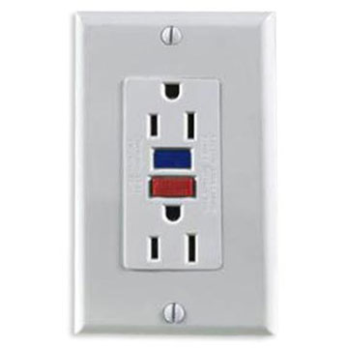

Ground Fault Circuit Interrupters
Fuses/circuit breakers don’t always keep you from getting electrocuted
But GFI’s (or GFCI’s) do
Under normal use, the current on the live wire matches the current on the neutral wire
Ampere’s Law tells you there is no B-field around the orange donut shape
GFCI
Now, imagine you touch the live wire – current path changes (for the worse)
There is magnetic field around the donut
Changing magnetic field means EMF in blue wire
Current flows in blue wire
Magnetic field produced by solenoid
Switch is magnetically turned off

