Slide 1
Inductance
Ch. 31
Self Inductance
Consider a solenoid L, connect it to a battery
Area A, length l, N turns
What happens as you close the switch?
Lenz’s law – loop resists change in magnetic field
Magnetic field is caused by the current
“Inductor” resists change in current
A
l
_{ε}
+
–
$$ℰ_{L}=−\frac{dΦ_{B}}{dt}$$
$$ℰ=−L\frac{dI}{dt}$$
Notes:
Note L = Nphi/I

Slide 2
Warmup 18

Slide 3
Inductors
L
An inductor in a circuit is denoted by this symbol:
An inductor satisfies the formula:
L is the inductance
Measured in Henrys (H)
$$ℰ=−L\frac{dI}{dt}$$
Kirchoff’s rules for Inductors:
Assign currents to every path, as usual
Kirchoff’s first law is unchanged
The voltage change for an inductor is L (dI/dt)
Negative if with the current
Positive if against the current
In steady state (dI/dt = 0) an inductor is a wire
I
L
ε
+
–
$$0=ℰ$$
What is Kirchoff’s law for the loop shown?
A) ε + L (dI /dt) = 0 B) ε – L (dI /dt) = 0
C) None of the above
D) I don’t know Kirchoff’s law for switches
$$\frac{dI}{dt}=\frac{ℰ}{L}$$
$$I=\frac{ℰ}{L}t$$

Slide 4
JIT Quick Quiz 31.1
Ans c, f

Slide 5
Solve on Board

Slide 6
Warmup 18

Slide 7
Energy in Inductors
Is the battery doing work on the inductor?
L
ε
+
–
Integral of power is work done on the inductor
It makes sense to say there is no energy in inductor with no current
Energy density inside a solenoid?
Just like with electric fields, we can associate the energy with the magnetic fields, not the current carrying wires

Slide 8
Quick Quiz 31.3
JIT
You are performing an experiment that requires the highest-possible magnetic energy density in the interior of a very long current-carrying solenoid. Which of the following adjustments increases the energy density? (More than one choice may be correct.)
increasing the number of turns per unit length on the solenoid
increasing the cross-sectional area of the solenoid
increasing only the length of the solenoid while keeping the number of turns per unit length fixed
increasing the current in the solenoid
Ans a,d

Slide 9
RL Circuits
Circuits with resistors (R) and inductors (L)
In the steady state, with the switch closed, how much current flows through R₂? How much current flows through R₂ the moment after we open the switch?
A) 0 A B) 6 A C) 3 A
D) 2 A E) None of the above
L
R₁ = 2 Ω
6 A
6 A
6 A
R₂ = 4 Ω
–
+
ε = 12 V
In the steady state, the inductor is like a wire
Both ends of R₂ are at the same potential: no current through R₂
The remaining structure had current I = ε/R₁ = 6 A running through it
I = ε /R₁ = 6 A
Now open the switch – what happens?
Inductors resist changes in current, so the current instantaneously is unchanged in inductor
It must pass through R₂
I = 6 A

Slide 10
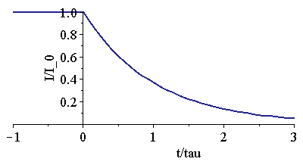
RL Circuits (2)
What happens after you open the switch?
Initial current I₀
Use Kirchoff’s Law on loop
Integrate both sides of the equation
R₁ = 2 Ω
L
I
R = 4 Ω
–
+
ε = 12 V

Slide 11
RL Circuits (3)
Where did the energy in the inductor go?
How much power was fed to the resistor?
Integrate to get total energy dissipated
It went to the resistor
Powering up an inductor:
Similar calculation
R
L
$$I=\frac{ℰ}{R}\left(1−e^{−\frac{t}{τ}}\right)$$
–
+
ε

Slide 12
Concept Question
The circuit at right is in a steady state. What will the voltmeter read as soon as the switch is opened?
A) 0.l V B) 1 V C) 10 V
D) 100 V E) 1000 V
R₁ = 10 Ω
L
I = 1 A
V
R₂ = 1 kΩ
–
+
ε = 10 V
The current remains constant at 1 A
It must pass through resistor R₂
The voltage is given by ΔV = IR
Note that inductors can produce very high voltages
Inductance causes sparks to jump when you turn a switch off
Loop has unin-tended inductance
–
+
Notes:
RL circuit
RLC circuit
Tesla coil
Spark
Two coils
Transformer

Slide 13
Sample Problem
An inductor with inductance 4.0 mH is discharging through a resistor of resistance R. If, in 1.2 ms, it dissipates half its energy, what is R?
L = 4.0 mH
I
R

Slide 14
JIT Quick Quiz 31.2
Ans b
Ans d

Slide 15
Ans A

Slide 16
Assume inductor has no resistance
Ans A

Slide 17
Inductors in series and parallel
L₁
L₂
For inductors in series, the inductors have the same current
Their EMF’s add
$$ℰ=−L_{1}\frac{dI}{dt}$$
$$ℰ=−L_{1}\frac{dI_{1}}{dt}$$
L₁
For inductors in parallel, the inductors have the same EMF but different currents
$$ℰ=−L_{2}\frac{dI_{2}}{dt}$$
L₂
$$=−\frac{ℰ}{L_{1}}−\frac{ℰ}{L_{2}}$$
$$=−\frac{ℰ}{L}$$

Slide 18
Parallel and Series - Formulas
 | Capacitor | Resistor | Inductor
Series
Parallel
Fundamental Formula
$$ℰ_{L}=−L\frac{dI}{dt}$$

Slide 19
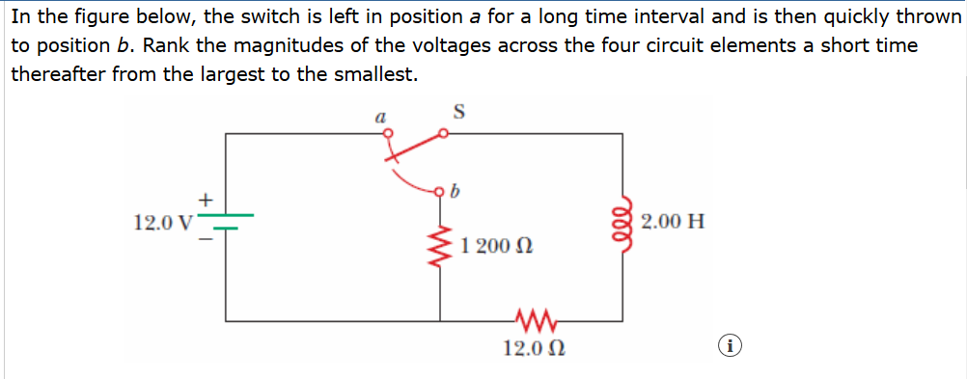

Slide 20
Ans B

Slide 21
Warmup 19
Notes:
M = N*Phi/I, ability to have flux for given amount of current.

Slide 22
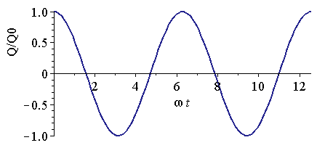
LC Circuits
$$Q_{0}=CΔV=Cℰ$$
Inductor (L) and Capacitor (C)
Let the battery charge up the capacitor
Now flip the switch
Current flows from capacitor through inductor
Kirchoff’s Loop law gives:
I
C
Q
_{ε}
+
–
L
$$Q∼\cos\left(ωt\right) \\ Q∼\sin\left(ωt\right)$$
What function, when you take two deriva-tives, gives the same things with a minus sign?
This problem is identical to harmonic oscillator problem
Notes:
Ch 28 for I, Add minus sign if I doesn’t enter from the same side as +Q

Slide 23
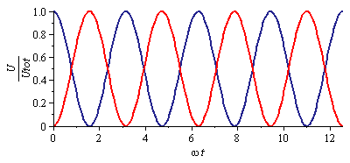
LC Circuits (2)
Substitute it in, see if it works
I
C
Q
L
Let’s find the energy in the capacitor and the inductor
Energy sloshes back and forth

Slide 24
Warmup 19

Slide 25
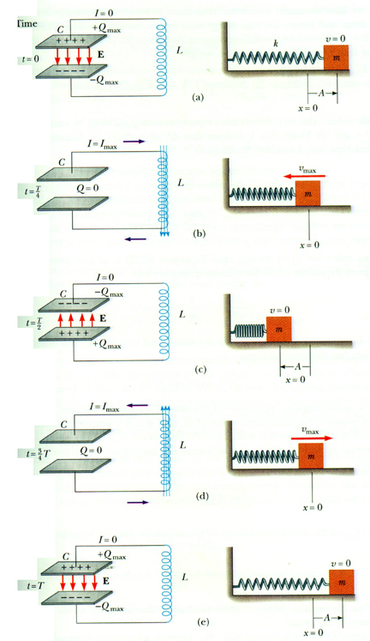

Slide 26
Frequencies and Angular Frequencies
The quantity ω is called the angular frequency
The period is the time T you have to wait for it to repeat
The frequency f is how many times per second it repeats
T
WFDD broadcasts at 88.5 FM, that is, at a frequency of 88.5 MHz. If they generate this with an inductor with L = 1.00 μH, what capacitance should they use?

Slide 27
Solve on Board = like example 31.6, also find frequency of oscillation

Slide 28
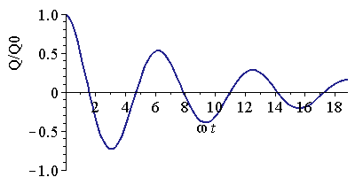
RLC Circuits
Resistor (R), Inductor (L), and Capacitor (C)
Let the battery charge up the capacitor
Now flip the switch
Current flows from capacitor through inductor
Kirchoff’s Loop law gives:
Extra equation for capacitors:
I
C
Q
_{ε}
+
–
L
R
This equation is hard to solve, but not impossible
It is identical to damped, harmonic oscillator

