Slide 1
DC Circuits
Ch. 27
These circuit elements and many others can be combined to produce a limitless variety of useful devices
wire
open switch
closed switch
2-way switch
Two devices are in series if they are connected at one end, and nothing else is connected there
Two devices are in parallel if they are connected at both ends
+
ideal battery
1.5 V
–
47 μF
capacitor
4.7 kΩ
resistor
Notes:
https://www.youtube.com/watch?v=aIhk9eKOLzQ
Are you smarter than a MIT grad

Slide 2
Resistors in Parallel and in Series
R₁
R₂
When resistors are in series, the same
current must go through both of them
The total voltage difference is
The two resistors act like one with resistance
When resistors are in parallel, the same potential is across both of them
The total current through them is
The two resistors act like one with resistance
R₁
R₂

Slide 3
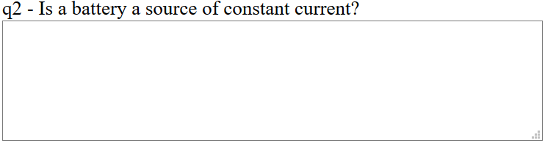
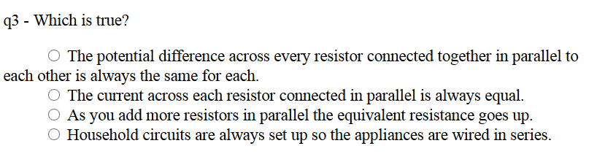
Warmup 10c
Notes:
Are there other types of lights that uses these (JIT)

Slide 4
Parallel and Series - Formulas
 | Capacitor | Resistor | Inductor*
Series
Parallel
Fundamental Formula
* To be defined in a later chapter

Slide 5
The Voltage Divider
Many circuits can be thought of as a voltage divider
  Intentionally or unintentionally
What’s the voltage drop across each of the resistors?
R₁
+
E
–
R₂
The larger resistor gets most of the voltage
If Mr. Curious has a resistance of 10 kΩ and the light bulb has a resistance of 240 Ω, how bright is Mr. Curious?
+
–
120 V
Not very bright
Notes:
Do light bulb demo
JIT – what is EMF – potential difference across battery, poor words (historical), ignores –ir.

Slide 9
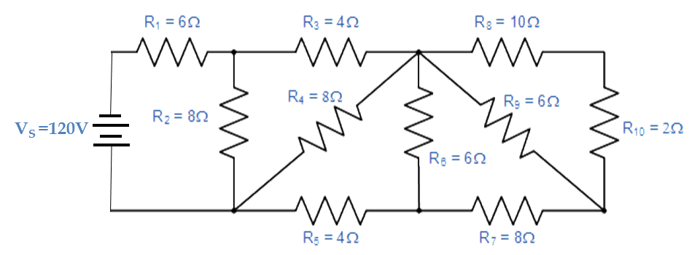

Which resistors are in series and which are in parallel

Slide 10
Solve on Board

Slide 11
Warmup 10c

Slide 12
Ideal vs. Non-Ideal Batteries
Up until now, we’ve treated a battery as if it produced a fixed voltage, no matter what we demand of it
Real batteries also have resistance
  It limits the current and therefore the power that can be delivered
If the internal resistance r is small compared to other resistances in the problem, we can ignore it
E
–
+
ideal battery
r
E
–
+
realistic battery
The maximum potential difference E across the battery is called electromotive force (emf)
10 Ω
30 V
–
+
A 30 V battery with 10 Ω of resistance is connected to a 50 Ω resistor. What is the actual voltage across the 50 Ω resistor?
A) 30 V B) 36 V C) 6 V
D) 25 V E) 24 V
50 Ω
Notes:
Dashed lines are for the battery – like in Fig 28-1. deltaV is also R/(r+R)Εpsilon = (50/60)30

Slide 13
Kirchoff’s Second Law
The total voltage change around a loop is always zero
How to apply it:
First, assign a direction to every loop
  I often pick clockwise
Start anywhere, and set 0 equal to sum of potential change from each piece:
For batteries: ΔV = E
  It is an increase if you go from – to +
  It is a decrease if you go from + to –
For resistors: ΔV = IR
  It is a decrease if you go with the current
  It is an increase if you go against the current
12 V
I₁
–
+
3 Ω
I₂
+
–
5 Ω
6 V
4 Ω
I₃

Slide 14
Kirchoff’s Second Law (2)
What is Kirchoff’s Second Law for the purple loop?
A) 0 = +5I₂ – 6 – 4I₃ B) 0 = +5I₂ + 6 – 4I₃
C) 0 = –5I₂ – 6 – 4I₃ D) 0 = –5I₂ + 6 – 4I₃
12 V
I₁
–
+
3 Ω
I₂
+
–
Three equations in three unknowns: solve it
We can let Maple do it for us
5 Ω
6 V
> solve({i3=i1+i2,0=-5*i2-6-4*i3,
0=18-3*i1+5*i2},[i1,i2,i3]);
4 Ω
I₃
Negative currents means we guessed the wrong way
Not a problem

Slide 15

Solve on Board

Slide 16
Kirchoff’s Laws with Capacitors
I
If know which side is positive then that is high potential – work like battery.
Q
The voltage change is given by ΔV = Q/C
  It is a decrease if (+)Q is the side you are going in
  It is an increase if Q is the side you are going out
The current is related to the time change of Q
  Add minus sign if I doesn’t enter from the same side as Q – it is minus if decreasing
If you are in a steady state, the current through a capacitor is always zero
C
+
–
In this circuit, in the steady state, where is current flowing?
+
+
It’s really just a battery and two resistors in series!
–
–
Notes:
If know + and – q then + is at high potential.

Slide 17
The Simplest RC Circuit
R
Q₀
In the circuit shown at left, the capacitor starts with charge Q₀. At time t = 0, the switch is closed. What happens to the charge Q?
C
I
Current begins to flow around the loop, so the charge Q will change
This is a differential equation, and therefore hard to solve
Check the units:
Notes:
Show how get Q0

Slide 18
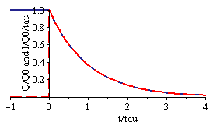
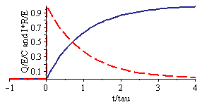
Charging and Discharging Capacitors
The combination RC = τ is called the time constant
  It’s the characteristic time it takes to discharge
We can work out the current from
Q
I
R
+
C
–
In this circuit, the capacitor is initially uncharged, but at t = 0 the switch is closed
E
Notes:
Show I, same as discharging, just opposite direction (note how drawn).

Slide 19
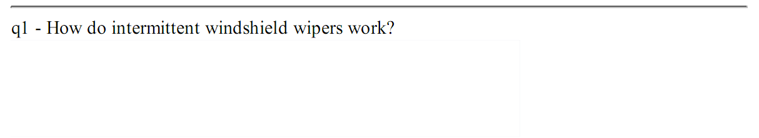
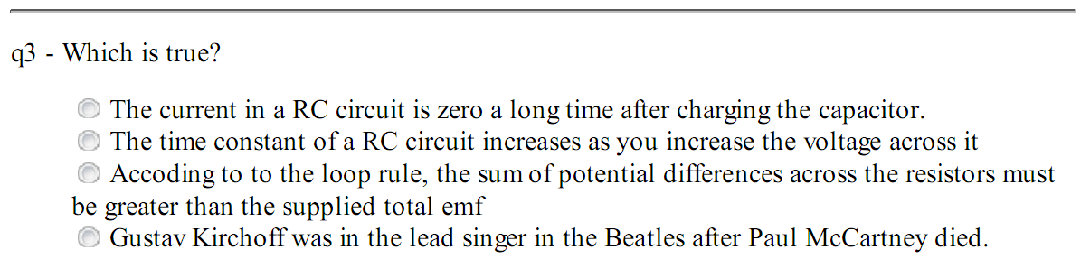
Warmup 11

Slide 21
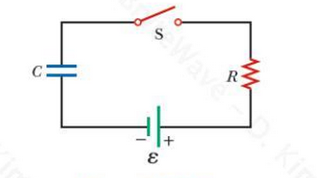
Solve on Board

Slide 22
Ammeters and Voltmeters
An ammeter is a device that measures the current (amps) anywhere in a circuit
  To use it, you must route the current through it
  A perfect ammeter should have zero resistance
A voltmeter is a device that measures the potential difference (volts) between any two points in a circuit
  To use it, you can simply connect to any two points
  A perfect voltmeter has infinite resistance
A
V
A
Which meter is installed incorrectly?
A) Left voltmeter B) Right voltmeter
C) Left ammeter D) Right ammeter
E) All are correct
+
V
A
–
V
Voltmeters should be connected to two places in an existing circuit
  The left voltmeter is placed correctly
A voltmeter has infinite resistance
  The right one effectively blocks the current on the right

Slide 23
Household Wiring
*Actually, this is alternating current, later chapter
All household appliances consume electrical power
  Think of them as resistors with fixed resistance R
Devices are designed to operate at 120 V*
  Often, they give the wattage at this voltage
  Can easily get the effective resistance from
To make sure power is given to each device, they are all placed in parallel
Fuse
box
A
+
–
Inside House
If you put too many things on at once, a lot of current is drawn
The wires, which have some resistance, will start to get hot
To avoid setting the house on fire, add a fuse (or a circuit breaker)

Slide 24
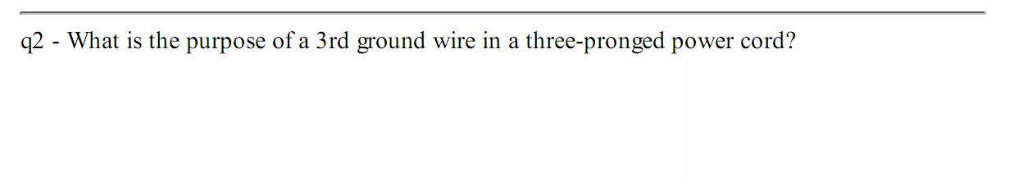
Warmup 11
Notes:
JIT why ground connnected to neutral (neutral goes to ground). And note – neutral not connected to casing.
Can you plug in three pong in two prong outlet – yes.

Slide 25
Why three wires?
If a device is functioning properly, you need only two wires
  “Live” and “Neutral” wires
Toaster
If the live wire accidentally touches the casing, the person can be electrocuted
The wrong solution – connect the neutral to the casing
Now imagine the neutral wire breaks
  The person again can be electrocuted
The right solution: Add a third “ground” wire connected directly to ground
  Normally no current will flow in this wire
  If the hot wire touches the casing, it will trigger the fuse/circuit breaker and protect the person

