Slide 1
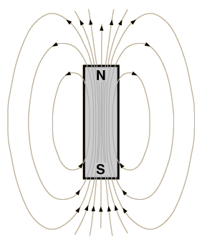
Magnetic Fields
Ch. 28
Certain objects and circuits produce magnetic fields
Magnetic fields, like electric fields, are vector fields
  They have a magnitude and a direction
  Denoted by B, or B(r)
They have no effect on charges at rest
They produce a force on moving charges given by
  Perpendicular to magnetic field
  Perpendicular to velocity
Magnetic field strengths are measured in units called a tesla, abbreviated T
  A tesla is a large amount of magnetic field

Slide 2
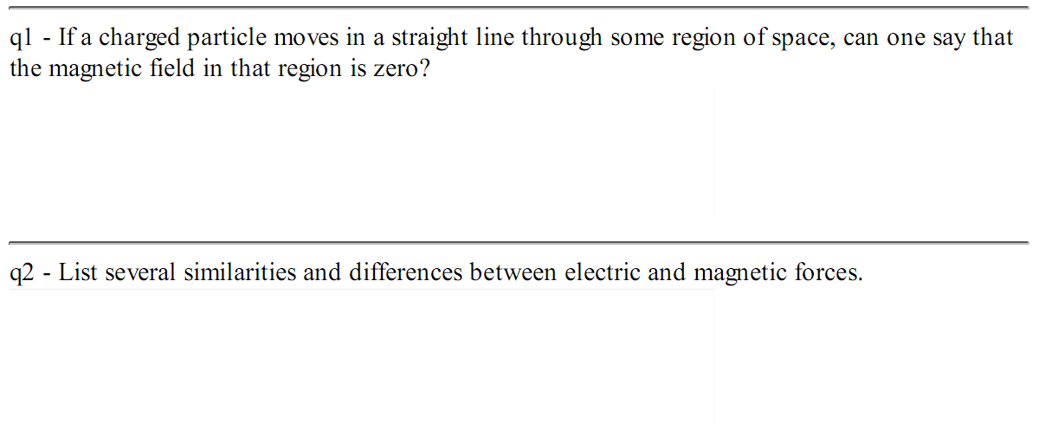
Warmup 12

Slide 3
The Right Hand Rule
To figure out the direction of magnetic force, use the following steps:
Point your fingers straight out in direction of first vector v
Twist your hand so when you curl your fingers, they point in the direction of B
Your thumb now points in the direction of v × B
If q is negative, change the sign
v × B
Vectors in the plane are easy to draw
Vectors perpendicular to the plane are hard
  Coming out of the plane
  Going into the plane
v
B

Slide 4
Finding the direction
proton
What is the direction of the force for each of the situations sketched?
A) B) C) D) E)
F) None of the above
B
p
v
4. If q is negative, change the sign
Ca⁺² ion
electron
B
e
v
Ca
B
v

Slide 5
Solve on Board

Slide 6
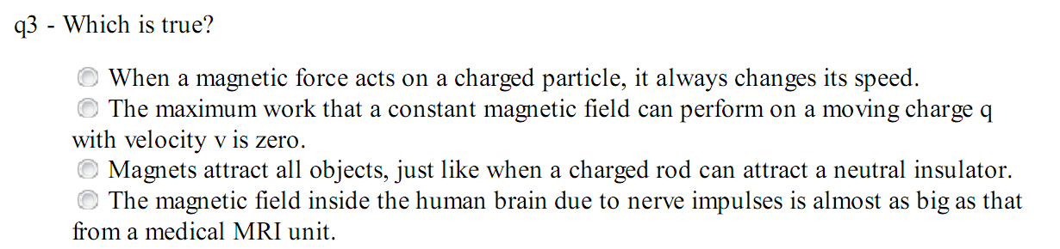
Warmup 12
Notes:
Brain 10^-13 T

Slide 7
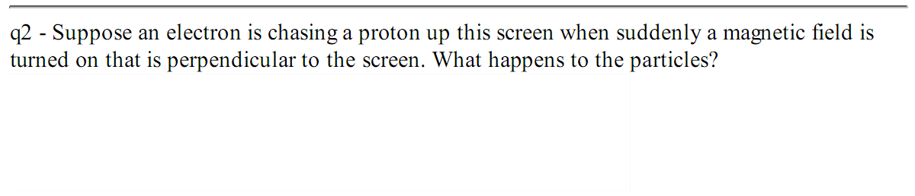
Warmup 13

Slide 8
Cyclotron Motion
Consider a particle of mass m and charge q moving in a uniform magnetic field of strength B
B
v
v
Motion is uniform circular motion
Centripetal force formula:
F
F
F
q
F
v
v
Let’s find how long it takes to go around:

Slide 9


Slide 10
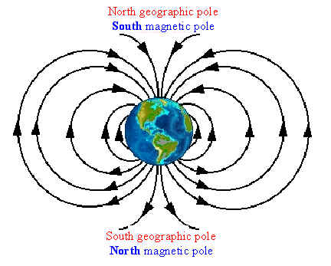
The Earth has magnetic field lines
Charged particles from space follow them
Hit only at magnetic poles aurora borealis aurora australis

Slide 11
Concept Question
Two particles with the same mass are moving in the same magnetic field, but particle X is circling in less time than particle Y. What can account for this?
A) Particle X is moving faster (only)
B) Particle Y is moving faster (only)
C) Particle X has more charge (only)
D) Particle Y has more charge (only)
E) A and C could both account for this
F) B and C could both account for this
B
X
Y
Moving faster doesn’t help
  Higher speed means bigger radius
Higher charge does help
  You turn corners faster

Slide 12
Velocity Selector / Mass Spectrometer
When we have both electric and magnetic fields, the force is
Magnetic field produces a force on the charge
Add an electric field to counteract the magnetic force
Forces cancel if you have the right velocity
Now let it move into region with magnetic fields only
Particle bends due to cyclotron motion
Measure final position
Allows you to determine m/q
+
detector
–
F_{B}
v
F_{E}

Slide 13
An electron has a velocity of 1.00 km/s (in the positive x direction) and an acceleration of 2.00×10¹² m/s² (in the positive z direction) in uniform electric and magnetic fields. If the electric field has a magnitude of strength of 15.0 N/C (in the positive z direction), determine the components of the magnetic field. If a component cannot be determined, enter 'undetermined'.
Notes:
Review full determinant (write on board). Note Bx could be anything so mathematically undetermined. B parallel to E creates no force.
Other way i X ? = -k. Gives By.

Slide 14
Force on a Current-Carrying Wire
Suppose current I is flowing through a wire of cross sectional area A and length L
  Think of length as a vector L in the direction of current
  Think of current as charge carriers with charge q and drift velocity v_{d}
B
I
L
F

Slide 15
Solve on Board

Slide 16
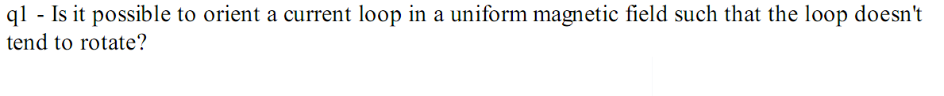
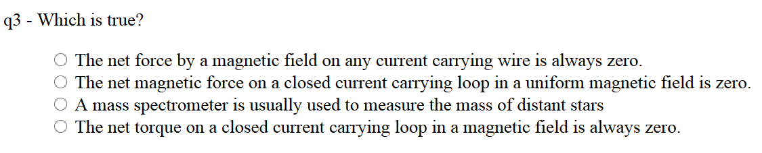
Warmup 13

Slide 17
Force/Torque on a Loop
Suppose we have a current carrying loop in a constant magnetic field
  To make it simple, rectangular loop size L × W
L
Left and right side have no force at all, because cross-product vanishes
Top and bottom have forces
F_{t}
I
W
τ
Total force is zero
This generalizes to general geometry
F_{b}
B
There is, however, a torque on this loop
Skipped derivation
Notes:
Assume screen is x-y plane

Slide 18
Torque on a Loop (2)
F
What if the loop were oriented differently?
Torque is proportional to separation of forces
θ
τ
Wsinθ
W
B
F
Edge-on view of Loop
This formula generalizes to other shapes besides rectangles?
It is true for circular loops, or oddly shaped loops of current
Skipped derivation-basically this whole slide.

Slide 19
Torque and Energy for a Loop
Define A to be a vector perpendicular to the loop with area A and in the direction of n-hat
Determined by right-hand rule by current
  Curl fingers in direction current is flowing
  Thumb points in direction of A
Define magnetic dipole moment of the loop as
A
R
I
Torque is like an angular force
It does work, and therefore there is energy associated with it
θ
τ
A
Loop likes to make A parallel to B
B
Edge-on view of Loop
Notes:
Do quantitative problem too (JIT)?

Slide 22
How to make an electric motor
Have a background source of magnetic fields, like permanent magnets
Add a loop of wire, supported so it can spin on one axis
Add “commutators” that connect the rotating loop to outside wires
Add a battery, connected to the commutators
Current flows in the loop
There is a torque on the current loop
Loop flips up to align with B-field
Current reverses when it gets there
τ
To improve it, make the loop repeat many times
F
A
F
–
+

