Slide 1
Electromagnetic Waves
Maxwell's Equations
Chapter 33

Slide 2
Warmup 20

Slide 3
Ampere’s Law is Not Complete!
Maxwell realized Ampere’s Law is not self-consistent
This isn’t an experimental argument, but a theoretical one
Consider a parallel plate capacitor getting charged by a wire
Consider an Ampere surface between the plates
Consider an Ampere surface in front of plates
But they must give the same answer!
There must be something else that creates B-fields
Note that for the first surface, there is also an electric field accumulating in capacitor
Maybe electric fields?
Take the time derivative of this formula
Speculate : This replaces I for first surface
I
I
Notes:
This is in Chapter 33 now. It used to be in chapter 30 and pg 37 of my notes.
CT-5 from chapter 30 can now be used for 34.
Ampere’s law says that integral of b dot ds = mu zero times I, where I is the total current through any surface bounded by the closed path s.
See Fig 34.1

Slide 4
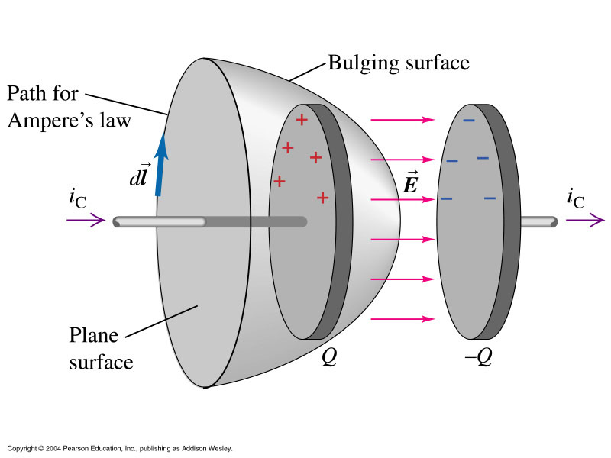
Ampere’s Law (New Recipe)
Notes:
Ampere’s law says that integral of b dot ds = mu zero times I, where I is the total current through any surface bounded by the closed path s.

Slide 5
Maxwell’s Equations
We now have four formulas that describe how to get electric and magnetic fields from charges and currents
Gauss’s Law
Gauss’s Law for Magnetism
Ampere’s Law (final version)
Faraday’s Law
Collectively, these are called Maxwell’s Equations
There is also a formula for forces on charges
Called Lorentz Force
All of electricity and magnetism is somewhere on this page

Slide 6
Warmup 20

Slide 7
Electromagnetic Waves
Wave solutions
We can solve Maxwell’s Equations
(take my word for it) and come up with two “simple” differential equations.
I could have used cosine instead, it makes no difference
I chose arbitrarily to make it move in the x-direction
These are waves where we have .

Slide 8
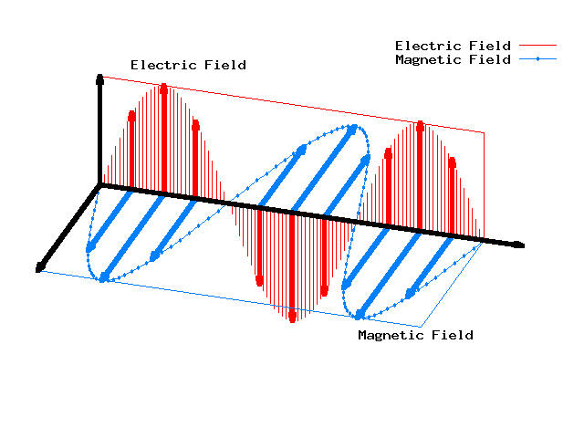
http://www.ariel.ac.il/sites/cezar/ariel/ANIMATIONS/physics3.html

Slide 9
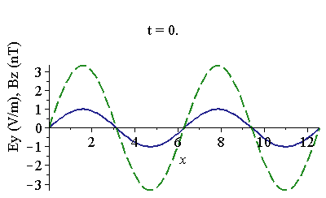
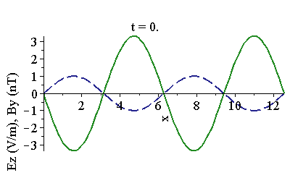
Wave Equations summarized:
Waves look like:
Related by:
Two independent solutions to these equations:
B₀
E₀
Note that E, B, and direction of travel are all mutually perpendicular
The two solutions are called polarizations
We describe polariza-tion by telling which way E-field points
E₀
B₀
Note E × B is in direction of motion
Notes:
Do thing with y = x^2. y = (x-3)^2. y = (x-t)^2.
Note there are other polarization (ex diagonal).

Slide 10
Understanding Directions for Waves
The wave can go in any direction you want
The electric field must be perpendicular to the wave direction
The magnetic field is perpendicular to both of them
Recall: E × B is in direction of motion
A wave has an electric field given by E = j E₀ sin(kz – ωt). What does the magnetic field look like?
A) B = i (E₀/c) sin(kz - ωt) B) B = k (E₀/c) sin(kz - ωt)
C) B = - i (E₀/c) sin(kz - ωt) D) B = - k (E₀/c) sin(kz - ωt)
The magnitude of the wave is B₀ = E₀ / c
The wave is traveling in the z-direction, because of sin(kz - ωt).
The wave must be perpendicular to the E-field, so perpendicular to j
The wave must be perpendicular to direction of motion, to k
It must be in either +i direction or –i direction
If in +i direction, then E × B would be in direction j × i = - k, wrong
So it had better be in the –i direction

Slide 12
The meaning of c:
Waves traveling at constant speed
Keep track of where they vanish
c is the velocity of these waves
This is the speed of light
Light is electromagnetic waves!
But there are also many other types of EM waves
The constant c is one of the most important fundamental constants of the universe

Slide 13
Wavelength and wave number
The quantity k is called the wave number
The wave repeats in time
It also repeats in space
λ
EM waves most commonly described in terms of frequency or wavelength
Some of these equations must be modified when inside a material

Slide 14
Solve on Board

Slide 15
Warmup 21

Slide 16
Energy and the Poynting Vector
Let’s find the energy density in the wave
Now let’s define the Poynting vector:
It is energy density times the speed at which the wave is moving
It points in the direction energy is moving
It represents the flow of energy in a particular direction
Units:

Slide 17
Intensity and the Poynting vector
The time-averaged Poynting vector is called the Intensity
Power per unit area
In Richard Williams’ lab, a laser can (briefly) produce 50 GW of power and be focused onto a region 1 μm² in area. How big are the electric and magnetic fields?

Slide 18
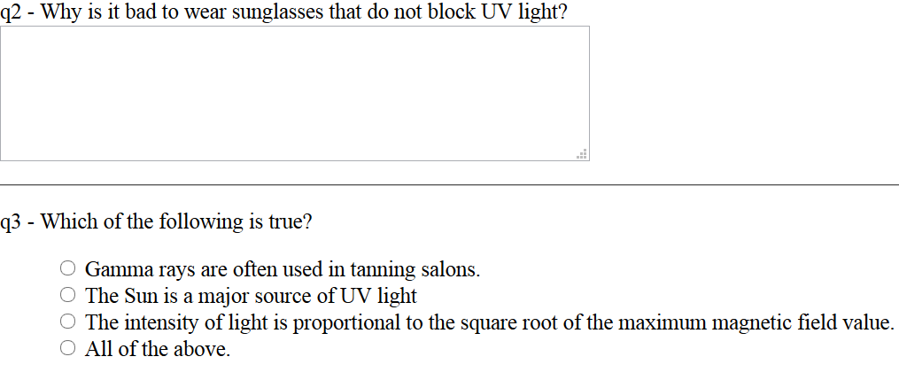
Warmup 21

Slide 19
Serway Problem 33-19
Solve on Board

Slide 20
The Electromagnetic Spectrum
Different types of waves are classified by their frequency (or wavelength)
Boundaries are arbitrary and overlap
Visible is 380-740 nm
Radio Waves
Microwaves
Infrared
Visible
Ultraviolet
X-rays
Gamma Rays
Red
Orange
Yellow
Green
Blue
Violet
Which of the following waves has the highest speed in vacuum?
A) Infrared
B) Orange
C) Green
D) Blue
E) It’s a tie
F) Not enough info
Vermillion
Saffron
Chartreuse
Turquoise
Indigo
f Increasing
λ Increasing

Slide 21
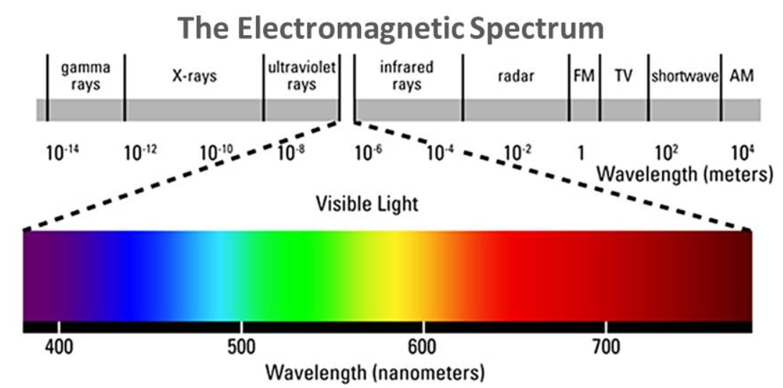

Slide 22
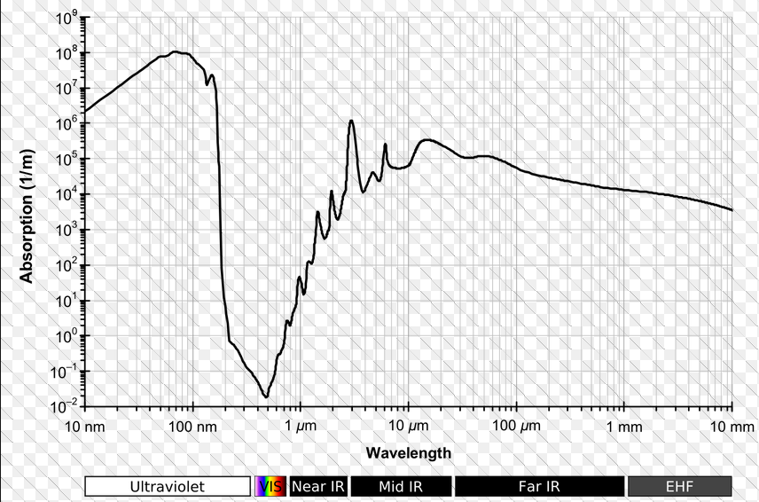
Absorbance of Water

Slide 23
Sources of EM waves
A charge at rest produces no EM waves
There’s no magnetic field
A charge moving at uniform velocity produces no EM waves
Obvious if you were moving with the charge
An accelerating charge produces electromagnetic waves
Consider a current that changes suddenly
Current stops – magnetic field diminishes
Changing B-field produces E-field
Changing E-field produces B-field
You have a wave
–
+

