Slide 1
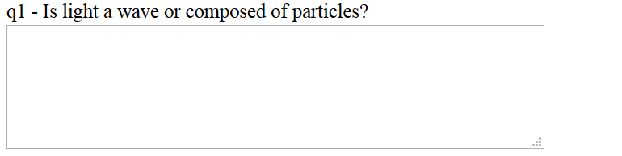
Reflection
and Refraction
Ch. 34
The Nature of Light
Warmup22

Slide 2
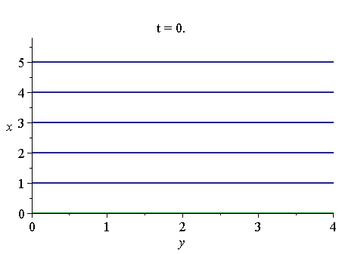
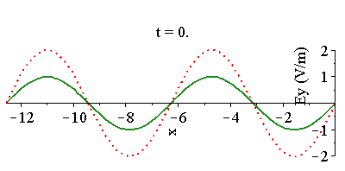
Reflection
What happens when our wave hits a conductor?
  E-field vanishes in a conductor
  Let’s say the conductor is at x = 0
Add a reflected wave going other direction
In reality, all of this is occurring in
three dimensions
Incident Wave
Reflected Wave
Total Wave

Slide 3
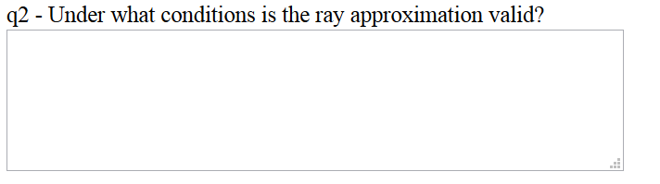
Warmup22

Slide 4
Law of Reflection
k_{i} = k_{r}
θ_{i} = θ_{r}
We assume the mirror is infinitely large
If the wavelength is sufficiently tiny compared
to objects, this might be a good approximation
For the next week, we will always make
this approximation
  It’s called geometric optics
In geometric optics, light waves are represented by rays
You can think of light as if it is made of little particles
  In fact, waves and particles act very similarly
  First hint of quantum mechanics!
θ_{i}
θ_{r}
Mirror

Slide 5
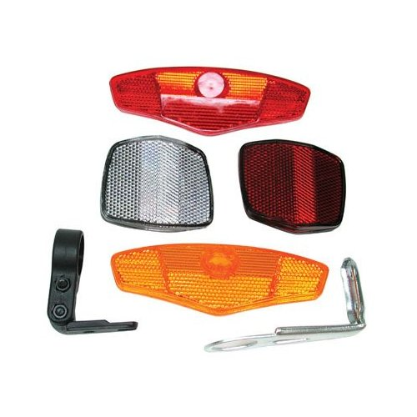
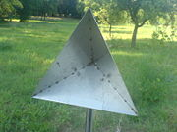
Concept Question
A light ray starts from a wall at an angle of 47° compared to the wall. It then strikes two mirrors at right angles compared to each other. At what angle θ does it hit the wall again?
A) 43° B) 45° C) 47° D) 49° E) 51°
θ
= 47°
47°
43°
47°
Mirror
47°
43°
43°
This works for any angle
In 3D, you need three mirrors
Mirror

Slide 6
The Speed of Light in Materials
The speed of light in vacuum c is the same for all wavelengths of light, no matter the source or other nature of light
Inside materials, however, the speed of light can be different
Materials contain atoms, made of nuclei and electrons
The electric field from EM waves push on the electrons
The electrons must move in response
  Absorption and scattering
This generally slows the wave down
  n is called the index of refraction
The amount of slowdown can depend
on the frequency of the light
Indices of Refraction
Air (STP) 1.0003
Water 1.333
Ethyl alcohol 1.361
Glycerin 1.473
Fused Quartz 1.434
Glass 1.5 -ish
Cubic zirconia 2.20
Diamond 2.419

Slide 7
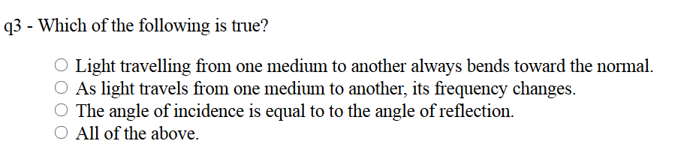
Warmup22

Slide 8
Refraction: Snell’s Law
The relationship between the angular frequency ω and the wave number k changes inside a medium
Now imagine light moving from one medium to another
Some light will be reflected, but usually most is refracted
  The reflected light again must obey the law of reflection
θ₁ = θ_{r}
k₁sinθ₁
θ₁
θ_{r}
index n₁
index n₂
Snell’s Law
y
θ₂
x
k₂sinθ₂

Slide 9
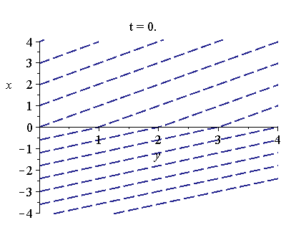

Snell’s Law: Illustration
A light ray in air enters a region at an angle of 34°. After going through a layer of glass, diamond, water, and glass, and back to air, what angle will it be at?
A) 34° B) Less than 34°
C) More than 34° D) This is too hard
34°
θ₂
θ₂
n₄ = 1.33
n₅ = 1.5
θ₃
θ₃
θ₄
n₆ = 1
θ₄
n₁ = 1
n₂ = 1.5
n₃ = 2.4
θ₅
θ₅
θ₆

Slide 11
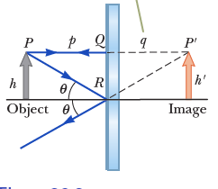
Image Formation
Reflection
Refraction
I
O

Slide 14
Solve on Board

Slide 15
Solve on Board

Slide 16
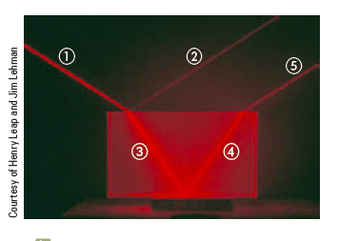
Warmup23

Slide 17
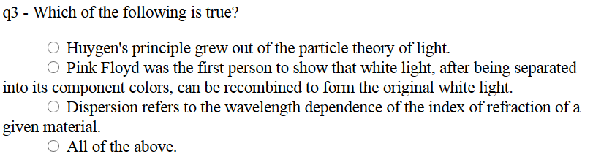
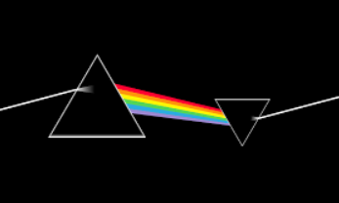
Warmup23

Slide 18
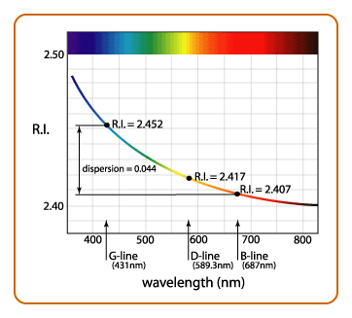
Dispersion
The speed of light in a material can depend on frequency
  Index of refraction n depends on frequency
  Its dependence is often given as a function of wavelength in vacuum
  Called dispersion
This means that different types of light
bend by different amounts in any given
material
For most materials, the index of refraction
is higher for short wavelength
Red Refracts Rotten
Blue Bends Best

Slide 19
Prisms
Put a combination of many wavelengths (white light) into a triangular dispersive medium (like glass)
Prisms are rarely used in research
  Diffraction gratings work better
Lenses are a lot like prisms
  They focus colors unevenly
  Blurring called chromatic dispersion
  High quality cameras use a combination of lenses to cancel this effect

Slide 20

Rainbows
A similar phenomenon occurs when light bounces off of the inside of a spherical rain drop
This causes rainbows
If it bounces twice, you can
get a double rainbow

Slide 21
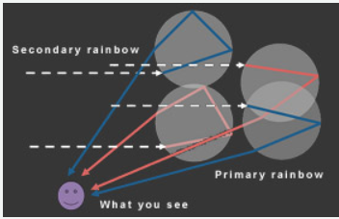
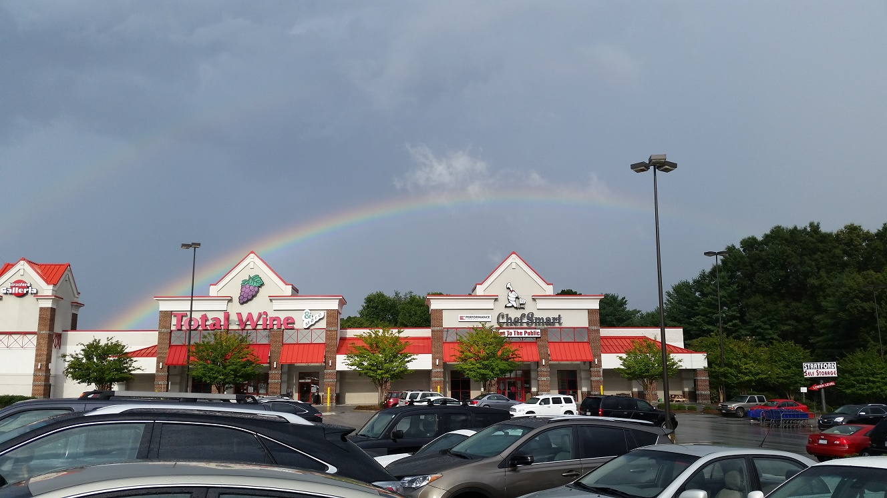
http://www.globalgiving.org/double-rainbow/

Slide 22
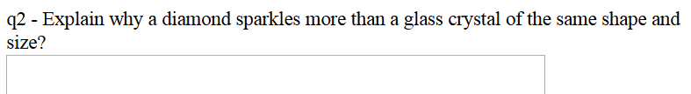
Warmup23

Slide 23
Total Internal Reflection
A trick question:
A light ray in diamond enters an air gap at an angle of 60°, then returns to diamond. What angle will it be going at when it leaves out the bottom?
A) 60° B) Less than 60°
C) More than 60° D) None of the above
n₁ = 2.4
60°
θ₂
θ₂
n₂ = 1
θ₃
n₃ = 2.4
This is impossible!
Light never makes it into region 2!
It is totally reflected inside region 1
This can only happen if you go from a high index to a low
Critical angle such that this occurs:
  Set sinθ₂ = 1

Slide 24


View from the pool
Which diver is more likely to see the lifeguard (Do as clicker question)?
Guy on left B) Guy on right
C) I don’t know D) Same

Slide 25
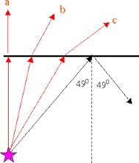
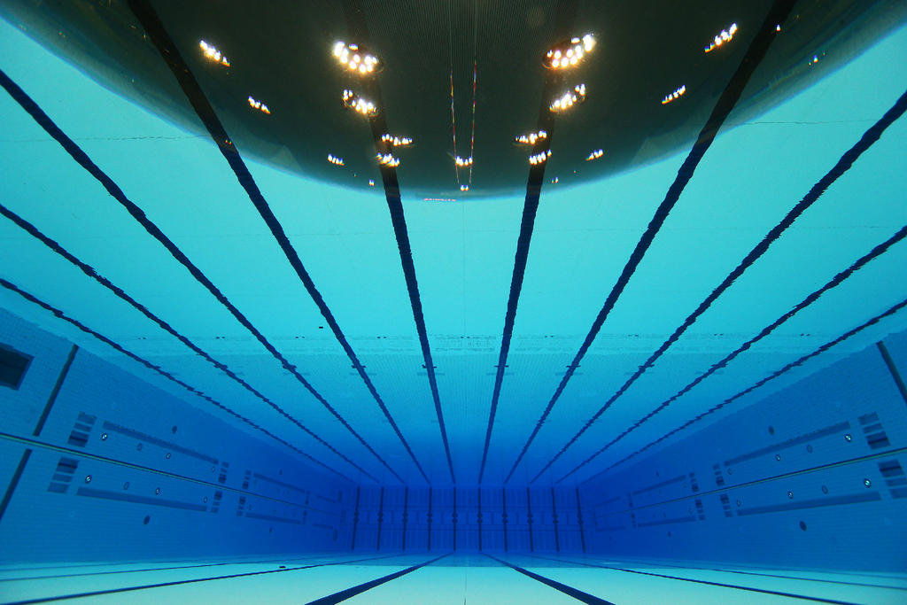
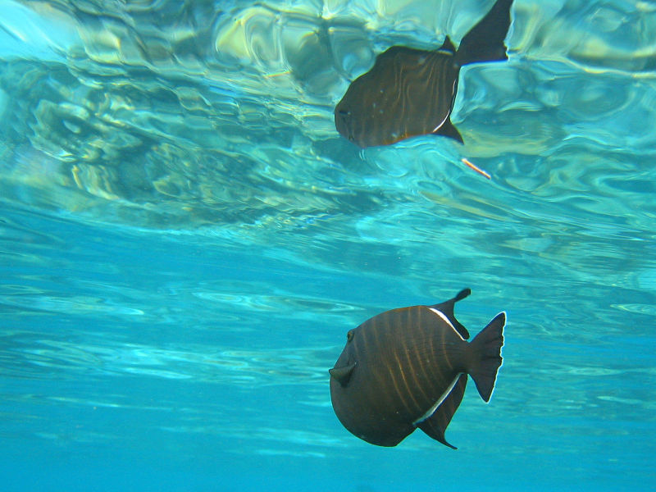
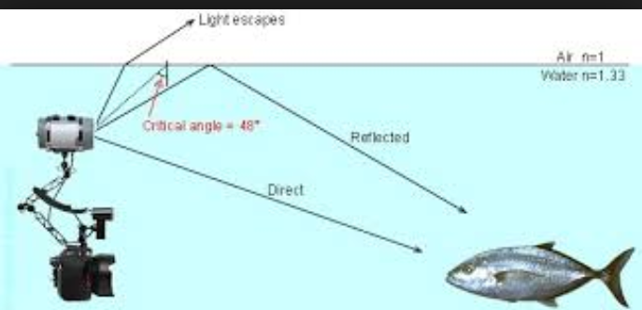

Slide 26
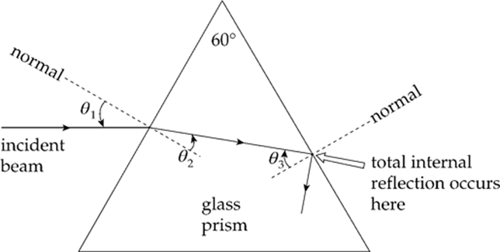
How to get TIR in prism.
Looking at complementary angles inside the triangles we have
  90-θ₂ + 90-θ₃ = 120
θ₂ + θ₃ = 60
As θ₁ increases θ₂ increases (snell’s law) and θ₃ decreases
Avoid TIR as θ₁ increases

Slide 27
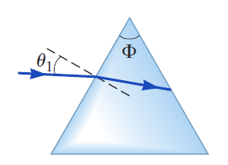
Serway 34.7.OP.018.M, Solve on Board
A triangular glass prism with
apex angle Φ = 60.0° has an
index of refraction n = 1.50. What is the
smallest angle of incidence
θ₁ for which a light ray can
emerge from the other side?

Slide 28
Optical Fibers
Protective Jacket
Low n glass
High n glass
Light enters the high index of refraction glass
It totally internally reflects – repeatedly
Power can stay largely undiminished for many kilometers
Used for many applications
  Especially high-speed communications – up to 40 Gb/s

Slide 29
Chapter 35
Images. Mirrors and Lenses

Slide 30
Lenses and Mirrors Summarized
The front of a lens or mirror is the side the light goes in
 | R > 0 | p > 0 | q > 0 | f
mirrors | Concave front | Object in front | Image in front
lenses | Convex front | Object in front | Image in back
Variable definitions:
f is the focal length
p is the object distance from lens
q is the image distance from lens
h is the height of the object
h’ is the height of the image
M is the magnification
Other definitions:
q > 0 real image
q < 0 virtual image
M > 0 upright
M < 0 inverted

Slide 31
Notes:
Maybe just do mirrors and lenses summarized and some problems.

