Slide 2
Your eyes tell you where/how big an object is
Mirrors and lenses can fool your eyes
Images
Ch 36
Flat mirror images
Place a point light source P in front of a mirror
If you look in the mirror, you will see the object as if it were at the point P’, behind the mirror
As far as you can tell, there is a “mirror image” behind the mirror
For an extended object, you get an extended image
The distances of the object
from the mirror and the image
from the mirror are equal
Flat mirrors are the only
perfect image system
(no distortion)
P’
P
Object
Image
Mirror
p
q

Slide 3
Image Characteristics and Definitions
h
h’
p
q
Object
Image
Mirror
The front of a mirror or lens is the side the light goes in
The object distance p is how far the object is in front of the mirror
The image distance q is how far the image is in front* of the mirror
  Real image if q > 0, virtual image if q < 0
The magnification M is how large the image is compared to the object
  Upright if positive, inverted if negative
*back for lenses
If you place an object in front of a flat mirror, its image will be
A) Real and upright B) Virtual and upright
C) Real and inverted D) Virtual and inverted

Slide 5
Spherical Mirrors
Typical mirrors for imaging are spherical mirrors – sections of a sphere
  It will have a radius R and a center point C
We will assume that all angles involved are small
Optic axis: an imaginary line passing through the center of the mirror
  Vertex: The point where the Optic axis meets the mirror
The paths of some rays of light are easy to figure out
A light ray through the center will come back exactly on itself
A ray at the vertex comes back at the same angle it left
Let’s do a light ray coming in parallel to the optic axis:
  The focal point F is the place this goes through
  The focal length f = FV is the distance to the mirror
A ray through the focal point
comes back parallel
θ
X
C
F
V
f
R

Slide 6
Spherical Mirrors: Ray Tracing
Any ray coming in parallel goes through the focus
Any ray through the focus comes out parallel
Any ray through the center comes straight back
Let’s use these rules to find the image:
F
Do it again, but harder
A ray through the center won’t
hit the mirror
So pretend it comes from the center
Similarly for ray through focus
Trace back to see where they came from
C
F
P
C

Slide 7
Spherical Mirrors: Finding the Image
The ray through the center comes straight back
The ray at the vertex reflects at same angle it hits
Define some distances:
X
h
Q
V
P
C
h’
Y
Magnification
Since image upside down, treat h’ as negative

Slide 8
Convex Mirrors: Do they work too?
Up until now, we’ve assumed the mirror is concave – hollow on the side the light goes in
  Like a cave
A convex mirror sticks out on the side the light goes in
The formulas still work, but just treat R as negative
The focus this time will be on the other side of the mirror
Ray tracing still works
Summary:
F
A concave mirror has R > 0;
convex has R < 0, flat has R = ∞
Focal length is f = ½R
  Focal point is distance f in front of mirror
p, q are distance in front of mirror of image, object
  Negative if behind
C

Slide 9
Mirrors: Formulas and Conventions:
A concave mirror has R > 0; convex has R < 0, flat has R = ∞
Focal length is f = ½R
  Focal point is distance f in front of mirror
p, q are distance in front of mirror of object/image
  Negative if behind
For all mirrors (and lenses as well):
The radius R, focal length f, object distance p, and image distance q can be infinity, where 1/∞ = 0, 1/0 = ∞
Light from the Andromeda Galaxy bounces off of a concave mirror with radius R = 1.00 m. Where does the image form?
A) At infinity B) At the mirror
C) 50 cm left of mirror D) 50 cm right of mirror
Concave, R > 0

Slide 10
Solve on board

Slide 11
Images of Images: Multiple Mirrors
You can use more than one mirror to make images of images
  Just use the formulas logically
Light from a distant astronomical source reflects from an R₁ = 100 cm concave mirror, then a R₂ = 11 cm convex mirror that is 45 cm away. Where is the final image?
5 cm
45 cm
10 cm

Slide 12
Refraction and Images
Now let’s try a spherical surface between two regions with different indices of refraction
Region of radius R, center C, convex in front:
Two easy rays to compute:
Ray towards the center continues straight
Ray towards at the vertex follows Snell’s Law
X
R
n₁
q
h
θ₁
C
Q
P
p
h’
n₂
θ₂
Magnification:
Y

Slide 13
Comments on Refraction
R is positive if convex (unlike reflection)
  R > 0 (convex), R < 0 (concave), R = ∞ (flat)
n₁ is index you start from, n₂ is index you go to
Object distance p is positive if the object in front (like reflection)
Image distance q is positive if image is in back (unlike reflection)
We get effects even for a flat boundary, R = ∞
Distances are distorted:
X
R
n₁
q
h
Q
P
p
n₂
θ₂
Y
No magnification:

Slide 14
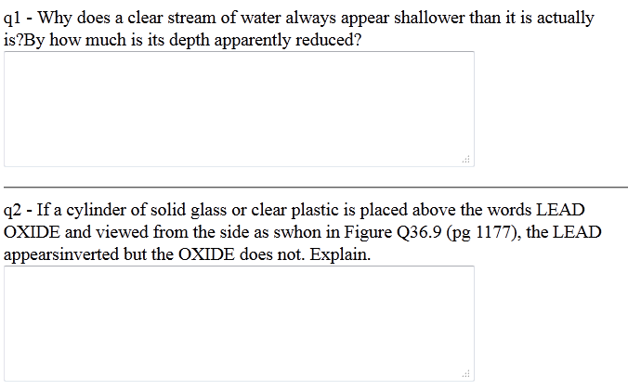

Warmup 25
CG36.16 page 1125

Slide 15

Flat Refraction
A fish is swimming 24 cm underwater (n = 4/3). You are looking at the fish from the air (n = 1). You see the fish
A) 24 cm above the water B) 24 cm below the water
C) 32 cm above the water D) 32 cm below the water
E) 18 cm above the water F) 18 cm below the water
R is infinity, so formula above is valid
Light comes from the fish, so the water-side is the front
Object is in front
Light starts in water
For refraction, q tells you
distance behind the boundary
18 cm
24 cm

Slide 17
Double Refraction and Thin Lenses
Just like with mirrors, you can do double refraction
  Find image from first boundary
  Use image from first as object for second
We will do only one case, a thin lens:
Final index will match the first, n₁ = n₃
The two boundaries will be very close
n₁
n₂
n₃
p
Where is the final image?
First image given by:
This image is the object for the second boundary:
Final Image location:
Add these:
n₁
n₂
n₁

Slide 18
Thin Lenses (2)
Define the focal length:
  This is called lens maker’s equation
Formula relating image/object distances
  Same as for mirrors
Magnification: two steps
Total magnification is product
Same as for mirrors

Slide 19
Using the Lens Maker’s Equation
If f > 0, called a converging lens
  Thicker in middle
If f < 0, called a diverging lens
  Thicker at edge
If you are working in air, n₁ = 1, and we normally call n₂ = n.
By the book’s conventions, R₁, R₂ are positive if they are convex on the front
You can do concave on the front as well, if you use negative R
  Or flat if you set R = ∞
If you turn a lens around, its focal length stays the same
If the lenses at
right are made of
glass and are used
in air, which one
definitely has f < 0?
Light entering on the left:
We want R₁ < 0: first surface concave on left
We want R₂ > 0: second surface convex on left
D
A
B
C

Slide 20
Ray Tracing With Converging Lenses
Unlike mirrors, lenses have two foci, one on each side of the lens
Three rays are easy to trace:
Any ray coming in parallel goes through the far focus
Any ray through the near focus comes out parallel
Any ray through the vertex goes straight through
F
F
f
f
Like with mirrors, you sometimes have to imagine a ray coming from a focus instead of going through it
Like with mirrors, you sometimes have to trace outgoing rays backwards to find the image

Slide 21
Ray Tracing With Diverging Lenses
With a diverging lens, two foci as before, but they are on the wrong side
Still can do three rays
Any ray coming in parallel comes from the near focus
Any ray going towards the far focus comes out parallel
Any ray through the vertex goes straight through
F
F
f
f
Trace purple ray back to see where it came from

Slide 22
Lenses and Mirrors Summarized
The front of a lens or mirror is the side the light goes in
 | R > 0 | p > 0 | q > 0 | f
mirrors | Concave front | Object in front | Image in front
lenses | Convex front | Object in front | Image in back
Variable definitions:
f is the focal length
p is the object distance from lens
q is the image distance from lens
h is the height of the object
h’ is the height of the image
M is the magnification
Other definitions:
q > 0 real image
q < 0 virtual image
M > 0 upright
M < 0 inverted

Slide 23
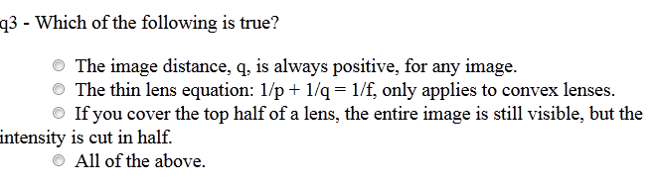
Warmup 25

Slide 24
Solve on Board

Slide 25
Imperfect Imaging
With the exception of flat mirrors, all imaging systems are imperfect
Spherical aberration is primarily concerned with the fact that the small angle approximation is not always valid
F
Chromatic Aberration refers to the fact that different colors refract differently
F
Both effects can be lessened by using combinations of lenses
There are other, smaller effects as well

Slide 26
Angular Size & Angular Magnification
To see detail of an object clearly, we must:
  Be able to focus on it (25 cm to ∞ for healthy eyes, usually ∞ best)
  Have it look big enough to see the detail we want
How much detail we see depends on the angular size of the object
θ₀
h
d
Two reasons you can’t see objects in detail:
For some objects, you’d have to get closer than your near point
  Magnifying glass or microscope
For others, they are so far away, you can’t get closer to them
  Telescope
Angular Magnification:
how much bigger the angular size of the image is
Goal: Create an image of an object that has
Larger angular size
At near point or beyond (preferably ∞)

Slide 27
The Simple Magnifier
The best you can do with the naked eye is:
  d is near point, say d = 25 cm
Let’s do the best we can with one converging lens
To see it clearly, must have |q| ≥ d
p
h’
h
-q
F
Maximum magnification when |q| = d
Most comfortable when |q| = ∞
To make small f, need a small R:
  And size of lens smaller than R
  To avoid spherical aberration, much smaller
  Hard to get m much bigger than about 5

Slide 28
The Microscope
A simple microscope has two lenses:
The objective lens has a short focal length and produces a large, inverted, real image
The eyepiece then magnifies that image a bit more
F_{e}
F_{o}
Since the objective lens can be small, the magnification can be large
Spherical and other aberrations can be huge
  Real systems have many more lenses to compensate for problems
Ultimate limitation has to do with physical, not geometric optics
  Can’t image things smaller than the wavelength of light used
  Visible light 400-700 nm, can’t see smaller than about 1 μm

Slide 29
The Telescope
A simple telescope has two lenses sharing a common focus
The objective lens has a long focal length and produces an inverted, real image at the focus (because p = ∞)
The eyepiece has a short focal length, and puts the image back at ∞ (because p = f)
f_{o}
f_{e}
F
Angular Magnification:
Incident angle:
Final angle:
The objective lens is made as large as possible
  To gather as much light as possible
In modern telescopes, a mirror replaces the objective lens
Ultimately, diffraction limits the magnification (more later)
  Another reason to make the objective mirror as big as possible
θ₀
θ

