Slide 1
Interference and Diffraction
Chs 37 and 38
Huygen’s Principle
Any wave (including electromagnetic waves) is able to propagate because the wave here affects nearby points there
  In a sense, the wave is the source for more of the wave
A wave here creates waves in all the forward directions
For a plane wave, the generated waves add up to make more plane waves
Notes:
Start 25

Slide 2
Diffraction Through a Tiny Hole
The waves come out in all directions
  It is only because the whole wave makes new waves that the waves add up to only go forwards
What if we let the wave pass through a tiny hole?
  Smaller than a wavelength
Only one point acts as source
Waves spread out in all directions
r
What’s interesting is that oscillations depend on distance from slit
Diffraction is bending

Slide 4
Interference Through Two Slits
Now imagine we have two slits, equally sized
Each slit creates its own waves
In some directions, crests add with crests to make bigger “brighter” crests
In others, crests combine with troughs to make minimum areas
In the end, what you get is a pattern of alternating light and dark bands
Derviation in book, skip to result:

Slide 5
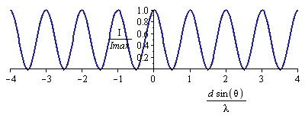
Two Slit Interference (2)
Where is it bright?
Where is it dark?

Slide 7
Solve on Board

Slide 8
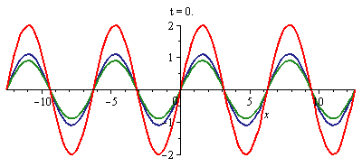
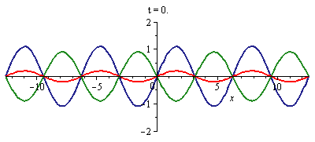
Phases
When you combine two (or more) waves, you need to know the phase shift between them:
  The angle φ is the phase shift
When the phase shift is zero, the waves add constructively
  The result is bigger
  Same thing for any even multiple of π
When the phase shift is π, the waves add destructively
  The result is smaller
  Same thing for any odd multiple of π
To find maximum/minimum effects, set phase shift to even/odd multiples of π

Slide 9
Phase Shift From Traveling
As a wave passes through any material, its phase shifts
For a distance d, we have:
Recall, wavelength λ changes inside a material
Light of wavelength 0.5 μm takes two paths, both of length 1 μm, one through air, the other through glass (n = 1.5). What is the difference in phase between the two waves in the end?
A) 0 B) π C) 2π D) 3π E) None of the above
1 μm

Slide 10
Solve on board

Slide 11
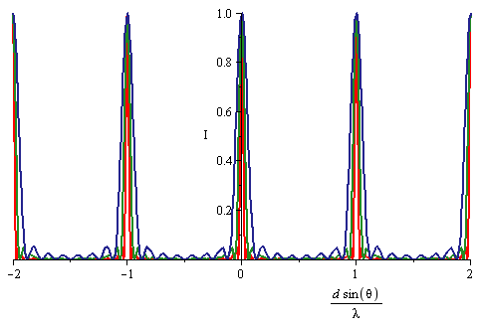
More Slits and Diffraction gratings
This process can be continued for more slits
  For N slits, every N – 1’th band is bright
  For large N, bands become very narrow
A device called a diffraction grating is just transparent with closely spaced regular lines on it
  You already used it in lab
N = 8
N = 16
N = 32
Diffraction gratings are another way to divide light into different colors
  More accurate way of measuring wavelength than a prism
  Commonly used by scientists

Slide 13
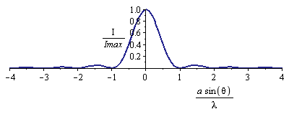
Diffraction through a single slit
What if our slit is NOT small compared to a wavelength?
Treat it as a large number of closely spaced sources, by Huygen’s principle
Let the slit size be a
Skip to result
x
a
Very similar to equation for multi-slit diffraction, but . . .
a is the size of the slit
This equation is for dark, not light
Note m= 0 is missing
  Central peak twice as wide

Slide 14
Solve on board

Slide 15
Screens and Small Angles
Usually your slit size/separation is large compared to the wavelength
  Multi-slit: Diffraction:
When you project them onto a screen, you need to calculate locations of these bright/dark lines
For small angles, sinθ and tanθ are the same
x
L

Slide 16
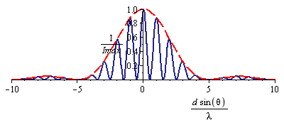
Diffraction and Interference Together
Now go through two finite sized slits
Result is simply sum of each slit
Resulting amplitude looks like:
a
d
a
a = d/5
Resulting pattern has two kinds of variations:
Fast fluctuations from separation d
Slow fluctuations from slit size a

Slide 17
Diffraction Limit:
When light goes through a “small” slit, its direction gets changed
Can’t determine direction better than this
a
If we put light through rectangular (square) hole,
we get diffraction in both dimensions
A circular hole of diameter D is a trifle smaller, which causes a bit more spread in the outgoing wave
For homework, use this formula; for tests, the approximate formula is good enough
a
D

Slide 19
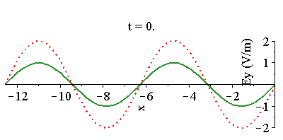
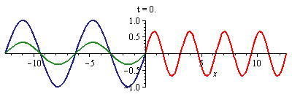
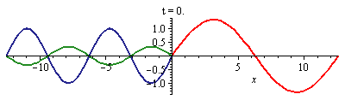
Reflection and Phase Shift
When you reflect off of a mirror, the reflected wave must cancel the incoming wave
  It has a π phase shift
When you go from a low index of refraction medium to a high one, some of the wave is reflected
  It also has a π phase shift
π phase shift
π phase shift
When you go from a high index of refraction medium to a low one, some of the wave is reflected
  This has a 0 phase shift
0 phase shift

Slide 20
Concept Question
Suppose we are in a glass medium, and we have a wave that goes from glass to air to glass. If the layer of air is much smaller than one wavelength, then the two reflected waves will add
A) Constructively B) Destructively C) Insufficient Info
First transition: high to low
  no phase shift
Second transition: low to high
  π phase shift
Compared to each other, the two waves are π out of phase with each other
They will have a tendency to cancel
Very little effect from layer if thinner than a wavelength

Slide 21

Interference from Thin Films
Suppose we go through a thin soap film
  Index goes up then down
Front surface:
Phase shift of π from reflection (low-high)
Back surface:
Phase shift of 2πt/λ from traveling
Phase shift of 0 from reflection
Phase shift of 2πt/λ from traveling
Total phase shift between two reflected waves:
Weak reflection when odd times π:
Strong reflection when even
Same results for index down then up
Opposite for:
  Index up, then up
  Index down, then down
t

Slide 22
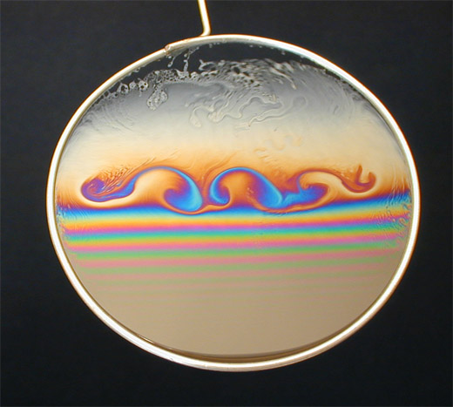
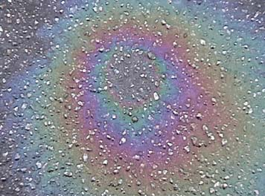
Applications of Thin Film Interference
What if the light isn’t monochromatic?
Some wavelengths are enhanced, others are not
  Soap bubbles
  Oil on water
Newton’s rings: convex lens on flat glass plate
  Air gap changes thickness in circular pattern
  Alternating light/dark regions
d
narrow air gap

Slide 23
Solve on Board

Slide 24
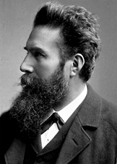
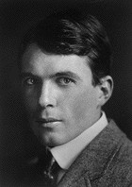
Crystal Scattering of X-rays
Mysterious rays were discovered by Röntgen in 1895
  Suspected to be short-wavelength EM waves
  Order 1-0.1 nm wavelength
Scattered very weakly off of atoms
Bragg, 1912, measured wavelength accurately
θ
θ
d
dcosθ
Scattering strong only if waves are in phase
Must be integer multiple of wavelength
dcosθ

Slide 25
Polarization
B₀
Recall that light waves have electric and magnetic fields perpendicular to the direction of motion
  But there are two independent ways of arranging this
  Called polarization
Our eyes can’t tell these two polarizations apart
But some instruments can measure or take advantage of polarization
We describe polarization by telling which direction the electric field points, e.g. vertically or horizontally
A polarizer polarizes light along its transmission axis.
Malus’s Law
E₀
E₀
B₀

Slide 26
Methods of Producing Polarization (1)
Direct production
Antennas produce waves that are automatically polarized
Scattering
Light waves of all orientations hit small targets
Target has vibrating charges, like an antenna
Reflection and Brewster’s Angle:
When light hits a substance, some of it reflects and some refracts
Fraction of each depends on polarization
There’s a special angle – Brewster’s angle – where reflected is completely polarized
++++++
– – – – – –
E₀
n₁
θ_{P}
n₂

Slide 27
Methods of Producing Polarization (2)
Birefringent Crystals
Index of refraction has to do with electric fields from the wave pushing atoms around
In some crystals, it is easier to push them one way than another
Index of refraction depends on polarization
You can use such birefringent crystals to sort light based on polarization
Selective absorption
Similarly, some materials absorb one polarization better than another
E₀
E₀
E₀
E₀
E₀

Slide 28

Some uses for Polarization
Polarized Sun Glasses
“Glare” comes mostly from light scattered in the atmosphere and reflected from water
  Mostly polarized
  Sun glasses use selective absorption to eliminate it
Optical Activity
Some materials are capable of rotating the plane of polarization
These materials are not mirror-symmetric
  Enantiomers, especially biological molecules
Studying rotation of polarized light detects presence of these molecules
E₀
Sugar water
E₀

Slide 30
Solve on Board

