Slide 1
The Big Bang Theory
Ways of Labeling Past Events
Time in the Universe
We can see the universe is expanding
Extrapolating backwards, we conjecture that there is a time when everything was together
We will call this event The Big Bang
We will call this time t = 0
Though in fact, we can’t actually extrapolate all the way to t = 0
The big bang theory really describes all the things that happen after t = 0
As we work our way backwards, we will discover that conditions/temperatures/etc. become increasingly difficult to do experiments
Therefore, we pass from knowledge to speculation the earlier we get
Any comments about t = 0 or even t < 0 are pretty much pure speculation

Slide 2
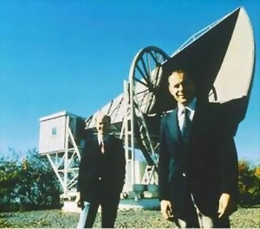
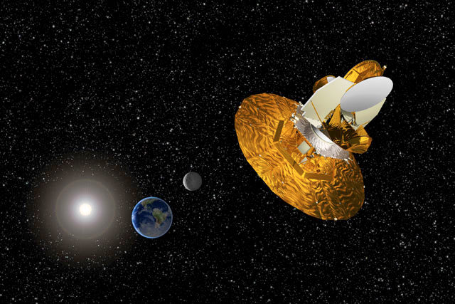
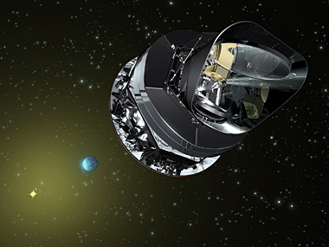
The Cosmic Microwave Background Radiation
In 1964, Arno Allan Penzias and Robert Woodrow Wilson discovered microwaves of extraterrestrial origin
Since then, dedicated spacecraft have been sent up to study it in great detail
These observations allow us to see directly back to when the universe was only a few thousand years old
Indirectly, they allow us to study the universe almost back to the big bang
Wilkinson Microwave Anisotropy Probe
Planck Observatory

Slide 3
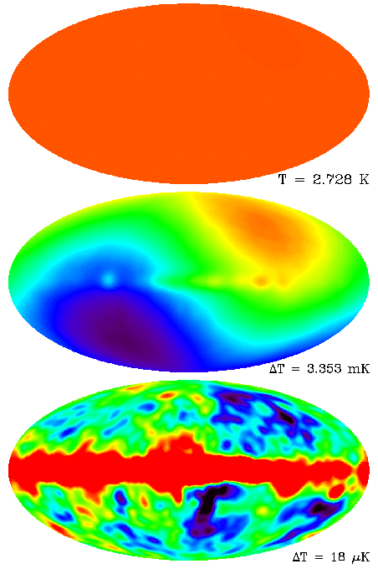
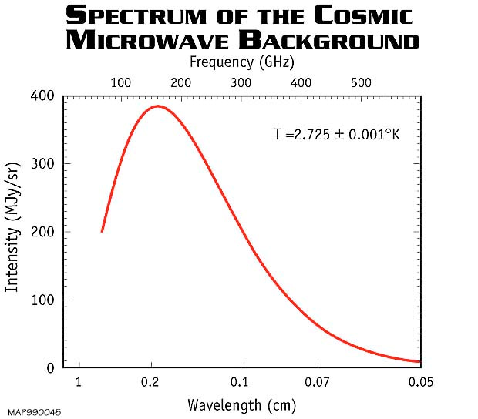
The CMBR – What We See
The CMBR is almost a perfect thermal spectrum
Furthermore, it is almost exactly isotropic
Slightly hotter in one direction
This is due to OUR peculiar velocity – about 370 km/s
Which can also be subtracted
There are foreground sources that also have to be subtracted

Slide 4
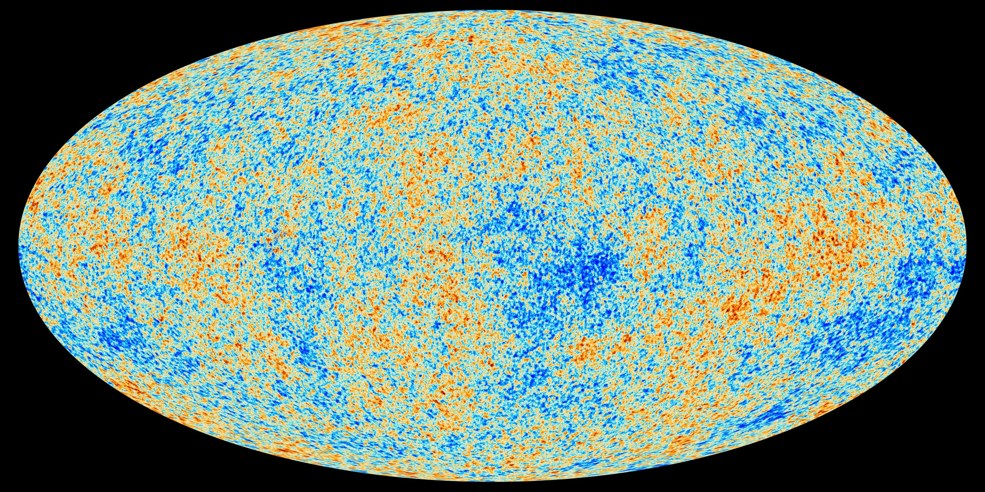
The CMBR – The True Variation
You then subtract foreground sources
What remains are a few ppm true fluctuations

Slide 5
Radiation in the Evolving Universe
As the universe expands, the density of radiation energy changes
Number density of radiation changes proportional to a^{–3}
However, the wavelength also expands proportional to a
This implies frequency decreases proportional to a^{–1}
Each photon reduces its energy as a^{–1}
Total energy density proportional to a^{–4}
Mass density proportional to a^{–4}
Today it is thermal at temperature T₀. What was it yesterday?
Recall that for thermal distribution, probabilities satisfy
Number of photons in any given state doesn’t change
But the energy of the states does change.
A thermal distribution remains thermal at all times
To explain why it is thermal now, explain why it was thermal in the past

Slide 6
Three Ways of Labeling Past Events
Past events can be labeled by what time t they happened (s or yr)
They can also be labeled by their red-shift z, or z+ 1
I won’t be using this one much
We can also label them in terms of temperature T (in K)
Or even multiply by Boltzmann’s Constant to get energy k_{B}T (in eV)
The relation is simple:
This works well back to very early times
Imprecise at high z (10⁹) due to electron-positron annihilation
Breaks down completely at inflation (10²⁷?)
Beyond z = 10⁹ we won’t use z at all, but will use k_{B}T

Slide 7
Outline of History of Universe
Time T or k_{B}T Events
10⁻⁴³ s 10¹⁸ GeV Planck Era; time becomes meaningless?
10⁻³⁹ s 10¹⁵ GeV Inflation begins; forces unified
10⁻³⁵ s 10¹⁴ GeV Inflation ends; reheating; forces separate; baryosynthesis (?)
10⁻¹³ s 1500 GeV Supersymmetry breaking, LSP (dark matter)
10⁻¹¹ s 160 GeV Electroweak symmetry breaking
14 μs 150 MeV Quark Confinement
0.4 s 1.5 MeV Neutrino Decoupling
1.5 s 0.7 MeV Neutron/Proton freezeout
20 s 170 keV Electron/Positron annihilation
200 s 80 keV Nucleosynthesis
57 ky 0.76 eV Matter-Radiation equality
370 ky 0.26 eV Recombination
300 My 40 K First Structure/First Stars
13.8 Gy 2.725 K Today
The matter era

Slide 8
The Matter Dominated Era
Time–Red-Shift Relation
In the recent past, the universe was dominated by matter
The age of the universe now is given by:
Recall: x = a/a₀ = 1/(1+z)
Time-red-shift relation:
For z > 1 or so, the Ω_{m}/x term dominates, ignore the others
Substitute H₀ = 67.7 km/s/Mpc and Ω_{m} = 0.3111
Complete actual relation:
For small z, we neglected Ω_{Λ}
12% error at z = 1, 1% error at z = 4
For large z (z >1000) this formula is wrong because we neglected radiation

Slide 9
Time – Temperature Relations
Rewrite in terms of temperature
More meaningful to rewrite in terms of k_{B}T:

Slide 10
Recombination
Thermal or Not Thermal?
For something to be in thermal equilibrium, it must interact with something
Let Γ by the rate at which something interacts, say by scattering
To thermalize, it must make many scatterings in the age of the universe t
Number of scatterings is Γt
If Γt < 1, then no scattering
Distribution of particles will be unmodified; universe is transparent
If Γt >> 1, then lots of scattering
Universe is opaque, particles may become “thermalized”

Slide 11
Cross Section and Rates
The cross-section σ is the area of the targets that are getting hit by some sort of projectile
Units of area: m²
The rate will also be proportional to the number density of targets n
Units of m⁻³
It will also be proportional to the speed at which they come together
Units m/s
Put it all together

Slide 12
What Thermalizes Photons?
Photons can scatter off of any charged particle
Most likely with light particles, like electrons
Cross section – comes from particle physics
k_{e} is Coulomb’s constant
m is mass of electron
e is electron charge
This assumes the electrons are free
If bound in atoms, cross-section is much lower
What is current density of electrons in the universe?
Density of “baryons”, worked out in homework
But only 75% of it is actually hydrogen
Most of them are protons
Neutral universe → Comparable # electrons
The density in the past was higher
e⁻

Slide 13
When Did Photons Get Thermalized?
Relative velocity is c:
Age of universe at red shift z is:
Number of collisions is:
At present, (z = 0), universe is transparent
In the past (z ≈ 61) universe is opaque if electrons were free
Electrons are free now because of colliding galaxies, hot stars, etc.
Before z = 8.5, most electrons were bound
Temperature at z ≈ 61 was
Corresponding energy
Compare to hydrogen binding energy

Slide 14
Outline of History of Universe
Time T or k_{B}T Events
10⁻⁴³ s 10¹⁸ GeV Planck Era; time becomes meaningless?
10⁻³⁹ s 10¹⁵ GeV Inflation begins; forces unified
10⁻³⁵ s 10¹⁴ GeV Inflation ends; reheating; forces separate; baryosynthesis (?)
10⁻¹³ s 1500 GeV Supersymmetry breaking, LSP (dark matter)
10⁻¹¹ s 160 GeV Electroweak symmetry breaking
14 μs 150 MeV Quark Confinement
0.4 s 1.5 MeV Neutrino Decoupling
1.5 s 0.7 MeV Neutron/Proton freezeout
20 s 170 keV Electron/Positron annihilation
200 s 80 keV Nucleosynthesis
57 ky 0.76 eV Matter-Radiation equality
370 ky 0.26 eV Recombination
300 My 40 K First Structure/First Stars
13.8 Gy 2.725 K Today

Slide 15
Recombination – What It Is
The universe has thin gas of atoms, mostly hydrogen nuclei
There are a matching number of electrons
At high temperatures, the electrons prefer to be free
As temperature drops, they are attracted to the nuclei
The process where they come together is called recombination
p⁺
e⁻
Before recombination, the universe is opaque
And therefore in thermal equilibrium
After it, universe is transparent
The microwave background shows us universe at recombination
e⁻
p⁺
e⁻
e⁻
p⁺
Throughout recombination, universe in thermal equilibrium
We want to know when this happens.
We already know density of hydrogen atoms
p⁺

Slide 16
The Saha Equation (1)
At modest values of z, the temperature was cold enough that hydrogen is atomic
As z increases, temperature rises
Eventually, hot enough for atoms to be ionized
Density of photons is so high, electrons are in thermal equilibrium with them
Will electrons be free or bound? Depends on temperature
For a thermal distribution, probability for each possibility is:
First: Bound electrons in hydrogen:
Binding energy E = –E_{b} = – 13.6 eV
Density proportional to density of free protons:
Second: Free electrons:
Kinetic energy
Density requires us to add up all intermediate states
We need the ratio of these expressions

Slide 17
The Saha Equation (2)
We want to know what fraction x of electrons are free (same as free protons)
Let x be the fraction of hydrogen atoms that are free
Same as density of free protons
Density of bound electrons is
Substitute this all in:
Binding energy E_{b} = 13.6 eV
Density of hydrogen is
Substitute it all in:
Need to bind about 99% (?) of electrons to make universe transparent

Slide 18
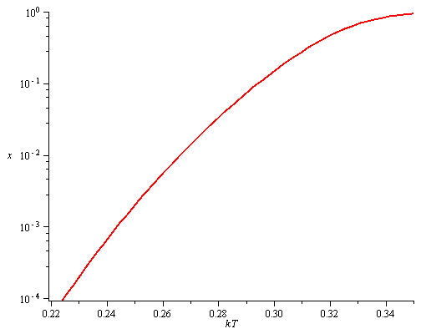
The Saha Equation (3)
Universe Transparent
My calculations indicate universe becomes transparent at k_{B}T = 0.265 eV
For some reason this number came out a little wrong
Actual recombination is at k_{B}T = 0.256 eV
Universe Opaque

Slide 19
Recombination – The Results
Universe becomes transparent at about k_{B}T* = 0.256 eV
This corresponds to z* = 1090 or T = 2973 K
Age of universe can be approximated as:
This is inaccurate because we are too close to radiation era
Time T or k_{B}T Events
373 ky 0.26 eV Recombination
The cosmic microwave background shows us the temperature of the universe at this time
We still have to explain the small fluctuations (much later)

