Slide 1
Galaxy Classification
General Categories
Some Cautionary Notes
Galaxies are not alike
For every general rule I give, one can find exceptions
Classifying galaxies is difficult
They look different in different wavelengths
If the galaxy is moving, you have to correct for red-shift
Even experts often disagree on the classification
There are different systems for classifying galaxies
The original one, developed by Hubble, is the basis for most other systems
I will use the Hubble - De Vaucouleurs system
An expansion on the original Hubble system

Slide 2
The Categories
Galaxies are classified by their appearance
Unbarrred Spiral
Central roundish bulge plus disk
Barred Spiral
Central elongated bulge plus disk
Elliptical
Roundish or elongated bulge, no disk
Irregular
No discernible shape
Dwarf Spheroidal
Small, dim, and round

Slide 3
Unbarred Spiral Galaxies
General Description
Denoted SA
Pinwheel-like
Central bulge, spiral arms
Spiral arms, etc., signs of rotation
Bulge is round
Young and old stars, gas, dust
80% of large galaxies are Spirals (Barred or Unbarred)
Sub-classified by amount of arms, and how tight or loose they are
SA0 - no distinguishable spiral arms
SAa, SAb, SAc, SAd - more spiral arms, and looser
SAm – no bulge, typically one distorted spiral arm

Slide 4
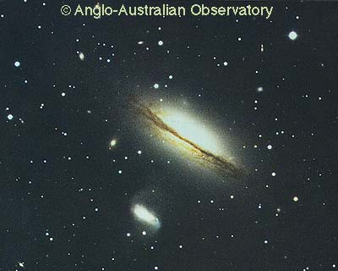
SA0
Also called lenticular galaxies
Central Bulge
Disk
No Spiral arms

Slide 5
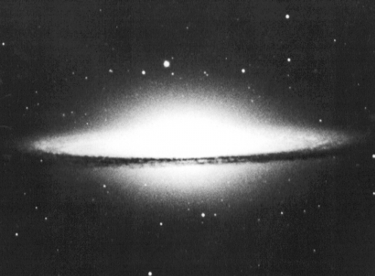
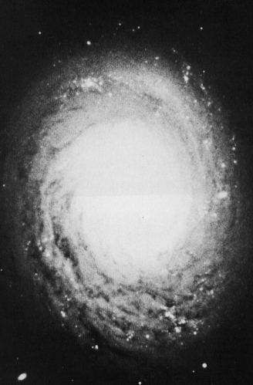
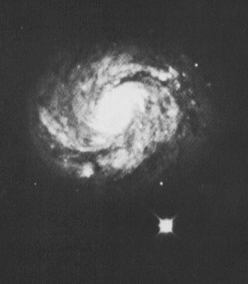
SAa
Central Bulge
Disk
Tight spiral arms

Slide 6
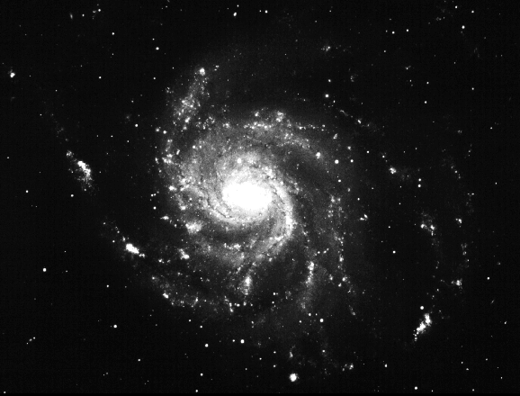
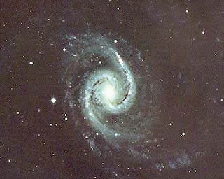
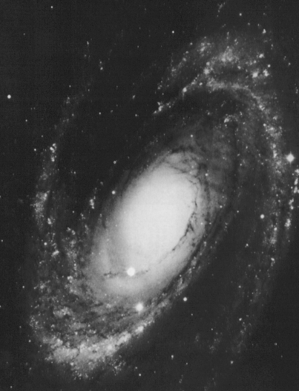
SAb
Central Bulge
Disk
Spiral arms

Slide 7
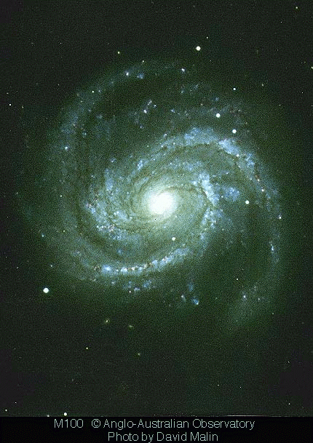
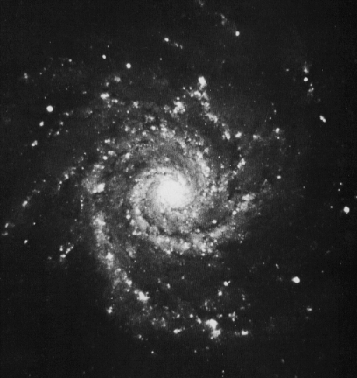
SAc
Central Bulge
Disk
Loose spiral arms

Slide 8
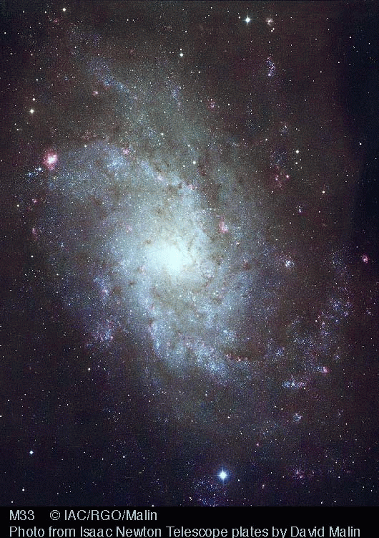
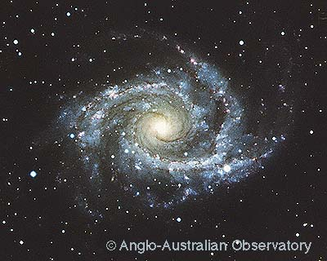
SAd
Central Bulge
Disk
Very Loose Spiral arms
Often, spiral arms are disconnected or broken

Slide 9
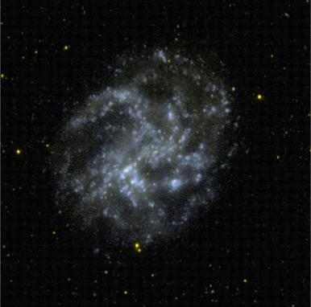
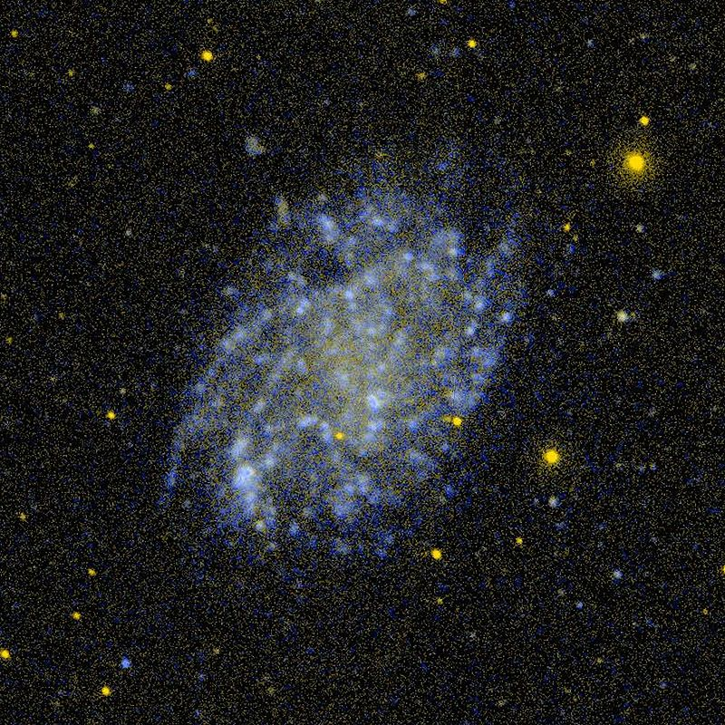
SAm
Classified by Hubble as irregular galaxies
They have just a bulge and typically one spiral arm
Probably a spiral galaxy disturbed by collision with a larger galaxy

Slide 10
Spiral Galaxy Structure
Overall, very similar to Milky Way
Disk contains
Gas
Dust
Young and old stars
Open clusters
Stars in the disk orbit in approximately circular orbits
The bulge contains older stars
Orbits much more random
The halo contains oldest stars and globular clusters
Orbits completely random
Most (all?) galaxies seem to have black holes in their centers
The disk
The bulge
The nucleus
The halo
Globular clusters

Slide 11
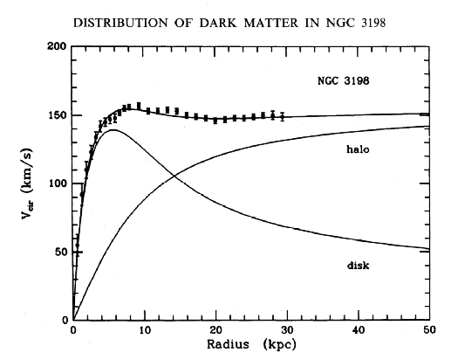
Dark Matter in Spiral Galaxies
Spirals Rotate
Rotation measured by Doppler shift
Mass, again, not concentrated in the center
85% of mass is dark matter
Flat rotation curves → dark matter

Slide 12
Barred Spiral Galaxies
General Description
Denoted SB
It is now believed that most spiral galaxies have at least some bar
Pinwheel-like
Central bulge, spiral arms
Spiral arms, etc., signs of rotation
Bulge is straight - barred
Young and old stars, gas, dust
80% of large galaxies are spirals or barred spirals
Sub-classified by amount of arms, and how tight or loose they are
SB0 - no distinguishable spiral arms
SBa, SBb, SBc, SBd - more spiral arms, and looser
SBm – no bulge, typically one distorted spiral arm

Slide 13
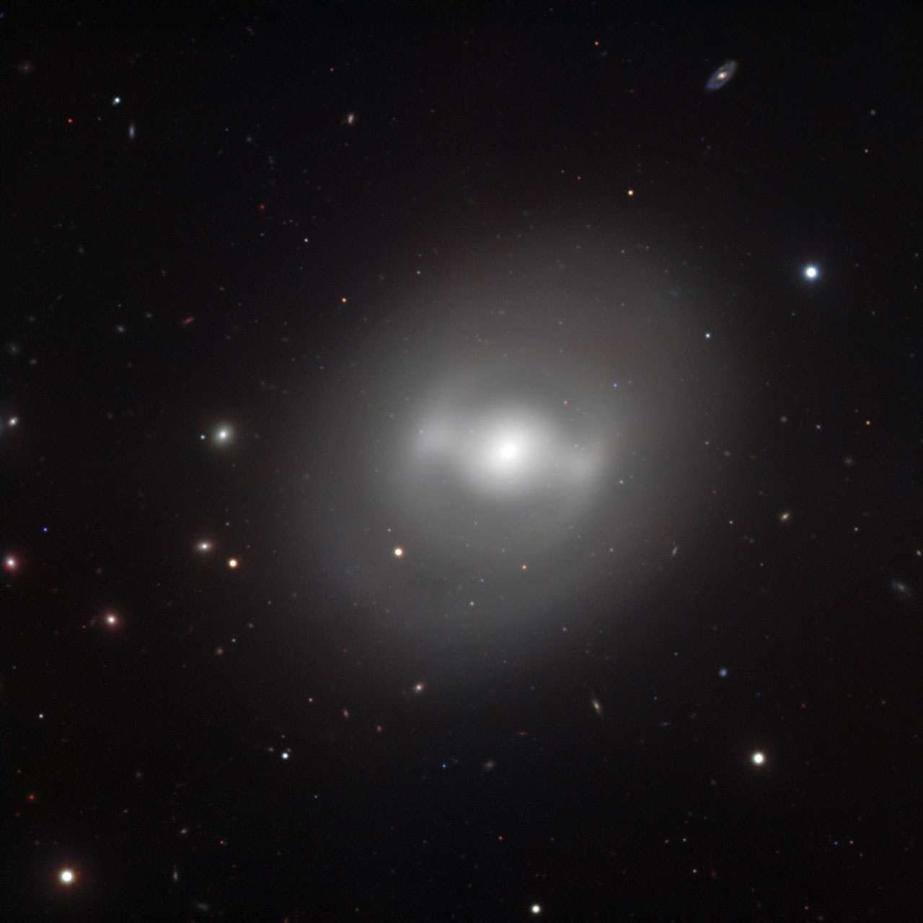
SB0
Also called lenticular galaxy
Central Bulge
Disk
No Spiral arms

Slide 14
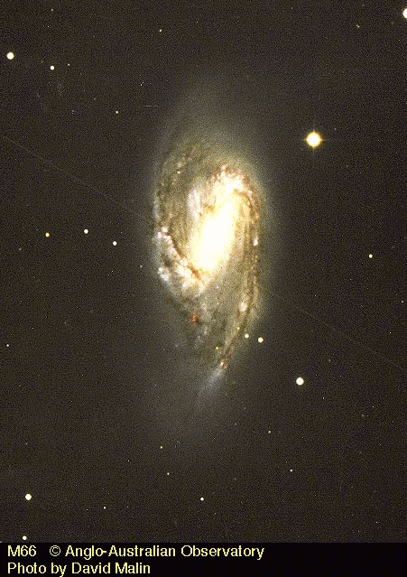
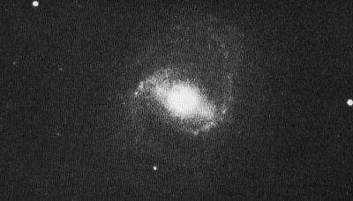
SBa
Central barred bulge
Disk
Tight spiral arms

Slide 15
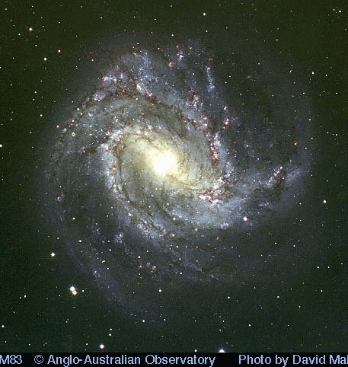
SBb
Central Bar
Disk
Spiral arms
This is approximately galaxy type of the Milky Way

Slide 16
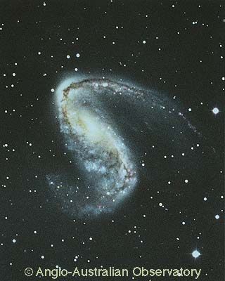
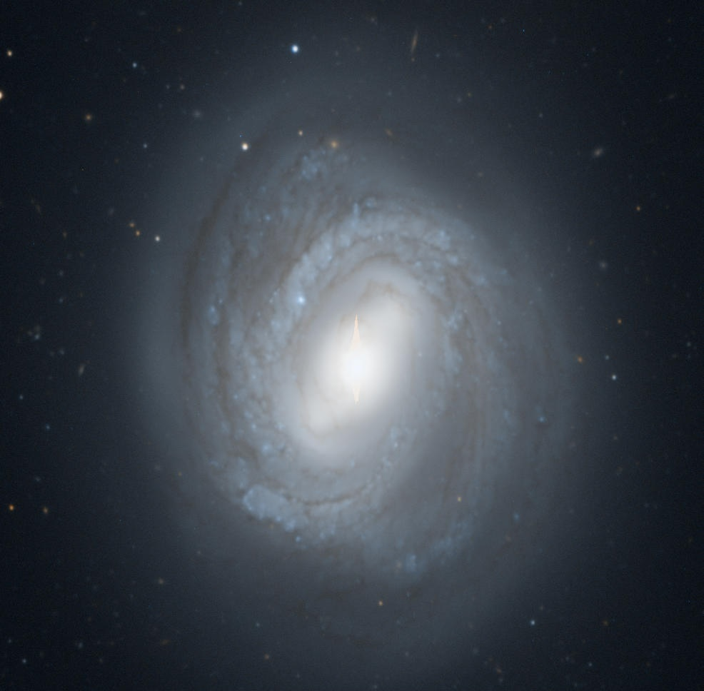
SBc
Central Bar
Disk
Looser spiral arms

Slide 17
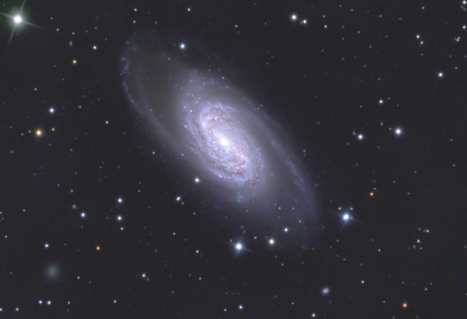
SBd
Central Bar
Disk
Very loose spiral arms
Often the arms are partially disconnected

Slide 18
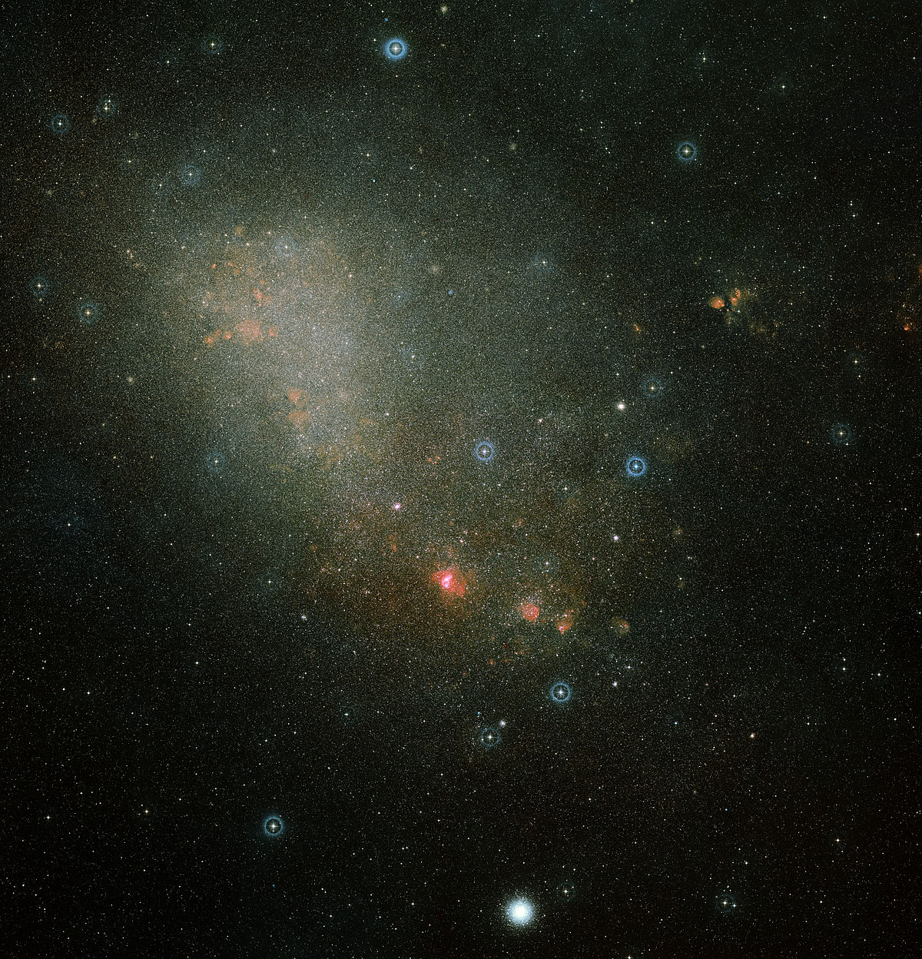
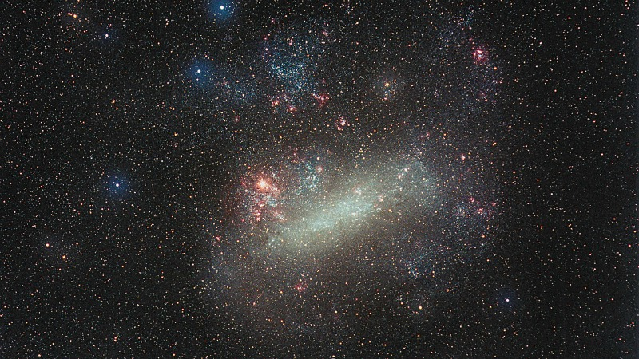
SBm
Classified by Hubble as irregular galaxies
They have just a bulge and typically one spiral arm
Coming off of a bar-shaped central region
Probably a barred spiral galaxy disturbed by collision with a larger galaxy

Slide 19
Intermediates
The amount of barring and the amount of spiral arms are continuous variables
As we have gotten better at classifying, it becomes useful to have categories between these
Between the spirals (SA) and the barred spirals (SB) are the intermediate spirals
Denoted SAB
Between each of the categories a through d, there are intermediate
Denoted by using both letters, like bc
For example, a SABcd galaxy would have
Some barring, but not as much as an SB galaxy
Looser arms than an SABc, but tighter than SABd

Slide 20
Barred Versus Unbarred Spirals
It is not obvious what causes bars to form
Numerical simulations indicate that over time, instability causes bars to form
Probably bars are a sign that a galaxy has “matured”
Over time, most (all?) unbarred spiral galaxies become barred spirals
Process takes a couple Gyr
Age of universe < 14 Gyr
Over long times, bars may also become unstable
May cause barred galaxies to return to unbarred (?)

Slide 21
Elliptical Galaxies
Categorization
Look like a sphere or a flattened sphere
Little gas and dust
Mostly old stars
Classified by how round they look
E0 looks circular
E7 is very elongated
There is a relatively objective way to classify them
Measure their long and short axes
Formula for the number is
Elliptical galaxies have the largest range of masses
Dwarf ellipticals are the smallest
Add the letter d in front, so it might be a dE2 galaxy
Giant ellipticals are the largest
2a
2b

Slide 22
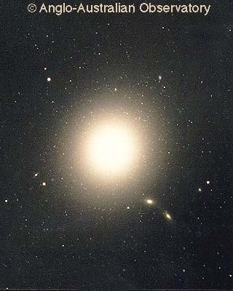
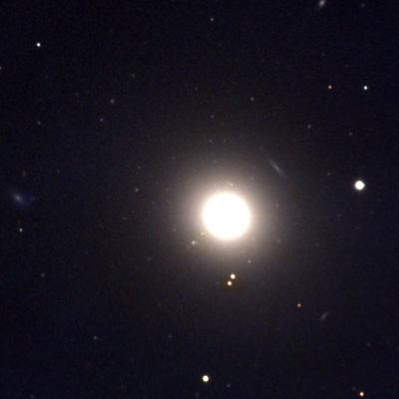
E0

Slide 23
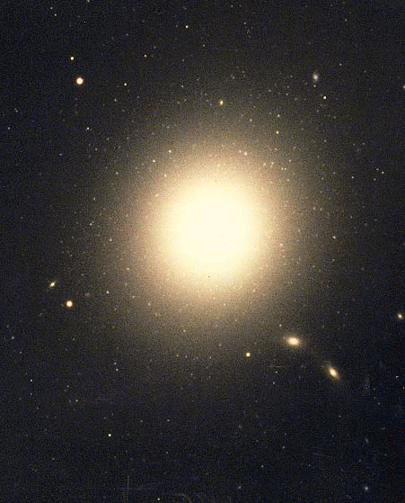
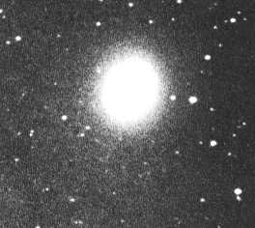
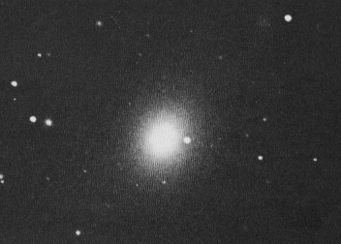
E1

Slide 24
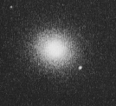
E2

Slide 25
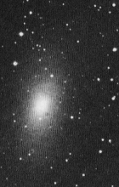
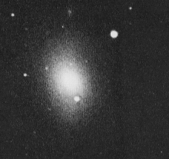
E3

Slide 26
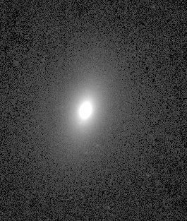
E4

Slide 27
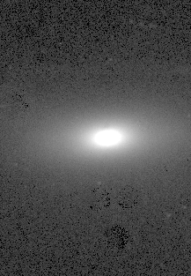
E5

Slide 28
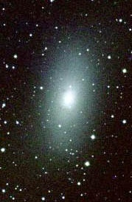
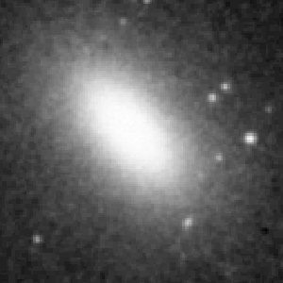
E6

Slide 29
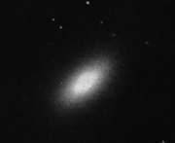
E7

Slide 30
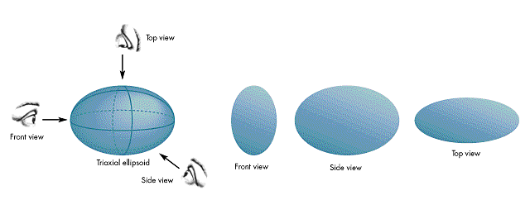
Elliptical Galaxy Shapes
Appearance may depend on angle of view
Amount of flattening probably has to do with rotation
Beyond E7, galaxy probably becomes unstable

Slide 31
Elliptical Galaxy Structure
Rather different from the Milky Way
Typically contains only old stars
Star orbits can be
Completely random, or
Have a bias so there is net angular momentum of the galaxy
Probably, the more rotation there is, the more flattened the shape is
No gas and dust, so no new stars
Halo often contains low-density hot gas
The visible part
The nucleus
The halo
Globular clusters

Slide 32
Elliptical Halos
Elliptical galaxies don’t have thick clouds, but they do have diffuse, hot gas
These gasses emit X-rays
Gravity vs. pressure – they expand to make a giant sphere
Amount of gravity tells us 85% of the mass of the galaxy is dark matter in the halo

Slide 33
Dwarf Ellipticals
Some elliptical galaxies are much smaller than typical galaxies
Denoted dE, for dwarf ellipticals
There are typically no spiral galaxies of this size
These galaxies probably originally had gas, but all gas has since been consumed
These may have been the first galaxies ever formed
Other galaxies formed primarily from mergers of dwarf ellipticals

Slide 34
Giant Ellipticals
The largest galaxies tend to be elliptical galaxies
Still denoted by E
There are typically no spiral galaxies this large
They tend to be more round
They galaxies often have low densities of stars
They are therefore “low surface brightness galaxies”
Denoted D in the Yerkes classification system
The largest of these are called cD or Central Dominant galaxies
Usually at the center of a cluster of galaxies
Often contain multiple nuclei
Multiple giant black holes
Probably formed from the merger of many smaller galaxies

Slide 35
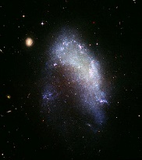
Other Types of Galaxies
Irregular Galaxies
Irregular galaxies don’t fit in well with the others
Some of them look a little like spiral galaxies
Gas, dust, young and old stars
Like a galactic disk, no spirals, a mess
Probably caused by disruptive collisions
Classified as Im

Slide 36
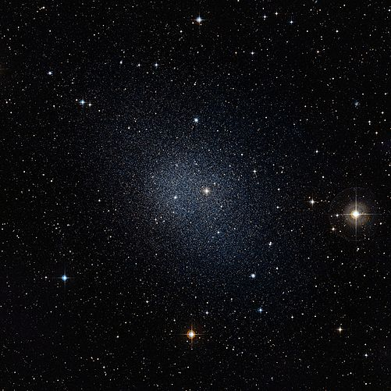
Dwarf Spheroidal Galaxies
Much lower mass than typical galaxies
Stars are spread out – low density
Mass of stars insufficient to hold them together
Strong indication they are mostly dark matter, not much else
Difficult to see beyond nearby galaxies
Denoted dSph

Slide 37
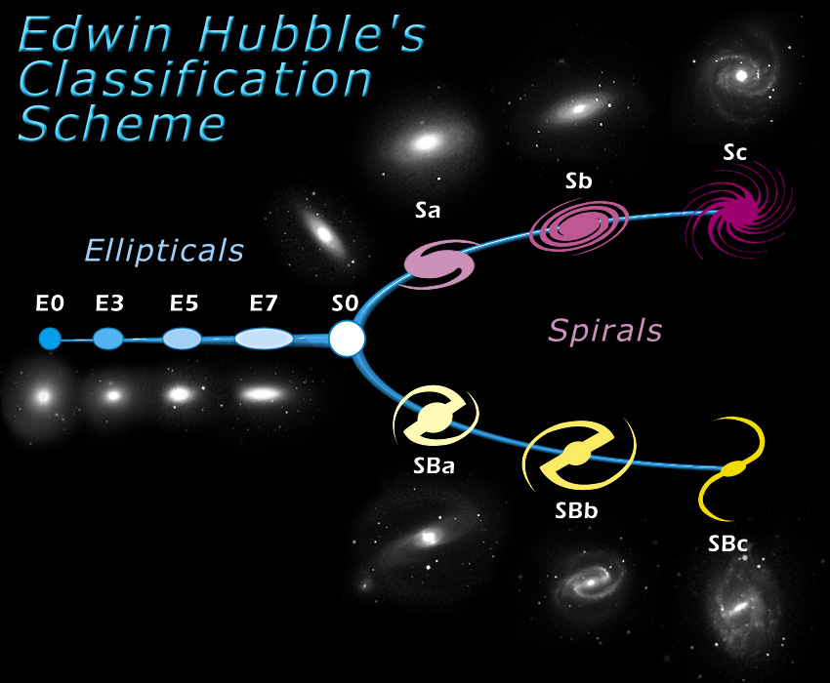
Putting it All Together
The Original Tuning Fork
Original Hubble classification had a two-pronged system that described how these go together
Because he didn’t have intermediate bars (SAB)
With the De Vaucouleurs system, it is now a three pronged fork
And the “tines” have gotten longer

Slide 38
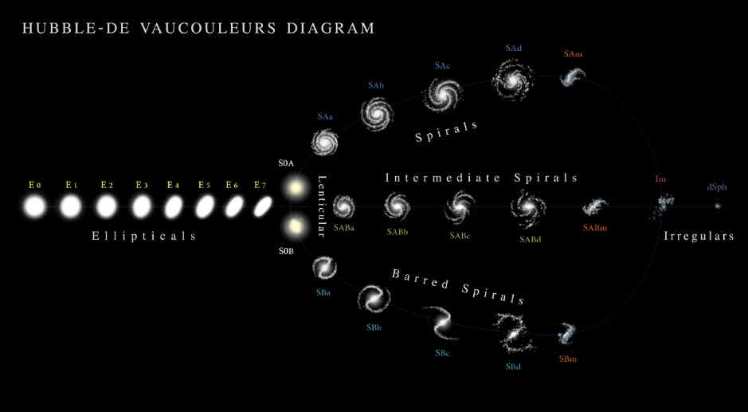
The Updated Tuning Fork

Slide 39
Differences - Spirals vs. Ellipticals
Spirals have disks and spiral structure
Spirals have dust/gas/young stars in the disk
Ellipticals have hot gas spread out through a large halo
Can we explain these differences?

Slide 40
Hot Gas Vs. Cool Gas
Hot gas has low density
Atoms cool off by colliding and radiating light
But at low density, collisions are rare
Low density gas cools slowly
Will not cool off in age of universe
Hot gas has pressure:
Gravity vs. pressure = sphere
An elliptical galaxy
Cool gas has high density
High density gas collides more often
And then can radiated that energy
Can cool off further in short time
Cool gas has little pressure, but still has rotation
Gravity vs. rotation = disk
A spiral (or barred spiral) galaxy

Slide 41
What Determines Galaxy Type?
If we have a source of cool gas:
Gas will form a disk
Disk will form stars
There will be young stars
If all gas is hot:
Gas remains in a giant halo, no disk
No star formation
No young stars
Conclusion: If you have a source of cool gas, you get a spiral or barred spiral, otherwise get elliptical

