Slide 1
Galaxy Collisions and Active Galaxies
Galaxy Collisions
What Happens When Galaxies Collide?
When two galaxies collide or nearly collide, what happens?
The stars do not collide with each other
The separation between them is very great
But the clouds of gas in them can collide
Also, the two galaxies can gravitationally influence each other
Even if they miss each other
Galaxy collisions take millions of years to occur
We don’t see any change in real time
But we can see galaxies in mid-collision
And we can see galaxies that have already collided

Slide 2
Near Miss Collisions
Suppose a galaxy of mass M is passing by another galaxy
As it passes, it pulls on each of the stars in the other galaxy
Let’s say it passes a star with an impact parameter b
And it is currently y from its closest point
The gravitational acceleration is
The position is continually changing
We need to integrate the acceleration over time
b
y

Slide 3
Tidal Friction
Not surprisingly, the closer and more massive the impactor is, the more effect it has
Perhaps surprisingly, the slower it moves, the more effect it has
Note that stars in different positions will have unequal accelerations
This effect is called tidal forces
The average acceleration will simply cause the entire galaxy to accelerate in the direction of the passing object
The passing object also accelerates towards the other
This just causes them to orbit each other
The differences in acceleration means that kinetic energy is being added to the internal motion of the stars in the galaxy
Causes the galaxy to expand
This “heating up” of the internal energy of the galaxy is called tidal friction
b

Slide 4
Orbital Decay
Suppose one galaxy is in orbit around the other
Each time it goes around, kinetic energy goes into the internal energy of the galaxies
This does disturb both galaxies a little
Not surprisingly the small galaxy is affected more
Where does the energy come from?
It must come from the kinetic energy of the overall motion
The galaxy slows down – its orbit gets smaller
Over several cycles, it gradually spirals towards the other galaxy
Eventually, the two galaxies will undergo a true collision

Slide 5
True Galaxy Collisions
What happens depends on relative size of the two galaxies
Big + Small:
Small galaxy is completely disrupted
Stars enter large galaxy
Over time, they get absorbed
Galactic cannibalism
This is currently happening in our own galaxy
Sagittarius Dwarf and Canis Major Dwarf – currently being disrupted
Virgo Stellar Stream – a dead galaxy whose stars are being absorbed
Two comparable sized galaxies:
At high speed, the galaxies can pass through each other
But gas clouds still collide
At low speed, the galaxies will merge

Slide 6
Comparable Size Galaxy Collisions
When comparable size galaxies collide, there are major consequences
Gas clouds collide
Gas compresses – can cause a dramatic sudden increase in star production
A starburst galaxy
Gas can get heated to high temperatures
Gas may get completely knocked out of the galaxies
If they collide at low speeds, the two galaxies will merge
Initially, the galaxy will be irregular (probably SAm or SBm or Im)
The energy converted to internal kinetic energy makes the resultant galaxy large in size
And, of course, increased mass
Depending on whether there is any cool gas left, eventually galaxy settles down to a spiral or elliptical

Slide 7
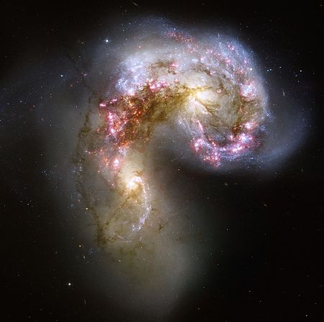
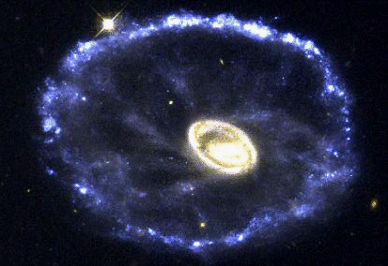
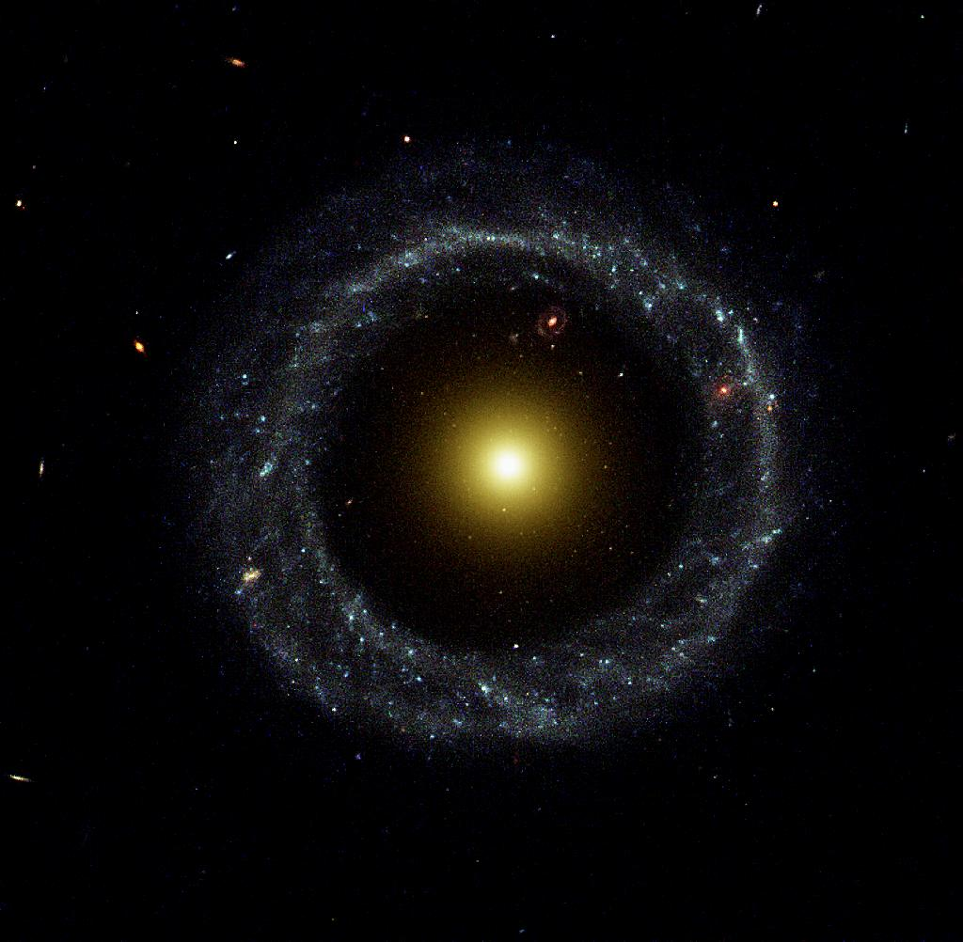
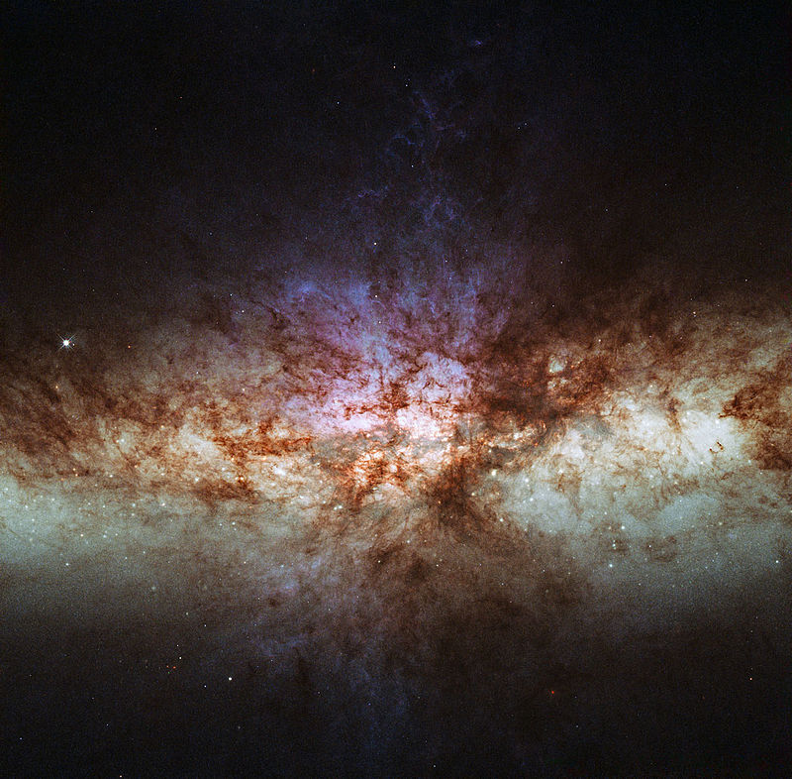
Starburst Galaxies
Fast star formation
Caused by compression of gas from recent galaxy collisions

Slide 8
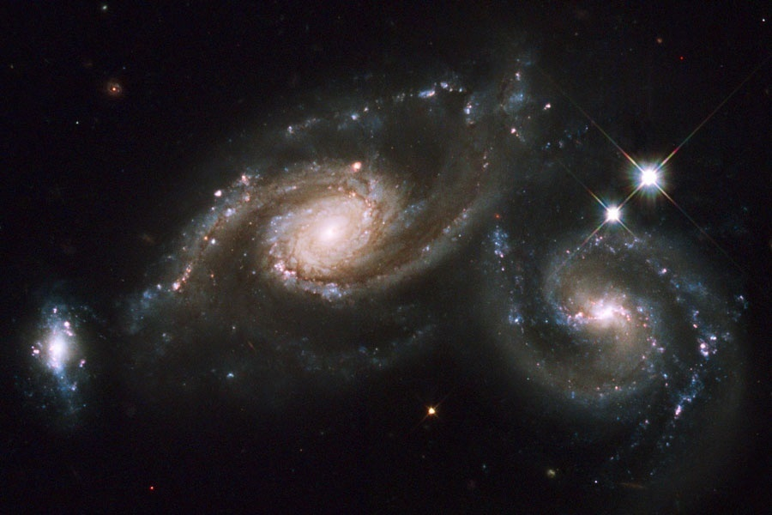
Colliding Galaxies – Images (1)

Slide 9
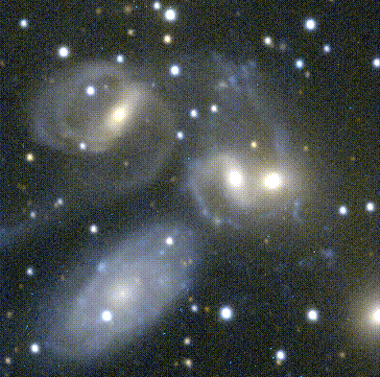
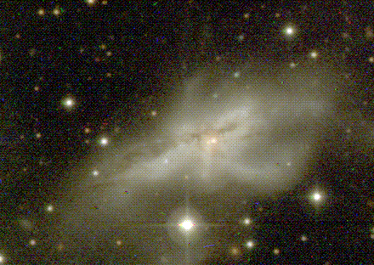
Colliding Galaxies – Images (2)

Slide 10
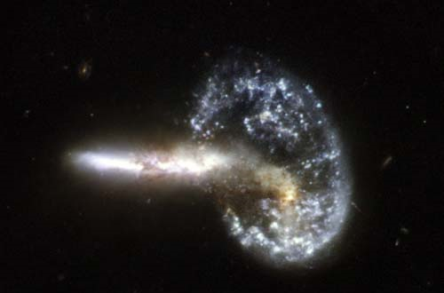
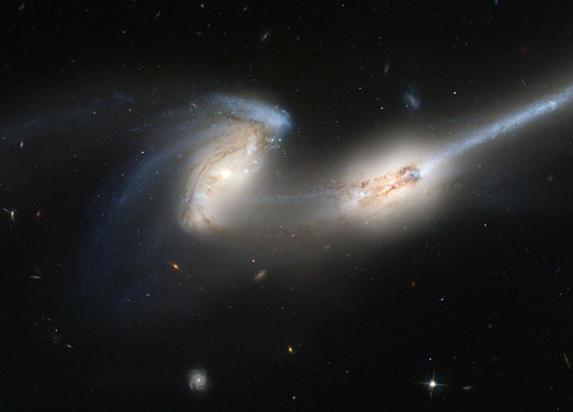
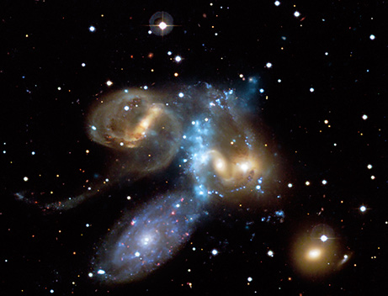
Colliding Galaxies – Images (3)

Slide 11
Milky Way Collision with Andromeda
Our galaxy is currently headed towards Andromeda, the nearest large galaxy
Distance about 780 kpc
Relative velocity measured by Doppler shift
Have to subtract Sun’s velocity around our galaxy
About 110 km/s
Transverse velocity measured recently by Hubble using proper motion
Very slow transverse motion
Suggests the two will collide, or nearly collide about 4 billion years from now
After initial encounter, two galaxies will probably merge “shortly” thereafter
MW - Andromeda Collision
Best guess is that after that, they will merge to make a large elliptical galaxy

Slide 12
Giant Elliptical Galaxies
In the centers of clusters of galaxies, many galaxies combine and merge
Collisions pretty much guarantee all the cold gas will be heated
It then will expand throughout the halo
The kinetic energy transferred to the stars causes the galaxy to become very large
And of course, it is very massive too
It will generally be almost spherical
These galaxies are now giant elliptical galaxies
The largest of these are the cD or central dominant galaxies
They are central because they tend to be at the center of clusters of galaxies

Slide 13
Looking Out = Looking Back
Light travels at about 0.3 pc per year
The farther away you are looking, the longer ago you are seeing
1 kpc → 3.3 ky
1 Mpc → 3.3 My
1 Gpc → 3.3 Gyr
You can see back almost to the beginning of the Universe!

Slide 14
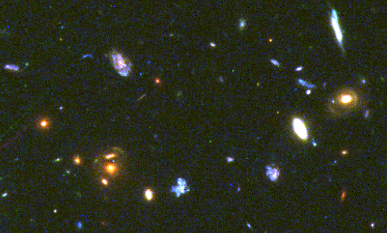
Galaxies Long Ago

Slide 15
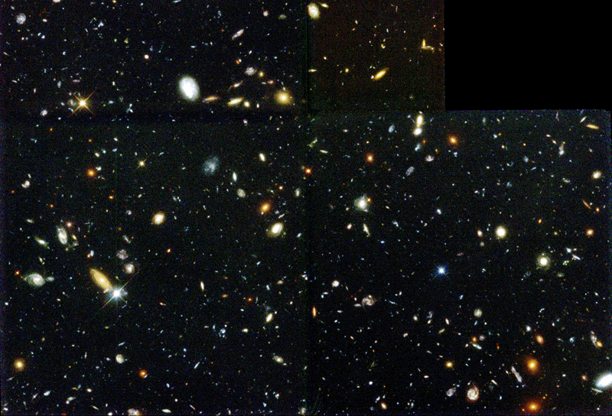
Galaxies Long, Long Ago

Slide 16
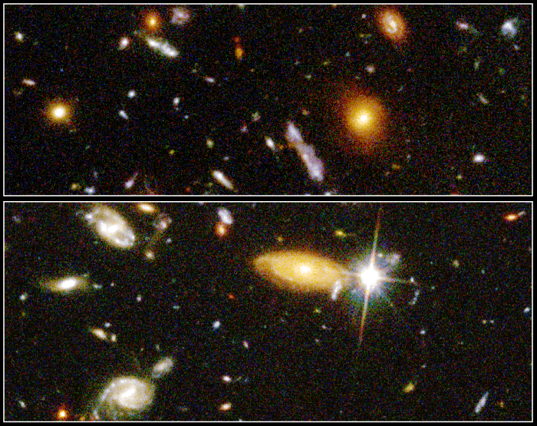
Galaxies Long, Long Ago (Close Up)

Slide 17
How Were Galaxies Different in the Past?
Generally, galaxies were smaller
Because small galaxies combined a lot to make the galaxies we see today
Generally, spirals were more likely to be unbarred (SA) than barred (SB)
Because bars take a lot of time to form
There were more irregular galaxies back then
Because collisions were still building galaxies

Slide 18
Active Galaxies
General Description
Most of the power of galaxies come from the stars
Almost all nearby galaxies
Some galaxies have very bright sources right at the center
Can be as bright as a galaxy!
Or even much brighter
Called Active Galactic Nuclei (AGN’s)
They can be incredibly bright
Up to 10¹⁵ L_{Sun}
Their power comes out with different spectra
Visible
Radio
Some of them vary their power in a day or less
This proves they are very, very small!
Infrared
Ultraviolet
X-rays

Slide 19
Fast Implies Small
A large source will not – can not – change all at once
Roar from a stadium crowd
Light (and other EM radiation) travels at c
If it changes in a time t it must be no larger than
If it changes in a day, its size is no bigger than

Slide 20
Types of Active Galactic Nuclei (AGN’s)
Seyfert Galaxies
Relatively dim as AGN’s go
Emission lines – shows something exciting atoms to high temperature
Usually Spiral galaxies – with lots of gas in plane of galaxy
Seyferts subcategorized as Seyfert 1 and Seyfert 2
Seyfert 1 – broad emission lines – shows source has high velocity, more than 10,000 km/s
Seyfert 2 – narrow emission lines – source is moving more slowly
Radio Galaxies
Produce enormous amounts of radio energy
Often, the radio emission is mostly not from the nucleus
Radio Quiet Quasars
Similar to Seyfert 1’s, but much brighter
Radio Noisy Quasar
Blazars / BL Lacartae Objects
Visible and radio signal can vary in as little as an hour

Slide 21
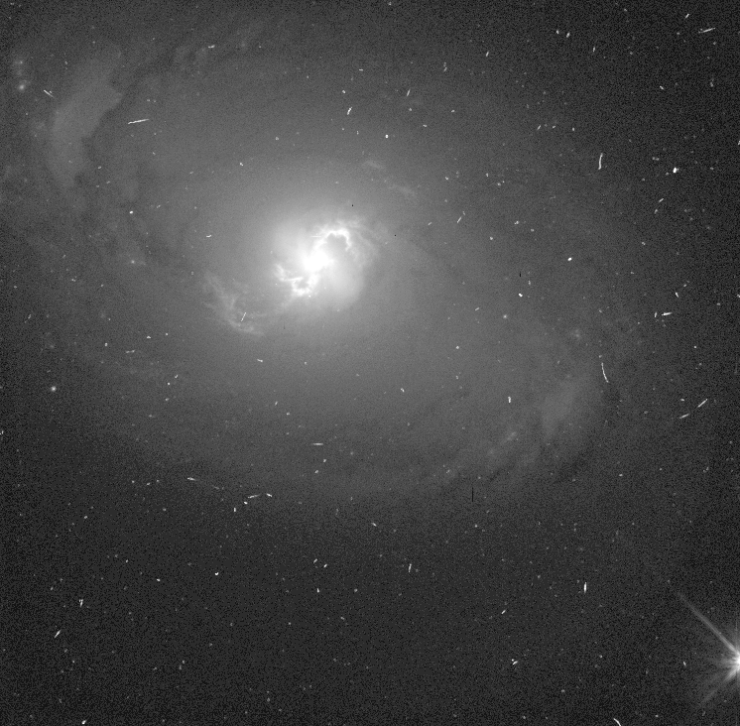
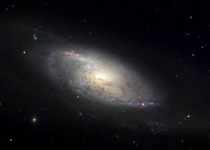
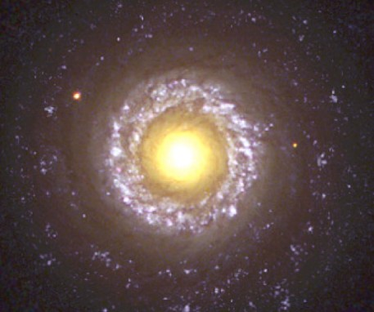
Seyfert Galaxies – Images

Slide 22
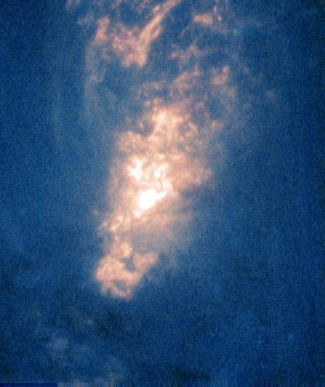
Core of a Seyfert Galaxy

Slide 23
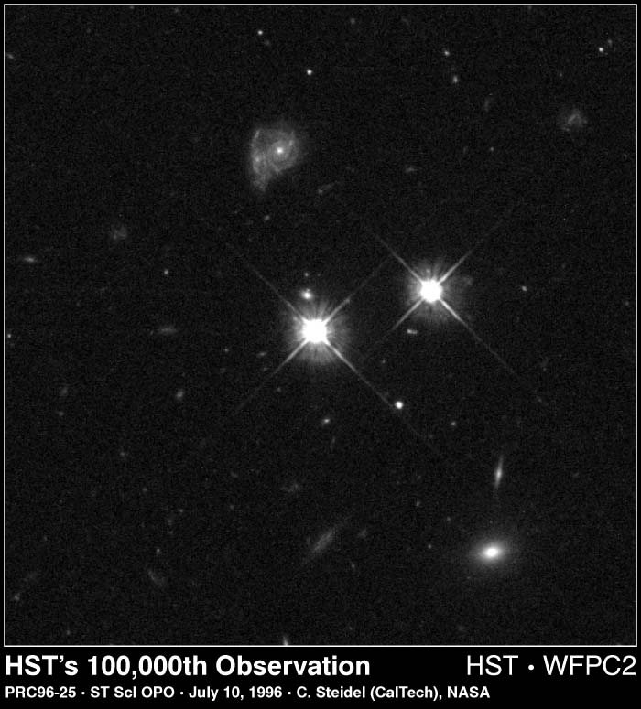
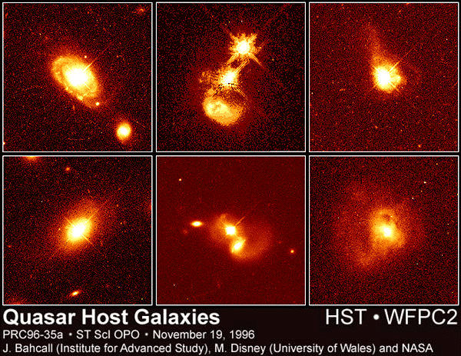
Quasars (1)
Other Galaxies
Quasar
Foreground Star

Slide 24
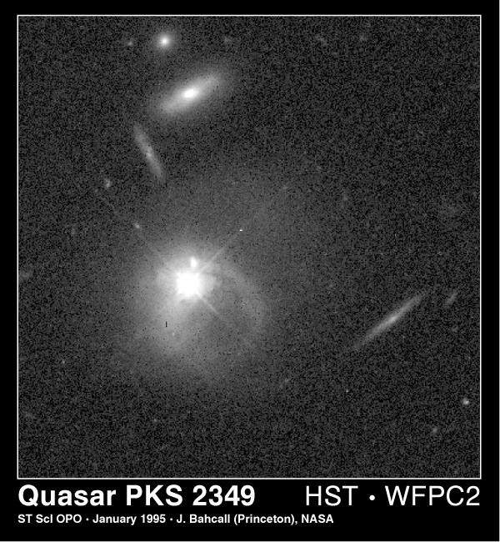
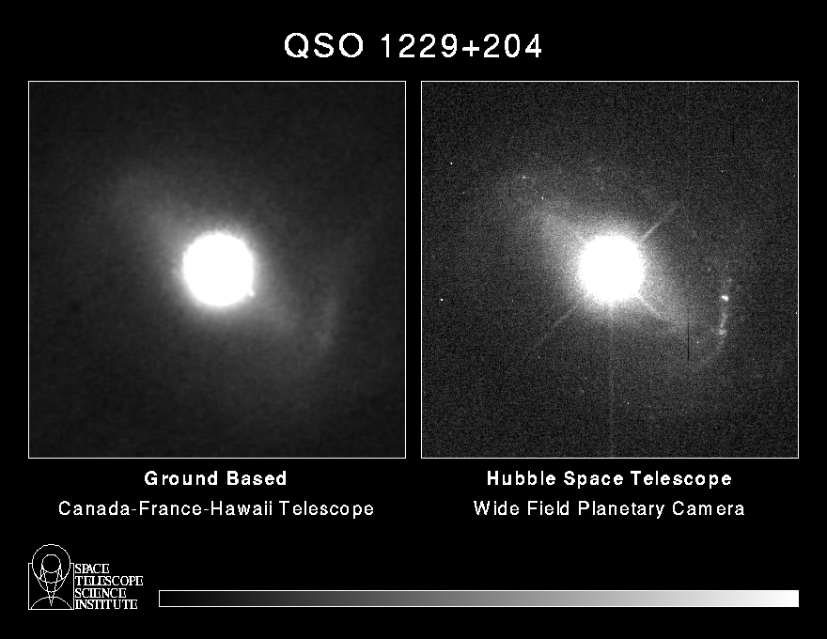
Quasars (2)

Slide 25
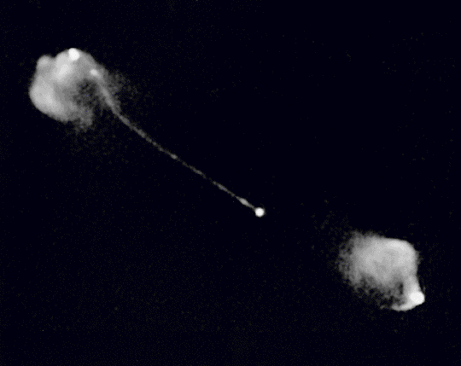
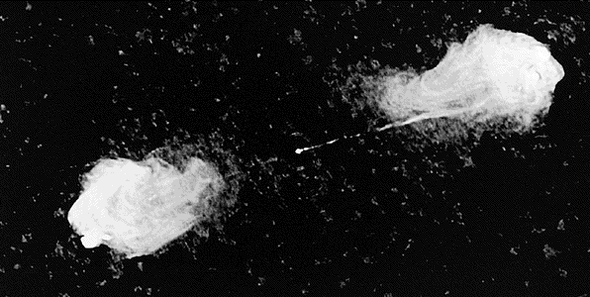
Radio Galaxy in Radio

Slide 26
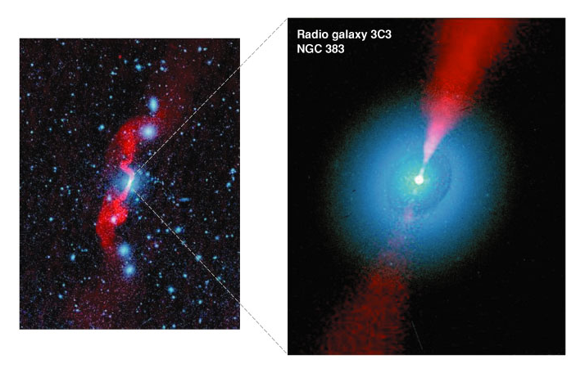
Radio Galaxy in Visible and Radio

Slide 27
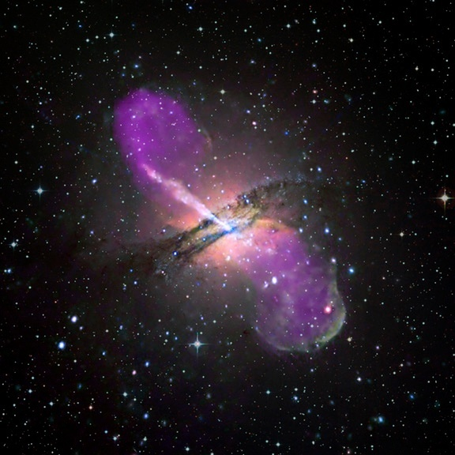
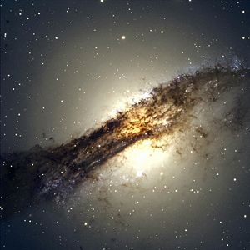
Centaurus A, a Radio Galaxy
Visible
Composite visible / radio

Slide 28
What Causes an AGN?
Black hole in center
10⁴ – 10¹⁰ M_{sun} (possibly higher)
Size of Earth up to size of Solar system
Source of gas - a gas torus (doughnut)
Gas getting dumped into the center
An accretion disk of gas falling in
Rotating very fast
Friction makes it hot – X-rays
Very efficient – 50% mass → energy
Thin gas surrounding the center
Heated by X-rays from the accretion disk
Sometimes, jets shooting out

Slide 29
Jets and Lobes
Magnetic fields trapped in gases can explode outwards
Gases swept along
Flung away from AGN very fast
Beams light forward
Beams radio waves mostly forward

Slide 30
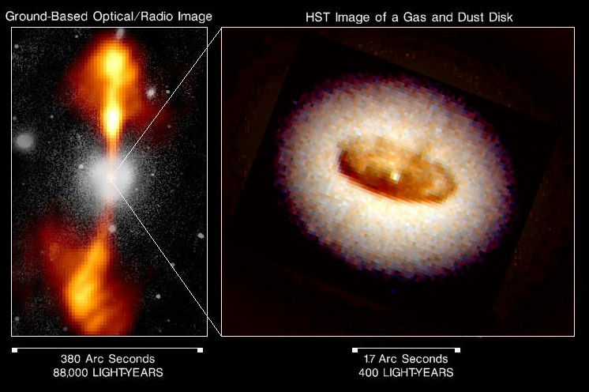
Core of an Active Galaxy

Slide 31
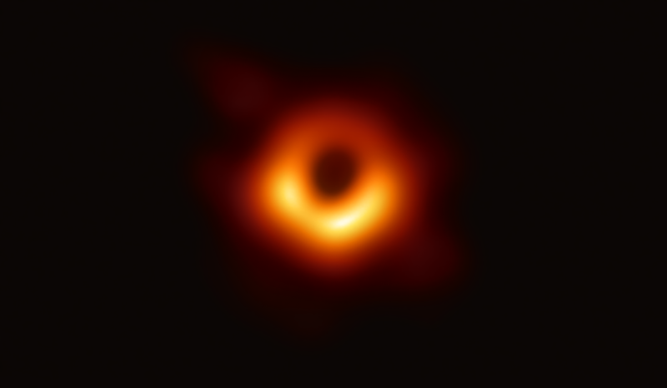
Black Hole in M87 Galaxy in Radio
Image released April 10, 2019
First image of black hole
6.5 billion solar masses
Compare: Ours is 4.3 million

Slide 32
Unified Picture of Active Galaxies
Some are brighter, some are dimmer
What you see depends on what angle you see it from
Blazar
Seyfert or Quasar or Radio Quasar
Radio Galaxy

Slide 33
Active Galaxies Used to be More Common
Active galaxies, especially bright ones, are rare now
But common in the past
Why?
Active galaxies require fuel to be fed into the black hole
Colliding galaxies allow gas to flow to center
Galaxy collisions were much more common in the past

