Slide 1
General Relativity
Principle of Equivalance
The Odd Thing about Gravity
The force of gravity is proportional to the mass of the object it acts on
M
F
m
The acceleration is the same, no matter the mass you drop
r
Suppose you are in an elevator
Now, we cut the cable
  You fall
  Other things fall at the same rate
To you, it looks like you are weightless

Slide 2
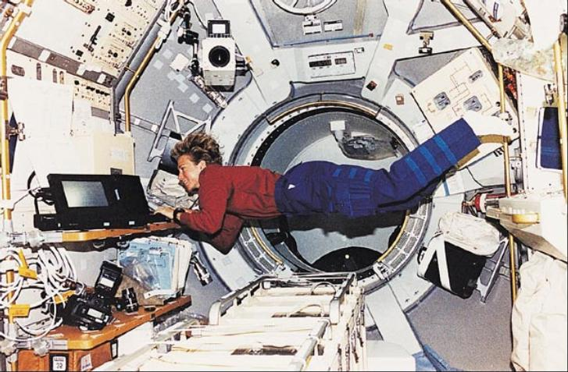
Weightlessness
This is why astronauts are weightless - they are always falling
  They are not far from the Earth

Slide 3
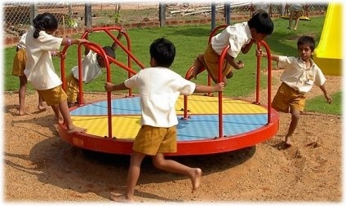
Principle of Equivalance
Are there any other force formulas that are proportional to mass?
  Suppose you are on a merry-go-round
  Centrifugal force
Like gravity, everything “accelerates” equally
You can make it go away by letting go
Can we create “gravitational” effects through acceleration?
Put the person out in space in the elevator
Attach to an accelerating rocket
The effects are indistinguishable from
gravity
The effects of gravity are indistinguishable from
the effects of being in an accelerated reference frame

Slide 4
Reexamining the Metric
We will start by reexamining the metric – the distance formula
  Or in this case, the proper time formula
This formula works if you move in a straight line
What if you don’t move in a straight line?
You can divide any longer path into several short segments
Then, find the distance formula for each one
We won’t be using this formula
Interestingly, you can show that the straight line has the longest proper time path – called a geodesic
An object with no forces acting on it will always follow a geodesic,
which is the longest proper time path between two points in spacetime

Slide 5
Changing Coordinates
It is important to be able to change coordinates to a different system
Let’s change to spherical coordinates: (x,y,z,t) → (r,θ,φ,t)
Similarly,

Slide 6
Moving in Curved Coordinates (1)
The geodesic principle works in any coordinate system
An object with no forces acting on it will always follow a geodesic,
which is the longest proper time path between two points in spacetime
It is possible, starting from the metric, to find equations that describe geodesic motion

Slide 7
Moving in Curved Coordinates (2)
The effects of moving in curved coordinates looks like acceleration
y
But it really isn’t
  It is moving as straight as it can in curved coordinates
You can always eliminate this apparent acceleration, simply by returning to “flat” coordinates
It is possible, starting from the metric alone, to prove that spacetime is really just flat
x

Slide 8
Curved Space
It is possible to live in a spacetime that is inherently curved
  It’s not just the coordinates, it’s spacetime itself that is curved
Consider the surface of the Earth
  Think of it as a 2D object
Imagine two explorers setting out from the North Pole in “straight lines” (geodesics)
At first they are traveling away from each other
When they reach the equator, they will be traveling “parallel” to each other; their distance is no longer increasing
They then start traveling towards each other
They meet at the south pole
The curvature is real
It is space itself that is curved, not the coordinates only

Slide 9
Curvature
How can we tell, looking only at the distance formula (the metric), if the curvature is real or a consequence of our coordinate choice?
The Riemann Tensor tells
you if it is curved
If the Riemann tensor is zero, space is not curved; if it is non-zero, it is curved
Changing coordinates doesn’t make it go away
Some other measures of curvature:
The Ricci tensor:
The Ricci scalar:
The Einstein tensor:

Slide 10
The Stress-Energy Tensor
What causes gravity? Energy and momentum
The presence of matter, or mass density, is the cause of gravity
  Mass density is proportional to energy density
If energy makes a difference, why not momentum as well?
  Momentum density also contributes to gravity
V
The flow of energy and momentum also causes gravity
Another way of looking at momentum density is the transfer of energy
  It is like power flowing through an area
You can also transmit momentum across a boundary
  This is what forces do
  Pressure is a good example
  A more general example is called the stress tensor
P
A
F
Gravitational effects in general relativity are caused by the energy density u, the momentum density vector g, and the stress tensor σ

Slide 11
Einstein’s Equations
The central idea of Einstein:
Gravity looks just like acceleration, except
  When you have a source of gravity,
  parallel doesn’t remain parallel
This tells you gravity has to do with curvature
M
a
m
a
m
The stress-energy tensor T_{µν} must be related to the curvature
Einstein found a relationship that worked, now called Einstein’s equations
It may look simple, but it isn’t
  This is really 16 equations (since α and β each take on 4 values)
  The expression on the left contains hundreds of terms
  It is highly non-linear

Slide 12
Geodesics in Curved Spacetime
Why do particles curve under the influence of gravity?
  Because spacetime itself is curved!
An object with no non-gravitational forces acting on it will always follow a geodesic, which is the longest proper time path between two points in spacetime
Matter tells space how to curve, and
space tells matter how to move

Slide 13
Homogenous and Isotropic Geometries
Flat Geometry in Spherical Coordinates
The universe is, apparently, homogenous and isotropic
  The same everywhere and in all directions
This is sufficient to almost specify the shape of space right now
What possible shape of space are uniform and isotropic?
One obvious one is flat space,
which has distance formula
Most useful to rewrite this in
spherical coordinates
With some work (PHY 215),
the local distance formula is then

Slide 14
The 2-Sphere
There are other geometries that are homogenous and isotropic
For example, the set of points a distance a from the origin in 3D is called a 2-sphere
Every point on the sphere is equivalent to every other point
These points satisfy
All such points can be
described by giving just two angles
The distance can then be worked out using the 3D flat metric
But we want a space with three internal dimensions

Slide 15
The 3-Sphere
Consider the set of points in four dimensions a distance a from the origin
These points can form a three-dimensional space –
the 3-sphere – which can be descried in terms of three angles
If you work out the distance between nearby points, it works out to
Just like flat space, this three-dimensional space is isotropic and homogenous

Slide 16
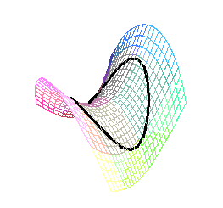
Isotropic and Homogenous Geometries
So far we have two possible
geometries that work:
There is one parameter describing the
second one, the radius a or scale factor
of the universe
  In contrast, flat space has no “scale” to it
The first is said to have zero curvature, the second has positive curvature
There is one more type of solution,
with negative curvature:
This one also has a scale factor a which is meaningful
The 2d equivalent of this is saddle shaped

Slide 17
A Common Way of Writing Them
Here are all our possible geometries:
To make them all look as similar as
possible, we can make the following
substitutions in cases 2 and 3:
Then we have
And our metric becomes, in these two cases:
In fact, if you simply set a = 1 for the first case,
you can make all three formulas nearly identical:
We have k = 0 for the first case, k = +1 for the second and k = –1 for the third.

Slide 18
It’s Time to Include Time
This is what the universe looks like at any moment of time
From isotropy and homogeneity we know the only thing that can happen over time is that the distances between objects can increase or decrease uniformly
Therefore, the only thing that
is different at different times is
to change a to a function of time
We also should include time itself in the formula
By homogeneity, time runs at the same rate everywhere
At some point (say here), this would add a –c²dt² to the distance formula
Therefore, the
distance formula is

Slide 19
Two Equivalent Ways of Writing the Metric
We can also go back to writing this equation in terms of ψ
General Relativity works in any choice of coordinates
  Pick whichever is easiest for computations

Slide 20
The Friedman-Robertson-Walker Metric
This is the only possible universe that is isotropic and homogenous at all times
Any particular object “at rest” in this universe will stay at constant r, θ, and φ
The behavior of the scale factor a(t) will depend on gravity
Einstein’s equations relate the curvature G_{αβ} to the presence
of that which causes gravity, the Stress-Energy Tensor T_{αβ}:
We need to find T_{αβ}

Slide 21
Matter and Energy in the Universe
The Stress-Energy Tensor
Use the fact that the universe is homogenous
  So it can’t depend on location
And it’s isotropic
  So it can’t prefer any particular direction
The component u is just the energy density
Since there is no net motion, this is just
  Where ρ is the mass density
The components g_{x}, g_{y}, g_{z} represents momentum in the x-, y-, and z-direction
  Clearly this must vanish
Terms like σ_{xy} represents force in the y-direction transported in the x-direction
  Terms like this must also vanish
Terms like σ_{xx} represents pressure in the x-direction
  These won’t vanish, but must be the same in all directions
This is just the pressure

Slide 22
Friedman’s Equation
We now need to use Einstein’s equations
Getting the Einstein tensor is a lot of work
  Fortunately, I have programs that do the work for me
I will use only the time-time component
Substitute this in
Now rearrange slightly
This is the Friedman Equation
we found before

Slide 23
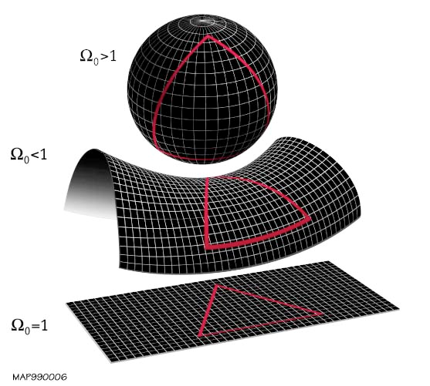
Ω and The Shape of the Universe
Recall again that
We also defined
the density parameter
So that we have
If we know the sign of Ω – 1, we
also know the sign of k
And since k = 0, +1, or –1, we know k
Dens. Curv. Name
< 1 k = -1 Open
= 1 k = 0 Flat
> 1 k = +1 Closed

