Slide 1
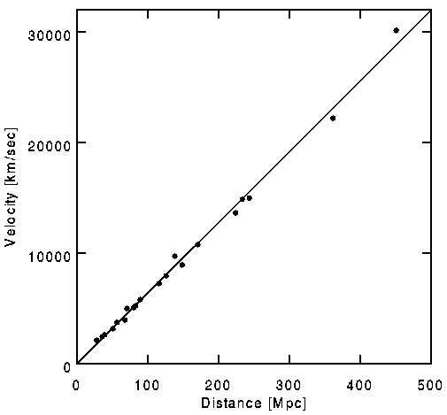
Hubble’s Law and Expansion of Universe
Hubble’s Law
Hubble’s Constant
Plot distance vs. velocity. We find:
Velocity proportional to distance
H₀ is called Hubble’s constant
Best fit today (includes many assumptions)
Uncertainties:
Until recently, we didn’t know H₀ very well, so we would write
h = 0.677 ± 0.004
I’ll probably avoid h.
Many published documents write answers in terms of h so that we remove the uncertainty in H₀

Slide 2
Past and Future History of Hubble’s Constant
In the mid 1900’s, Hubble’s constant was > 200 km/s/Mpc
Relied crucially on Cepheid Variable stars
When it was realized that there were stars of different metallicity, and that the period-luminosity relationship was affected, H₀ suddenly decreased by factor of 2
In the 1980’s, there were two sets of techniques that measured Hubble’s constant
One group gave values around 100 km/s/Mpc
The other group gave values around 50 km/s/Mpc
Around 1990, it was realized that white dwarf supernovae were a great way to measure distances
We realized the value was around 70 km/s/Mpc
And we all lived happily ever after, until
In the 2010’s, various techniques yielded much more precise values
Methods using the cosmic distance ladder give 72±1 km/s/Mpc
Methods using fit to cosmological models give 68±1 km/s/Mpc
This discrepancy is currently unresolved
We will use the value

Slide 3
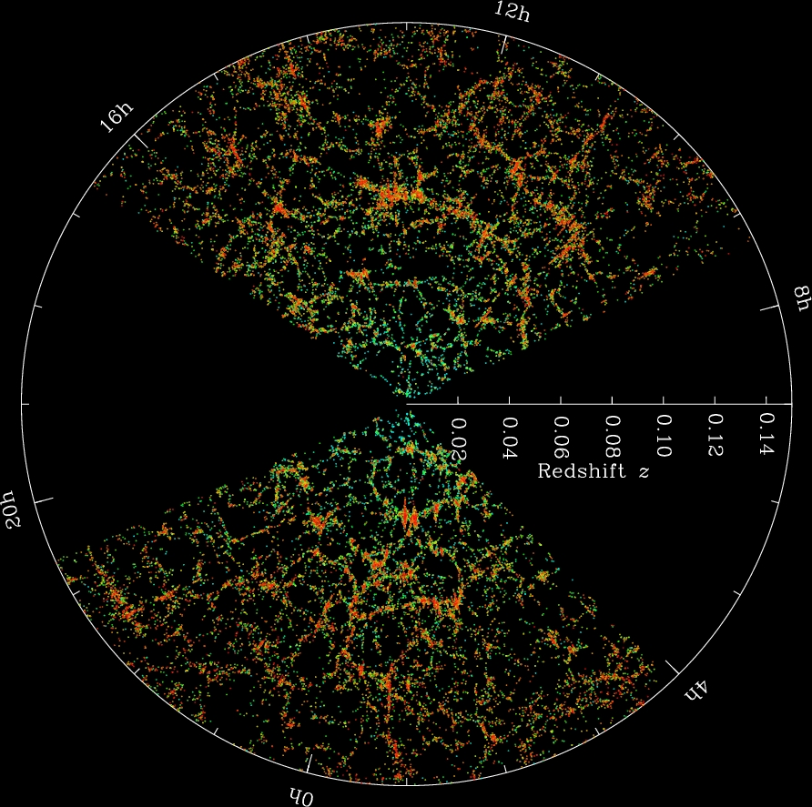
What’s So Great About Hubble’s Law?
You can measure spectrum of almost any bright object
Don’t have to wait for a supernova, or similar rare event!
You can then use Doppler shift to get the velocity
Then you use Hubble’s Law to get the distance
Some caveats will be in order shortly
Because this system is so robust, it is used to map out large portions of the universe
Because velocity is proportional to z, which is directly measured, we can plot z and it will be proportional to distance
For this reason, most such maps simply plot z instead of distance
This also bypasses any uncertainties in H₀

Slide 4
Sample Problem
A spectral line from a galaxy normally at 415.00 nm appears instead at 423.00 nm.
How fast is the galaxy moving away from us?
What is the distance to the galaxy?

Slide 5
Failure of Hubble’s Law at Small z
Hubble’s Law isn’t perfect. In particular, for low z:
Not everything expands
Galaxies, galaxy clusters, and smaller objects are not necessarily expanding
Galaxy superclusters expand more slowly than Hubble’s Law implies
Objects have extra velocities, called peculiar velocities
Because gravity changes velocities
Typically of order 500 km/s or so
This causes errors, usually random, of magnitude v_{p} /H₀ in the distance
Typically 7 Mpc or so
Poor distance indicator for distances under 50 Mpc or so.
We also have our own peculiar velocity that needs to be compensated for
We know how to do this

Slide 6
Failure of Hubble’s Law at Large z
Hubble’s Law isn’t perfect. In particular for high z:
As z gets large (> 0.2) objects are moving relativistically
Relativistic corrections
Distance gets confusing as well
We are also looking back into the past
Bad: Expansion might not be constant
Good: We can study the universe in the past (!)
Still, higher z corresponds to greater distance
If we can accurately measure distance to some high z objects, we can set up a calibration scale
Bottom Line: Once a calibration is set up at high z, you can use modified Hubble’s Law if you are careful

Slide 7
The Cosmic Distance Ladder:
Radar
Cepheid Variables
Hubble’s Law
Parallax
Planetary Nebulas
TRGB
LE
Type Ia Supernovae
Spectroscopic Parallax
Cluster Fitting
1 AU
1
10
100
1
10
100
1
10
100
1
10
pc
kpc
Mpc
Gpc

Slide 8
End of Material for Midterm Test
Midterm Exam:
Wednesday October 13
2:00 – 4:00
Location TBA
Material for Exam:
Pen/Pencil
Paper
Calulator
30 cm metric ruler
List of equations for Midterm is on the Web

Slide 9
Hubble Expansion
Homogeneity and Isotropy
On small scales, the universe is not at all uniform
Galaxies, Clusters, and Superclusters
But on the largest scales, it seems to be roughly homogeneous
The same at all places
It also looks isotropic
The same in all directions
Many properties of the Universe can be worked out just from homogeneity and isotropy

Slide 10
Hubble’s Law is Not Arbitrary
For now, neglect relativity
Assume the universe is homogenous and isotropic
Suppose we see galaxy X at distance d moving away from us at speed v
By isotropy, a galaxy Y on the other side of us at distance d must also be moving away at speed v
But as viewed by galaxy X, galaxy Y is now moving away at speed 2v and is at a distance 2d
If the universe is homogenous, then galaxy Z, at distance 2d from us must also be moving at speed 2v
Therefore, if distances are expanding (or contracting), the speed must be proportional to distance – Hubble’s Law is inevitable
d
d
d
2v
v
v
us
X
Z
Y

Slide 11
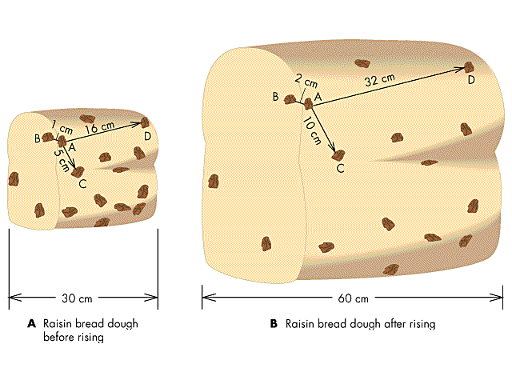
Two Ways of Thinking About Hubble Expansion
Hubble’s Law can be thought of two ways:
All galaxies are flying apart from each other
The space between the galaxies is expanding
There is no special place in the universe
It is meaningless to ask “where is it expanding from”
All observers see the same thing

Slide 12
Age of the Universe: A Naïve Computation:
Hubble’s Law tells us relation between distance and velocity
We can therefore figure out how long ago all this stuff was here:
Call t₀ the time when everything left here:
This time is called the inverse Hubble time:
Compare to oldest stars 13 ± 1 Gyr
This is incorrect because the velocity of other galaxies is probably not constant
Assuming gravity slows things down, should the actual age of the universe be grater than the inverse Hubble time, or less?
Speeds are slowing down
Speeds used to be greater
Higher speed → Less time to get to where we are now

Slide 13
The Friedman Equation (1)
Assume the universe is homogenous and isotropic
We can treat any point (us), as center of the universe
We can use spherical symmetry around us
Let a be the distance to any specific distant galaxy
And let its mass be m
By Gauss’s Law, gravitational force is easy to find
Spherical symmetry tells us force is towards center
And caused by only mass closer than that galaxy
Because expansion of the universe is uniform, stuff closer than galaxy always closer
M is constant
Multiply both sides by 2da/dt and integrate over time
Don’t forget the constant of integration!
We could call it k, for example
For technical/historical reasons, it is called – kc²
This makes k dimensionless
a
us
distant galaxy
M

Slide 14
The Friedmann Equation (2)
Mathematical notation: Time derivatives
a
us
distant galaxy
Divide both sides by a²
Rewrite first term on right in terms of mass density ρ
M
The resulting equation is called the First Friedman Equation
The derivation was flawed
M does not necessarily remain constant
In relativity, other contributions to gravity
The equation is correct, including relativity
The left side is the square of Hubble’s constant
Left side and first term on right independent of which galaxy you use
We can pick a particular galaxy to make k bigger or smaller
Normally chosen so that k = 0, +1, or -1

Slide 15
Ω
We’d like to know what the value of k is
Define the ratio:
If we know how big Ω is, we’ll know k
It is common to break Ω into pieces
Ordinary atoms and stuff: Ω_{b}
Dark Matter: Ω_{d}
Matter: Ω_{m} = Ω_{d} + Ω_{b}
Radiation: Ω_{r}
Etc.
Ω changes with time
When referring to values today, we add the subscript 0
Sometimes
Dens. Curv. Name
< 1 k = –1 Open
= 1 k = 0 Flat
> 1 k = +1 Closed

Slide 16
So, What is Ω?
Stuff Cont. to Ω
Stars 0.013
Gas, Dust 0.036
Neutrinos 0.0014 – 0.14 (probably near low end)
Dark Matter 0.258 ± 0.011
Light ~ 10⁻⁴
Total ~ 0.308
Ω_{b} = 0.0486 ± 0.0010
As we will see, we have missed a substantial fraction of Ω

Slide 17
Age of the Universe, Round 2 (1)
What’s the current density of stuff in the universe?
For ordinary matter, density ∝ 1/Volume
Substitute in:
Let x = a/a₀
For age of universe, let x run from 0 to 1
Integrate to get the age of the universe:

Slide 18
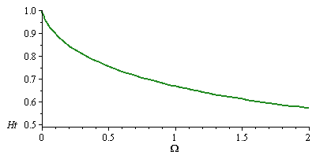
Age of the Universe, Round 2 (2)
If Ω₀ = 0.308, then
t₀ = 11.6 ± 0.16 Gyr
Theorists like Ω₀ = 1
If Ω₀ = 1.000, then
t₀ = 9.61 ± 0.13 Gyr
The oldest stars are 13 ± 1 Gyr old
The Age Problem

Slide 19
The Scale Factor
The distance a is called the scale factor
All distances increase with the same ratio
This applies to anything that is not bound together
Even to waves of light!
Red shift can be thought of as a stretching of universe
Or is it Doppler shift?
Either view is correct; there isn’t a right answer
This view does give us another relationship:
a
Early Universe
Now
a₀
Most common way to label something in the distant past: z
Bigger z means earlier

Slide 20
Annoying Notational Problems
The scale factor, describing the size of the universe, goes by different names
Many older sources call it R(t)
More commonly, it is now called a(t)
I like to stick with the book. So what does Ryder call it?
Her convention: a(t₀) ≡ 1, and R₀ is how big it is now
I refuse to use this messed up notation
Therefore, we are going to use the convention I’m most used to

Slide 21
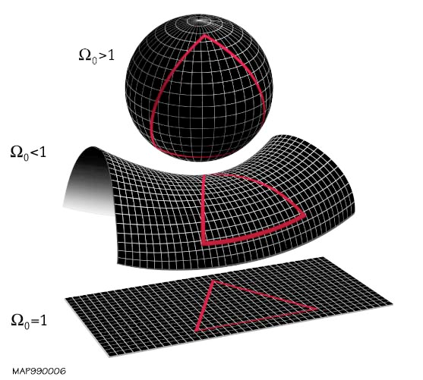
Ω and the Shape of the Universe
Dens. Curv. Name
< 1 k = -1 Open
= 1 k = 0 Flat
> 1 k = +1 Closed
What’s the circumference of a circle of radius r?
According to Einstein, Space time can be curved!
Shape of space depends on density parameter: Ω
If Ω = 1 then universe is flat and
If Ω > 1 then universe is closed and
If Ω < 1 then universe is open and
Surface area of a sphere:
A closed universe is finite

