Slide 1
Physics 310/610 Extragalactic Astronomy and Cosmology
Introduction
Am I in the Right Place?
Eric Carlson
“Eric”
“Professor Carlson”
Olin 306
OH: Mon, Wed, Fri 11:45–12:45
OH: Tue, Thu 12-2 or by appt.
Office: 336-758-4994
Cell: 336-407-6528
ecarlson@wfu.edu
Topics Covered:
Galaxies
The Universe
Everyone Pick Up:
Syllabus
2 homework passes
Who are you?
https://forms.gle/x3T3UjMiBJRRmzXP6
http://users.wfu.edu/ecarlson/cosmo2
8/28

Slide 2
Dr. Carlson’s Approximate Schedule
Monday
Tuesday
Wednesday
Thursday
Friday
9:00
10:00
11:00
12:00
office hour
office hour
office hour
office hour
office hour
1:00
PHY 310/610
office hour
PHY 310/610
office hour
PHY 310/610
2:00
PHY 215
Research
PHY 215
Research
PHY 215
3:00
Research
Research
Research
4:00
free food
Research
Research
Colloquium
5:00
Office Hours Tomorrow
12:45 – 2:00
Office Hours Mon., Wed. & Fri. 11:45 – 12:45
Office Hours Tues. & Thurs. 12:00 – 2:00
Or any time not shaded; contact me first
SPS meeting Tomorrow
12:00 – 12:45 Olin Lobby

Slide 3
Materials
Texts:
“Galaxies in the Universe,” 2nd edition by Sparks and Gallagher, available online for free from the library
Introduction to Cosmology, 2nd edition, by Ryden
Scientific Calculator
Metric Ruler
Maple or similar program
Laptop
https://ebookcentral.proquest.com/lib/wfu/reader.action?docID=307061

Slide 4
The Web
http://users.wfu.edu/ecarlson/cosmo2
Numerous materials can be found on web for this course:
Link to the textbook
Reading assignments
Homework assignments
And solutions
Handouts:
Units
Syllabus
Math Review
Lecture slides
Recorded lectures

Slide 5
Class Attendance and Seating
Attendance is expected every day
More than two unexcused absences count against your grade
If you have an advance excuse, contact me (email)
If you are ill, call/e-mail me OR bring Doctor’s note
Zoom link can be used if you have an excused absence
Class Participation
Class participation is 10% of your grade
Ask lots of questions
Answer my questions
You will be called on

Slide 6
Homework
About 1-3 problems per homework set
Due on Wednesdays and Fridays
Getting help is encouraged
Ask a friend
Ask me
Don’t copy – this is an honors code violation
Clarity counts
Keep track of units
Pay some attention to sig figs!
Twice per semester, you may delay turning in your homework by one day by using a homework pass
Homework:
Homework A by Friday
Sample Problem 0.1
The gravitational acceleration on the surface of the Earth is g = 9.80 m/s². What is this in c/y?

Slide 7
Exams
Midterm and a final
Midterm, possibly evening of October 18, 7-9 pm
Final Friday Dec. 15, 2-5 pm
Honors code violations will be turned in to the honor council
Normally, penalty is 1-term suspension and an irreplaceable F in the course
Combination of computation and essay questions
Dotted Red Line – Easily derived from other formulas
Solid Red Line – Memorize this formula
Other colors – not on test
Dashed Red Line – Know how to use it

Slide 8
Grades
Grade Assigned
94% A 73% C
90% A- 70% C-
87% B+ 67% D+
83% B 63% D
80% B- 60% D-
77% C+ <60% F
Percentage Breakdown:
Homework 40%
Class Part. 10%
Midterm 20%
Final 30%
Little if any curving
Do not allow extra credit
Pandemic Plans
If there is a catastrophic closing of the university, we will attempt to continue the class:
http://users.wfu.edu/ecarlson/cosmo2/index.html
ecarlson@wfu.edu
Cell: 336-407-6528

Slide 9
Units
Astronomy involves such large and small quantities that SI units are often inconvenient
Angles:
A circle contains 2π rad or 360 degrees
An arc-minute (') is 1/60 of a degree
An arc-second (") is 1/60 of an arc-minute
A milli-arc-second (mas) is 10⁻³ arc-second
1 Å = 10⁻¹⁰ m
Distance:
The Angstrom is sometimes used for wavelength
The Astronomical Unit or AU is the (path averaged) distance between the Sun and the Earth
The light-year (ly) is the distance that light goes in a year
Rarely used by real astronomers
The parsec (pc) is defined in terms of the AU

Slide 10
More Units
Energy:
Electron volts (eV) and metric multiples used for individual particles
keV = 10³ eV
MeV = 10⁶ eV
GeV = 10⁹ eV
Time:
Days and Years are commonly used
And metric multiples of years
ky = 10³ y
My = 10⁶ y
Gy = 10⁹ y
Temperature: 
Normally in Kelvin (K)
Room temperature is 300 K
For high temperatures, we will often give k_{B}T, where k_{B} is Boltzmann’s constant.
Typical thermal energy is about 1-3 k_{B}T.
Solar Units:  
Stars and galaxies often compared to the Sun

Slide 11
Angular Size and Small Angles
The actual size of an object is how big it is:
The angular size is how big it looks:
These are related through the distance
Sketch a right triangle as shown
Then we have
Using the small angle approximation, we have
So we have

Slide 12
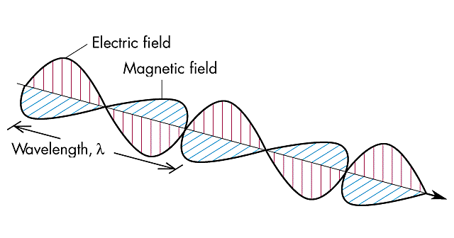
Physics “Review”
Electromagnetic Waves
More than 99% of what we know about the universe comes from observing electromagnetic waves

Slide 13
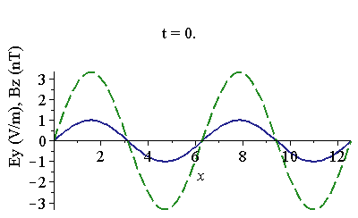
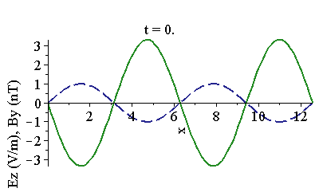
Wave Equations Summarized
This page stolen from PHY 114
Waves look like:
Related by:
Two independent solutions to these equations:
B₀
E₀
Note that E, B, and direction of travel are all mutually perpendicular
The two solutions are called polarizations
We describe polarization by telling which way E-field points
E₀
B₀

Slide 14
Frequency and Wavelength
The quantity k is called the wave number
The wave repeats in time
It also repeats in space
λ
EM waves most commonly described in terms of frequency or wavelength
Note that in this class, frequency is denoted by ν, not by f

Slide 15
The Electromagnetic Spectrum
Different types of waves are classified by their frequency (or wavelength)
Boundaries are arbitrary and overlap
Visible is 380-740 nm
This page stolen from PHY 114
Radio Waves
Microwaves
Infrared
Visible
Ultraviolet
X-rays
Gamma Rays
Red
Orange
Yellow
Green
Blue
Violet
Vermillion
Saffron
Chartreuse
Turquoise
Indigo
f Increasing
λ Increasing
Not these
Know these, in order
These too

Slide 16
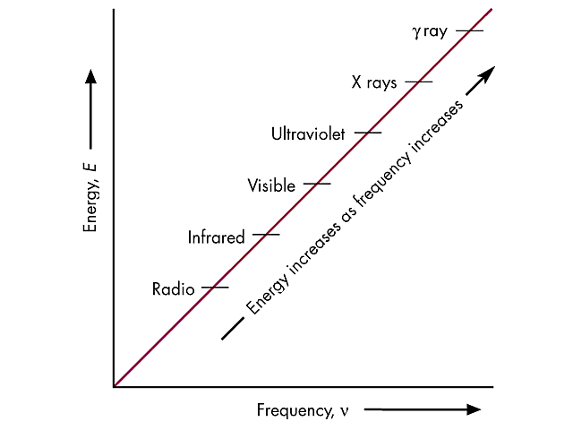
Photons and Quantum Mechanics
Classically, a wave can have any amount of energy, from 0 to ∞
But in quantum mechanics, it comes in packets whose energy is proportional to their frequency
h is called Planck’s constant
Can also be written in terms of , the reduced Planck constant, and the angular frequency
The individual packets of energy are called photons

