Slide 1
The Milky Way Galaxy
General Information
Structures in the Universe
Levels of organization:
Stellar Systems
Stellar Clusters
Galaxies
Galaxy Clusters
Galaxy Superclusters
The Universe
Everyone should know where they live:
The Solar System
(we don’t live in a cluster)
The Milky Way Galaxy
The Local Group
Laniakea Supercluster
The Universe

Slide 2
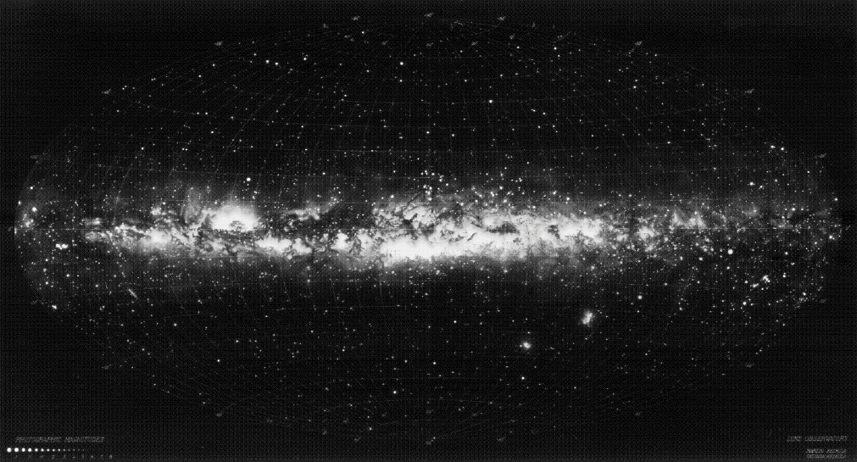
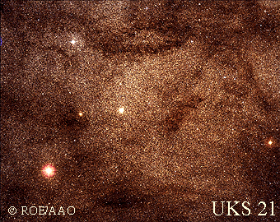
Milky Way as We See It
Closeup view:

Slide 3
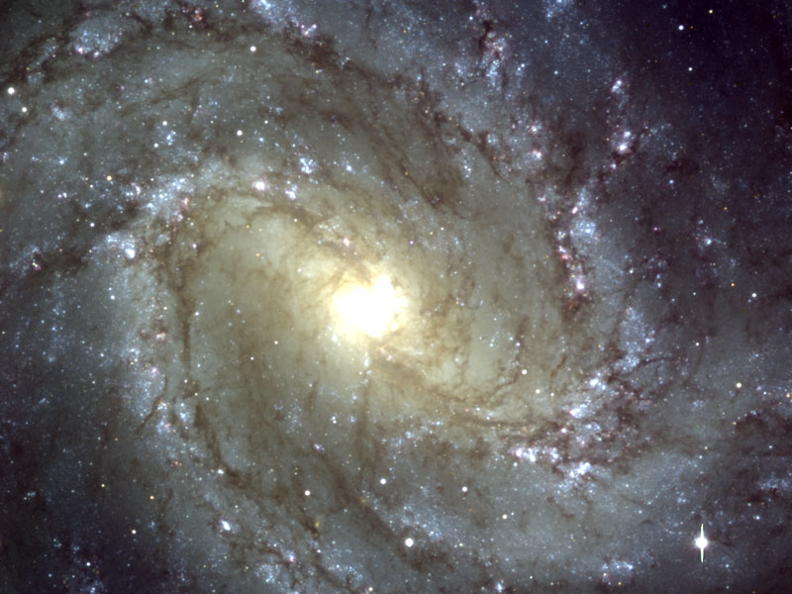
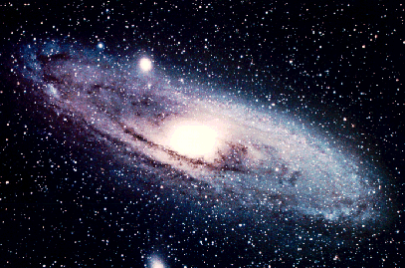
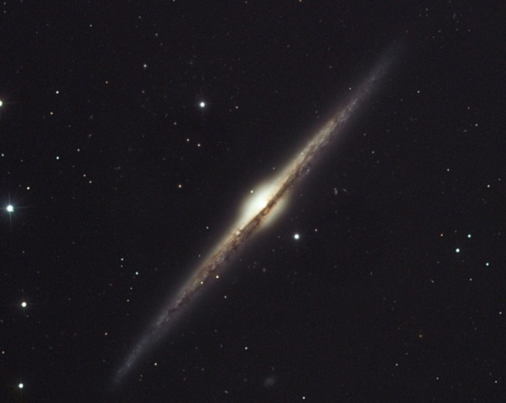
Milky Way from Outside
Tilted view:
Edge on view:

Slide 4
Studying Galaxies
We cannot get outside our galaxy
The distances are too great – we cannot send a spacecraft even to the nearest stars
The “outside” views are of other galaxies, probably similar to our own
We are inside our galaxy
This lets us see details of our galaxy with unparalleled precision
However, there is dust in the plane of the galaxy – makes it hard to study within the plane of our galaxy
It makes it very difficult to see the overall shape and distribution of our galaxy
We infer other galaxies have many details similar to ours
We infer our galaxy has an overall shape and structure similar to others

Slide 5
The Milky Way – Basic Structure
The disk
The bulge
The nucleus
The halo
Globular clusters
The Sun

Slide 6
The Disk
Dimensions and Structure
A large, flat disk, shaped like a pancake
About 30 kpc in diameter
About 1 kpc thick
We are about half way out (8 kpc)
Has prominent spiral structure
The disk
The bulge
The nucleus
The halo
Globular clusters
8 kpc
The Sun
1 kpc
30 kpc

Slide 7
Characterizing Locations
The position of any object can be described in our galaxy using cylindrical coordinates:
How far out they are from the center (R)
How high (vertically) they are from the disk (z)
The azimuthal angle (φ) of the star compared to our Sun
The Sun
R
z
φ
For example, the Sun’s position is approximately:
R = 8.23 ± 0.12 kpc (out pretty far)
z = 10 ± 10 pc
φ = 0 (by definition)

Slide 8
Characterizing Distributions
The disk is (roughly) rotationally symmetric
Everything is independent of φ
Therefore the density of any object within it will depend only on the radius R and the height z
The Sun
R
z
φ
In general, the distribution will look something like
The scale height h_{z} tells us how far things stray from the disk
The scale length h_{R} tells us how things fall off with distance from the center

Slide 9
The Disk – Composition
Stars
Thin disk stars
Sometimes in Open Clusters
Thick disk stars
Gas
Molecular Clouds
Hydrogen is in H₂ molecules
HI regions*
Neutral hydrogen atoms
HII regions
Hydrogen is ionized
Dust
*When an element is followed by a roman numeral, the roman numeral is one greater than the charge

Slide 10
Stars in the Disk
Stars in the disk orbit the center in roughly circular orbits
Near the Sun, they orbit at about 200 km/s
Probably comparable at larger/smaller radii
They are more concentrated near the middle
Scale length ~ 3 or 4 kpc
They fall into two groups: thin disk and thick disk
Thin disk stars
Common (90 – 95% of disk stars)
98 – 99% of nearby stars
Metallicity 0.4% to 2%
Scale height ~ 300 to 400 pc
Masses 0.1 to 100 M
Stars are 0 to 8 Gyr in age
Small deviations from circular orbits
Thick disk stars
Rare (5 – 10% of disk stars)
1 – 2% of nearby stars
Metallicity 0.1% to 0.4%
Scale height ~ 1 to 1.5 kpc
Masses from 0.1 to 1 M
Stars are 8+ Gyr in age
Large deviations from circular orbits

Slide 11
Thin vs. Thick Disk Stars
Thin disk stars
Common (90 – 95% of disk stars)
98 – 99% of nearby stars
Metallicity 0.4% to 2%
Scale height ~ 300 to 400 pc
Masses 0.1 to 100 M
Stars are 0 to 8 Gyr in age
Small deviations from circular orbits
Thick disk stars
Rare (5 – 10% of disk stars)
1 – 2% of nearby stars
Metallicity 0.1% to 0.4%
Scale height ~ 1 to 1.5 kpc
Masses from 0.1 to 1 M
Stars are 8+ Gyr in age
Large deviations from circular orbits
How can we account for these differences?
Stars form in a relatively small region near the center (thin disk)
About 8 Gyr ago, something disturbed the stars in the disk at the time
Probably collision with another galaxy
Eventually they settle down and form the thick disk
Relatively little metals in these early stars
Metals come from previous stars that died
New stars made since then comprise our current thin disk

Slide 12
Number of Stars in the Disk
Density of stars in the neighborhood of the Sun is about 0.1/pc³
The total number of stars in the disk is of order 100×10⁹
Total mass about 60×10⁹ M
Total luminosity about 20×10⁹ L
Note that this suggests a typical star is less massive than the Sun
Also less luminous than the Sun
Clusters of Stars in the Disk: Open Clusters
The youngest stars are often in loose associations called stellar clusters
These are recently born collections of stars that are still together
Not surprisingly, they are in the thin disk
Over time, stars probably wander away from the clusters where they were born
These clusters are called open clusters
Range in size from 100 to 30,000 M

Slide 13
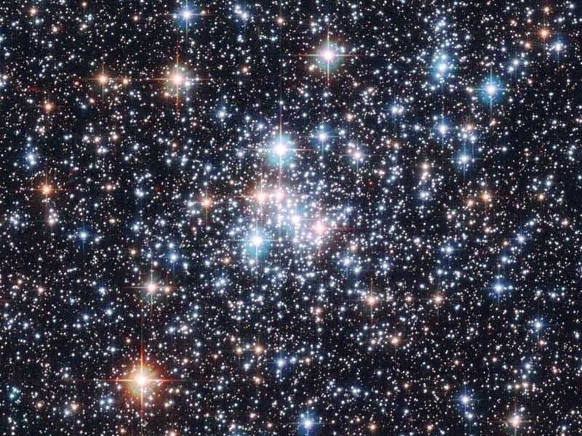
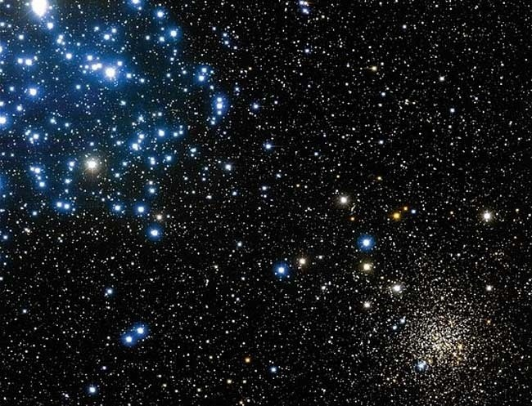
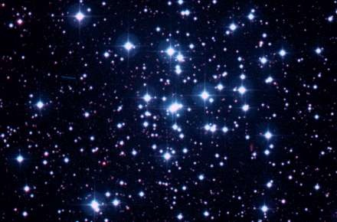
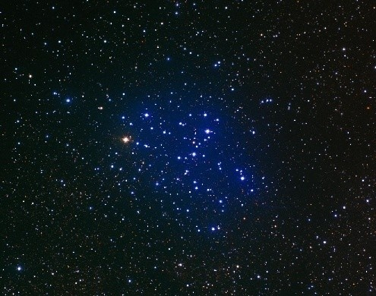
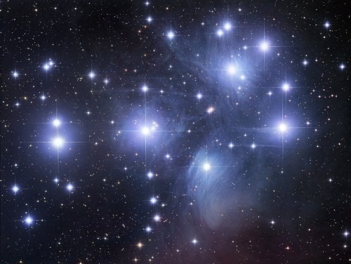
Open Clusters
NGC 290
M35
NGC 2158
Pleiades
M6
M36

Slide 14
The Interstellar Medium
Interstellar space is not quite empty
It contains thin gas and dust, generally mixed together
Total mass about 10×10⁹ M
The gas is concentrated with a scale height ~ 100 pc
Compare thin disk ~ 300 pc and thick disk ~ 1000 pc
The gas comes in a variety of temperatures
HII regions contain ionized hydrogen
Heated by bright stars, supernovae, and other violent events
Can be detected by their recombination radiation
HI regions contain atomic hydrogen
Not sufficiently cooled to make molecules
Detected mostly using the 21 cm line
Molecular clouds contain hydrogen molecules H₂
Detected using emissions from other molecules, like CO
The dust annoyingly makes everything difficult to see
Especially in the disk!

Slide 15
HII Regions
Interstellar gas gets heated by light from various sources
High mass stars
Supernovae
If the density is high enough, and the temperature not too high, you can get recombination radiation from atoms getting ionized and then recombining
Light from the star knocks an electron free
The electron finds an unbound nucleus and settles back in
As it goes from one level to another, it emits light
Typical light from hydrogen will be visible or near ultraviolet
At high temperatures, light from elements like Fe⁺²⁴ will be X-rays
At extremely high temperatures and low densities, you can still get light from electron-electron collisions
Light

Slide 16
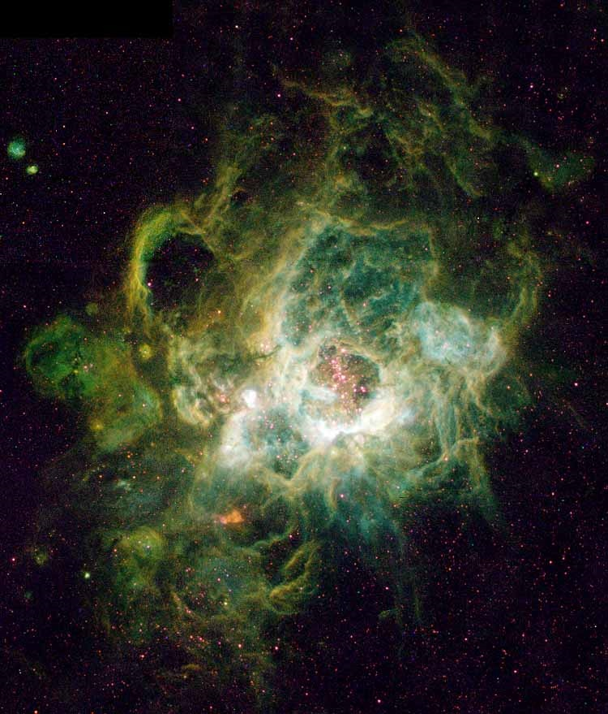
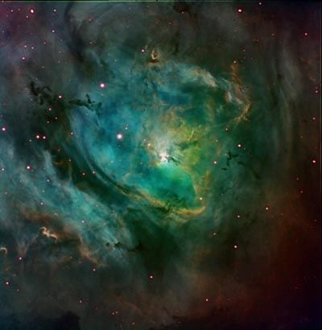
Ionization (Emission) Nebulae (1)

Slide 17
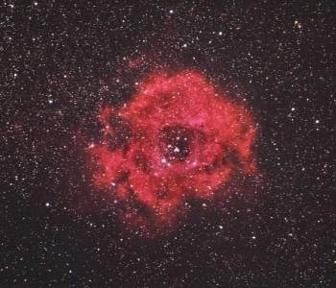
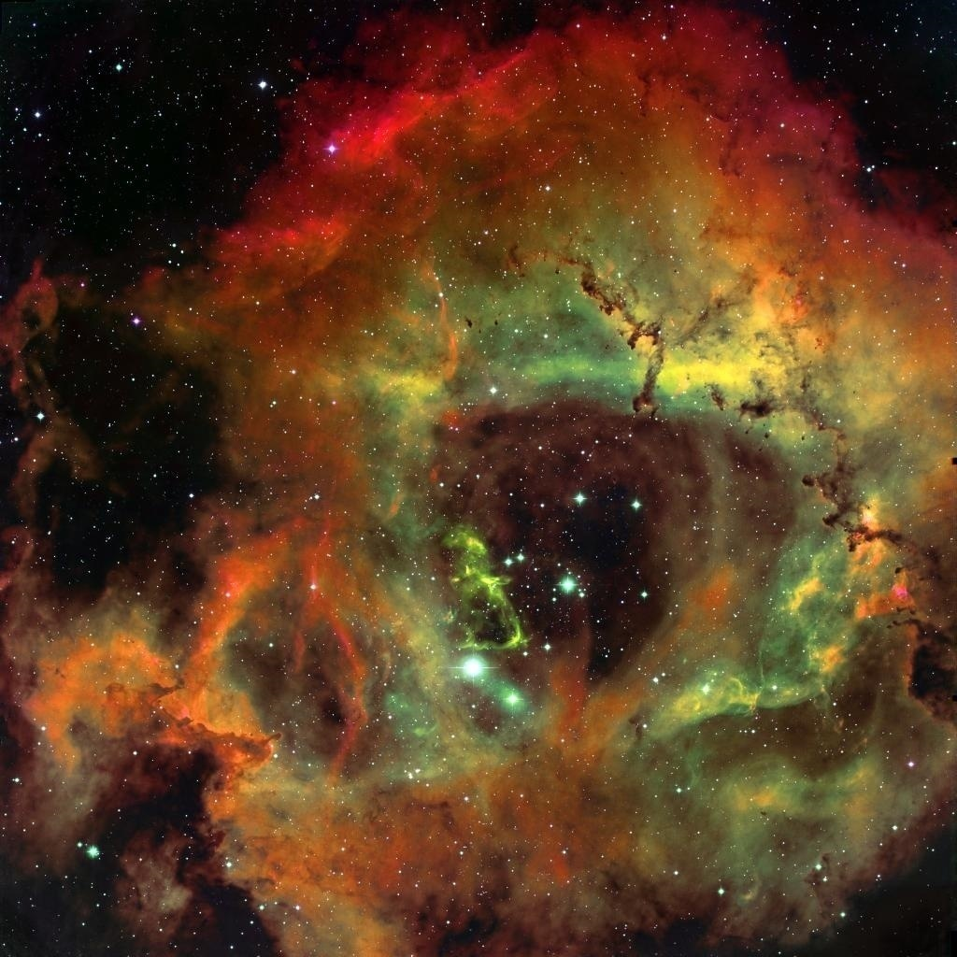
Ionization (Emission) Nebulae (2)

Slide 18
HI Regions
At intermediate temperatures/densities, hydrogen (and other elements) will be bound into atoms
But not molecules
The nucleus and the electron both have spin
Spinning charges produce magnetic fields
The atom has lower energy when spins cancel
Because of collisions between atoms, they nonetheless often end up aligned
The atom then makes a transition when the electron spin flips over
The release of energy is emitted in a photon with wavelength 21 cm
Takes on the average about 10 Myr
We can not only detect hydrogen this way, we can use Doppler shift to get the velocity
Radio waves

Slide 19
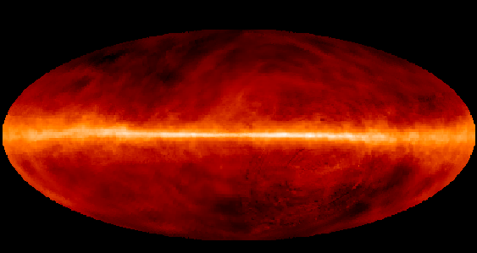
The 21 cm line

Slide 20
Molecular Clouds
At low temperatures (and/or high densities), the hydrogen atoms bond together to make H₂ molecules
Molecular hydrogen is very difficult to detect directly
Fortunately, there are small amounts of other gasses that are easier
CO, HCN, OH, NH₃, H₂O, etc.
These molecules all have dipole moments that make them more efficient at radiating energy.
More positive on one side, more negative on the other
They produce electromagnetic waves efficiently when they vibrate
And when they rotate
+
C
O
–

Slide 21
Molecular Clouds and Star Formation
Molecular clouds are cool and dense enough that gravity can overcome pressure
Over time, they slowly contract and form new stars
The gas tends to be very close to the galactic plane
Stars tend to form very close to the galactic plane

Slide 22
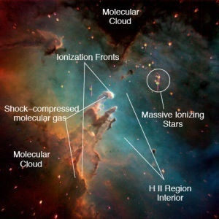
Labeled Eagle Nebula

Slide 23
Dust (1)
Galaxies like ours have a lot of dust in the disk
For us, about 1% of the mass
Consists mostly of carbon compounds and silicates
Size of dust particles range from 0.01 μm to 1 μm
These are efficient at scattering and absorbing light
The probability of scattering or absorbing roughly proportional to 1/λ
Short wavelengths are scattered the most
Objects behind dust will be dimmer and redder
Must be compensated for
The scattered light will look blue
Much like the blue sky
Dust cloud

Slide 24
Dust (2)
Dust is warmed by absorbing light from stars
It glows in the infrared
Typical temperature ~ 10 K

Slide 25
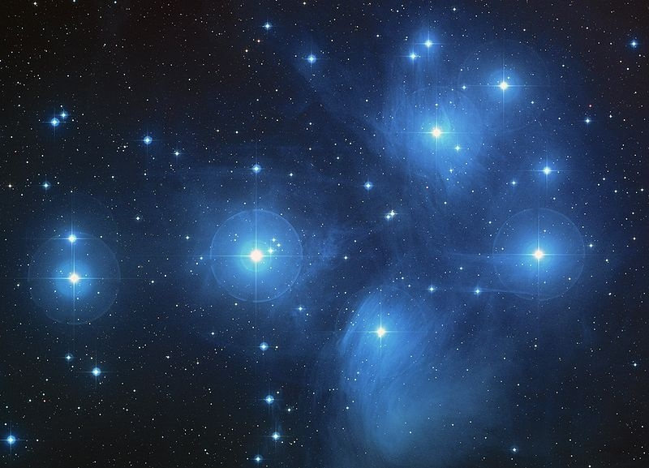
Reflection Nebula: The Pleiades
The light reflected from nearby stars causes the dust to look blue

Slide 26
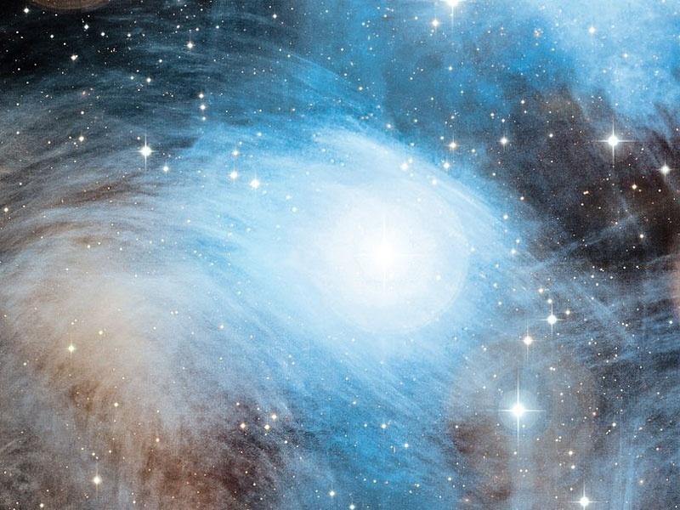
Reflection Nebula: Merope Nebula

Slide 27
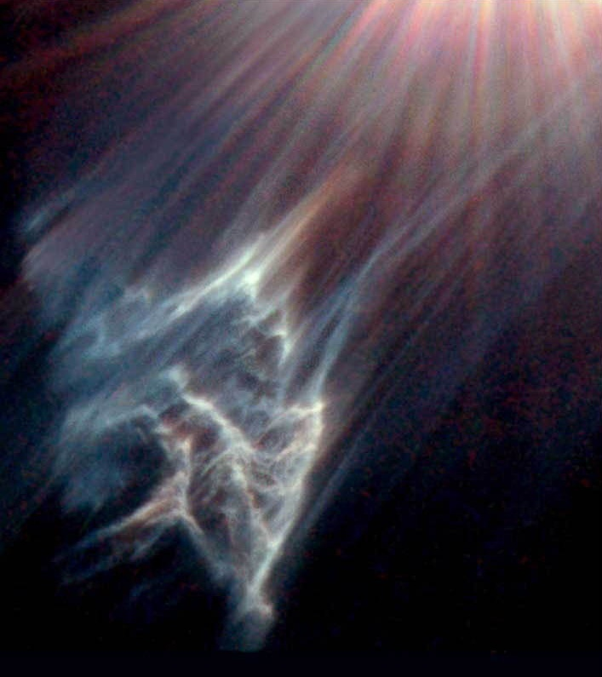
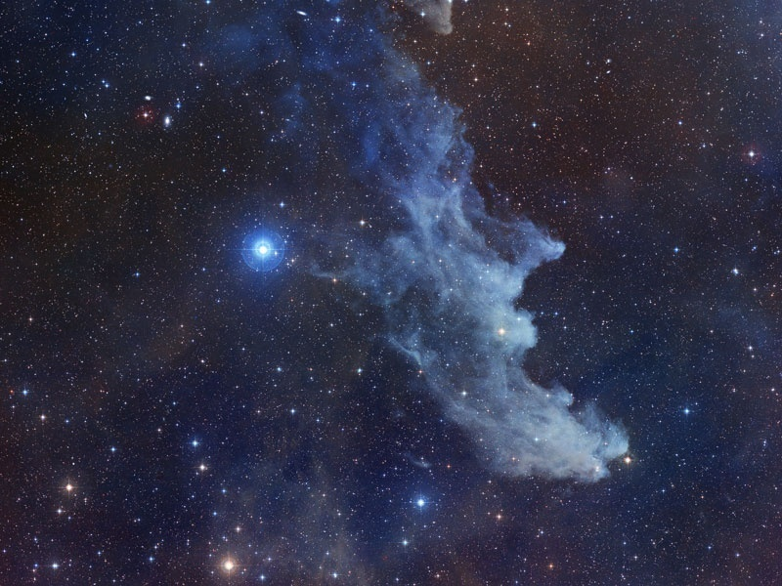
More Reflection Nebulae
IC 349
Witch Head Nebula

Slide 28
The Milky Way – Basic Structure
The disk
The bulge
The nucleus
The halo
Globular clusters
The Sun

Slide 29
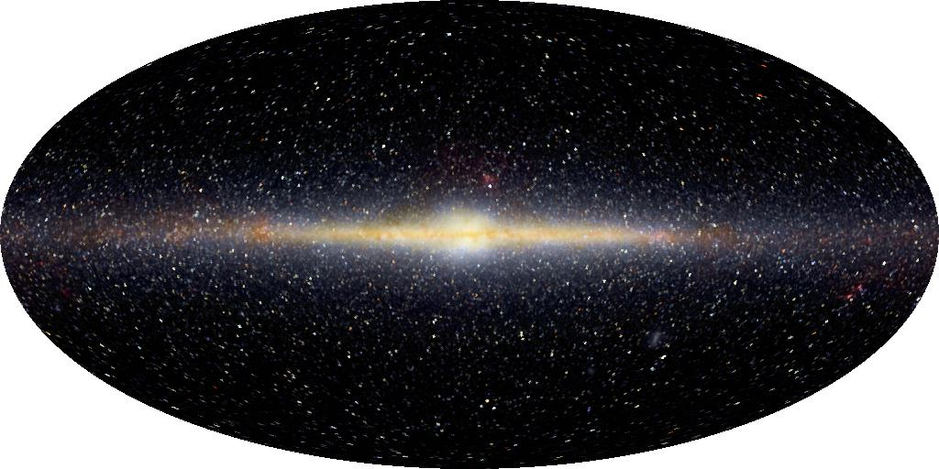
The Bulge
As Viewed in Infrared

Slide 30
General Information About the Bulge
Must be studied via infrared, because view blocked by gas and dust
High metallicity stars, comparable to the Sun (1.6%) , some as high as 5%
Probably production of metals got an earlier start or proceeded more quickly in this region
Almost all older stars, 1 Gyr or more
Little or no gas and dust
Without free gas, no current star formation
Rotating around the center, same direction as disk, but slower
Typical speeds 100 km/s (compare v = 220 km/s)
Much more elliptical orbits
Lots of up and down motion as well
Total mass in bulge about 20×10⁹ M

Slide 31
Color of the Bulge
Disk appears blue from young stars
Bulge appears red from old stars

Slide 32
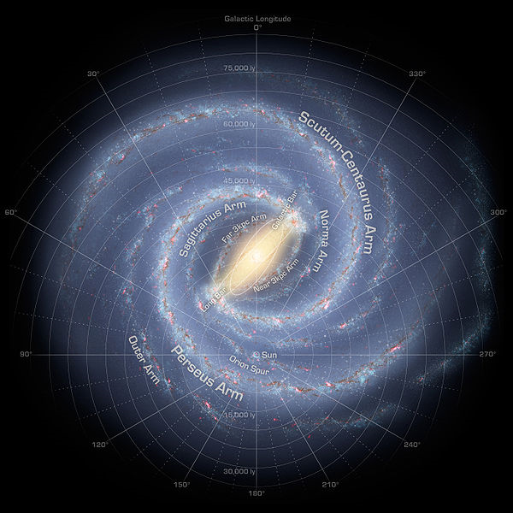
The Shape of the Milky Way’s Bulge
The bulge is approximately 2 kpc in radius and 1 kpc thick
Flattened sphere?
One side of the bulge looks thicker than the other
Best guess – this side is closer to us
This implies our galaxy is a barred spiral galaxy
Bulge is bar shaped

Slide 33
The Milky Way – Basic Structure
The disk
The bulge
The nucleus
The halo
Globular clusters
The Sun

Slide 34
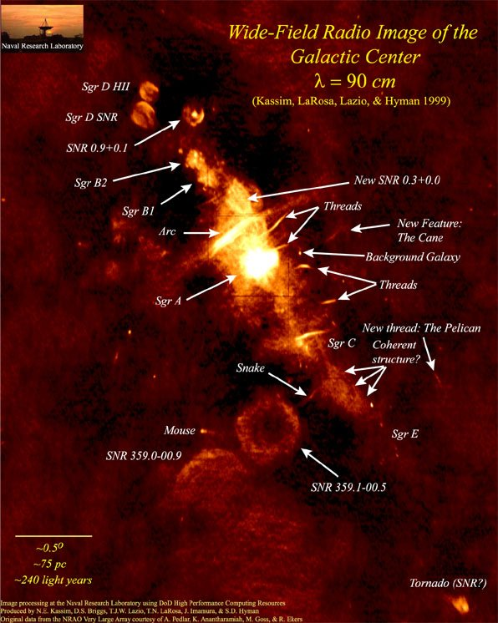
The Nucleus
General Description
Near the center of our galaxy lies the nucleus
Density of stars ~ 2×10⁶ /pc³
compare 0.1/pc³ near us
Total mass about 10⁷ M
Many high mass stars
Must be young
Some more luminous than 10⁶ L
Several recent Type II supernova remnants
Suggests current star formation
Lots of gas
Much of it at high temperatures
Moving in many cases at high velocities
Intense radio sources can penetrate gas and dust

Slide 35
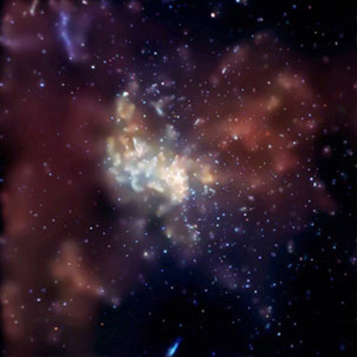
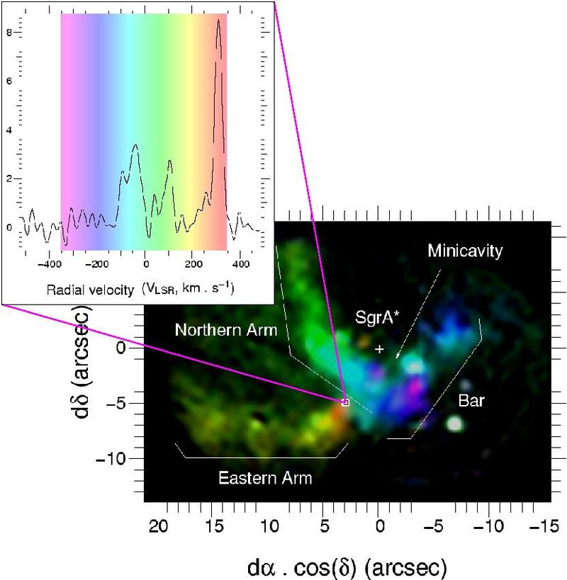
Details Near the Center
We see gas heated by super-hot stars
More than 100 O and B stars
We see gas streaming into the center at speeds as high as 1000 km/s
We see gas producing large amounts of X-rays
Very near the center
A strong radio source: Sgr A*
This seems to be the center of our galaxy
X-ray image

Slide 36
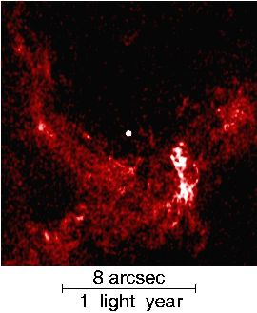
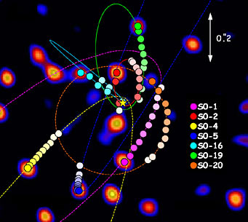
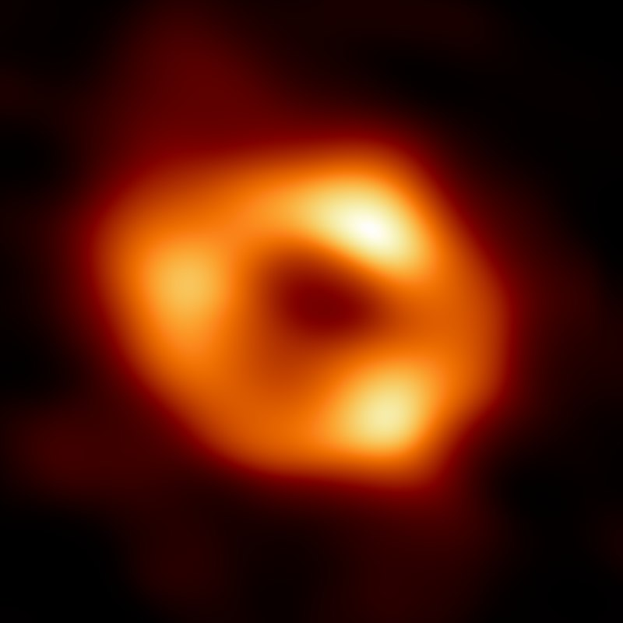
Stars Near the Center
We see stars orbiting very quickly
S2 is a star that completes an orbit every 15 years
Compare: Sun orbits in 250 Myr
Speeds up to 5000 km/s
By studying orbits of these close stars, we can get an estimate of the mass of the central object
Mass about 4.15×10⁶ M
Quite small size
Diameter of ring is 0.4 AU
Only object we can imagine is a black hole
Radius 0.09 AU
Radio Image

Slide 37
The Monster in the Middle
We can use the motion to find the distance
Doppler shift tells us the velocity
Period & velocity tells us the radius
Apparent size tells us the distance
7.9 ± 0.4 kpc
Radio waves can’t come from black hole itself
Gas from nearby attracted by gravity
Accelerates to near light speed
Friction creates heat/X-rays/etc.
More efficient than any other power source
We can also determine the mass of Sagittarius A*
About 4.15 million M
Black hole
4.2 million M_{Sun}

Slide 38
Black Holes in Galaxies
Our galaxy contains a 4.15×10⁶ M black hole
Far too large to have formed from a single star
Most guesses are that they started as one or a few normal black holes
Though the earliest black holes were probably pretty massive
Over time, black holes merged to form a larger black hole
Black hole also swallowed gas and stars to grow
Our black hole is not atypical!
Many galaxies have black holes
Probably most galaxies
Maybe all galaxies
Some galactic black holes are smaller, and some are MUCH larger
Some more than 41×10⁹ M

Slide 39
The Halo
General Description
The halo is the largest part of the galaxy
Roughly spherical in shape (not well measured)
Extends out to ~ 50 kpc in radius (not well measured)
Disk ~ 15 kpc
It is made of:
Individual stars
Globular clusters
Thin clouds of gas
Dark matter!
The nature of the dark matter is not known

Slide 40
Halo Stars
Halo stars are very low metallicity
Typically Z < 0.04% (sun Z = 1.6%, thick disk 0.1% to 0.4%)
Average velocity compared to the Sun of ~ – 200 km/s
Recall Sun has velocity 220 km/s
This means on average they are as likely to be going around the wrong way as the right way
They have additional random velocities in all three dimensions
Order 100 km/s in every direction
Indicates they are in all kinds of crazy orbits
Scale height probably several kpc
Probably not well described by the same distribution for disk stars
Local density is about 0.1% of local disk stars
But much thicker layer, so not as rare as you would think
Total mass of halo stars plus globular clusters around 10⁹ M

Slide 41
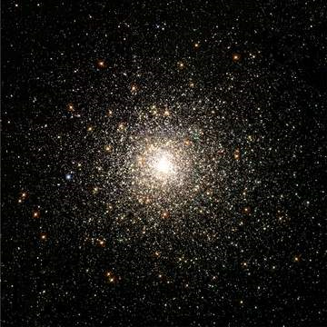
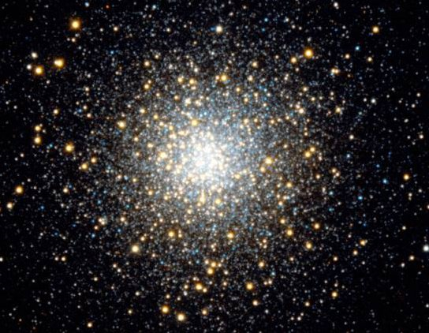
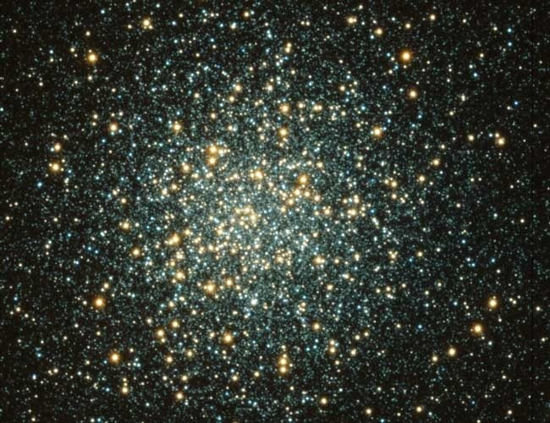
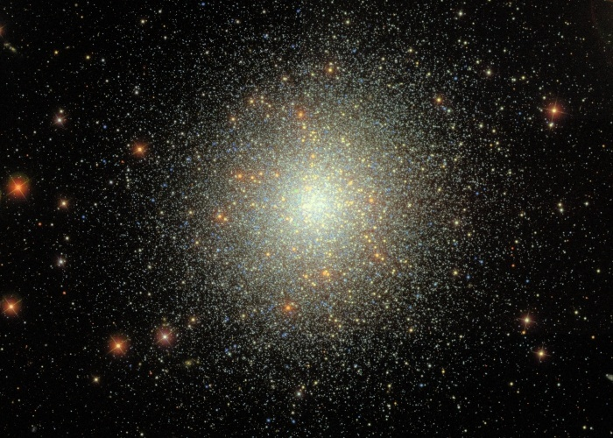
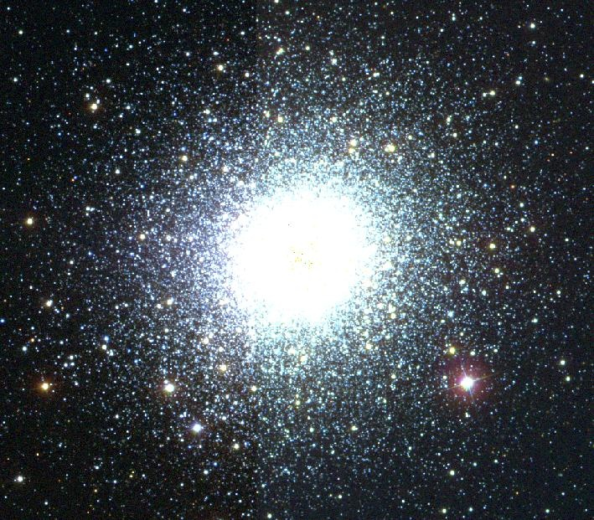
Globular Clusters - Images
M3
M80
M10
M2
M13

Slide 42
Globular Clusters - Information
In addition to open clusters, there are also globular clusters
They have masses in the range 10⁴ – 10⁷ M
They usually appear to be permanently gravitationally bound
Although some of them are slowly falling apart
They have metallicity much lower than the Sun (Sun = 1.6%)
Metal rich globular clusters have 0.1% < Z < 0.4%
Metal poor globular clusters have Z < 0.1%

Slide 43
Metal Rich vs. Metal Poor Globulars
Metal rich Z = 0.1% to 0.4%
Orbits similar to thick disk stars
Metal rich globular clusters are very old (commonly > several Gyr)
Metal poor Z = 0.004% to 0.1%
Orbits similar to halo stars
Halo stars are probably stars that escaped from globular clusters
Metal poor globular clusters are the oldest known stars
Oldest stars known are globular clusters and halo stars
Best estimate 13 ± 1 Gyr
Comparable to best guess of age of universe
Certainly > 11 Gyr
This puts constraints on age of the universe

Slide 44
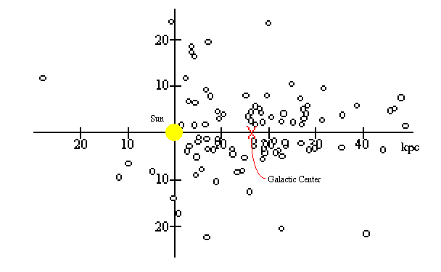
Distribution of Globular Clusters
The globular clusters (especially the metal-poor ones) are distributed throughout the halo
Very few of them crossing through the disk
Therefore, we don’t have a lot of gas and dust blocking our observations of them
We can therefore find all their 3D positions pretty well
It is observed that they are not centered on us, but instead on a point about 8 kpc away in the direction of Sagittarius
This was the first clue of the direction and distance to the center of our galaxy
We now use other, more accurate measures

Slide 45
Gas in the Halo
There is a small amount of gas in our halo
Elliptical galaxies can have a lot more gas
Some of this gas is thin and very hot
Probably heated by supernovas
Expelled from the Milky Way
But some of it is cold
Probably flowing into the galaxy from intergalactic space
Probably renews the disk gas

Slide 46
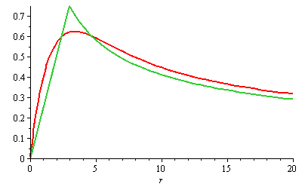
Total Mass of the Galaxy (?)
How much mass is there in the whole galaxy?
Method #1: Count stars and measure gas
Method #2: Measure Orbits
Counting stars and gas indicates a total mass of about 100 billion M. Maybe a little bit more
Almost all of this mass is closer than the Sun
From orbital motion of the Sun
Mass closer than Sun is about 90 billion M  Expect as we go outwards, this mass will remain about the same
This results in rotation curves that fall off at large r
Object Mass (M )
Disk Stars 60 × 10⁹
Disk Gas ~10 × 10⁹
Bulge 20 × 10⁹
Halo Stars 1 × 10⁹
Nucleus 0.01 × 10⁹
MACHOS ????
Dark Matter ????

Slide 47
Populations of Stars
This is not on the test
I am simply informing you in case you need to talk to astronomers
I am not including it because it is not in the book
Astronomers describe stars as belonging to various “Populations”
Population I stars high metallicity
The Sun
Thin disk stars
Thick disk stars are sometimes called “intermediary”
Population II stars are stars with low metallicity
Halo stars
Population III stars are hypothetical stars with no metals
Believed that the first stars in the universe were like this
None seen today
One of the primary goals of James Webb Space Telescope

