Slide 1
Gravity and Orbits
Gauss’s Law for Gravity
Potential Energy from Gravity
m
The gravitational force between two objects:
The “r-hat” is a unit vector pointing directly away from the source of gravity
F
r
M
Gravitational Potential Energy
The potential energy is the (negative of the) integral of the force

Slide 2
Simple Orbits
Circular orbits:
If the velocity is exactly right, you get a circular orbit
Gravitational force must match centripetal force
M
R
m
Other orbits:
If the velocity is smaller, or a bit bigger, you get an elliptical orbit
If the velocity is a lot greater, the object leaves
Depends only on speed, not direction
Kinetic energy must overcome potential energy
Minimum speed is escape velocity

Slide 3
Gravitational Field
In PHY 114, you learned a lot about electric forces and fields
We introduced the Electric Field as the force per unit charge
Compare this with gravity:
By analogy, introduce the gravitational field
If there are many sources of gravity, their effects must be added up

Slide 4
Gauss’s Law for Gravity
In 114, you learned the total electric flux out of a region was related to the total charge in that region:
θ
s
b
b
θ
There is an exactly analogous formula for the gravitational field:
r
r
z
a
q
b
What’s the gravitational flux from the region in this case?
m₄
a
m₃
m₁
m₂

Slide 5
Gauss’s Law and Spherical Symmetry
Gauss’s Law can be used to find the gravitational field when there is a lot of symmetry
Example: Spherical symmetry
Mass density depends only on distance from center
Draw a spherical Gaussian surface
Logically, gravitational field is radial everywhere
Gauss’s Law tells you flux is proportional to contained mass
The mass contained inside the sphere is just the sum of the masses on each spherical shell inside it
The volume of a thin spherical shell is the area of a sphere of radius r times the thickness dr.

Slide 6
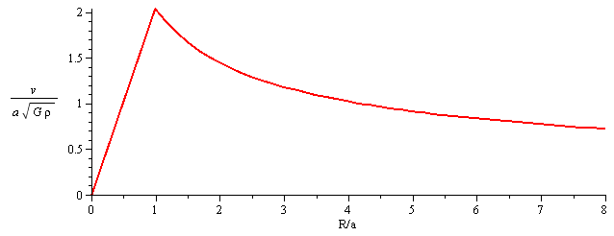
Sample Problem
A gravitational source takes the form of a uniform sphere of density ρ₀ and radius a
What is the gravitational field everywhere?
What is the corresponding orbital velocity for circular orbits?

Slide 7
Gauss’s Law For a Slab
Consider a slab source, spread out uniformly in two dimensions
Density depends only on z.
Assume the top half has same mass distribution as the bottom half
No gravity at z = 0.
Draw Gaussian surface
Box from z = 0 to z = Z, of area A.
Use Gauss’s Law:
For uniform density, we find:

Slide 8
Gravitational Potential
For electric fields, it is often more useful to work with the electrostatic potential
Exactly the same thing can be done for the gravitational field
The potential energy for one particle, then, is

Slide 9
Sample Problem (1)
What is the gravitational potential everywhere for a uniform sphere of density ρ₀ and radius a? What is escape velocity from the center of the sphere?
Because the gravitational field is only in the r- direction, the potential should depend only on r.
Therefore, the relationship between Φ and g is:
Must do inside and outside separately!
Don’t forget the constant of integration!
How can we find the constants of integration?
Potential at infinity is zero
Potential at the boundary must be continuous

Slide 10
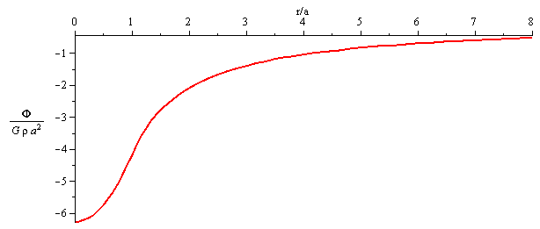
Sample Problem (2)
What is the gravitational potential everywhere for a uniform sphere of density ρ₀ and radius a? What is escape velocity from the center of the sphere?
To find escape velocity, match potential and kinetic energy at the origin

Slide 11
Global Conservation Laws
Consider a galaxy/structure which is not interacting with other galaxies/structures:
Often a good approximation
The following must be conserved:
Total energy, Total momentum, Total angular momentum
Total momentum describes overall motion
We can eliminate it by working in the “center of mass frame”
Energy is more complicated
Potential and kinetic
But there can be other contributions
If gravity is the only force involved, then global E_{p} + E_{K} energy is conserved
Stars, for example, rarely collide
If there are other effects, like collisions, energy can be transferred and lost
Gas clouds, in contrast, commonly collide
Finally, the total angular momentum of the galaxy is conserved

Slide 12
Gravitational Potential from a Distribution
Suppose mass is distributed in a continuous manner
How do we calculate potential and potential energy?
Divide into many small regions of size dV
These will each have mass ρ dV
Convert to an integral:
Potential energy for the whole system is:
Can be rewritten in terms of potential:

Slide 13
Sample Problem
What is the total gravitational binding energy for a uniform sphere of mass M and radius a?

Slide 14
Virial Theorem (1)
For circular orbits, there is a simple relationship between the potential energy and the kinetic energy:
For non-circular orbits, this is not true, because energy keeps changing between the two components.
However, if you average over time, this will still be true
If you have many objects, some of them will be at their maximum, and others at their minimum
Could this expression be true if you add everything up?
Consider a complicated combination of many masses acting gravitationally
Galaxy or Globular cluster, for example, consists of 10⁴ to 10¹⁴ stars
First, find the total kinetic and potential energy
And the force on any one object

Slide 15
Virial Theorem (2)
We will assume that the system isn’t changing much; i.e., though the individual stars are moving, there will be as many moving one way as another
Galaxy has no net motion
Any quantity that “adds up” effects of all components will be constant
Consider the following quantity:
Time derivative should vanish:

Slide 16
Measuring Rotation
The Sun’s Revolution
Measuring rotation in our galaxy is hard because we are inside it.
One method for measuring circular rate of rotation at our radius:
Study proper motion of Sagittarius A* over period of years
Possible using radio telescopes and interferometry
Multiply by distance, 8.23 ± 0.12 kpc
Result is about 230 ± 10 km/s
Subtract the Sun’s motion compared to nearby objects (local standard of rest):
Sun moves forward at 12 ± 2 km/s, upwards at 7 ± 1 km/s, inwards at 11 ± 1 km/s

Slide 17
Measuring Other Object’s Revolutions (1)
For other objects, it is hard to measure their rotation rates
Assume they are going in circular orbits at speed V
Let l (galactic longitude) be angle as viewed by us
Let α be angle of star viewed from center
Law of cosines:
Take time derivative:
V₀
l
D
V
R₀
α
R
The angular velocity of us and the other star is:
Law of sines:

Slide 18
Measuring Other Object’s Revolutions (2)
As we look inward, we see both closer and farther orbits
We see a mix of red and blue shifts
As we look outward, we see only more distant orbits
We see only red or blue shifts, depending on l
Blue shift forwards
Red shift backwards
Conclusion: Gas clouds at larger radius have smaller angular velocity (V/R is smaller)
V/R decreases with radius

Slide 19
The Tangent Method
Look inwards/forward at an angle
Clouds closer to the center will be red-shifted
Because they are moving at higher angular velocity
The one closest to the center will be the most red-shifted
The biggest Doppler red shift lets you calculate V
l
R₀
R
In a similar manner, you can look backwards
Clouds closer to the center will be blue-shifted
Because they are moving at higher angular velocity
The one closest to the center will be the most blue-shifted
The biggest Doppler blue shift lets you calculate V

Slide 20
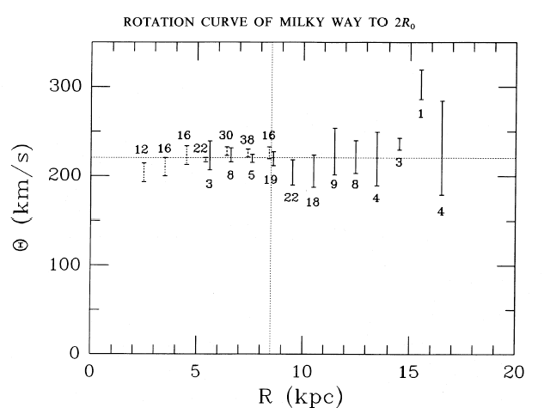
Rotations for Other Radii
At small radii, the gas cloud orbits are not very circular
Tangent method gives inaccurate results
Tangent method only tells you results for inner orbits
For more distant orbits:
Measure the distance to a star or cluster of stars
Measure radial velocity
Deduce orbital velocity

Slide 21
Rotation Curves and Mass Distribution
Let’s crudely assume the mass is distributed in a spherically symmetric manner
This is not true, but probably only introduces 10 – 20% error
Then we can find the mass closer than the Sun using R₀ = 8.3 kpc
This is the same as the mass of all the stars and gas in the galaxy
Suggests some missing mass
Stars can be seen out to at least twice this radius
Total mass is at least twice this
Mass is not concentrated near the center
21 cm line from atomic hydrogen out to at least 5 times this, maybe more
We can also study orbits of globular clusters out past 50 kpc
Finally, there are small galaxies orbiting ours out to 200 kpc or so
Again, speeds remain comparable
90% of the mass of the galaxy is not in the disk (nor the bulge), but in the halo
Approximately spherically symmetric
Mass contained in radius R is roughly proportional to R

Slide 22
Dark Matter
The Halo contains most of the mass of our galaxy
Probably around 90%
This matter is dark – it contributes little or nothing to the luminosity
We don’t know how far it goes out
At least 100 kpc
Probably less than half the distance to the next large galaxy
Andromeda galaxy ½(800 kpc) = 400 kpc
Probably around 300 kpc
Total galaxy mass is probably around 10¹² M
Object Mass (M_{Sun} )
Disk Stars 60 × 10⁹
Disk Gas ~10 × 10⁹
Bulge 20 × 10⁹
Halo Stars 1 × 10⁹
Nucleus 0.01 × 10⁹
Dark Matter > 500 × 10⁹

Slide 23
What is the Dark Matter? (1)
What could the dark matter be?
Could it be gas?
HI regions – produce spectral lines or X-rays – NO
HII regions – produce the 21 cm line – NO
Molecular clouds
Contaminants like CO produce spectral lines – NO
But perhaps there are clouds that are pure hydrogen – MAYBE
Arguments based on cosmology suggest we see most of the gas that is present – PROBABLY NOT
Could it be massive objects like:
White dwarfs – difficult to see since they are dim
Neutron stars – even harder to see
Black holes – impossible to see
“Jupiters” or “brown dwarfs” –formed without stars
These objects are collectively called Massive Compact Halo Objects (MACHOs)
Invisible massive particles

Slide 24
MACHOs and Bending of Light (1)
All of these objects are dim and hard to see
However, they all have a lot of gravity
According to Einstein, gravity bends light
As light passes any point-like source of gravity, it is deflected
Apparent position of the star is deflected by an angle
MACHOS
White dwarfs
Neutron stars
Black Holes
Brown dwarfs/ “Jupiters”
x
α
b
θ
y
β
M
d_{L}
d_{LS}
d_{S}
Label some distances and angles
Use small angle approximations
Do some math

Slide 25
MACHOs and Bending of Light (2)
Define the Einstein radius
Then we need to solve
Solution is:
x
α
b
θ
y
β
M
d_{L}
d_{LS}
d_{S}
There are, in fact, two images
One deflected above, as sketched
One deflected below
Unfortunately, these angles are too small to detect
Nonetheless, they can still magnify the star, making it brighter

Slide 26
MACHOs and Magnification of Light
To make things simple, assume shape of star is part of an annulus centered on the mass
Any shape can be made of such annuli
The star actually goes from angle β to β + dβ
And from azimuthal angle φ to φ + dφ
Without the mass, the star’s brightness would be proportional to
The star’s image goes from angle θ to θ + dθ
And from azimuthal angle φ to φ + dφ
The brightness of the image is, therefore,
The ratio of these is the magnification
The actual brightness is the sum of the two images put together
dβ
Star
β
Mass

Slide 27
How to Catch a MACHO
MACHOS
White dwarfs
Neutron stars
Black Holes
Brown dwarfs/“Jupiters”
Watch a random star
MACHO will pass in front of it
Light gets bent
Star gets brighter
MACHO moves away
Star gets dimmer again
MACHO:
What we see:
Lots of stars are variable
However, these stars will get brighter/dimmer equally at all wavelengths
And it will follow curve predicted by theory
Realistically, watch thousands of stars in small area
Bulge is a good place to look for them

Slide 28
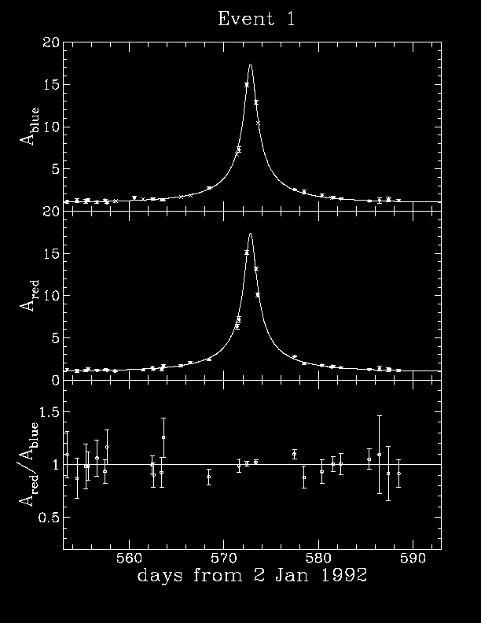
How Many MACHOS Are There?
We can study many background stars by looking at the bulge, or at the Larger Magellenic Cloud (a small, nearby galaxy)
Let a computer watch many stars and flag those that change brightness
If they do, study them over time
Compare multiple wavelengths (variable stars tend to change temperature)
Conclusions:
MACHOS exist
Mostly white dwarfs
Substantial fraction of stars, but not the dark matter

Slide 29
What Is the Dark Matter? (2)
Dark matter candidates
Cold hydrogen gas - Probably not
White dwarfs
Neutron stars
Black Holes
Brown dwarfs/“Jupiters”
Invisible massive particles
Probably not
We already argued against gas
MACHOS seem to be ruled out
A caveat – very small or very large black holes might still work
Invisible massive particles seem to work
Neutrinos are particles that we know exist and have mass
But they probably won’t work
No other known particles work
But many speculative theories contain such particles

Slide 30
Orbits of Disk Stars
Conservation of Angular Momentum
What governs stellar orbits of disk stars:
For the most part, we can treat all the “other” stars as being uniformly spread out
Don’t worry about effects of individual other stars
What conservation laws on a particular star can we use to figure out the motion?
Momentum of star is not conserved – there are forces on it
Energy conversation helps – but I won’t use this
Angular momentum conservation?
r
F
The cross product r × F will not generally vanish
However, the cross product will always be perpendicular to the vertical direction
Call this the z –direction
This component of the motion will be conserved
The combination Rv_{φ} is conserved

Slide 31
Three Types of Motion
We will be using cylindrical coordinates:
R – the distance from the z-axis, v_{r} the corresponding velocity
z – the vertical distance from the plane, v_{z} the corresponding velocity
φ – the angle around, v_{φ} the corresponding velocity
There will potentially be three kinds of motion
These will have associated with them three angular frequencies
κ – angular rate at which it wanders in and out
ν – angular rate at which it bobs up and down
Ω – angular rate at which it goes around
R
z
φ
Angular motion – the easiest to understand
The star goes approximately in a circle
Assume we know the angular velocity for circular orbits:
Assume that at some radius R₀ this is exactly v_{θ}
Approximate angular velocity and angular period is:
At all other radii, we must have:

Slide 32
Up and Down Motion
In the vertical direction, there will be small motions
The star should only be moving a small amount, z small
Locally, the disk looks much like a uniform slab
We found the gravitational acceleration previously
This looks like Hooke’s Law
Simple harmonic motion
Star bounces up and down

Slide 33
In and Out Motion: Epicycles (1)
In the radial direction, star moves in and out somewhat
I will work in a frame that is rotating around with the galaxy
In this frame, there will apparently be a centrifugal force
If it were in a perfectly circular orbit, force would cancel gravitational force, so
Effective force is the sum of these two
This will equal mass times radial acceleration
We are only interested in near circular orbits, so R ≈ R₀ circular and V ≈ V₀
Expand, keep only leading order term

Slide 34
In and Out Motion: Epicycles (2)
Taylor expand V² around R₀, then substitute:
Keep only leading order
This is yet another Harmonic oscillator
Example: flat rotation curves:

Slide 35
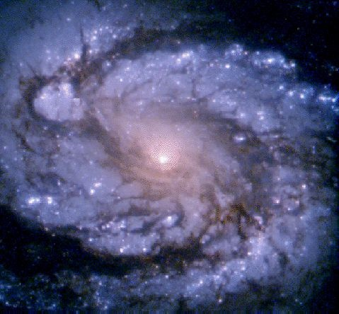
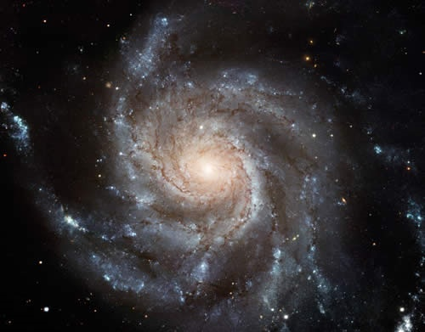
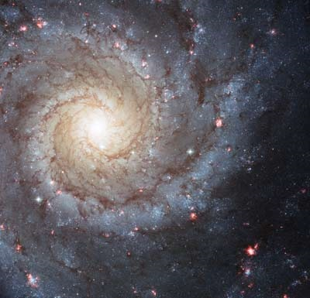
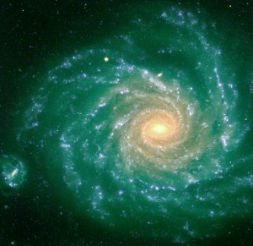
Spiral Arms: What Causes Them?
Spiral Arms vary between galaxies
Most spiral galaxies have two arms
Some have three or four
Some have “partial” spiral arms
The “winding” nature of them is a bit tricky
Not just simple winding!

Slide 36
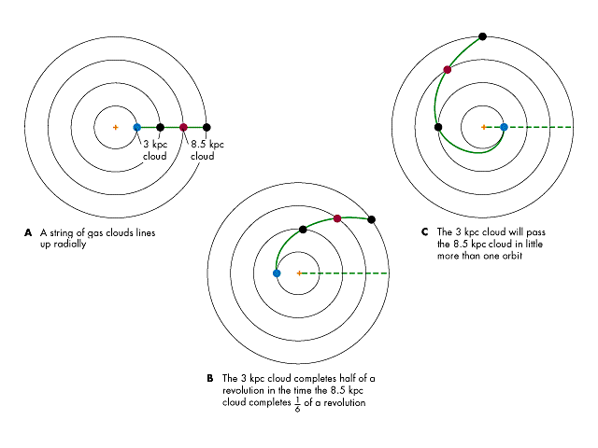
Simple Winding: The Wrong Theory
In one cycle, spiral arms would end up completely wound up
There have been 20 or so circuits since the beginning
Therefore, it’s not this simple
It cannot be the same stars that inhabit the spiral arm on each cycle
Different stars, clouds and gas inhabit it in each cycle

Slide 37
Density Waves: The Idea
Suppose a region in a rotating spiral galaxy has higher density “clump”
Due to random fluctuations, nearby galaxies, etc.
It attracts gas from in front, from behind, from inside, from outside
But they rotate at different rates, so the “clump” gets spread out
Which causes still more clumps to form
The pattern angular frequency Ω_{gp} will be a little different than the rotation rate Ω
Because it is spreading in both directions
How widespread the pattern can be depends on how many arms m you need
Can show that pattern only works if Ω_{gp} differs from Ω by at most κ/m.

Slide 38
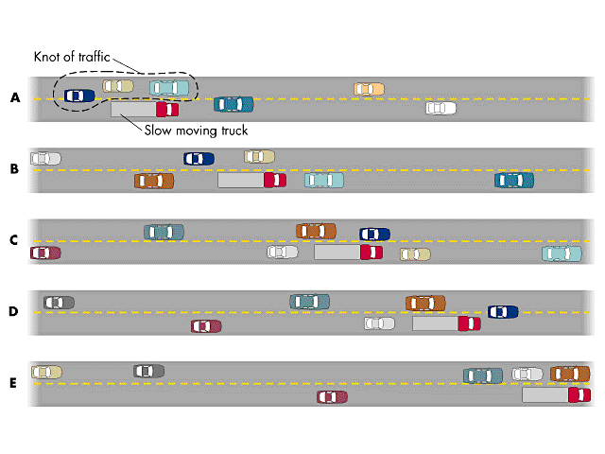
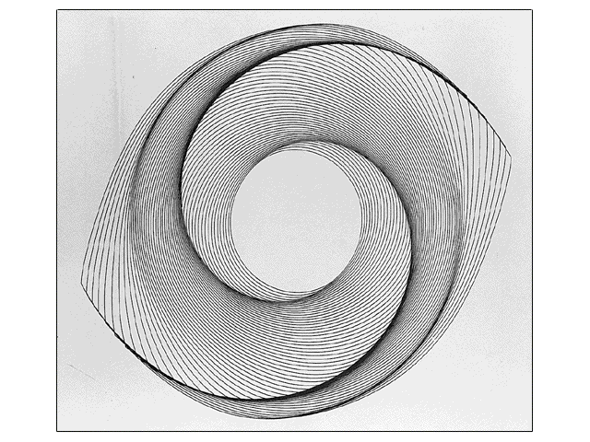
The Spiral Arms: What We’re Seeing
The “clumping” works best for objects with nearly perfect circular orbits to start with
Works best for cool gas
Molecular clouds – almost in perfect circular orbits
These regions are where the young stars will form
Young stars (the brightest) mark out the spiral arms
Once stars are born, they typically “fall out” of the spiral arms
The spiral arms are not made of particular stars – they change over time

Slide 39
Shapes of Clusters
Core and Tidal Radius
Shape of a cluster (especially globular clusters)
Typically roughly spherical
Dense inner region
Core radius r_{c}
Sharp dropoff at large radius
Tidal disruption radius r_{t}
Region where other gravitational objects have stripped stars away
r_{t}
r_{c}

Slide 40
Conservation Laws with Clusters
Clusters (especially globular clusters) most of the time have relatively little interaction with other objects
Conservation laws should hold within the cluster
Though they have net momentum, we can ignore that
Work in center of mass frame of the cluster
They usually were formed with little or no net angular momentum
Generally, this will just be conserved, so they stay that way
Over the course of approximately one orbit, potential energy ← → kinetic energy
Therefore, over time, the system will virialize
They then evolve due to two types of effects
Close encounters of pairs of stars in the cluster
Interaction of passing stars or other mass sources

Slide 41
Close Encounters of Pairs of Stars
When two stars pass near each other, they will alter each others’ orbits
This changes each star’s momentum and energy, but not the total
Over time, this allows transfer of energy between all the stars
System ends up in a sort of thermal type distribution
Don’t think of this dynamical “temperature” T_{D} too literally
Does not correspond to the temperature of the stars themselves
Recall, energy is kinetic plus potential energy
Note that both terms in the energy are proportional to mass
The probability distribution prefers lower energy states
This effect has the most effect on high mass stars
Therefore:
High mass stars tend to move at lower velocities
High mass stars tend to “fall” to the center of the cluster

Slide 42
Evolution of Cluster Shapes
Due to interactions between stars within the cluster:
Because the distribution depends only on energy, and this is the same in all directions, the cluster ends up as a sphere
The more massive stars are gradually moving towards the center, and slowing down
Less massive stars drift towards the edge
Over time, the core radius r_{c} shrinks smaller and smaller
Eventually r_{c} shrinks to zero
Many globular clusters seem to have already reached this stage
The outer layer should, over time, expand and slowly evaporate off
But that’s not what we see
r_{t}
r_{c}

Slide 43
Effects of Passing Mass on a Cluster (1)
What effect does a passing mass have on a cluster?
Typically, the passing mass is moving quickly past the cluster
As it goes by, it pulls on the stars
Net effect: The entire cluster accelerates in the direction of the passing star
But not evenly!
We don’t care about the net motion of the cluster
But we do care about what effect is has on the stars in the cluster
It pulls most strongly on the part of the cluster near it
It pulls more weakly on the far part of the cluster
It pulls diagonally on the parts to the side
This means it is adding internal kinetic energy to the cluster
r_{t}
r_{c}

Slide 44
Effects of Passing Mass on a Cluster (2)
The initial energy was negative
Can be easily seen from the total energy and the virial theorem
The total energy has increased
Over one dynamical time scale, this energy will get distributed between the kinetic and potential energy according to the virial theorem
The energy gets redistributed so that the kinetic and potential energy is shared
The cluster gets larger and more loosely bound
Stars near the outer edge eventually get completely stripped away
This causes there to be a relatively sharp outer boundary
If the cluster has insufficient mass, it will eventually be entirely disrupted
r_{t}
r_{c}

Slide 45
CAUTION!
Many of the details about how galaxies form structure are not well understood
Much of our understanding comes from computer simulations, without detailed theories
If an expert told you everything they knew, some of it would be wrong
I am not an expert, and hence some of what I am going to tell you is probably wrong
Take my comments as probably generally right, but probably wrong in details
And it will doubtless need revision over time

Slide 46
Shapes of Galaxies
Conservation Laws in Disks
The stars in a disk are formed from gas and dust in the disk
We need to understand these objects to understand the stars in them
Although a galaxy is moving, we are once again not interested in the net motion of the galaxy
Work in the center of mass frame of the galaxy
Unlike stars, gas clouds are huge and frequently undergo collisions
These collisions heat the gas
The gas then starts to radiate the heat, which leaves the disk
So we have Kinetic Energy → Heat → Radiation → Lost
Effectively, energy is not conserved in the gas of the disk
However, radiation carries off very little momentum
And therefore, very little angular momentum
Angular momentum is conserved in the disk

Slide 47
Early Star Formation In Galaxies
All stars come initially from clouds of gas
Initially, the clouds of gas can be any shape
Stars form throughout the cloud
Initially probably having little motion
Gravity pulls the stars towards the center
Converting gravitational energy to kinetic
Ultimately, the system virializes
If there is no net angular momentum, it will forma sphere
With stars having random motion in it
If there is some net angular momentum, it will form an oblate sphere
Stars having some random motion
But more going in direction of rotation than counter to it
These early stars may be the bulge stars

Slide 48
The Shapes of Disks
The cloud of gas is also getting pulled together
Because energy is not conserved in this cloud, it can shrink down a lot more
It can’t shrink to a point if it has angular momentum
It will ultimately become a disk
Only thing opposing it becoming infinitely thin is pressure
The lowest temperature gas (molecular clouds) will make a very thin disk
New stars will form in this disk
Hence the youngest stars always form in the thinnest disk

Slide 49
Evolution of Shapes of Disks
Passing galaxies and collisions with small galaxies will add kinetic energy to the remaining gas and stars
This causes orbits to distort, no longer circular, and moving above and below the plane
The gas ultimately loses this excess energy and goes back to being a disk
But the disk of the stars thickens permanently
The older parts of the disk will tend to be thicker than the younger parts

Slide 50
Instabilities in Disks and Bulges
A perfectly symmetric ellipsoid should remain that way indefinitely
But passing galaxies and other perturbations cause distortions
In the bulge, there is an instability that makes the oblate ellipsoid become more elongated (cigar shaped)
In the disk, there are instabilities that cause spiral arms to form
Much of this information comes from computer simulations

