Slide 1
Large Scale Structure
Groups and Clusters
Reminder – Our Address
Levels of organization:
Stellar Systems
Stellar Clusters
Galaxies
Galaxy Groups and Clusters
Galaxy Superclusters
The Universe
Everyone should know where they live:
The Solar System
(we don’t live in a cluster)
The Milky Way Galaxy
The Local Group
Laniakea Supercluster
The Universe

Slide 2
Descriptions of Groups and Clusters
Galaxies are not distributed randomly through space
Concentrated in collections called Groups and Clusters
Groups and clusters range from about 10¹³ M – 10¹⁵ M
Range in size from 2 Mpc to 10 Mpc across
They are categorized by how many bright galaxies they have
Bright is vague, but roughly brighter than 10% of the Milky Way
The two types of collections are groups and clusters
Groups: < 50 bright galaxies, (about 10¹³ M)
Clusters: ≥ 50 bright galaxies, (about 10¹⁴ M or 10¹⁵ M)

Slide 3
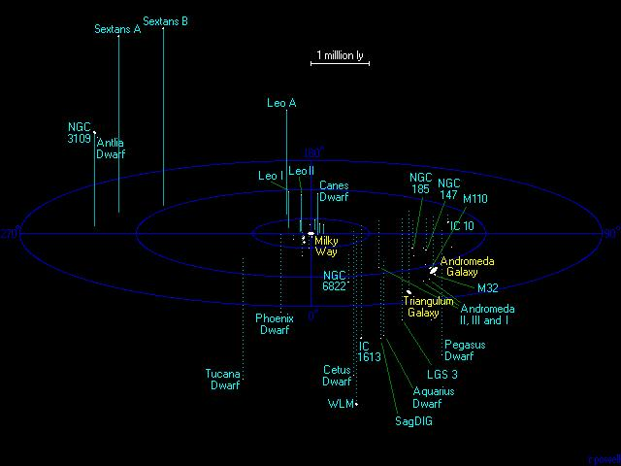
Our Group – The Local Group
It has about 120 total galaxies
Three spiral galaxies – two of them large
Milky Way Galaxy – a SBb or SBc or SBbc
Andromeda Galaxy (M31) – SAb
Triangulum galaxy (M33) – SAc or SAd
Several small satellites of these galaxies
Several miscellaneous galaxies
Total diameter about 3 Mpc

Slide 4
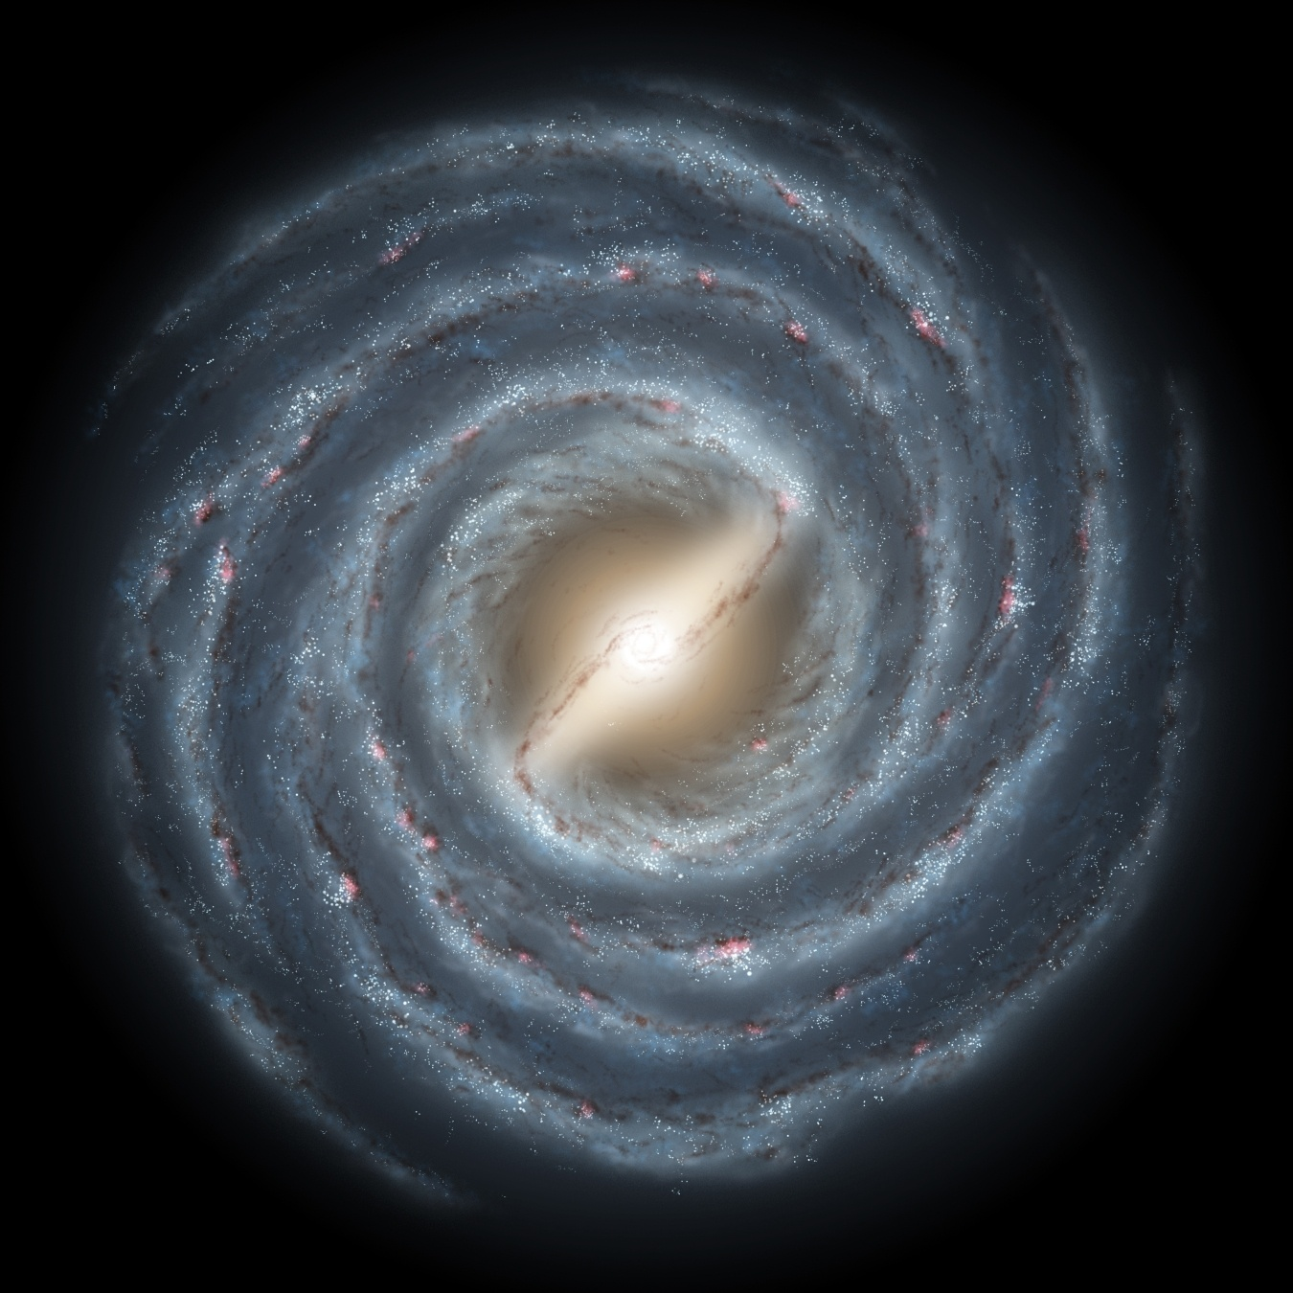
The Milky Way

Slide 5
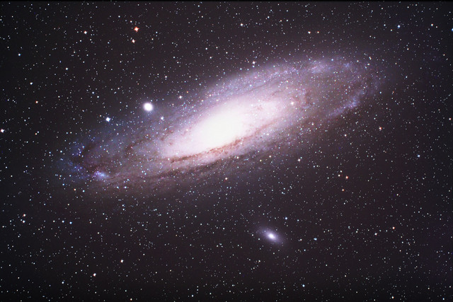
The Great Galaxy in Andromeda (M31)
Large Spiral Galaxy - SAb
About 50% brighter than our galaxy
About 50% more mass than our galaxy
780 kpc away
Moving towards us at 110 km/s
Will merge with us in 4 Gy?

Slide 6
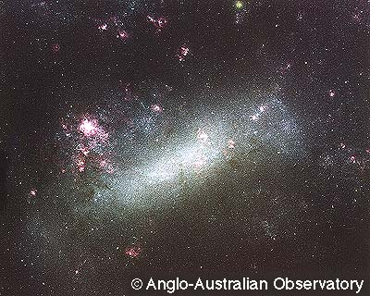
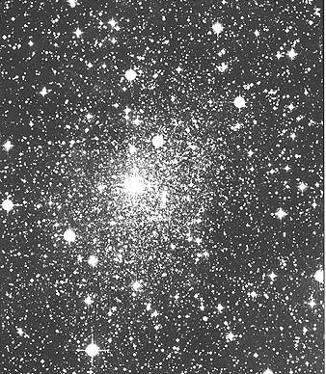
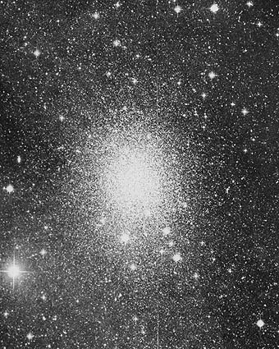
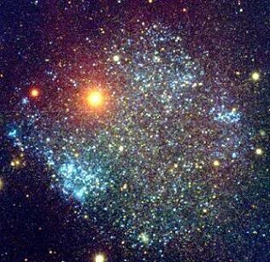
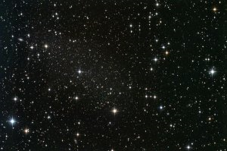
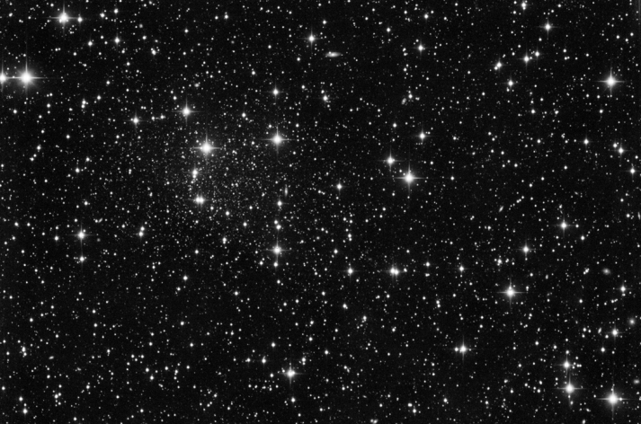
Our Companions (1)
Larger Magellenic Cloud
Sculptor Dwarf
Carina Dwarf
Sextans Dwarf
Ursa Minor Dwarf
Draco Dwarf

Slide 7
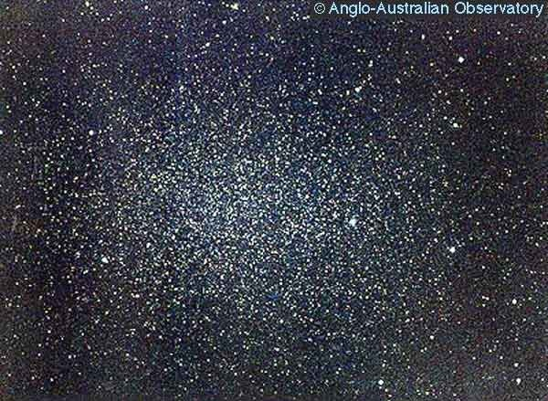
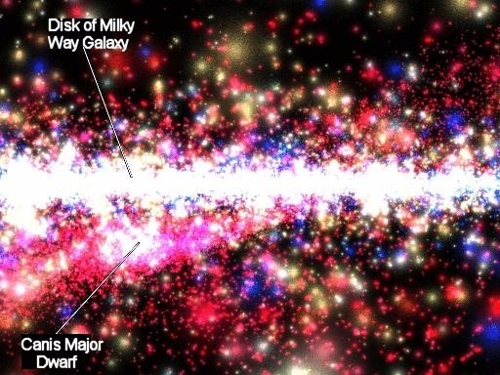
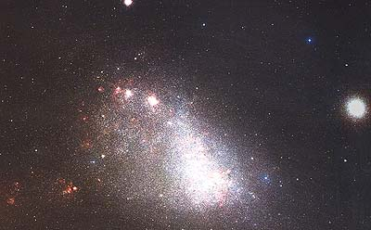
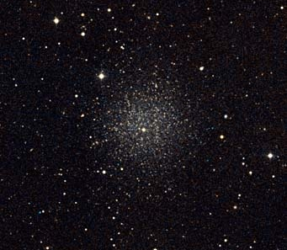
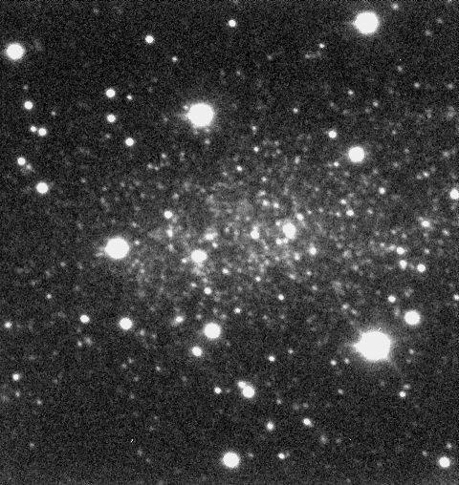
Our Companions (2)
Leo I
Canis Major Dwarf
Smaller Magellenic Cloud
Sagittarius Dwarf Elliptical
Leo II

Slide 8
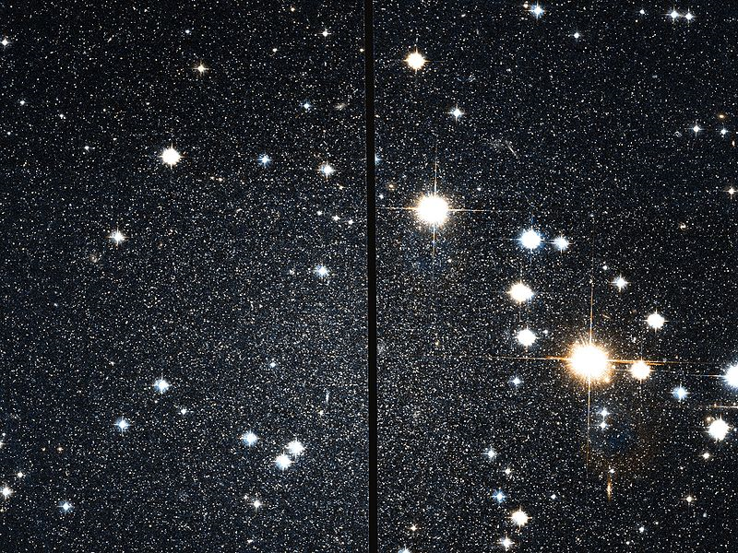
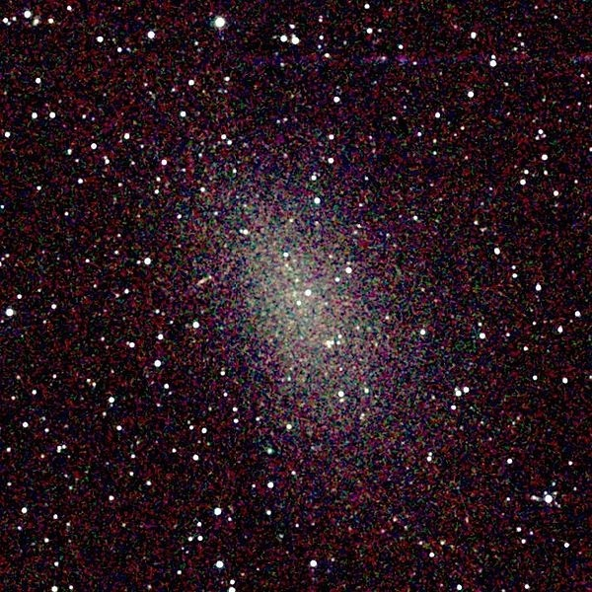
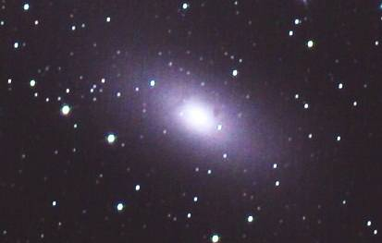
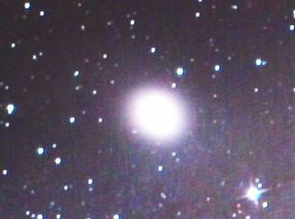
Companions of Andromeda (1)
Cassieopeia Dwarf
M110
M32
NGC 147

Slide 9
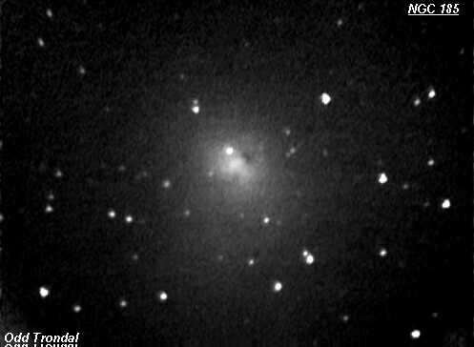
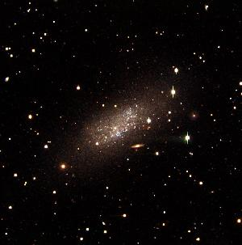
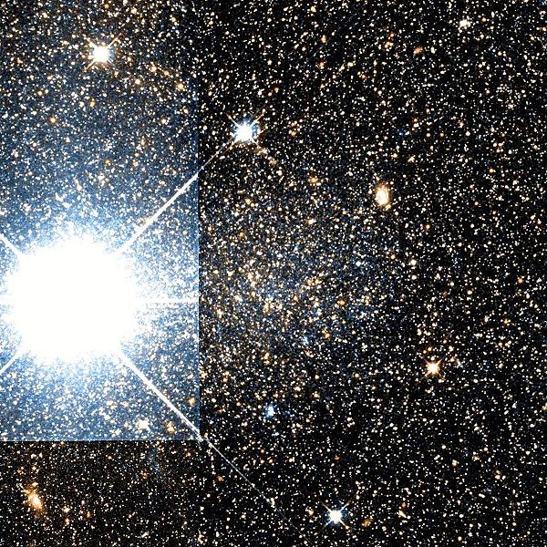
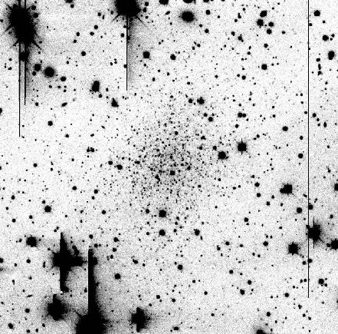
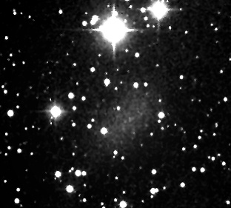
Companions of Andromeda (2)
Pegasus Dwarf
NGC 185
Andromeda III
Andromeda IV
Andromeda V

Slide 10
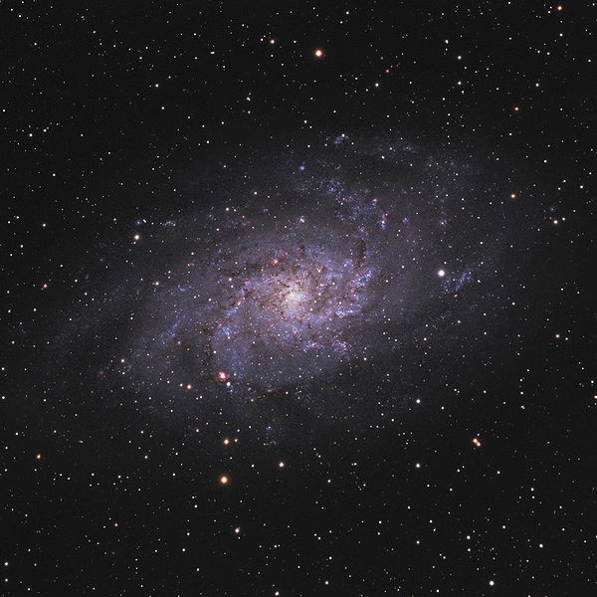
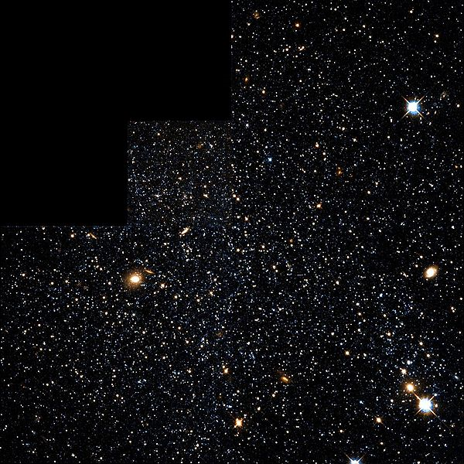
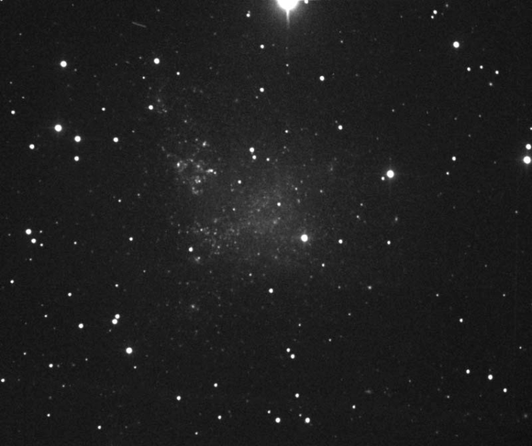
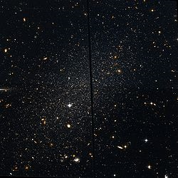
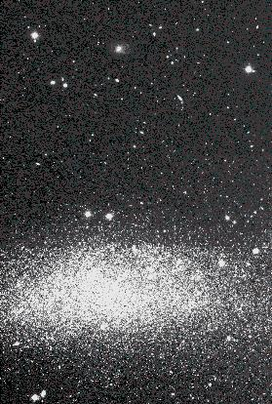
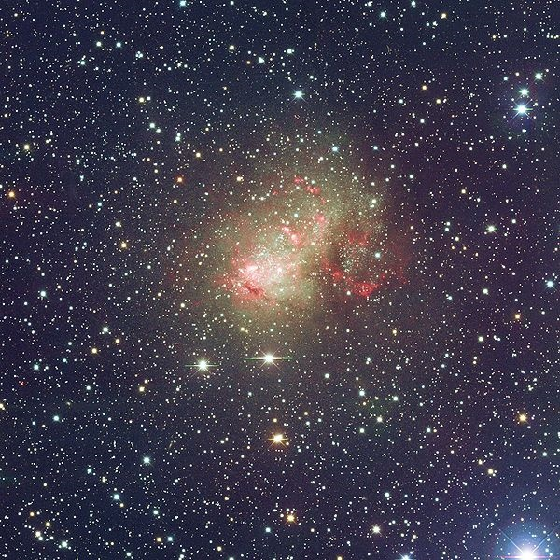
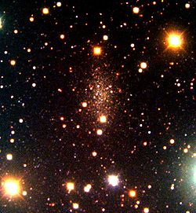
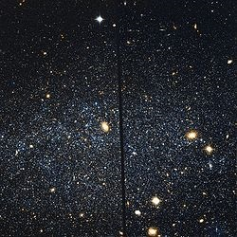
Other Members of Local Group
Phoenix Dwarf
IC 1613
Triangulum galaxy (M33)
Wolf-Lundmark-Melotte
Tucana Dwarf
Pisces Dwarf
IC 10
Leo A

Slide 11
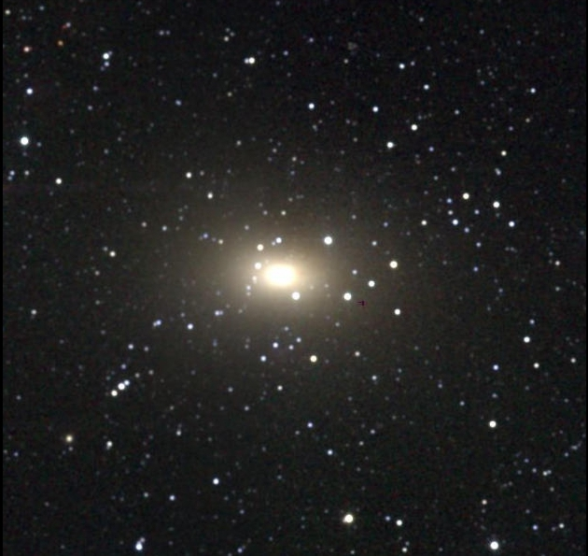
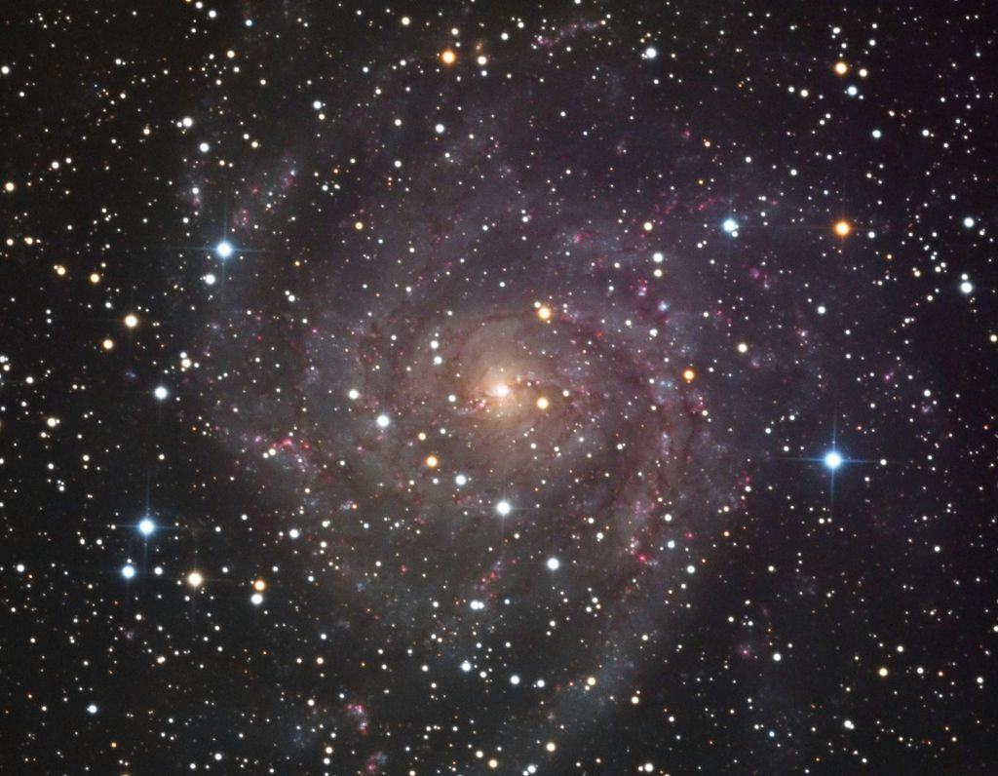
Nearby Groups and Clusters
Maffei/IC 342 Group
3.3 Mpc
Maffei I
IC 342

Slide 12
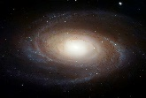
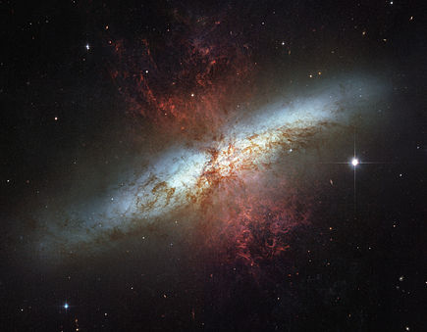
M81 Group
M82
M81
3.5 Mpc

Slide 13
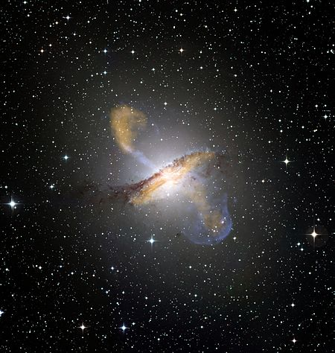
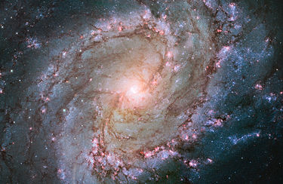
Centaurus A / M83 Group
Centaurus A
3.66 Mpc
M83

Slide 14
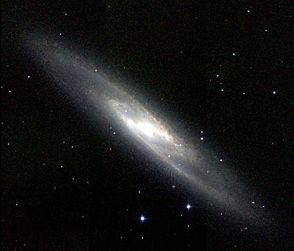
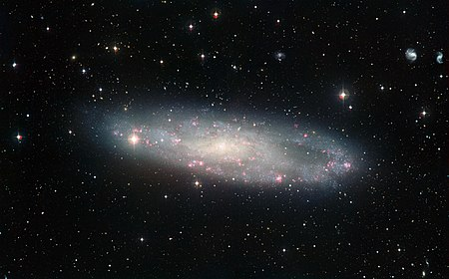
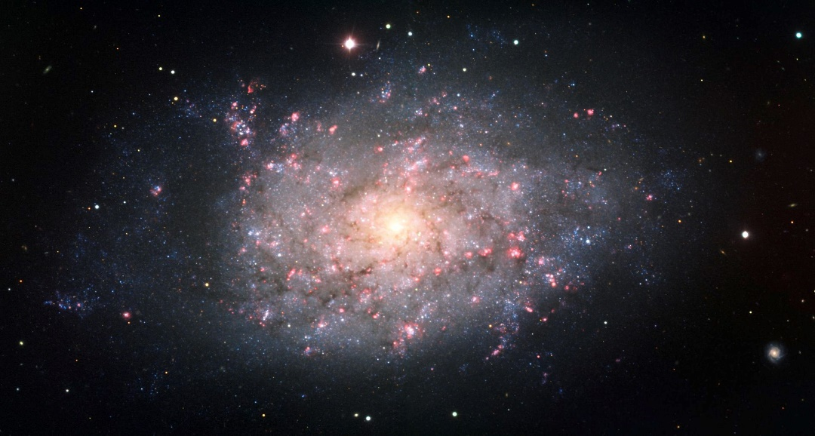
Sculptor Group
3.9 Mpc
Sculptor Galaxy
NGC 247
NGC 7793

Slide 15
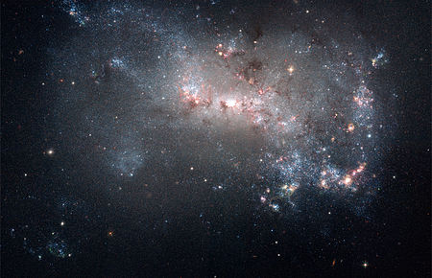
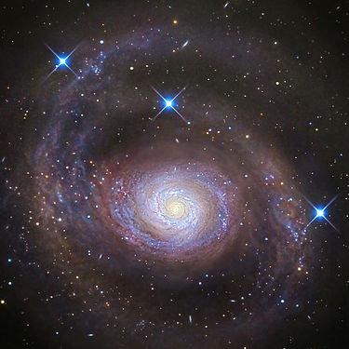
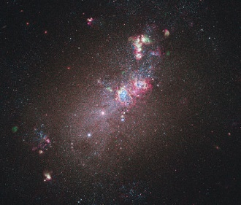
Venatici I Group
NGC 4449
4.0 Mpc
M94
NGC 4214

Slide 16
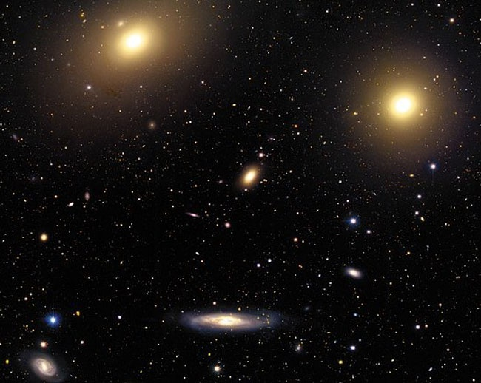
The Virgo Cluster
More than 1000 galaxies
Dozens of bright galaxies
Two giant ellipticals
Many bright spirals
16.5 Mpc away
Total mass about 1.2 × 10¹⁵ M_{Sun}

Slide 17
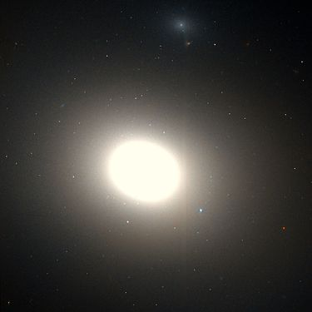
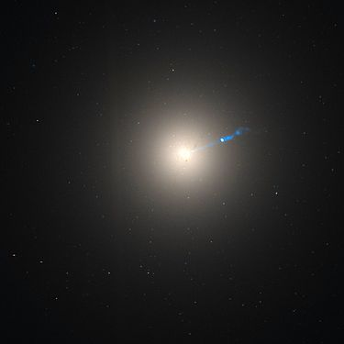
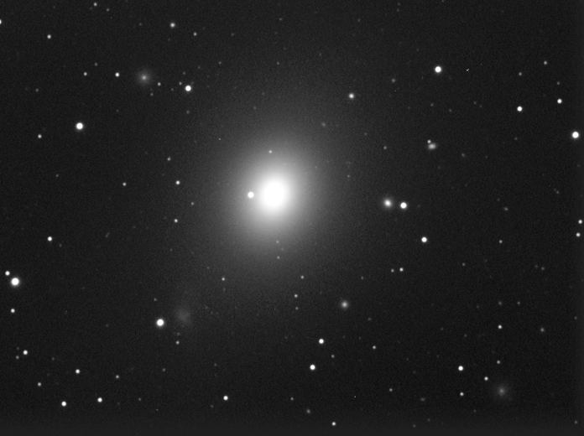
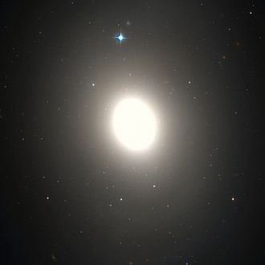
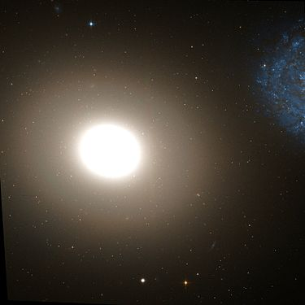
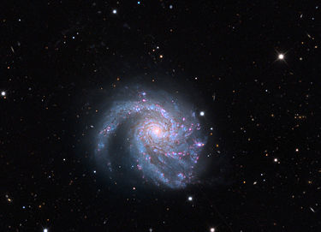
Some Members of Virgo
M86
M49
M87
M60
M85
M99

Slide 18
The Norma Cluster
Difficult to study because our galaxy in the way
About 68 Mpc away
Total mass > 10¹⁵ M_{sun}
Near the center of our supercluster

Slide 19
Other Clusters In Our Supercluster
Abell 3574
Hydra
Centaurus
Eridanus
Fornax

Slide 20
The Coma Cluster
1000+ galaxies visible
Many bright galaxies
Many giant ellipticals, especially in the center
Bright spirals towards the edges
About 99 Mpc away
Total mass about 3×10¹⁵ M_{sun}
Center of Coma Supercluster

Slide 21
Groups/Clusters and the Virial Theorem
The dynamical time is how long it takes for a galaxy to go through one cycle of orbiting the cluster
For groups, like the Local Group, this time scale can be very long
Probably of the order of 15 Gyr or more for the Local Group
Probably the upcoming Milky Way/Andromeda encounter will be the first such encounter
For clusters, they have more mass, so everything goes faster
Galaxies, especially near the center, will have orbited one or more times
In one dynamical time period, the system will virialize
Satisfy the virial theorem
Will start to get more spherical in shape
Typically, the galaxies near the center will virialize first
Outer galaxies will take longer

Slide 22
Cluster and Group Evolution
Galaxy Clusters and Groups change over time:
Heaviest galaxies fall towards the center
Tidal friction will enhance this effect
Galaxies will merge
For clusters, over time:
System will form a spherical distribution (more regular)
In the center, galaxies will coalesce
Giant ellipticals concentrated in the center
Spirals more towards the edge.
Collisions will knock gas out of the galaxies themselves
Twice as much gas between the galaxies as in the galaxies

Slide 23
Old Clusters
Old Galaxy Cluster
Ancient Galaxy Cluster

Slide 24
Is There Gas Between the Galaxies?
Collisions between galaxies have knocked much of the gas completely out of the cluster
Hot gas produces X-rays
In principle, it is possible to measure total amount of gas between galaxies by measuring the quantities of X-rays
In practice this is very difficult because the gas may be non-uniform in temperature, density, composition …
Rough estimate: there is twice as much gas between that galaxies as in the galaxies
However, there also could be dark matter between the galaxies
We would like a way to estimate the total mass of the entire cluster

Slide 25
Mass of the Cluster from Virial Theorem
If the galaxies have time to virialize, we can get an idea of the mass of the cluster
The kinetic energy is proportional to the velocity squared
The potential energy is proportional to the total mass of the cluster
Problem: not all galaxies will have had a chance to virialize
Introduces a bias into the measurement
Solution: use the elliptical and lenticular galaxies
But this is not a foolproof way to make sure they are virialized
Bottom line: This is a difficult way to get an accurate number

Slide 26
Mass of the Cluster from X-rays
Hot gas has been knocked out of the galaxies
Pressure wants it to leave
Gravity wants it to stay
If it isn’t leaving, then the two must balance
By studying temperature, we can estimate pressure
Assuming it is in balance, we can estimate mass
Problem: Gas might have several components at different temperatures
Problem: Gas might not be in equilibrium – it could be leaving
Bottom line: This is also difficult to do

Slide 27
Where is the Mass in a Galaxy Cluster?
Most (all?) galaxies have much more mass than is in the stars and gas
Dark matter is 85% of galaxies’ mass
How about clusters?
Need to find mass of cluster
Gravitational lensing!
Distant Source
Observer
Gravity bends light
You can see two or more images of source
Can estimate mass of cluster!
Cluster
There’s much more mass than is visible
5% is in stars and other visible matter
10% is in hot gas between the galaxies
85% is in dark matter

Slide 28
Clusters as Gravitational Lenses (1)

Slide 29
Clusters as Gravitational Lenses (2)

Slide 30
Clusters as Gravitational Lenses (3)

Slide 31
An Einstein Cross
Can show lensing by a smooth object always produces an odd number of images
In this famous example, a single object appears five times
Probably verified via its spectrum

Slide 32
An Occasional Lucky Break
We would like to see some of the most distant galaxies in the universe
They are dim due to
Enormous distance
Red-shift
Gravitational Lensing can magnify very distant objects, making them seem much brighter
Although such luck is rare, there are so many clusters in the universe that it happens occasionally.

Slide 33
3D Map of Nearby Clusters
Yellow are near the plane of the galaxy
Blue are above the plane of the galaxy
Red are below the plane of the galaxy

Slide 34
Superclusters
Where We Live
Levels of organization:
Stellar Systems
Stellar Clusters
Galaxies
Galaxy Groups and Clusters
Galaxy Superclusters
The Universe
Everyone should know where they live:
The Solar System
(we don’t live in a cluster)
The Milky Way Galaxy
The Local Group
Laniakea Supercluster
The Universe
Groups/clusters are themselves grouped into larger structures called Superclusters
Size: Up to around 200 Mpc
Our supercluster is called the “Laniakea Supercluster”
Superclusters are much more poorly defined than clusters
At this scale, the universe hasn’t had time to virialize
They are always irregular

Slide 35
Virgo Supercluster
Before 2014, it was known that the Local Group was part of a larger structure called the Virgo Supercluster
More than 100 galaxy groups and clusters
33 Mpc across
7000 times the volume of the local group

Slide 36
Virgo Supercluster?
Virgo cluster is moving towards an object called the “Great Attractor”
In 2014, a complete mapping of the motions of nearby clusters was performed
It was realized Virgo is part of something larger

Slide 37
Laniakea Supercluster
Discovered 2014
Study of “flow” of nearby clusters
Centered on Great Attractor, near Norma
160 Mpc across

Slide 38
Structure Near Us
Laniakea Supercluster
Coma Supercluster
Perseus-Pisces Supercluster

Slide 39
A Cool Picture I Found

Slide 40
Nearby Superclusters
Between the superclusters are “voids” almost devoid of galaxies
Little evidence of structure bigger than superclusters
No “hyperclusters”
Largest scale structure like soap bubbles
Mostly empty space
Superclusters are walls between the bubbles

Slide 41
Structure on the Largest Scale (1)
Sloan Digital Sky Survey

Slide 42
Structure on the Largest Scale (2)
SDSS and similar projects have catalogued several millions of galaxies’ distance
Actually it is recording red shifts. More on this later
Video
Beyond nearby galaxies, they record the correlation function – the probability that galaxies are near each other
Beyond 100 Mpc or so, this smooths out, indicating the universe is smooth
It can be Fourier transformed – broken into waves – to see how much clumping there is at different wavelengths
It falls off at very long wavelengths
With interesting additional features we will later discuss
This behavior on very large scales helps us constrain how the universe formed the structure we see
On scales larger than 200 Mpc or so, treat the universe as uniform

